Slide 1
関係代名詞
目的格の関係代名詞の省略

Slide 2
目的格の関係代名詞
の省略
接続詞（接着剤）
［
＋
we got
candies
］
the candies
which
目的格の関係代名詞は省略できる！！

Slide 3
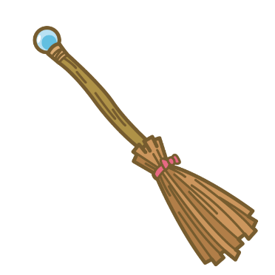

関係代名詞の省略（接触節）
主格の関係代名詞
省略できない
a broom
＋
the broom can fly
a broom
which
can fly
目的格の関係代名詞
省略できる
candies
＋
we got the candies
candies
which
we got
candies we got
Point
①目的格の関係代名詞は省略できる。・・・接触節とも言う
②省略された部分は名詞、名詞（主語）、動詞の順番で続く

Slide 4
主格の関係代名詞と
目的格の関係代名詞
省略できるか、できないか

Slide 5
This is the dictionary
which he uses every day.

Slide 6
Mr. Mori is a doctor
who is very kind to old people.

Slide 7
Mike has lost the toy
that his father bought for him.

Slide 8
He found the key
that she lost last week.

Slide 9
They want a house
that has five bedrooms.

Slide 10
Ms. Sato is a teacher
who teaches us English.

Slide 11

Have you seen the book
which I put on your desk?

Slide 12
The man that you saw at the store
is Takuya’s father.

Slide 13
This watch that he bought yesterday
is very expensive.

Slide 14
Do you have a cat
that is bigger than mine?

Slide 15
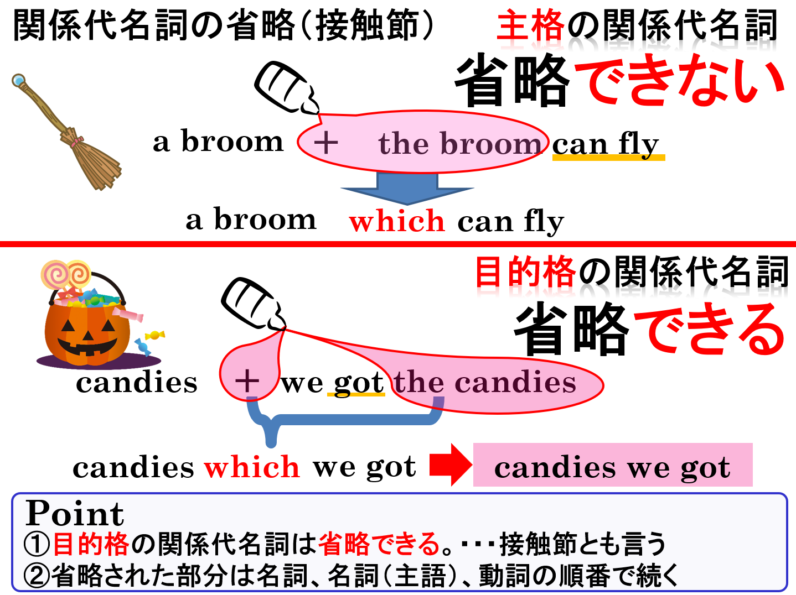

Slide 16
関係代名詞
目的格の関係代名詞の省略

