Slide 1
bare infinitive
原形不定詞

Slide 2


Let’s
play the piano.

Slide 3
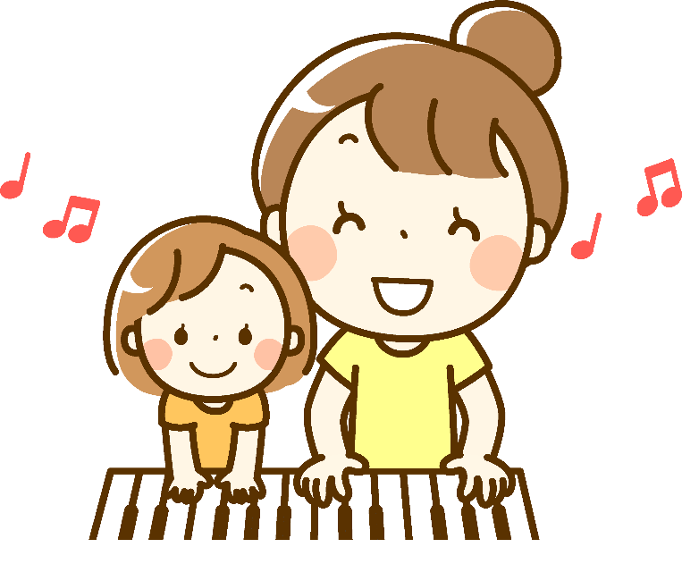

Slide 4

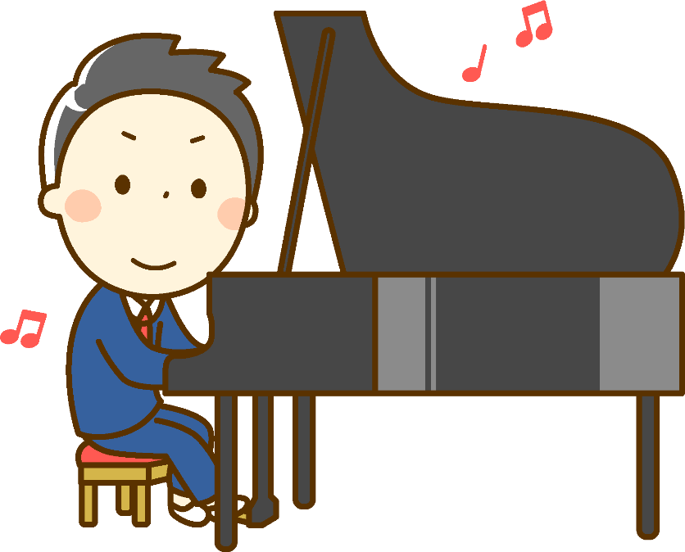
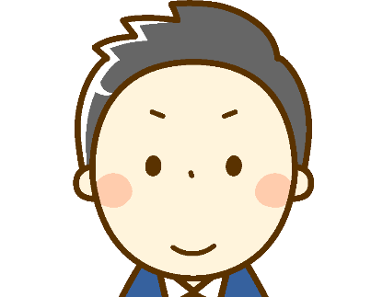
His mother
let
him
play the piano.

Slide 5



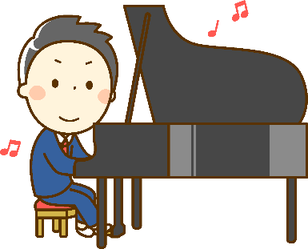


let / help
Let’s
play the piano.
His mother
let
him
play the piano.
Point
① letやhelpは次のような形を取ります。
let / help ＋人など＋動詞の原形
(目的語)
(原形不定詞)
② letは「目的語に動詞の原形させてあげる、することを許す」、
helpは「目的語が動詞の原形するのを手伝う」の意味です。
③ let’s 動詞の原形 は元々 let us 動詞の原形ですが、発展進化し
たものです。

Slide 6
let

Slide 7
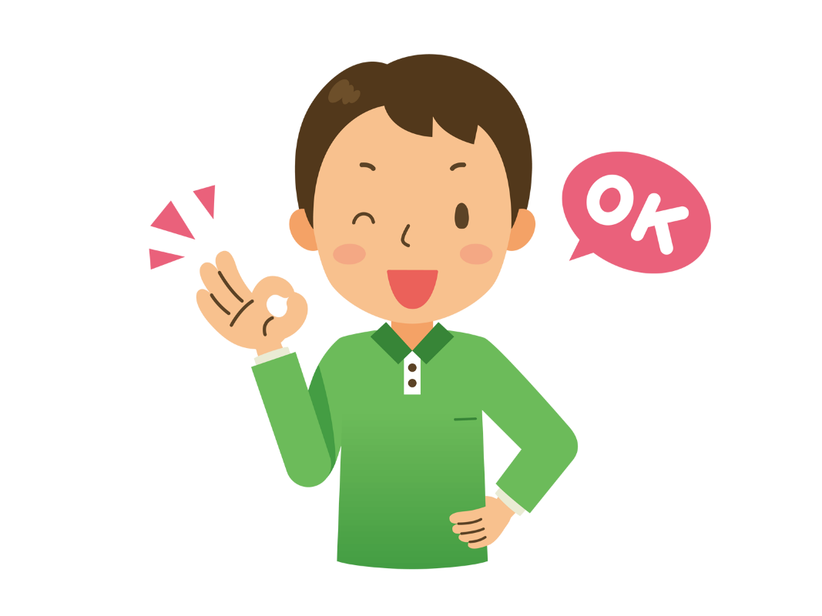

My father ( let ) me ( go ) abroad.
let
go
me
my father
go abroad

Slide 8
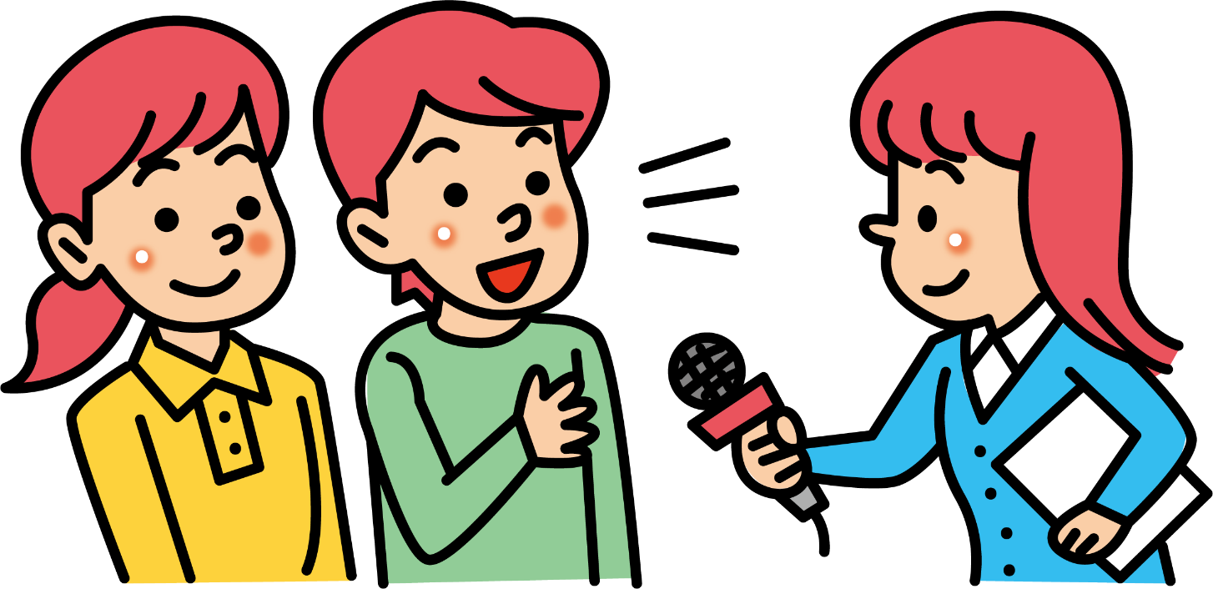
me
Please let ( me )( know ) the information.
know
me
know the information

Slide 9


( I )( let )( her )( use ) my computer.
I
let
her
use
I
her
use my computer

Slide 10
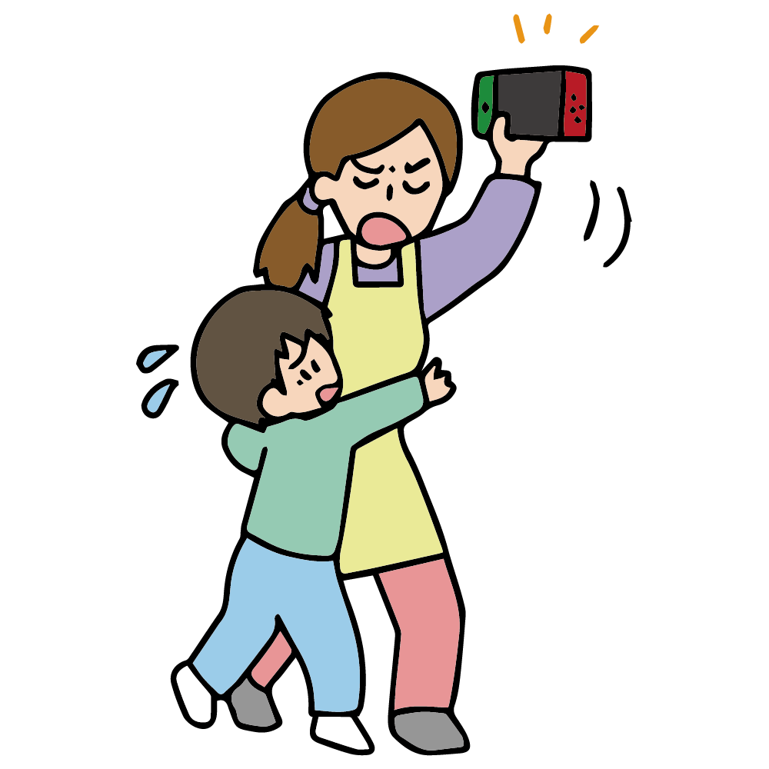
mother
him
( His )( mother ) didn’t ( let )( him )
( play ) video games.
His
let
play
His mother
him
play video games

Slide 11
( I )( let )( her )( use ) my computer.
I
let
her
use
I
her
use my computer

Slide 12
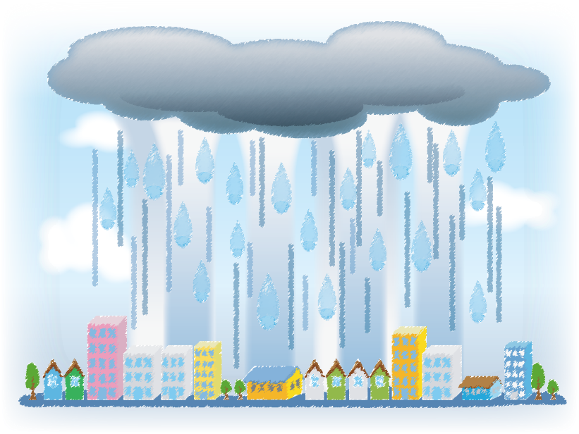

The
heavy
( The )( heavy )( rain )
( use ) her ( stay ) home.
rain
let
stay
her
The heavy rain
stay home

Slide 13
help

Slide 14

my
I ( help )( my )( mother )
( fold )( the )( laundry ).
help
mother
fold
the
laundry
my mother
I
fold the laundry

Slide 15
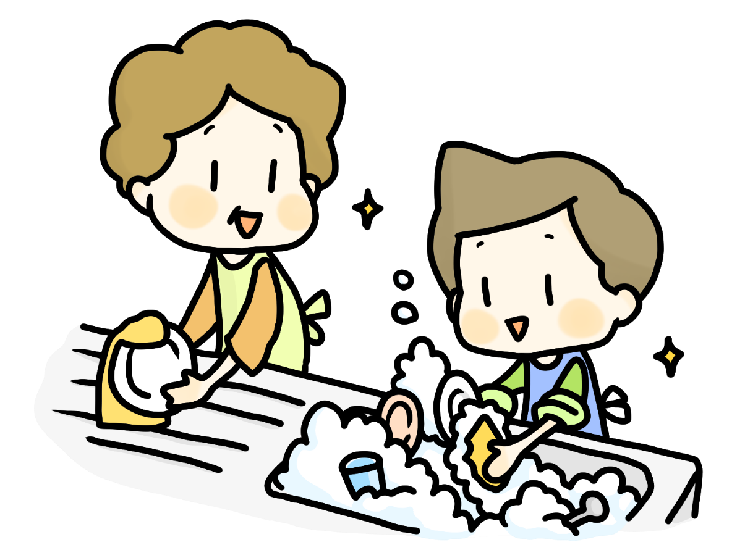
mother
Ken ( helps )( his )( mother )
( do )( the )( dishes ) every day.
helps
his
do
the
dishes
Ken’s
mother
Ken
do the dishes

Slide 16
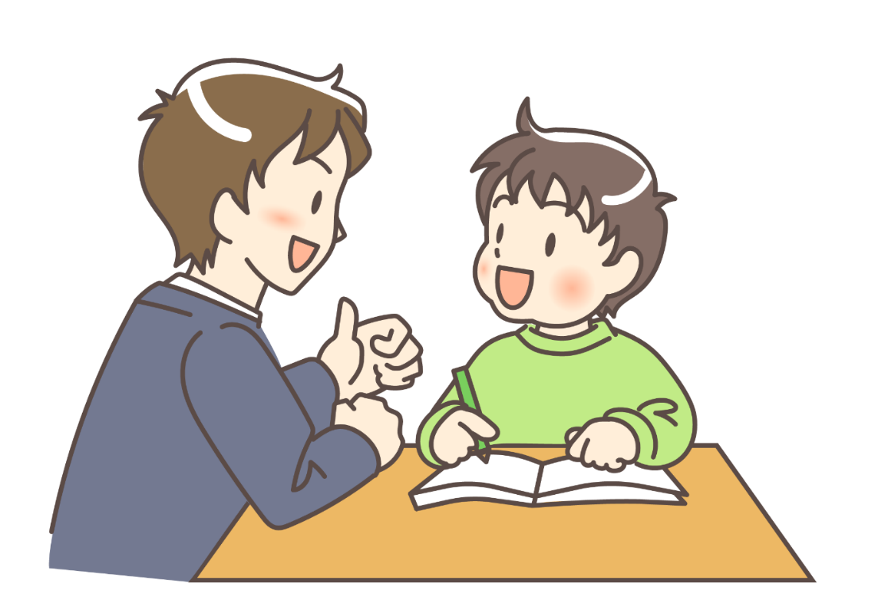
My brother ( helped )( me )
( do )( my )( homework ) yesterday.
helped
me
do
my
homework
me
my brother
do my homework

Slide 17
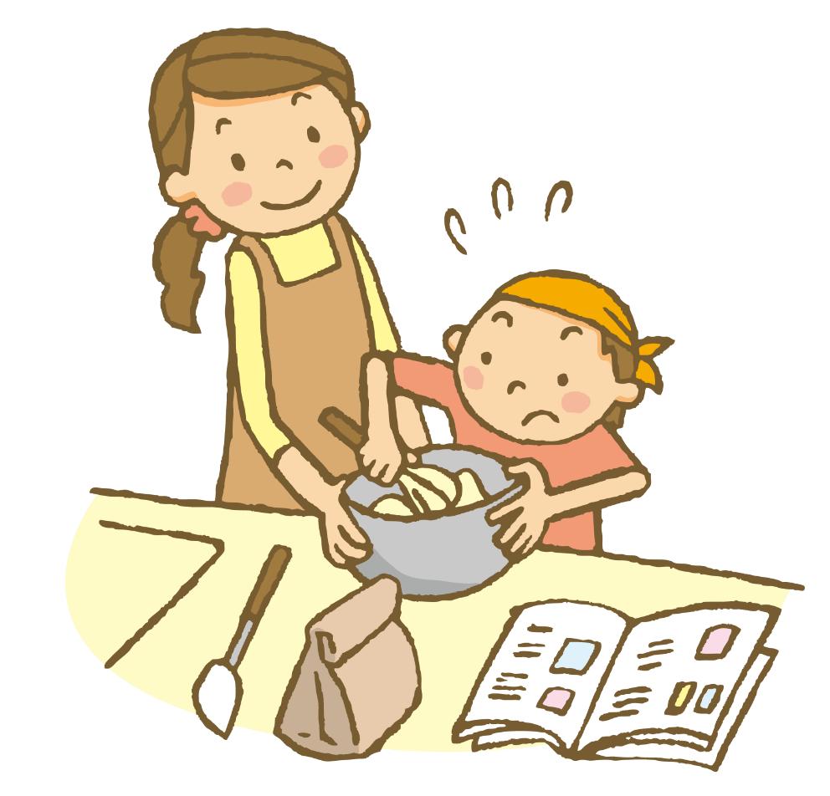
Risa ( helped )( her )( child )
( make )( cookies ) last night.
helped
her
child
make
cookies
Risa
Risa’s child
make cookies

Slide 18
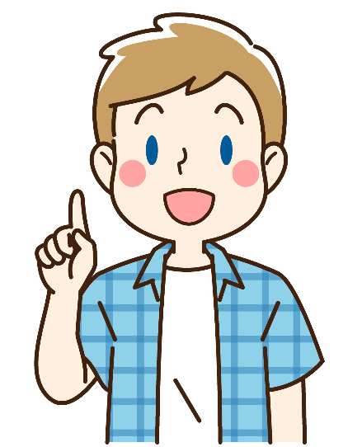
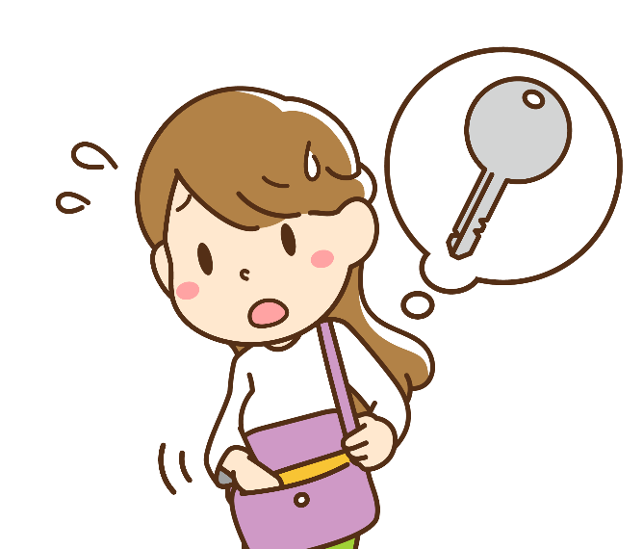
Tom( helped )( me )( look )( for )
my key.
helped
me
look
for
Tom
me
look for my key

Slide 19
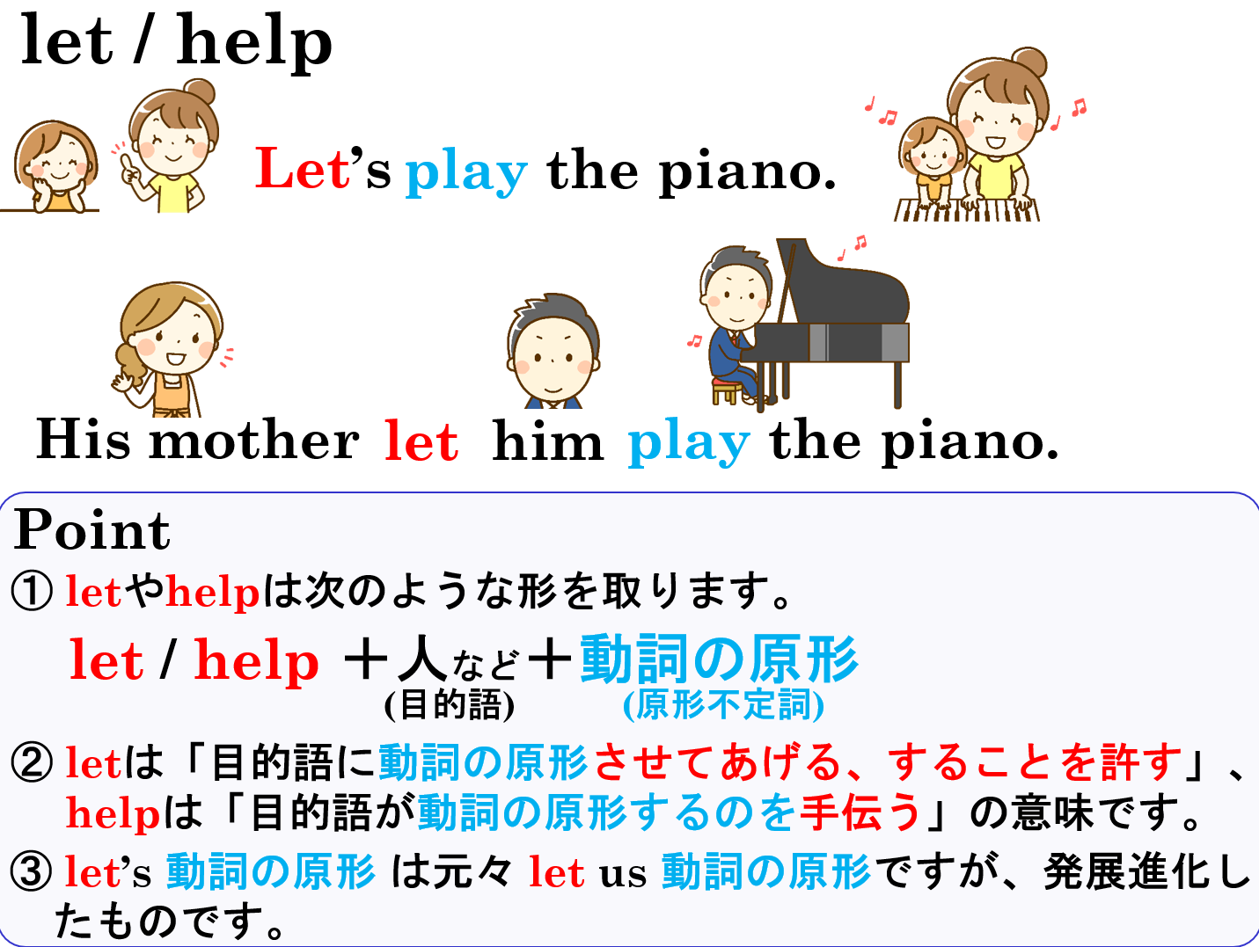

Slide 20
bare infinitive
原形不定詞

