Slide 1
動詞 目的語 疑問詞 （S）V
間接疑問文

Slide 2
He’ll
tell
Mary
the way to the station.
He’ll
tell
Mary
where the station is.

Slide 3
動詞＋目的語＋＜間接疑問文＞
He’ll
tell
Mary
the way to the station.
He’ll
tell
Mary
where the station is.
Point
①tell, show, askなど目的語に～と伝える、～とたずねるというというとき、
「～」の部分が間接疑問文になるときがあります。
主語 + 動詞 + 目的語 + ＜疑問詞 （S）V＞
S
V
伝える相手(O)
間接疑問文(O)
②目的語の後に来る「間接疑問文」は、疑問文ではないので、語順に注意しま
しょう。

Slide 4
動詞＋目的語＋＜間接疑問文＞の形をとる動詞
動詞 | 意味
tell
伝える／（言って）教える
ask
たずねる
show
見せる／
（見せて・見せるように）教える
teach
（できるように）教える
remind
思い出させる

Slide 5
Practice
疑問詞が主語以外の文で
Be動詞の場合（助動詞は無し）

Slide 6


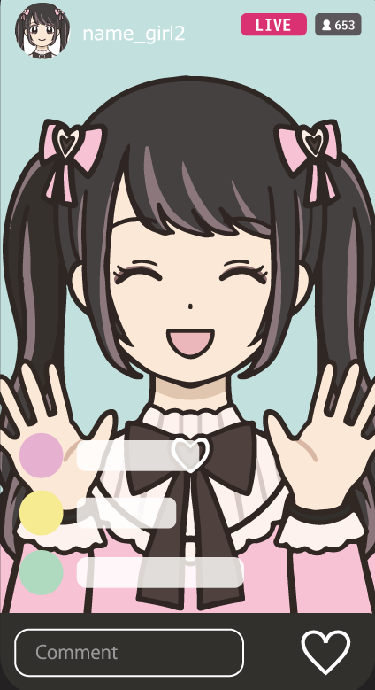
Who is that girl?
who
that girl is
Tell me ＜ who that girl is＞.

Slide 7
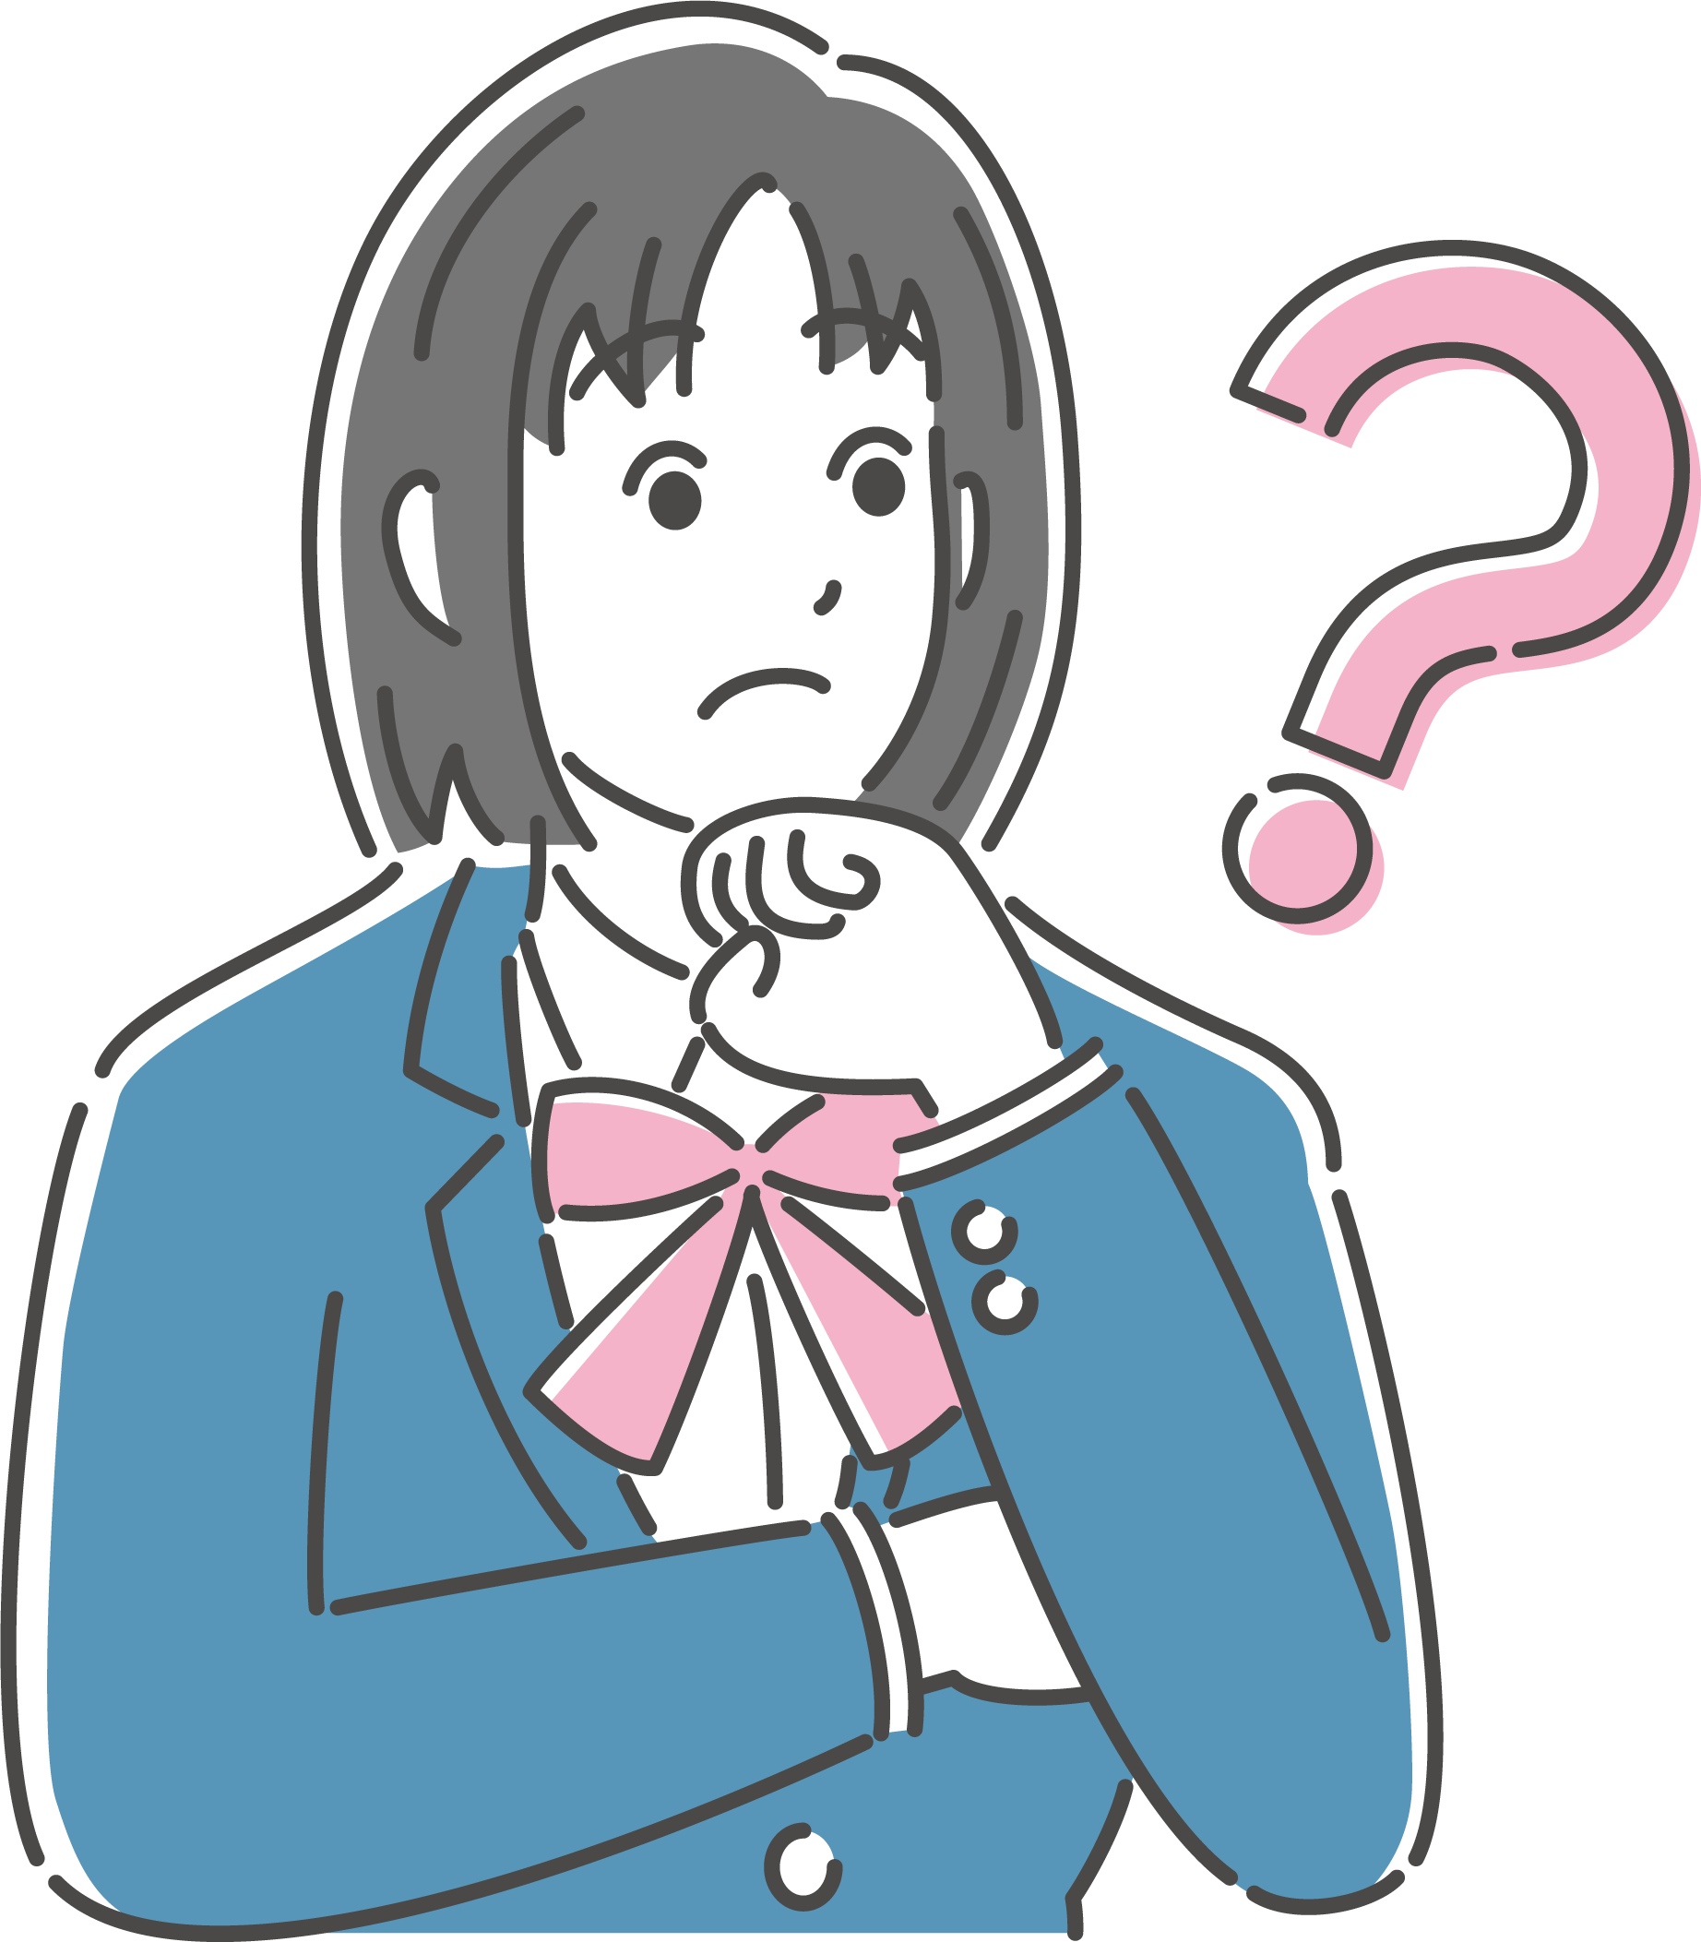


Where is that?
where
that is
Tell me ＜ where that is ＞.

Slide 8
Practice
疑問詞が主語以外で
一般動詞や助動詞がある文

Slide 9
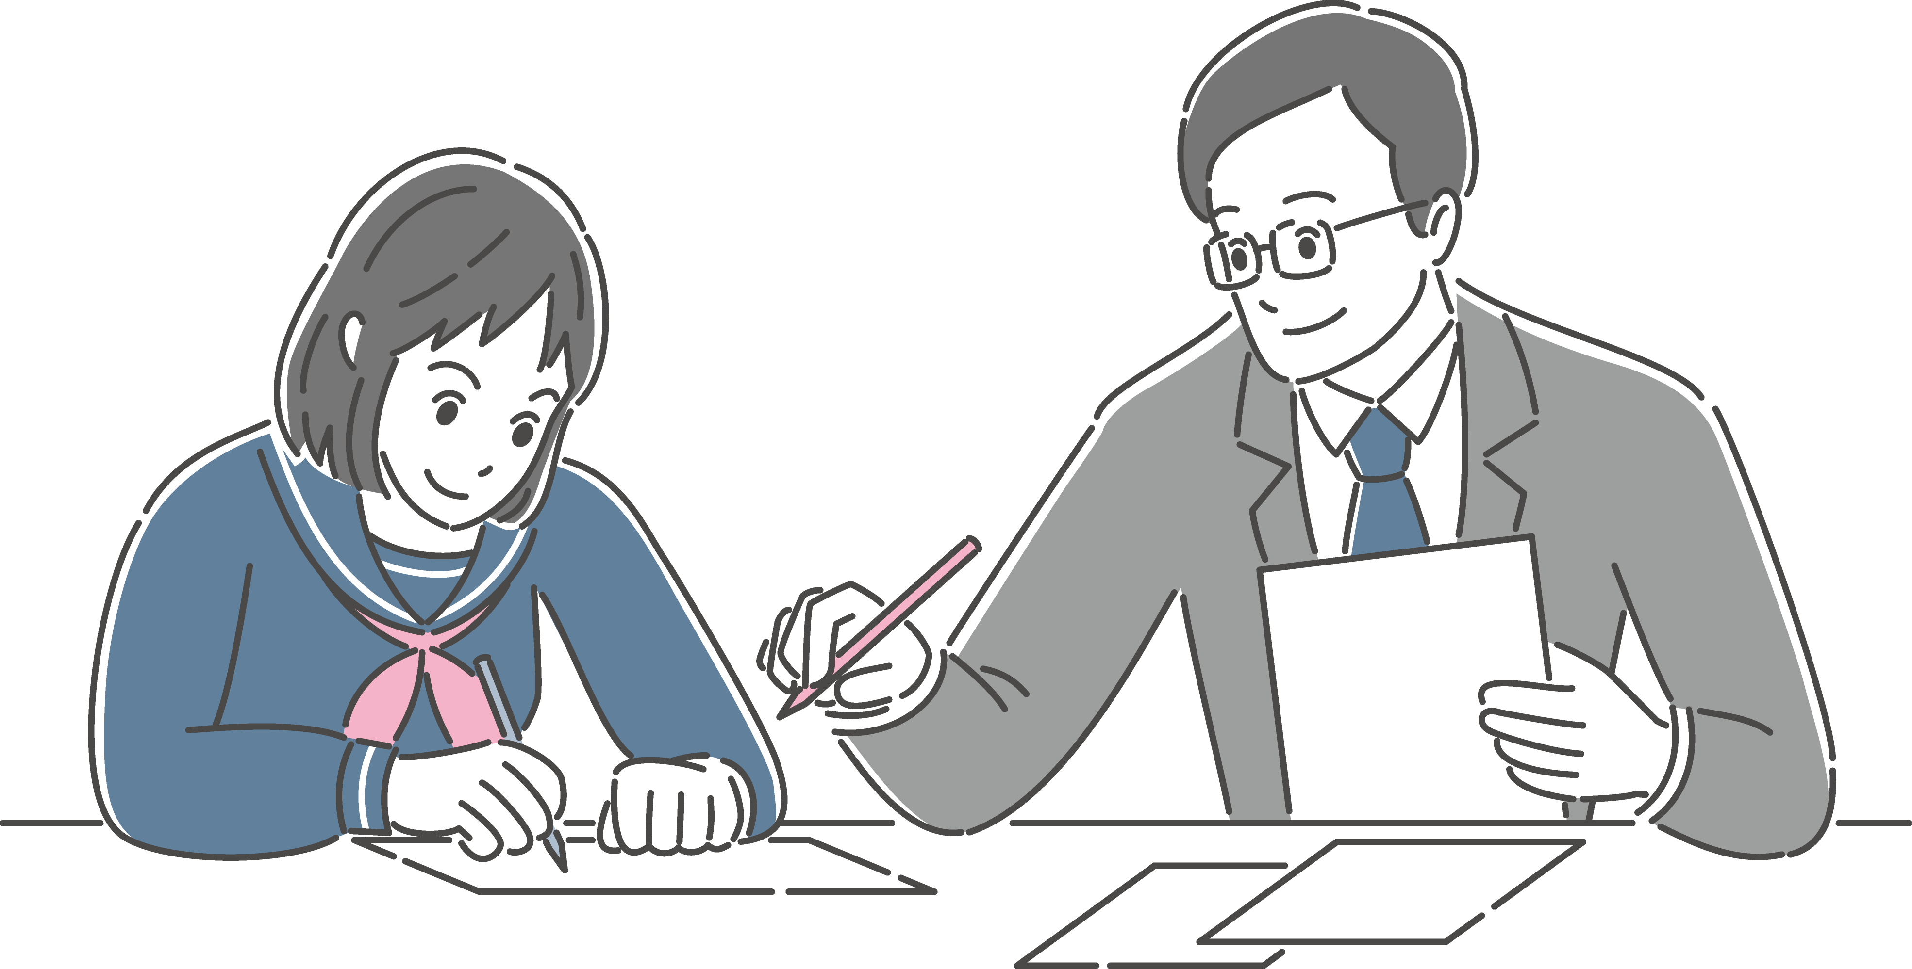
How can I solve this problem?
Can you teach ( me )
＜ how I can solve this problem ＞?
me
how
I can solve this problem

Slide 10
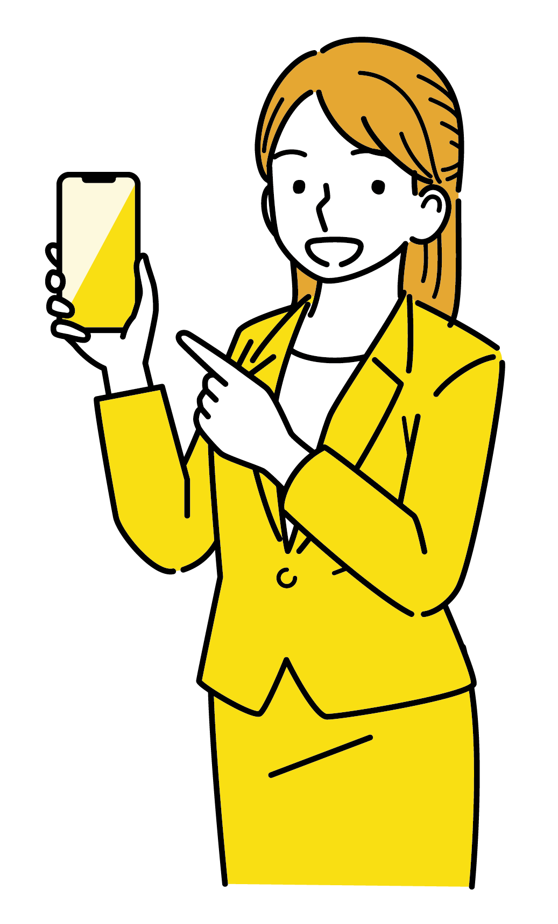

How can I use a smartphone?
She shows ( me )
＜ how I can use a smartphone ＞.
me
how
I can use a smartphone

Slide 11


I went shopping yesterday.
What did she buy?
I bought a bag and clothes.
what
she bought
She showed ( me )＜ what she bought＞.
me

Slide 12
Practice
疑問詞が主語の場合

Slide 13
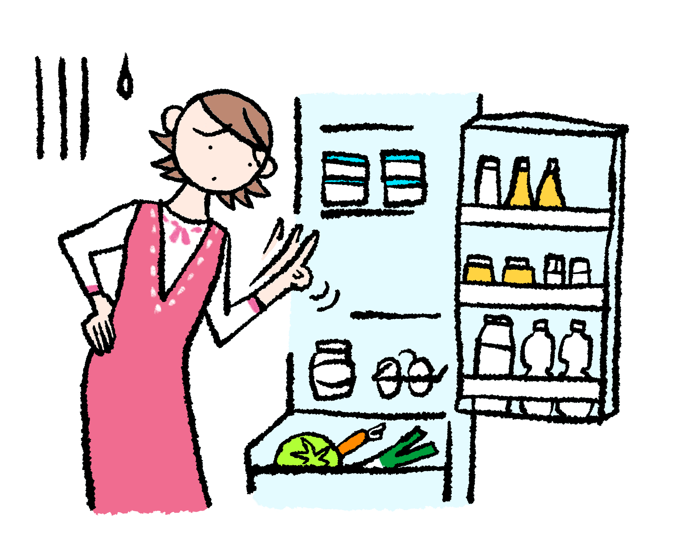
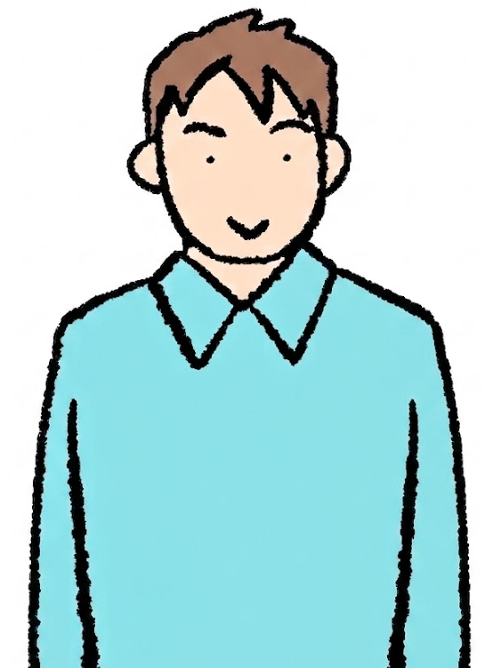
who ate the last piece of cake?
him
him
She asked ( him )
＜ who ate the last piece of cake ＞.
who
ate the last piece of cake

Slide 14


What mountain is the highest
in the world?
The computer shows you
＜what mountain is the highest in the world＞.
what mountain
is the highest in the world

Slide 15
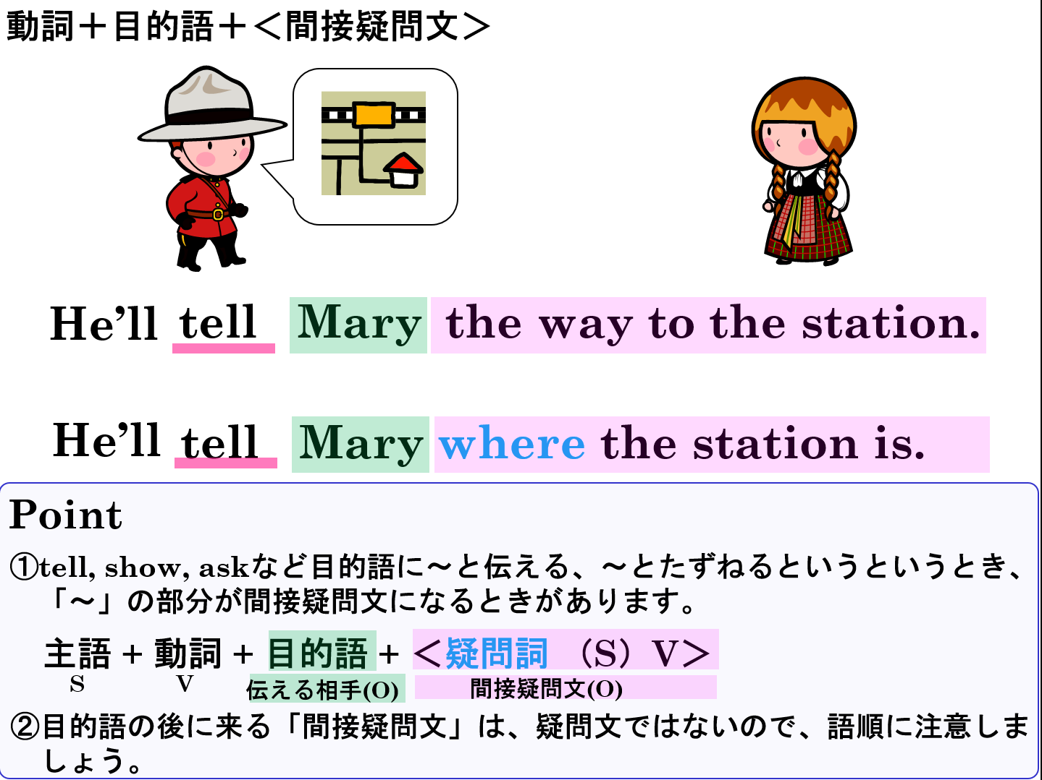

Slide 16
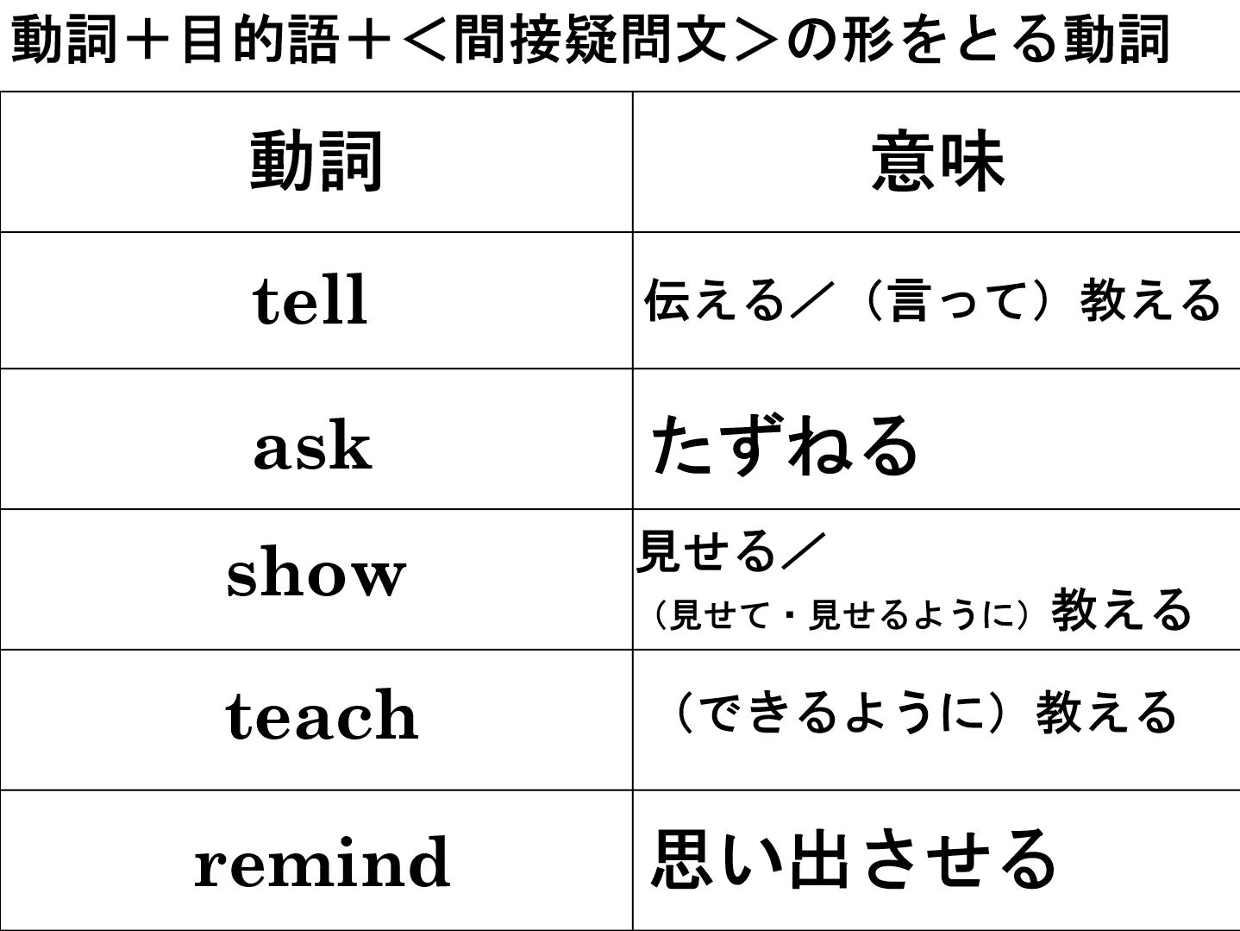

Slide 17
動詞 目的語 疑問詞 （S）V
間接疑問文

