Slide 1
Mustの疑問文
「～しなければなりませんか」

Slide 2
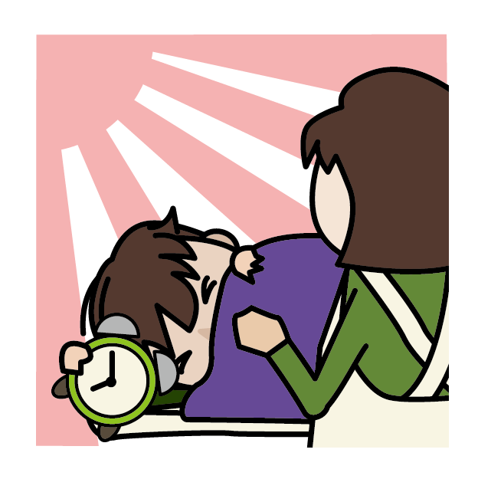
Must I get up now?
Yes, you must.

Slide 3
助動詞－mustの疑問文
I must get up now.
I must get up now.
must
Must
now?
Yes, you must.
No, you don’t have to.
Point
① mustは助動詞なので疑問文のときに文章の一番前に出ます。
②疑問文のときの助動詞（must）の判断は、たずねられた相手が
判断します。
③答えるときは、特に否定の答え方に注意しましょう。
Yes, ～ must.（～しなければならない）
No, ～ don’t(doesn’t) have to.（～しなくてもよい）

Slide 4
Mustの疑問文
Practice

Slide 5
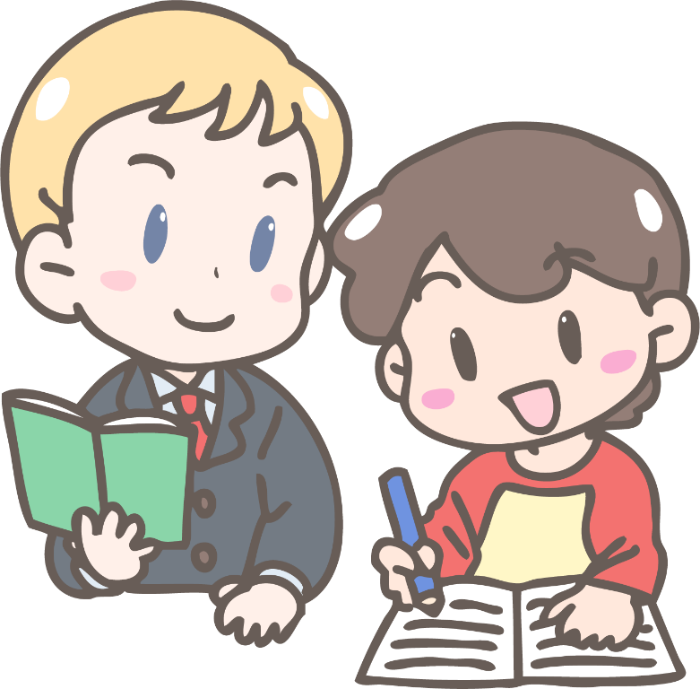
( Must ) I learn all these words?
Must
must
Yes, you ( must ).

Slide 6
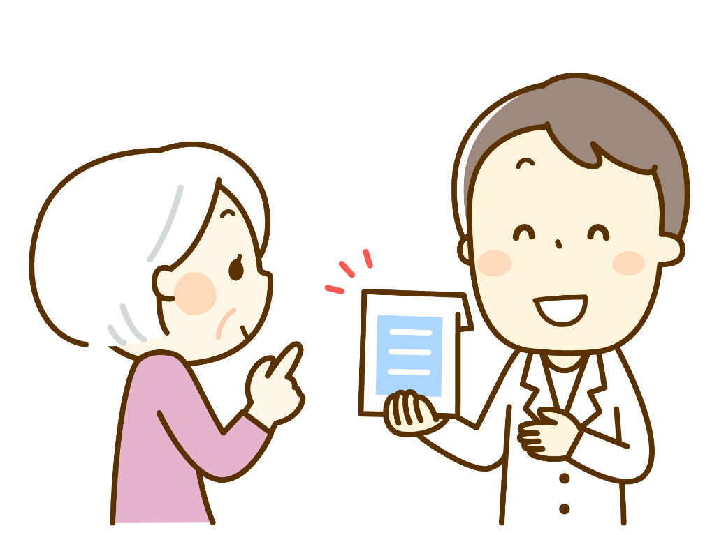
( Must ) I take this medicine now?
Must
don’t
have
to
No, you ( don’t ) ( have )( to ).

Slide 7

( Must ) I return these books
this week?
Must
must
Yes, you ( must ).

Slide 8
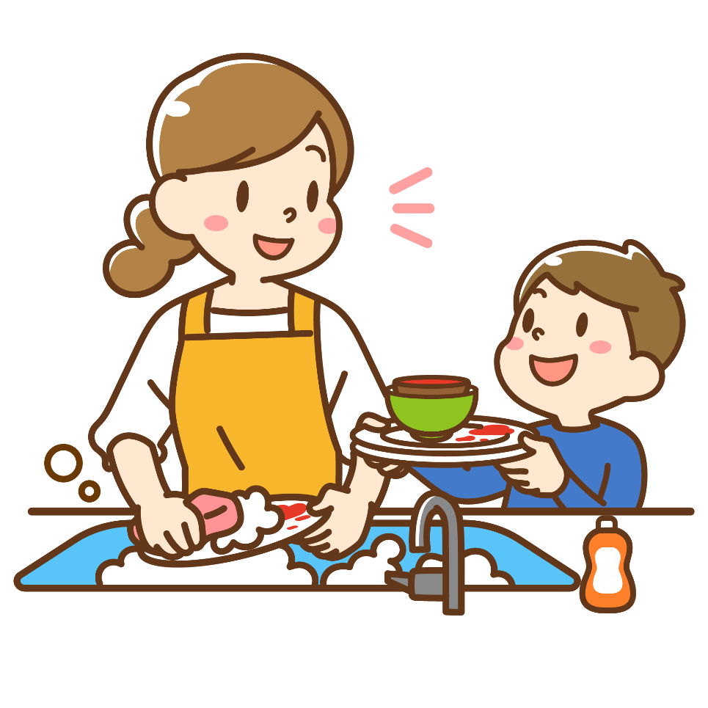
( Must ) I do the dishes?
Must
don’t
have
to
No, you ( don’t ) ( have )( to ).

Slide 9

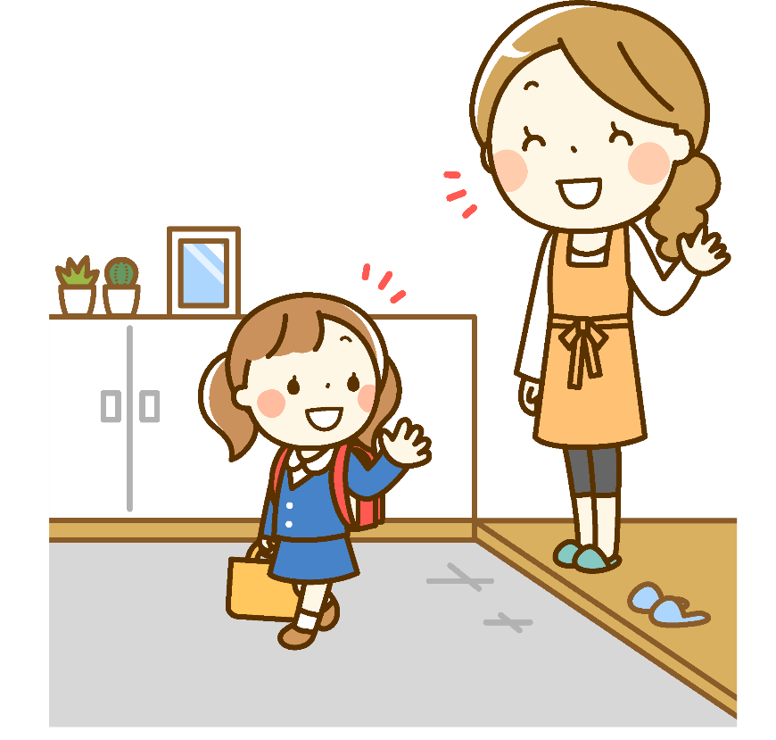
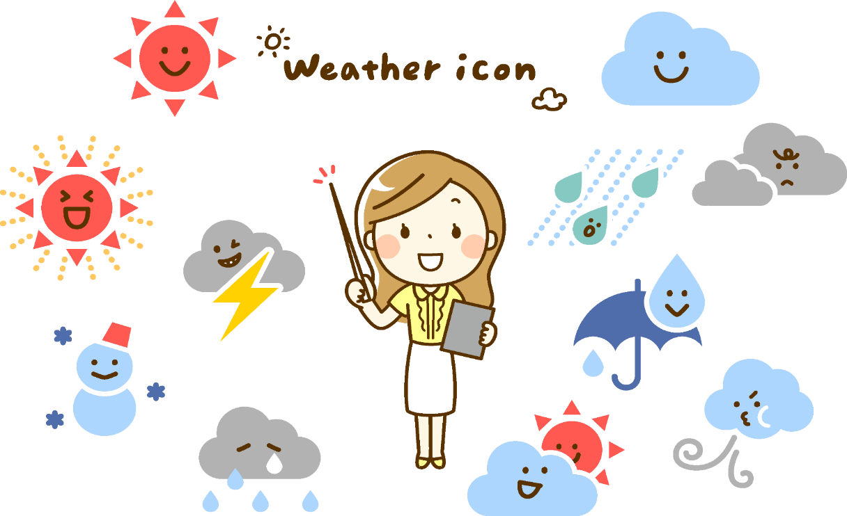

( Must ) I take my umbrella today?
Must
don’t
have
to
No, you ( don’t ) ( have )( to ).

Slide 10
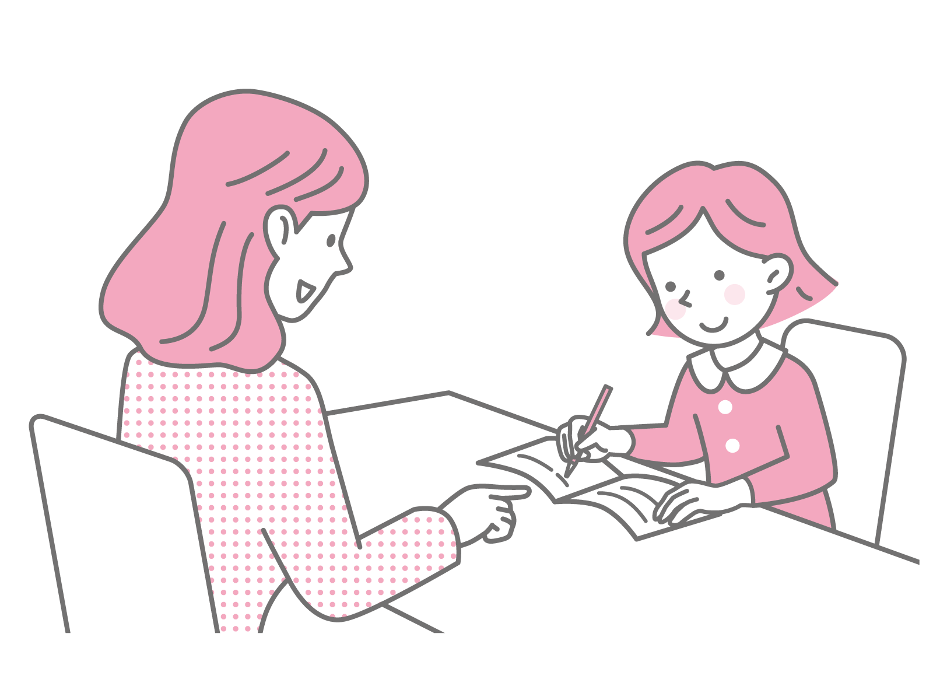
( Must ) I write in English only?
Must
must
Yes, you ( must ).

Slide 11
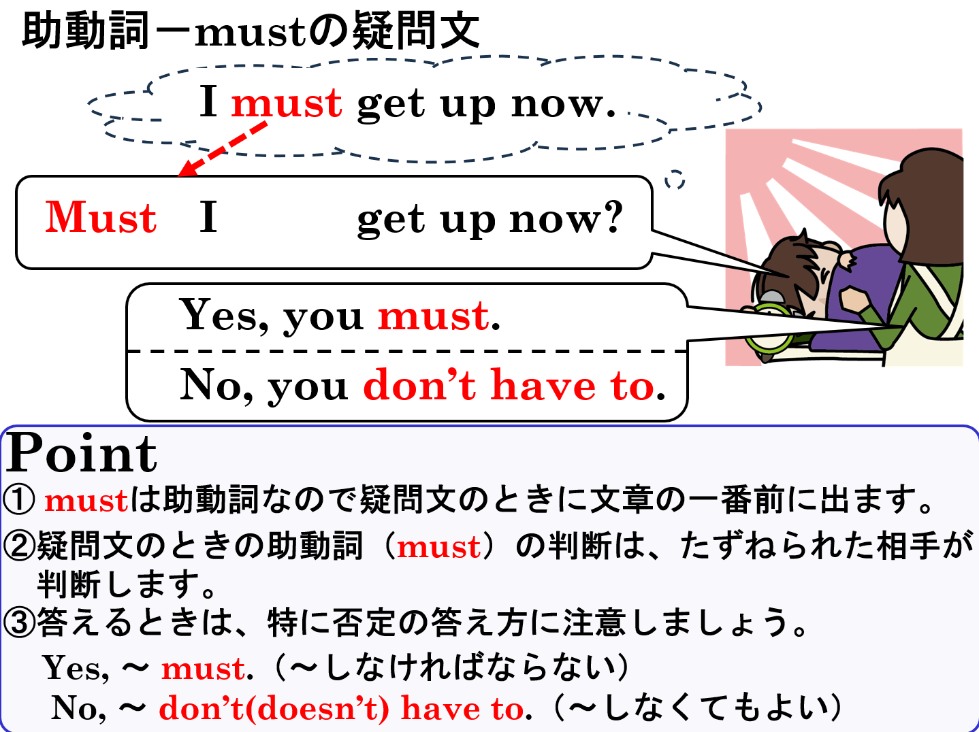

Slide 12
Mustの疑問文
「～しなければなりませんか」

