Slide 1
「ただものじゃない」
これから～するもの
adjective infinitive

Slide 2
You have a lot of things
to learn.
Today you learn this!

Slide 3

I have some books
to read.
I am reading books.
I have a lot of books.
I have a lot of books.

Slide 4
形容詞的用法の不定詞(to 動詞の原形)
I have some books
to read.
some books
to read
説明
Point
①名詞の後に「to ＋ 動詞の原形」を使ってその名詞を説明することができます。
②その説明は「これから～する」という意味の説明になります。
③この表現を使うの状況によって、「これから～する(will)」の意味だけ
でなく、～すべき(should)、～しなければならない(must)、
～できる(can)、 ～してもよい(may)などと考えるといいです。
④名詞にはsomethingがくることが多いです。
⑤この不定詞の文はhave、beなど動作でない動詞と使われることが多いです。
Notes:
これから読む本 これから洗うもの

Slide 5
I have some clothes
to wash.
I am washing clothes.
I have many clothes.
I have many clothes.

Slide 6

something
to wash
説明
I have something
to wash.
something
to eat
説明
I have something
to eat.
Notes:
Somethingがよく組み合わされます。上の場合はclothといったら、towelや socks は入らないので便利です。
下のものは food to eatでもよいですが・・・

Slide 7
「ただものじゃない」
これから～するもの
を練習しよう
Practice adjective infinitive

Slide 8
a letter
( to ) ( write )
to
write
a
letter
write
I have ( a )( letter )( to )( write ).
to

Slide 9
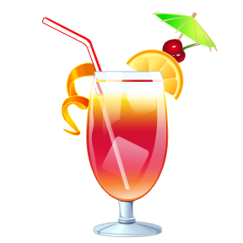

something
( to ) ( drink )
to
drink
something
You have ( something )( to )( drink ).
to
drink

Slide 10
Ken
study
( to ) ( study )
a lot of things
to
I have ( a )( lot )( of )( things )( to )( study ).
a
lot
of
things
to
study
Ken ( has )( a )( lot )( of )( things )( to )( study ).
has
a
lot
of
things
to
study

Slide 11
to
( to ) ( do )
a lot of homework
do
a
to
do
You have ( a )( lot )( of )( homework )( to )( do ).
lot
of
homework
a
lot
of
We have ( a )( lot )( of )( homework )( to )( do ).
homework
to
do

Slide 12

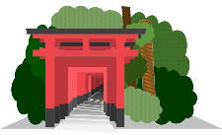
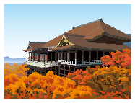
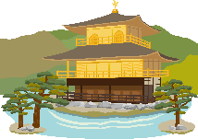

Kyoto
( to ) ( visit )
many places
to
visit
many
Kyoto has ( many )( places )( to )( visit ).
places
to
visit
many
visit
There are ( many ) ( places )( to )( visit ) in Kyoto.
places
to

Slide 13
Sara
( to ) ( meet )
many friends
to
meet
many
friends
meet
I have ( many )( friends )( to )( meet ).
to
Sara ( has ) ( many )( friends )( to )( meet ).
has
many
friends
to
meet

Slide 14
anything
( to ) ( eat )
to
eat
*疑問文・否定文のとき
to
Do you have ( anything )( to )( eat )?
anything
eat
He doesn’t have ( anything )( to )( eat ).
anything
to
eat
He has ( something )( to )( eat ).
something
to
eat

Slide 15
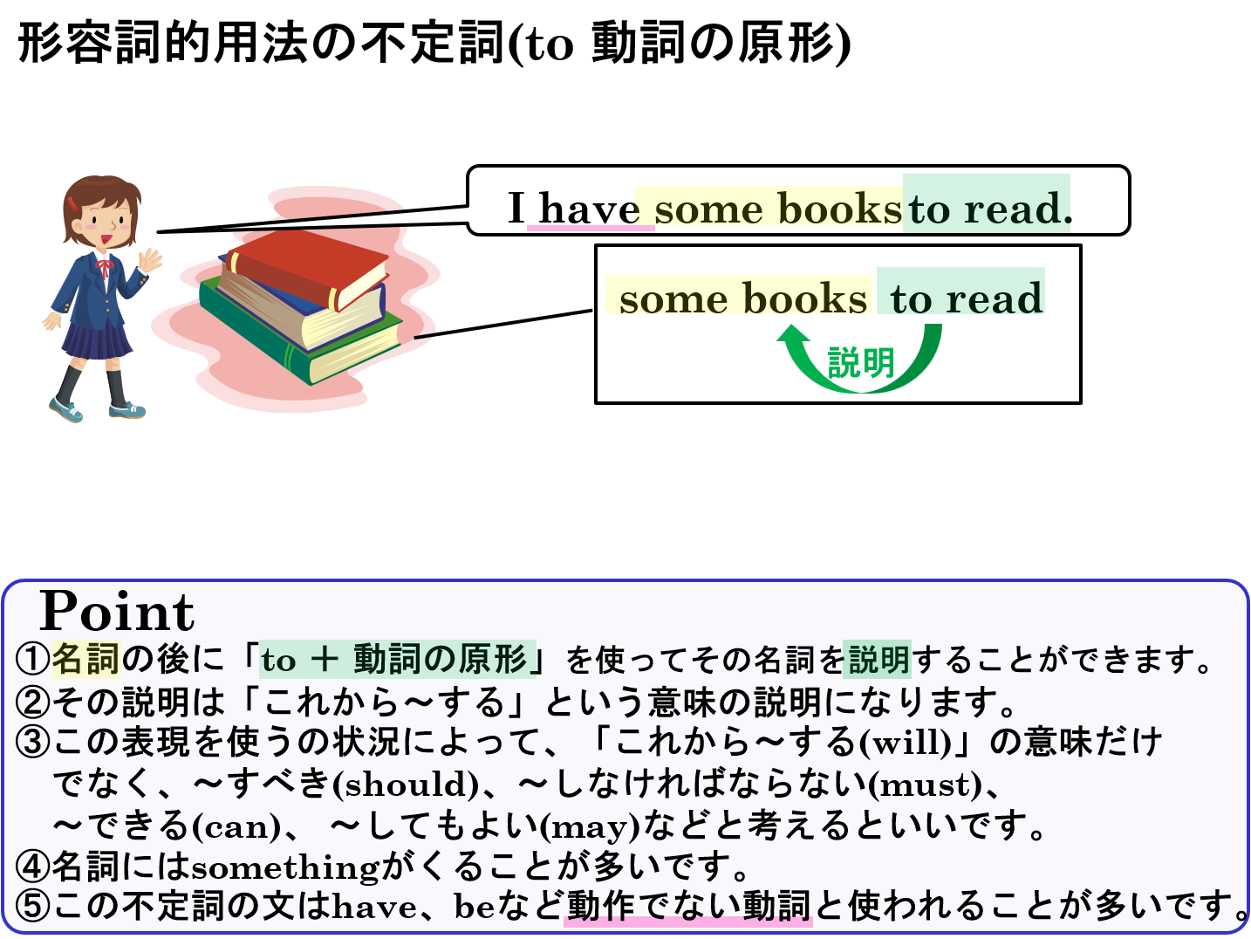

Slide 16
Quiz

Slide 17
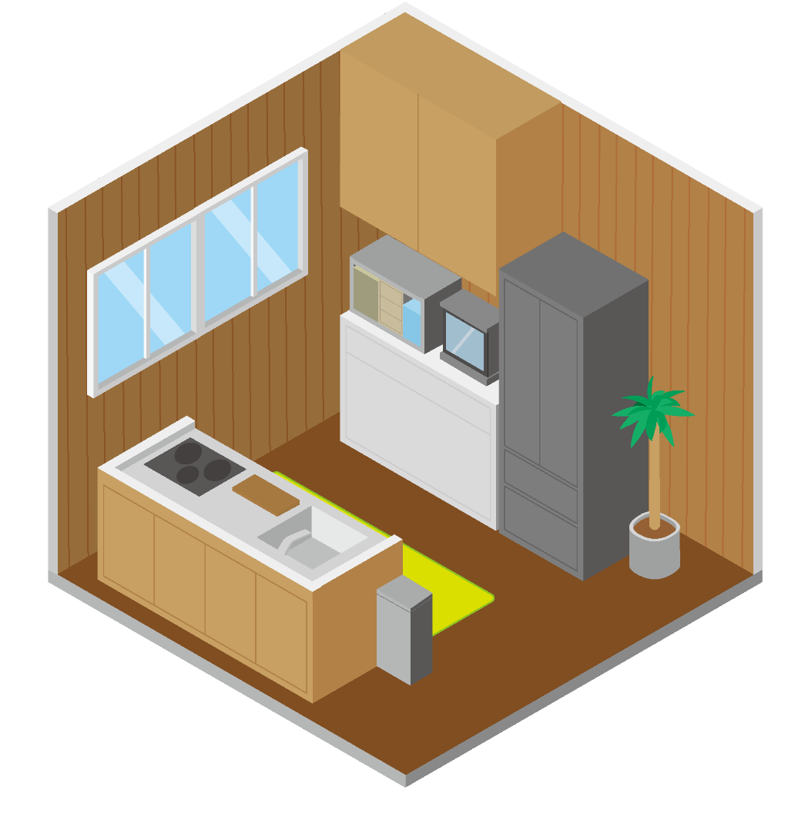
Example!
You have it in your house.
It’s a room to cook in.
What is it?
kitchen

Slide 18
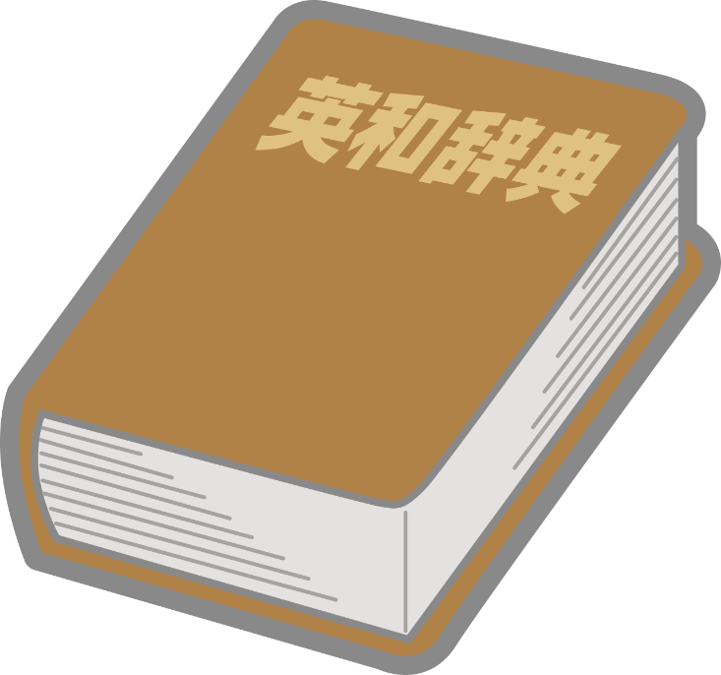
You have some in our classroom.
It’s a tool to check new words.
What is it?
dictionary

Slide 19
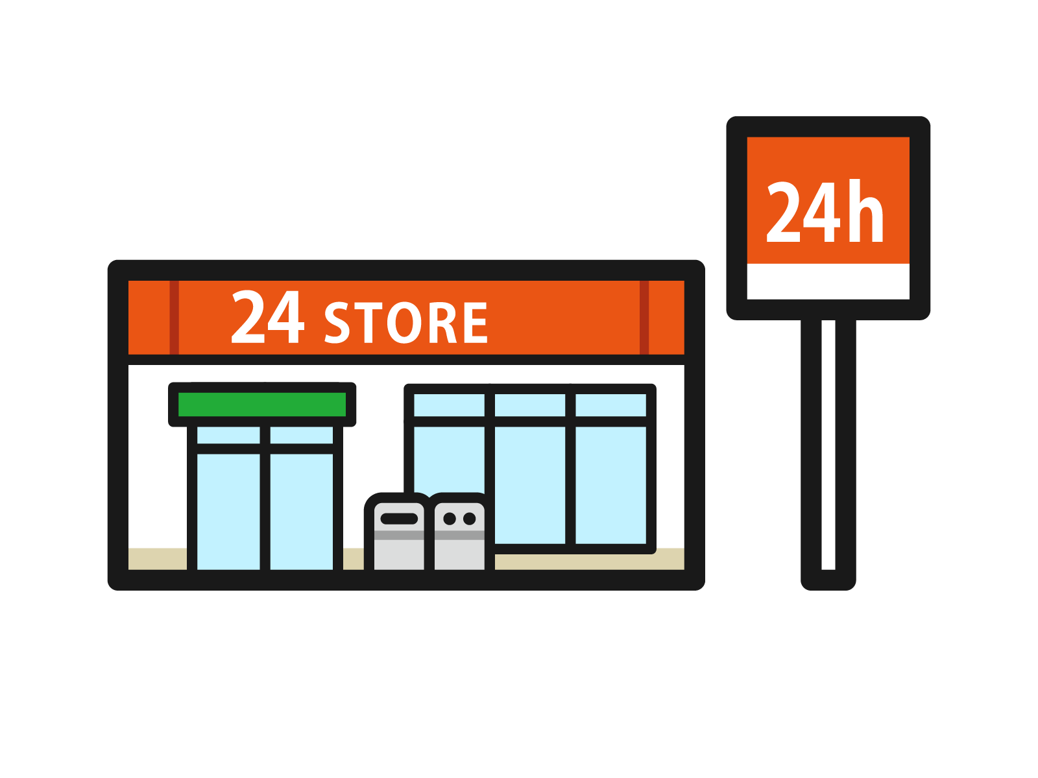
You have many in the city.
It’s a shop to buy many things for 24 hours.
What is it?
convenience store

Slide 20
「ただものじゃない」
これから～するもの
adjective infinitive

