Slide 1
助動詞 will
疑問文・否定文

Slide 2
これからするかたずねてみよう

Slide 3


未来のことを表す表現 助動詞 will の疑問文
You will play soccer tomorrow.
You will play soccer tomorrow
will
will
will
Will
you
?
?
Yes, I will.
No, I will not.
No, I won’t.
past
now
future
Point
① 「will」を使った文を疑問文にするときには「will」を文の一番前
に出します。
②答え方は、Yes,～will. / No, ～ will not . で答えます。
③will + not の短縮形として、「 won’t 」を使います。
④主語が「you 」のときは【意志】の確認です。主語が「 you 」
以外のときはこれからの【予測】の確認になります。

Slide 4
You will play baseball tomorrow.
Will
tomorrow
( Will ) you ( play ) baseball ( tomorrow )?
play
No, ( I )( will )( not ).
I
will
not
Yes,( I )( will ).
I
will
No, ( I )( won’t ).
I
won’t
?
past
now
future

Slide 5
?
past
now
future
Ken will study math tonight.
Will
tonight
( Will ) Ken ( study ) math ( tonight )?
study
No, ( he )( will )( not ).
he
will
not
Yes,( he )( will ).
he
will
No, ( he )( won’t ).
he
won’t

Slide 6
?
past
now
future
Judy will get up at six tomorrow.
Will
up
( Will ) Judy ( get )( up ) at six
( tomorrow )?
get
tomorrow
No, ( she )( will )( not ).
Yes,( she )( will ).
she
will
not
she
will
No, ( she )( won’t ).
she
won’t

Slide 7




?
past
now
future
He will go to America next year.
Will
to
( Will ) he ( go )( to ) America
( next )( year )?
go
next
year
No, ( he )( will )( not ).
Yes,( he )( will ).
he
will
not
he
will
No, ( he )( won’t ).
he
won’t

Slide 8



?
past
now
future
She will make breakfast tomorrow.
Will
breakfast
( Will ) she ( make )( breakfast )
( tomorrow )?
make
tomorrow
No, ( she )( will )( not ).
Yes,( she )( will ).
she
will
not
she
will
No, ( she )( won’t ).
she
won’t

Slide 9



?
past
now
future
They will study English tonight.
Will
English
( Will ) they ( study )( English )
( tonight )?
study
tonight
No, ( they)( will )( not ).
Yes,(they)( will ).
they
will
not
they
will
No, ( they)( won’t ).
they
won’t

Slide 10


You will be busy this afternoon.
Will
( Will ) you ( be ) busy ( his )( afternoon )?
be
this
afternoon
No, ( I )( will )( not ).
I
will
not
Yes,( I )( will ).
I
will
No, ( I )( won’t ).
I
won’t
?
past
now
future

Slide 11




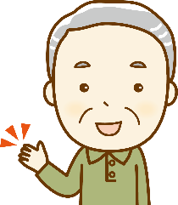

?
past
now
future
It will be sunny tomorrow.
Will
tomorrow
( Will ) it ( be ) sunny ( tomorrow )?
be
No, (it )( will )( not ).
it
will
not
Yes,( it )( will ).
it
will
No, ( it )( won’t ).
it
won’t

Slide 12
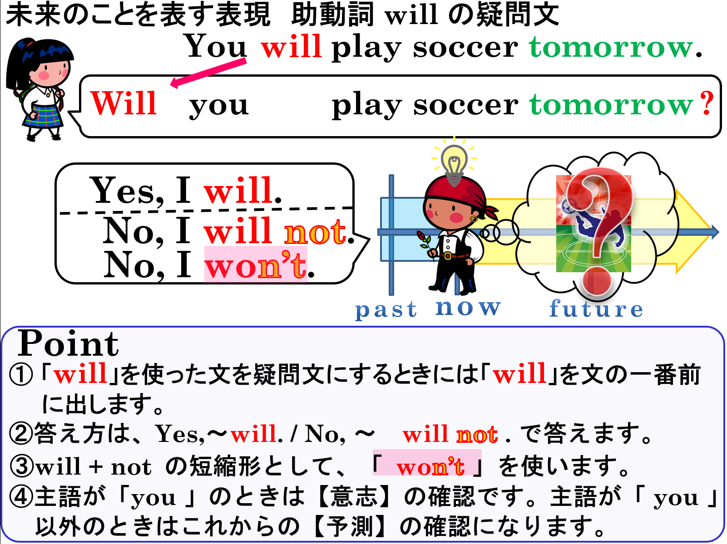

Slide 13
～するつもりはないよ
willの否定文

Slide 14

I will
not
play the piano tomorrow.
×
tomorrow
past
（過去）
now
future（未来）
She
won’t
play the piano
will
not
tomorrow.

Slide 15
未来のことを表す表現－助動詞willの否定文
×
past
（過去）
now
future
（未来）
tomorrow
I will not play the piano tomorrow.
She won’t play the piano tomorrow.
Point
① will を使った表現の否定文はwill の後に not を使います。
→「will + not +動詞の原形」で表します。
② will + not の短縮形は「won’t 」になります。

Slide 16
Practice
will not～
Notes:
Maeda Atsuko is an actress now.

Slide 17
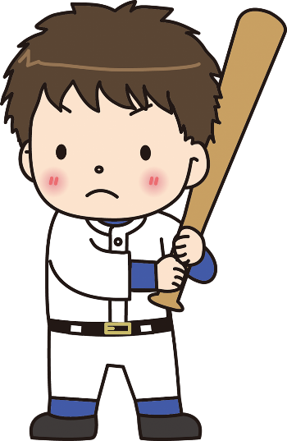
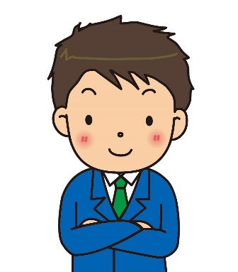
play baseball
now
future
（未来）
past
（過去）
×
tomorrow
I will ( not ) play baseball tomorrow.
not

Slide 18
play video games
×
now
future
（未来）
past
（過去）
tomorrow
I ( won’t )( ) video games
( ).
won’t
play
tomorrow

Slide 19


×
make dinner
now
future
（未来）
past
（過去）
tonight
You ( )( not )( make )
dinner ( tonight ).
will
not
make
tonight

Slide 20
play baseball
now
future
（未来）
past
（過去）
×
tomorrow
He ( will )( not )( play ) baseball
( tomorrow ).
will
not
play
tomorrow

Slide 21
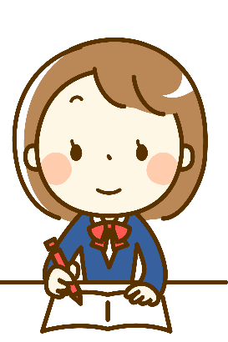


study English
×
now
future
（未来）
past
（過去）
tomorrow
won’t
study
She ( won’t )( study )( English )
( tomorrow ).
English
tomorrow

Slide 22




×
go to America
now
future
（未来）
past
（過去）
next month
They ( won’t )( ) to America
( )( ).
won’t
go
next
month

Slide 23

×
be busy
now
future
（未来）
past
（過去）
this evening
I ( won’t )( ) busy
( )( ).
won’t
be
this
evening

Slide 24


be sunny
×
now
future
（未来）
past
（過去）
tomorrow
It ( won’t )( ) sunny ( ).
won’t
be
tomorrow

Slide 25
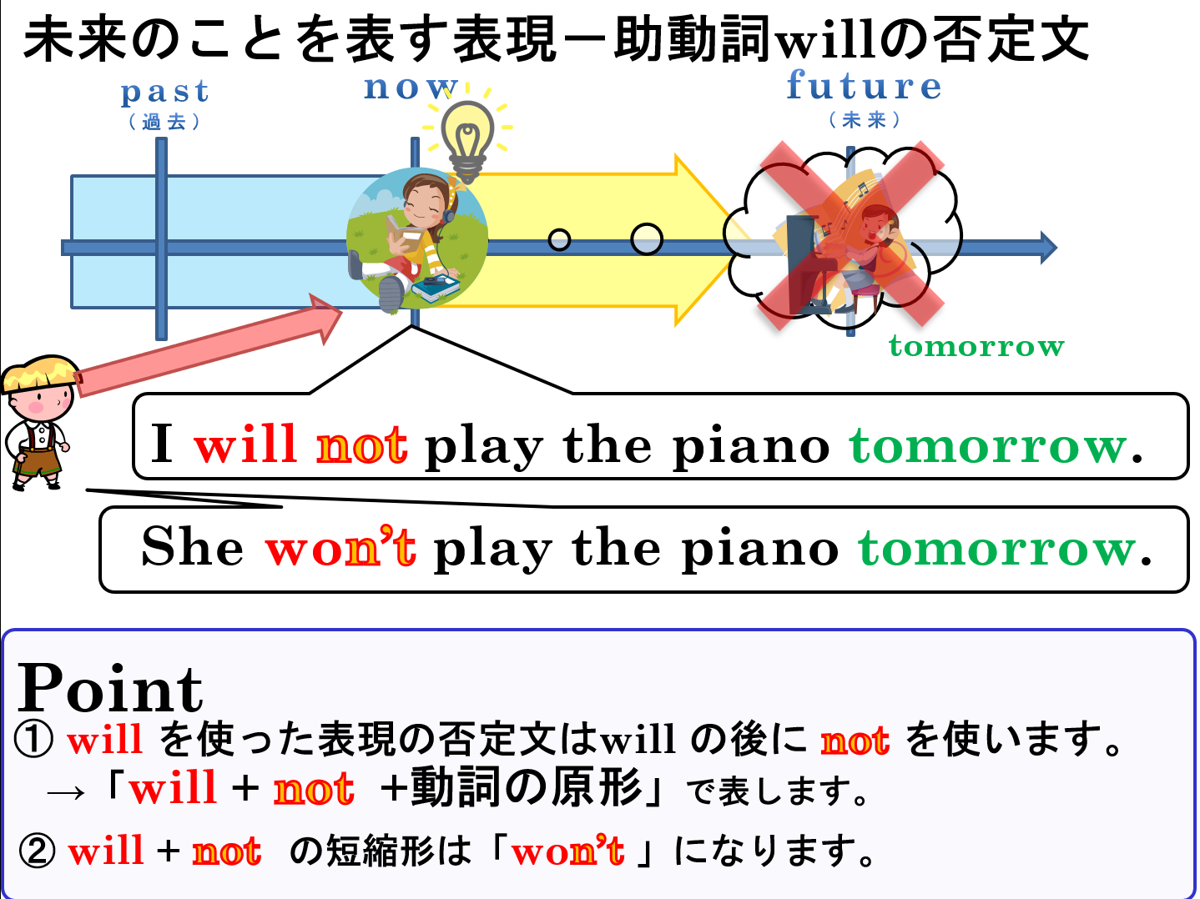

Slide 26
助動詞 will
疑問文・否定文

