Slide 1
be going to 動詞の原形

Slide 2
be going to + 原形の疑問文
Practice Are～? / Is～?

Slide 3



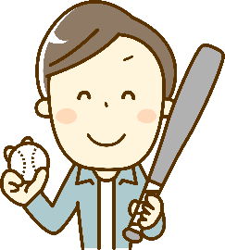
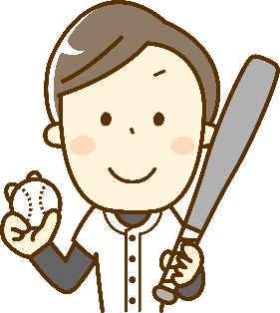
be going to ＋動詞の原形の疑問文
You are going to play baseball
tomorrow.
are
are
are
You are going to play baseball
tomorrow.
Are
you
?
tomorrow
?
Yes, I am.
No, I am not.
past
now
future
Point
① 「be going to＋動詞の原形」と言っても疑問文の形は今までの
be動詞がある文と同じです。be動詞が前にでます。
②答え方も今までのbe動詞の疑問文と同じ答え方です。

Slide 4

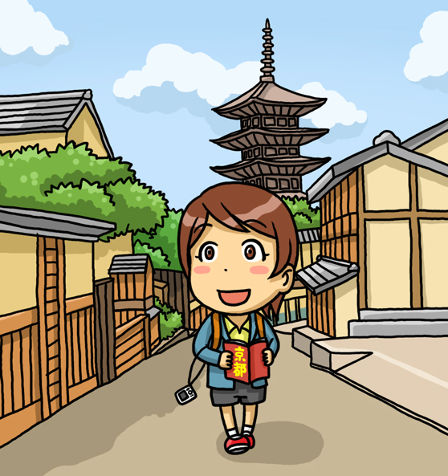


You are going to go to Kyoto
next Sunday.
going
go
( Are )( you )( going ) to ( go ) to Kyoto
( next )( Sunday )?
Are
you
next
Sunday
?
past
now
future
Yes, ( I )( am ).
I
am
No, ( I )( am )( not ).
I
am
not
No, ( I’m )( not ).
I’m
not

Slide 5



He is going to play basketball
this afternoon.
going
( Is )( he )( going ) to ( play ) basketball
( this )( afternoon )?
Is
he
play
this
afternoon
?
past
now
future
Yes, ( he )( is ).
he
is
No, ( he )( is )( not ).
he
is
not
No, ( he )( isn’t ).
he
isn’t

Slide 6
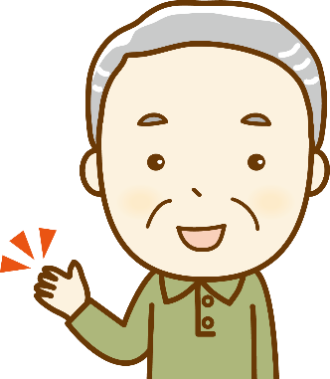


She is going to cook dinner
tomorrow.
going
( Is )( she )( going )( to )( cook ) dinner
( tomorrow )?
Is
she
to
cook
tomorrow
?
past
now
future
Yes, ( she )( is ).
she
is
No, ( she )( is )( not ).
she
is
not
No, ( she )( isn’t ).
she
isn’t

Slide 7



They are going to watch TV
tonight.
going
( Are )( they )( going )( to )( watch ) TV
( tonight )?
Are
they
to
watch
tonight
?
past
now
future
Yes, ( they )( are ).
they
are
No, ( they )( are )( not ).
they
are
not
No, ( they )( aren’t ).
they
aren’t

Slide 8




You are going to be busy
this evening.
going
be
( Are )( you )( going ) to ( be ) busy
( this )( evening )?
Are
you
this
evening
?
past
now
future
Yes, ( I )( am ).
I
am
No, ( I )( am )( not ).
I
am
not
No, ( I’m )( not ).
I’m
not

Slide 9
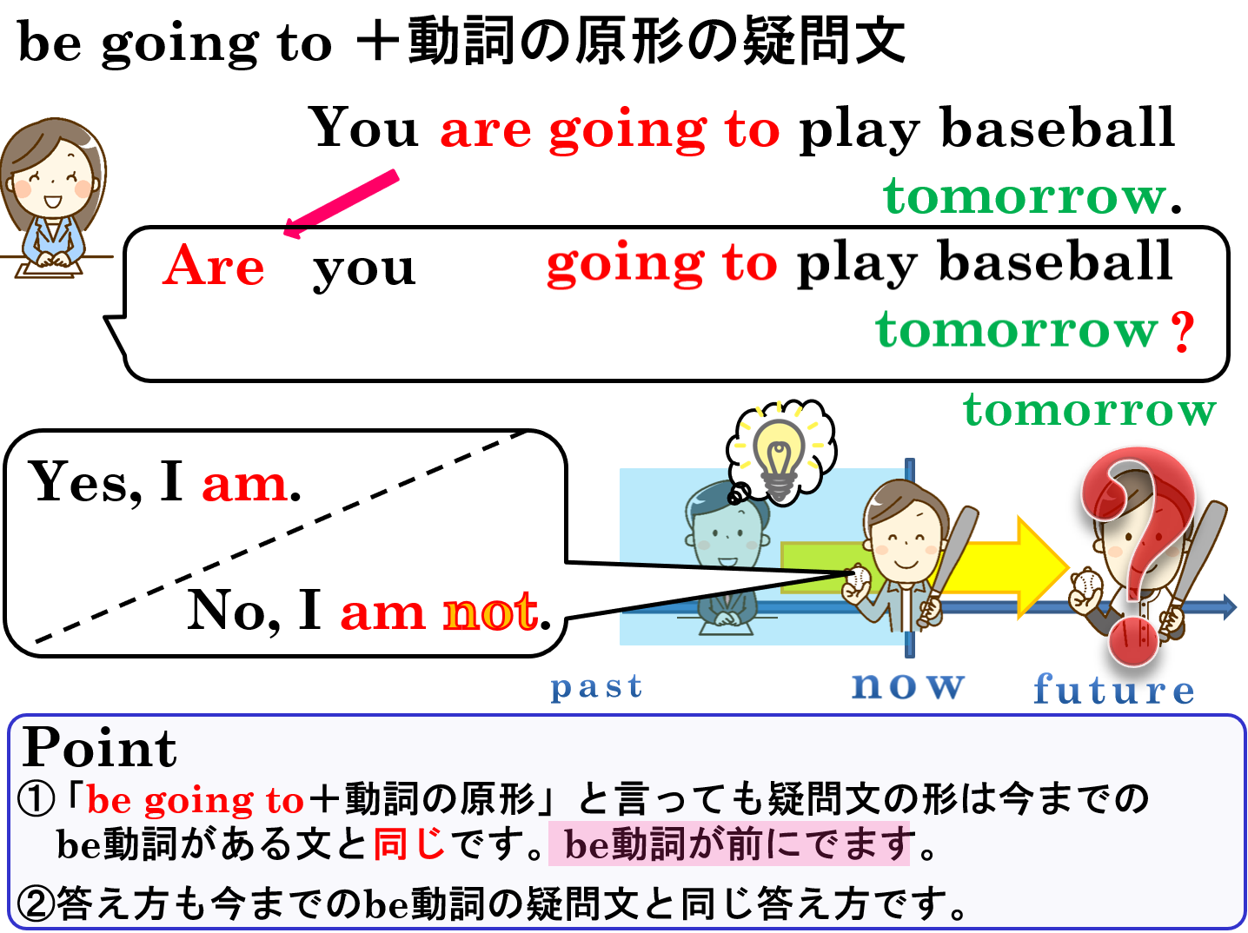

Slide 10
be going to + 原形の否定文

Slide 11
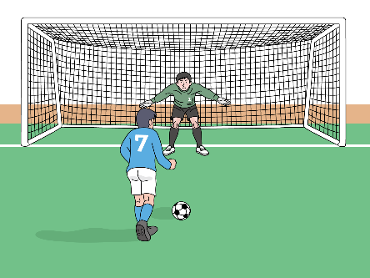

×
未来のことを表す表現－be going toの否定文
tomorrow
now
past
future
I
am
not
going
to
play soccer
tomorrow.
He
isn’t
going
to
play soccer
tomorrow.
Point
① 「be going to＋動詞の原形」と言っても否定文の形も今までの
be動詞がある文と同じ。be動詞の後ろにnotがきます。
→ be not going to 動詞の原形

Slide 12
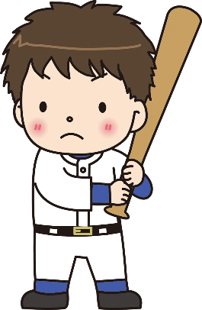


×
play baseball
now
future
（未来）
past
（過去）
tomorrow
I ( am )( not )( going )( to )( play )
baseball ( tomorrow ).
am
not
going
to
play
tomorrow

Slide 13


×
eat sushi
now
future
（未来）
past
（過去）
tonight
You ( )( not )( going )( to )
( play ) sushi ( ).
are
not
going
to
eat
tonight

Slide 14
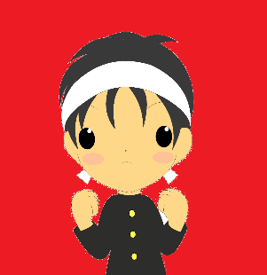

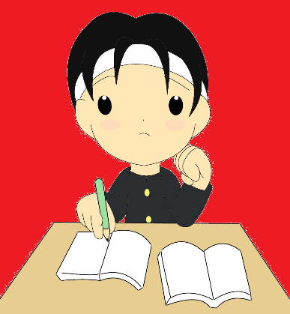
×
study math
now
future
（未来）
past
（過去）
tomorrow night
He ( )( not )( going )( to )( play )
math ( )( ).
is
not
going
to
study
tomorrow
night

Slide 15


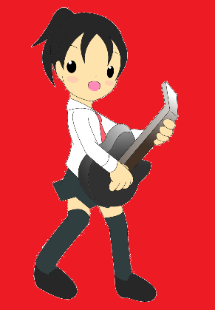
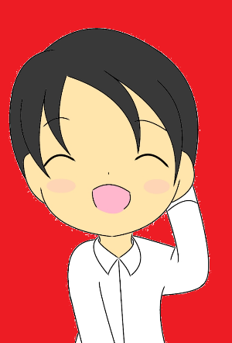
×
play the guitar
now
future
（未来）
past
（過去）
this afternoon
She ( )( not )( going )( to )( play )
the guitar ( )( ).
is
not
going
to
play
this
afternoon

Slide 16


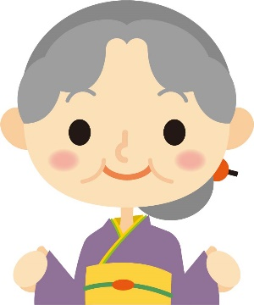
×
go to America
now
future
（未来）
past
（過去）
next week
They ( )( not )( going )( to )
( y ) to America ( )( ).
are
not
going
to
go
next
week

Slide 17
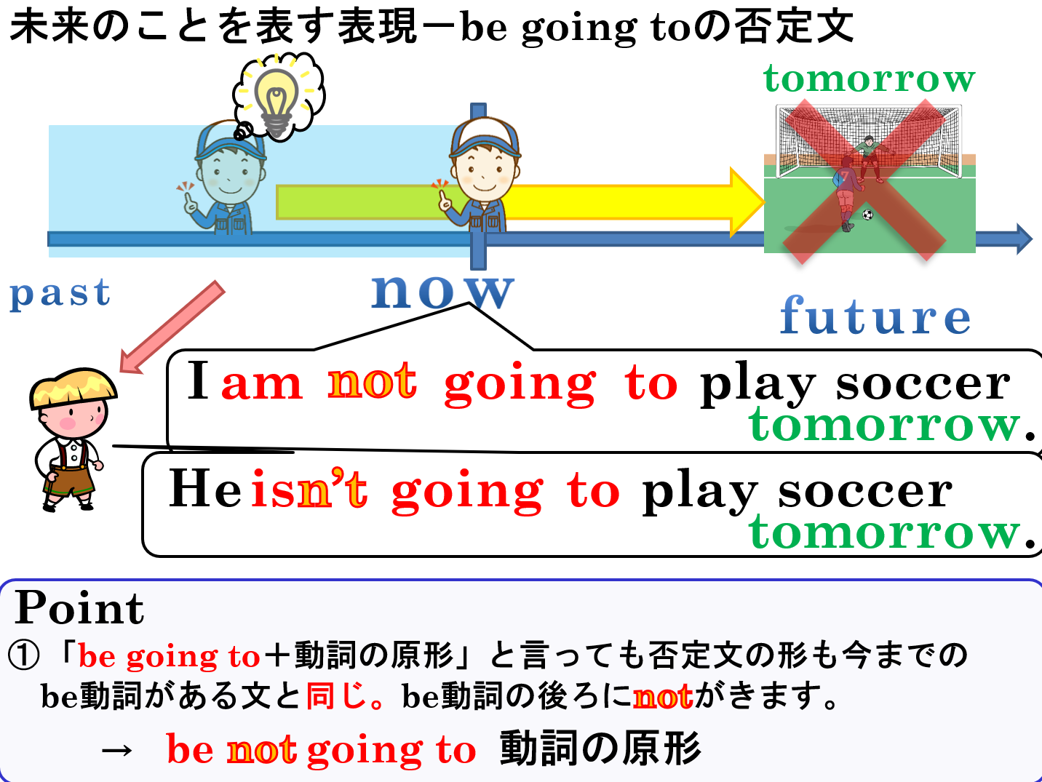

Slide 18
be going to 動詞の原形

