Slide 1
接続詞 when
～のときは

Slide 2


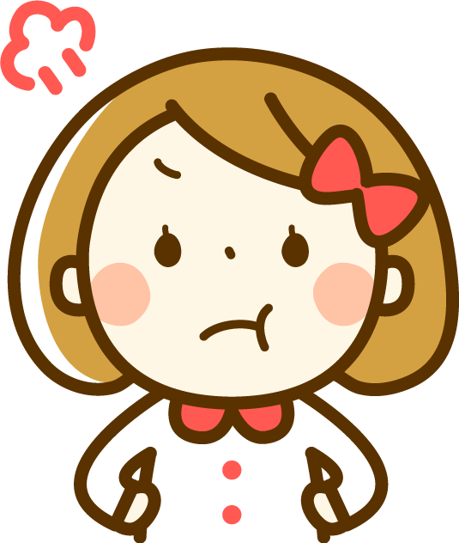
×
I like coffee now.
I didn’t like coffee
when
I was a child.
When
=
I was a child,
I didn’t like coffee.

Slide 3


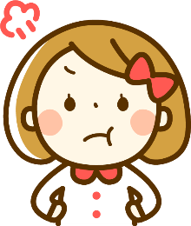
接続詞when (～とき)
I like coffee now.
I didn’t like coffee
when
I was a child.
When
=
I was a child,
I didn’t like coffee.
×
Point
① 「when ＋ 文章」で、「～とき」とある場面でのことを設定して説明でき
ます。「when ＋ 文章」以外を主節（一番伝えたい内容の文）といいます。
② 「 when 」は主節と文章をつないでるので、接続詞の役割をしています。
③文法的には「 when ＋ 文章」は主節の前でも後ろでどちらでもかまいませ
ん。「 when ＋ 文章」 が主節の前のときには、 「when ＋ 文章」の最後
に、「,」をつけ、ここまでが場面の設定ということわかりやすくします。
④「 when + 文章」が主節の前か後ろかは、映画やドラマで例えると、シーン
が切り替わったときには、「 When + 文章, 主節. 」の順で、シーンが切り替
わっていないときには、「主節 when + 文章.」の順になります。
Notes:
④については、ほとんどの副詞句、副詞節に当てはまることです。

Slide 4
接続詞 when
Practice when

Slide 5
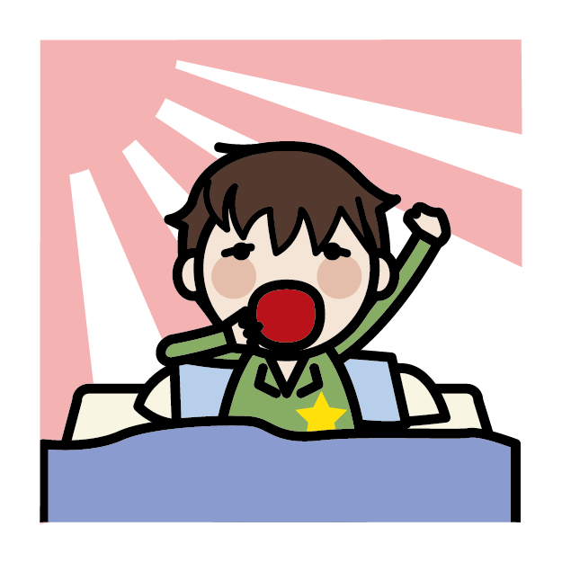
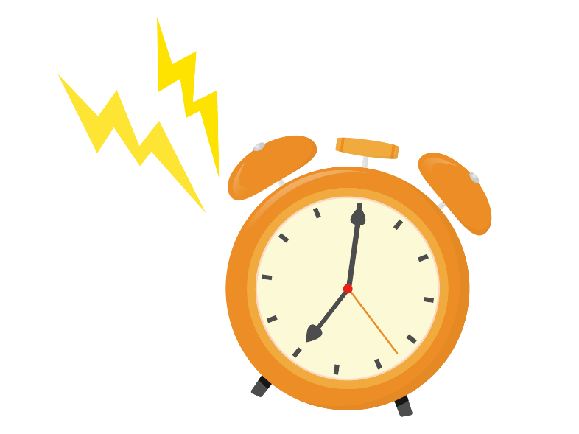
I got up at seven.

Slide 6
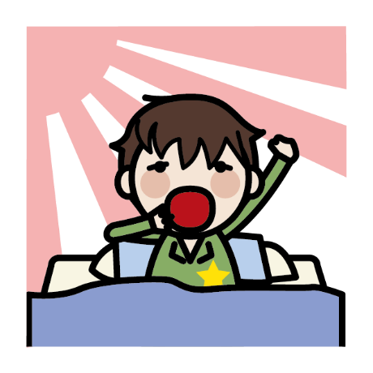

When I got up,
my mother
was
reading a book.

Slide 7
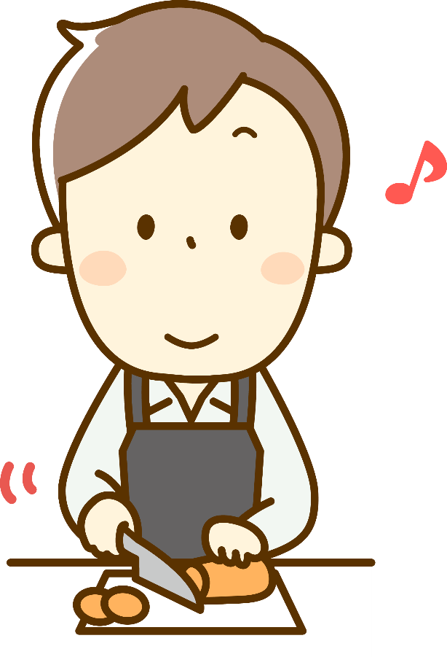
When I got up,
my father
was
cooking breakfast.

Slide 8
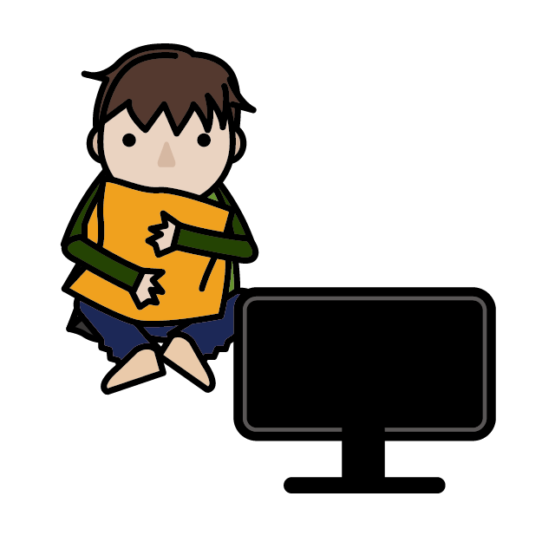
When I got up,
my brother
was
watching TV.

Slide 9
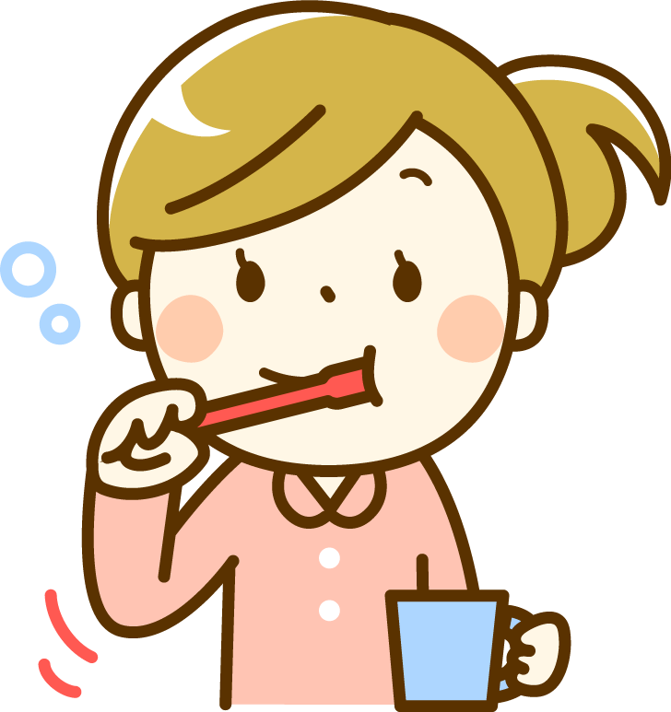
When I got up,
my sister
brushing her teeth.
was

Slide 10
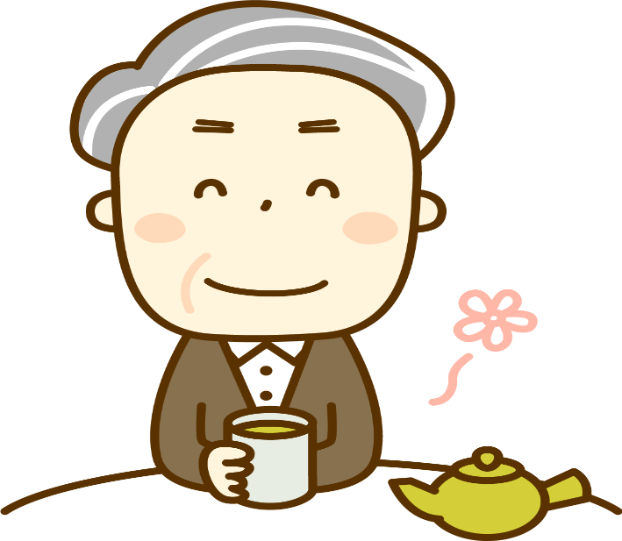
My grandfather
was
drinking green tea
when I got up.

Slide 11
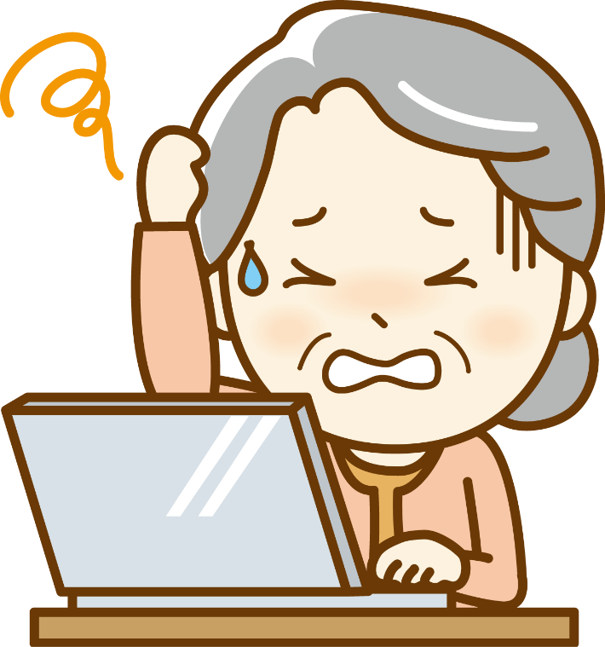
My grandmother
was
using a computer
when I got up.

Slide 12

My dog
was
sleeping
when I got up.

Slide 13
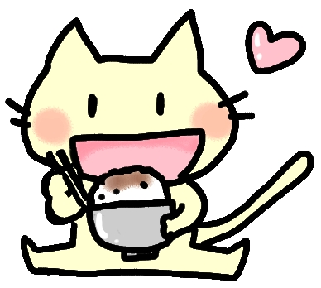
My cat
was
eating breakfast
when I got up.

Slide 14
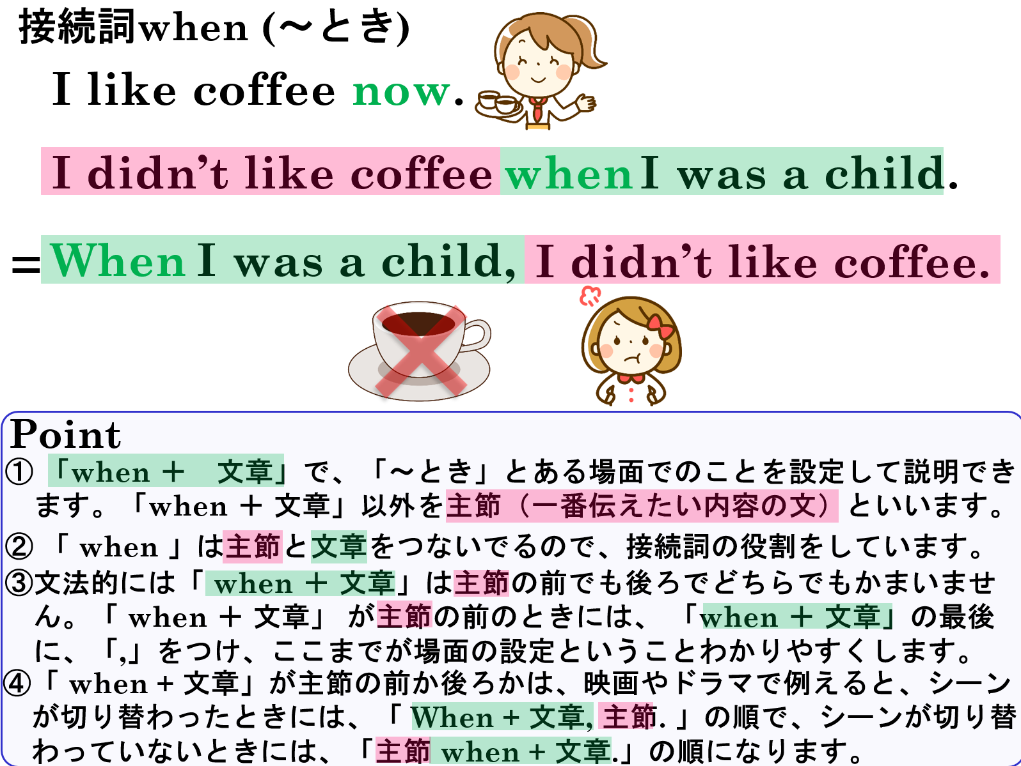

Slide 15
Let’s chat about yourself

Slide 16
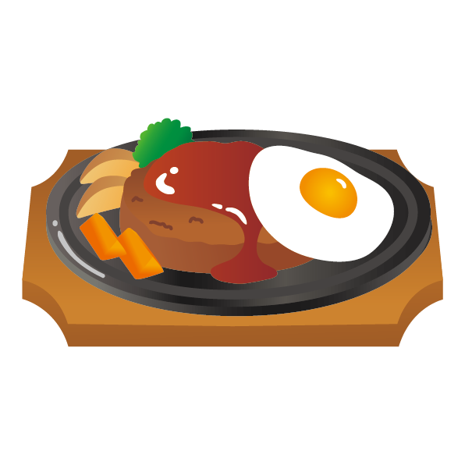

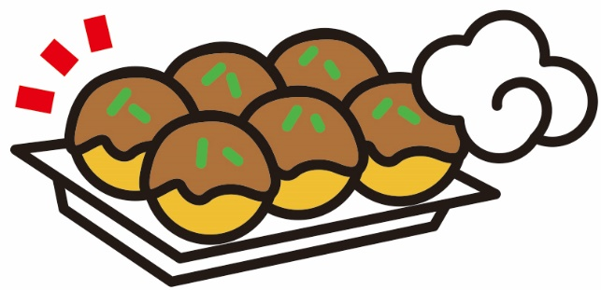
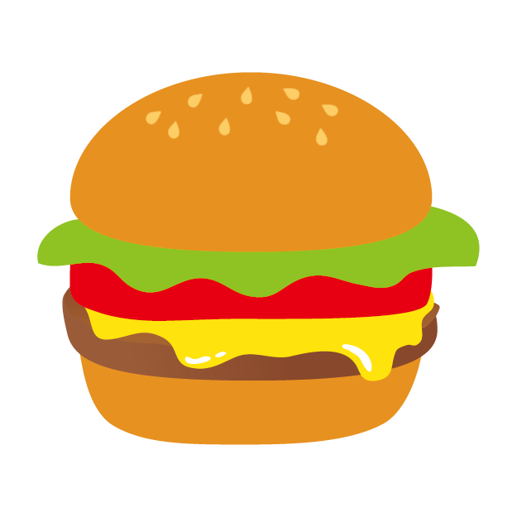
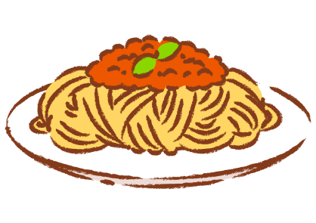
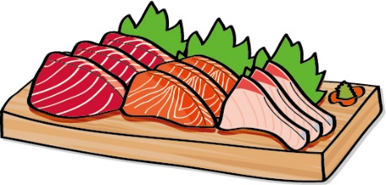
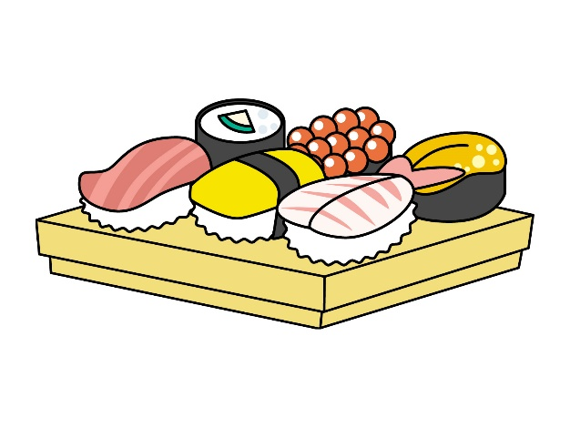
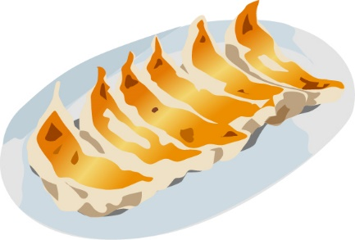
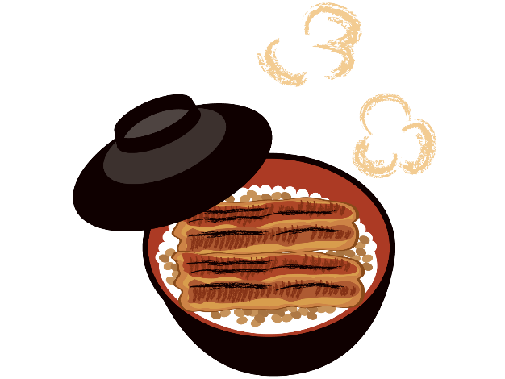
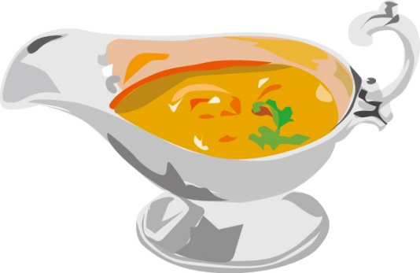
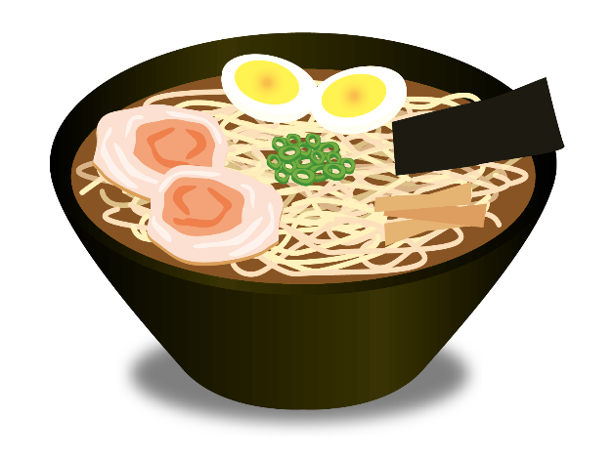
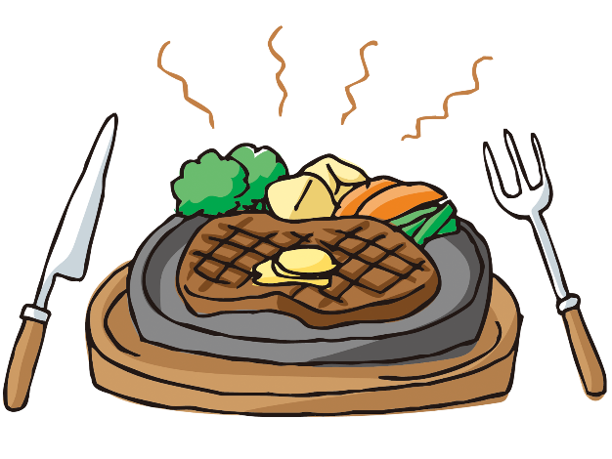
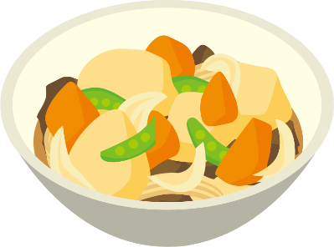
① What food do you like now?
② What food did you like
when you were 6?

Slide 18
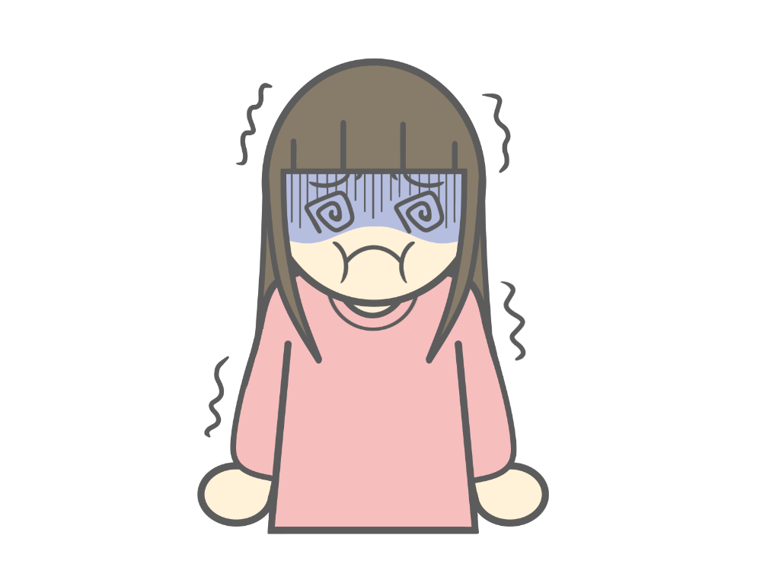
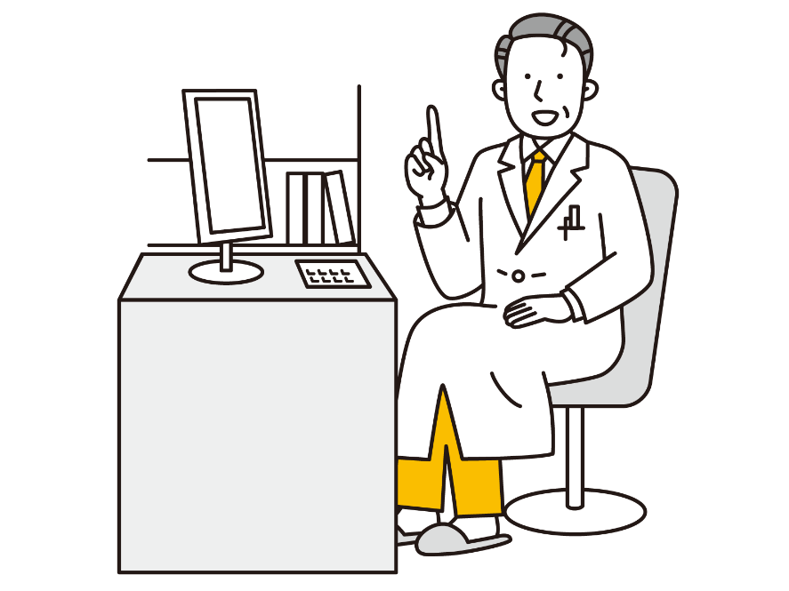
When I feel sick,
I see the doctor.

Slide 19

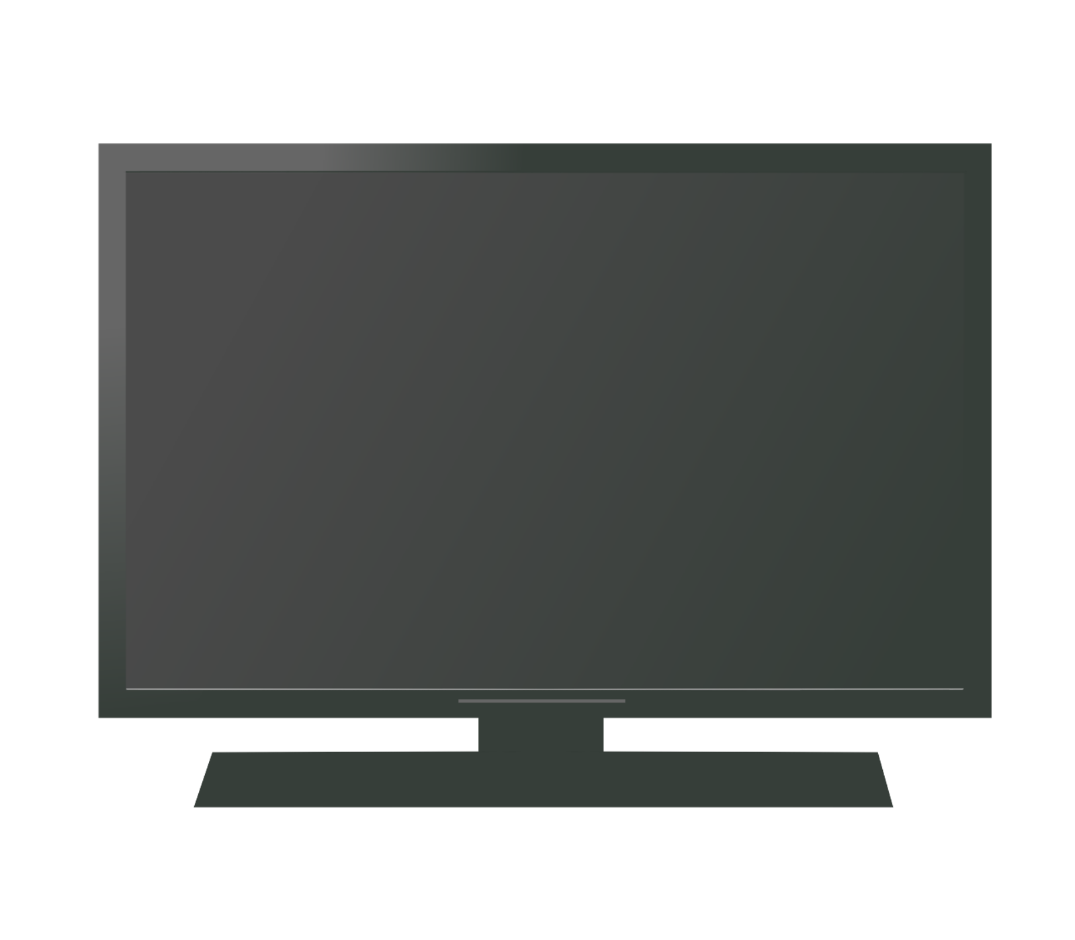
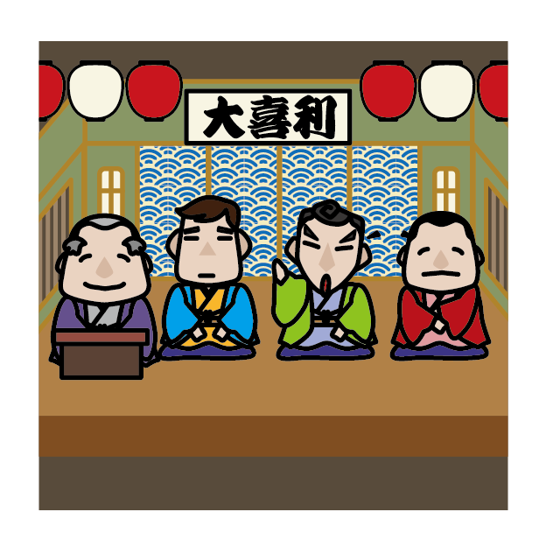
When my favorite TV show starts,
I watch it.

Slide 20

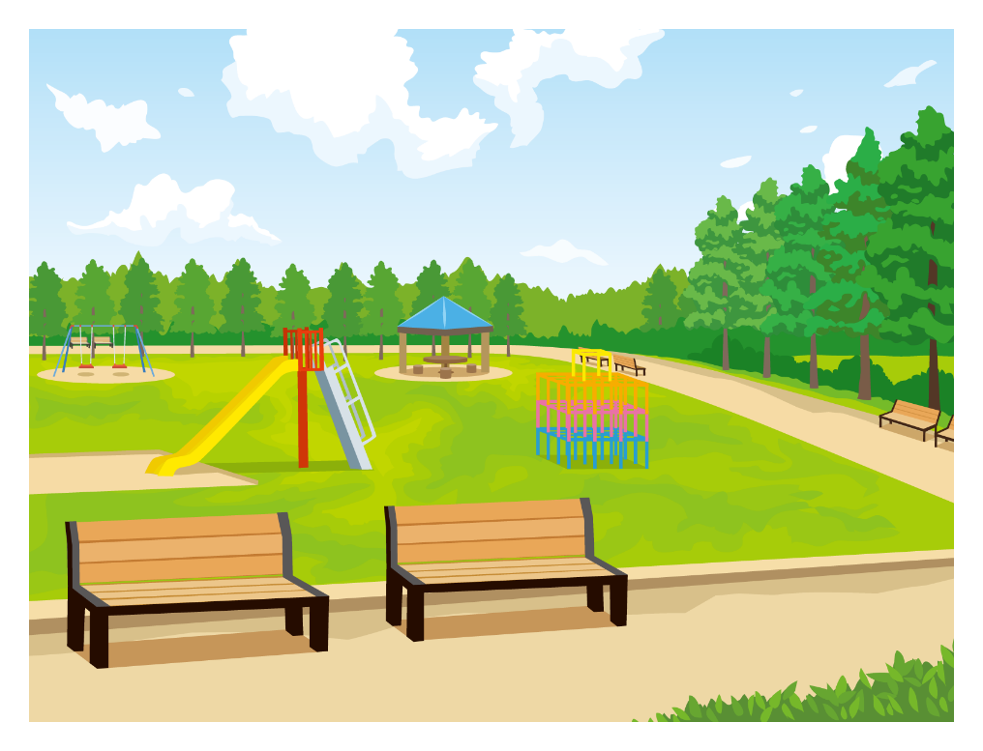
When I was a child,
I often played outside.

Slide 21
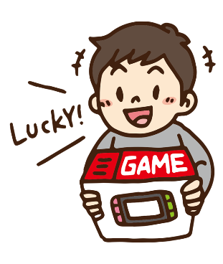
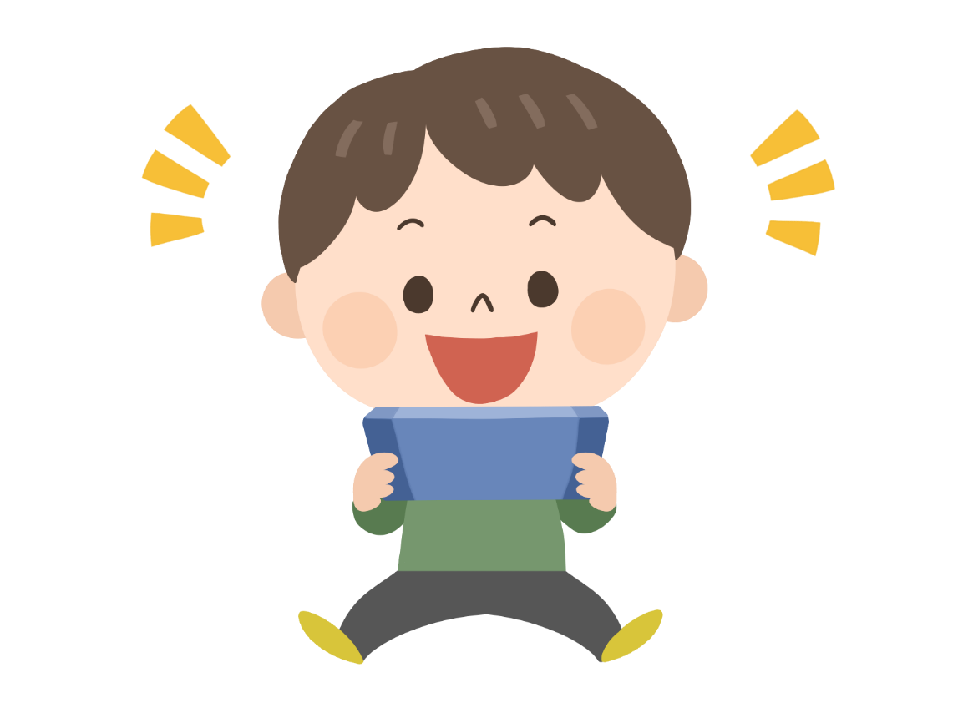
When I get a new game,
I play it right away.

Slide 22

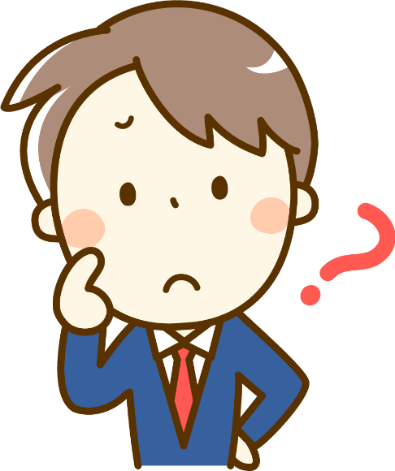
When I don’t understand,
I ask my teacher.

Slide 23
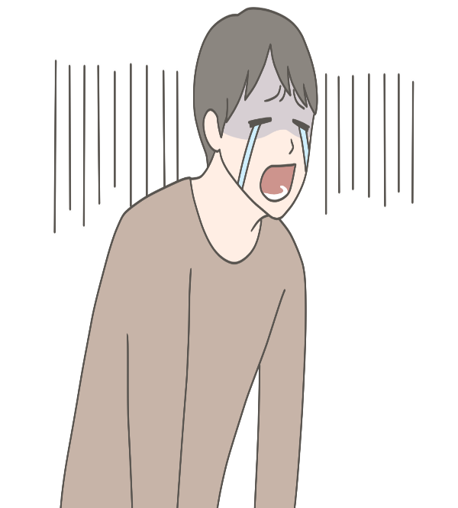
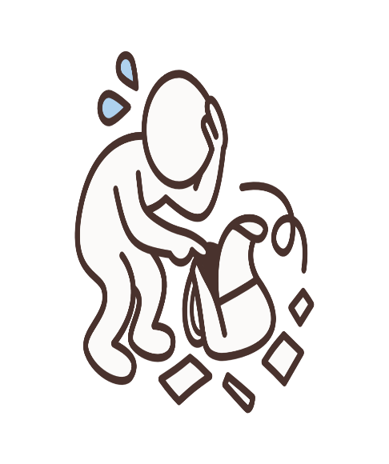
I felt very sad
when I lost my wallet.

Slide 24
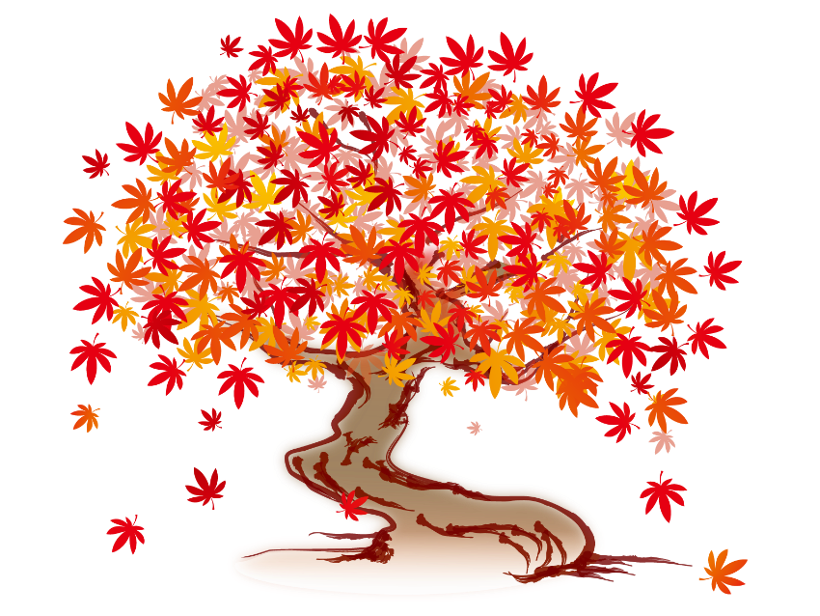
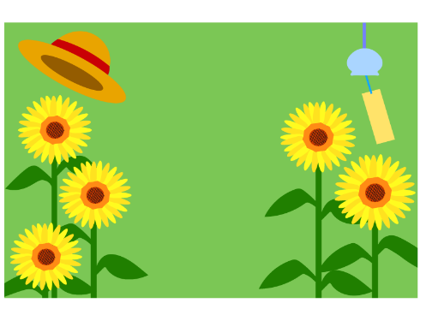

The leaves turned red
when it became autumn.

Slide 25
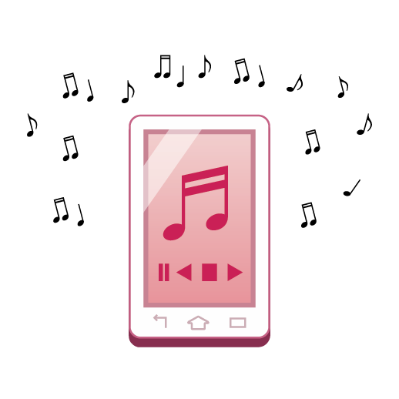
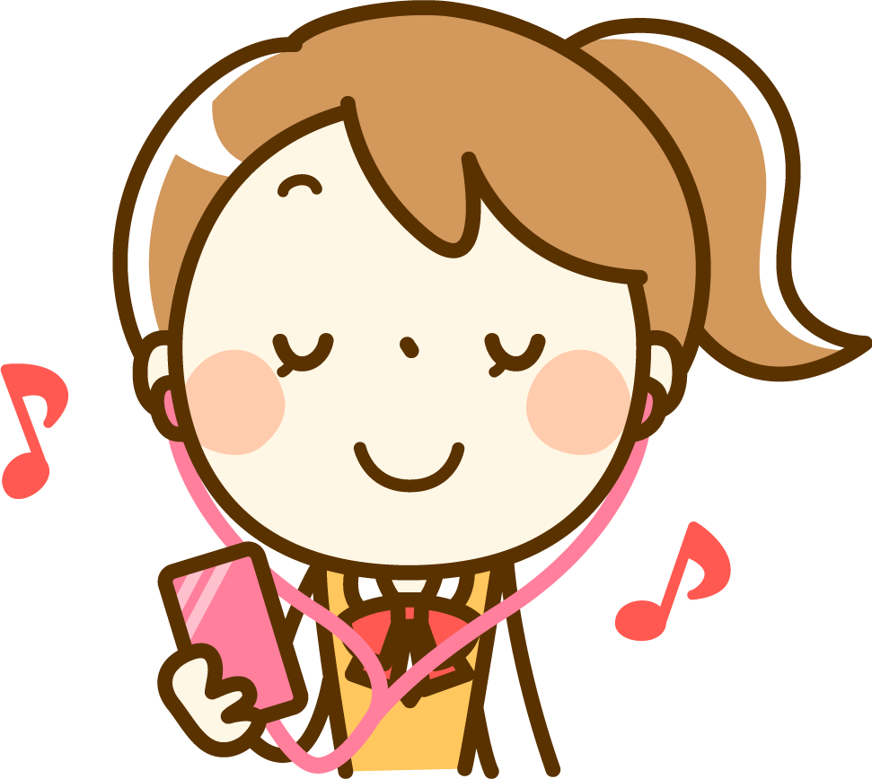
I felt very happy
when I listened to that song.

Slide 26
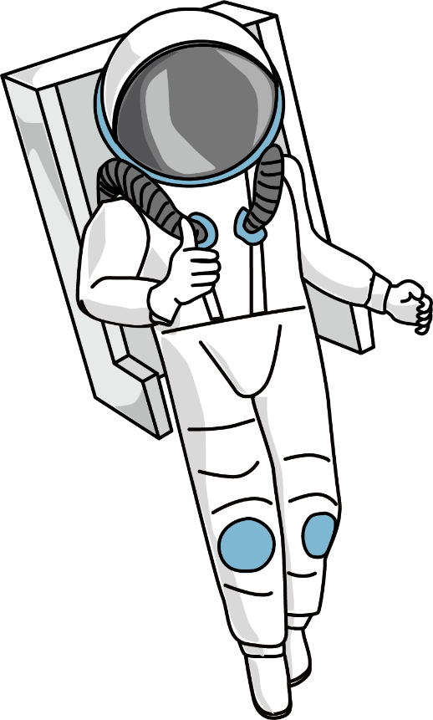
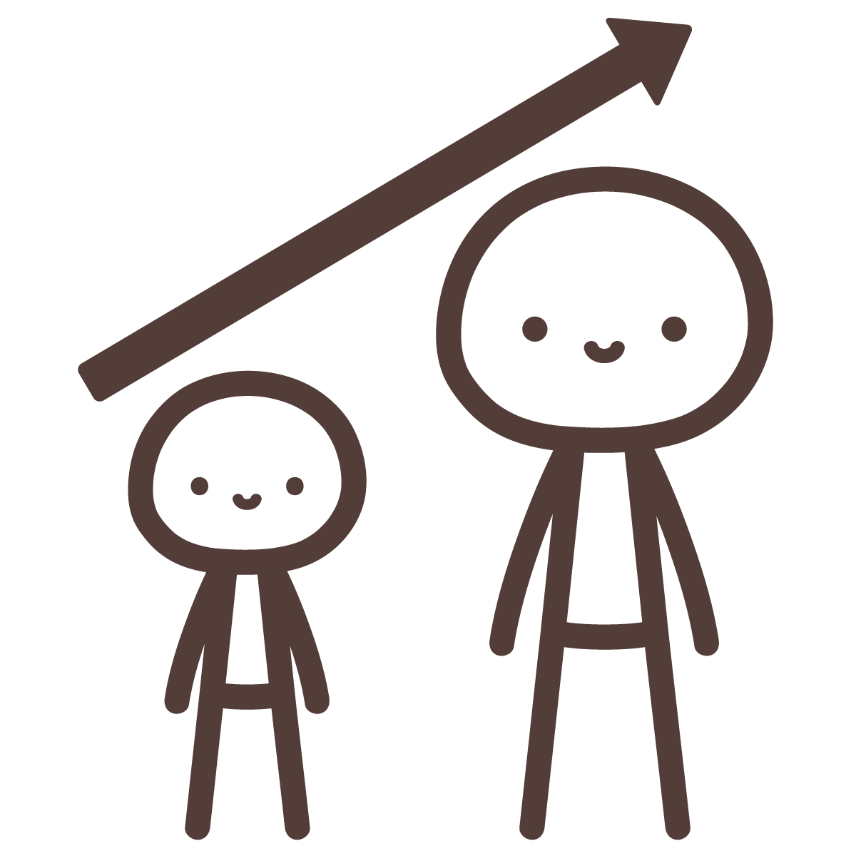
I want to be an astronaut
when I grow up.

Slide 27
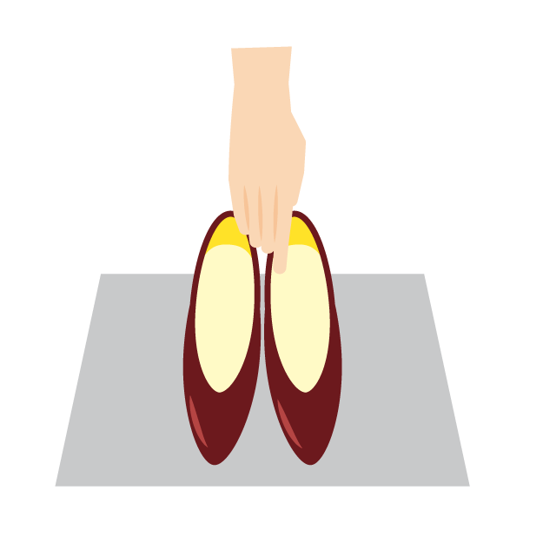
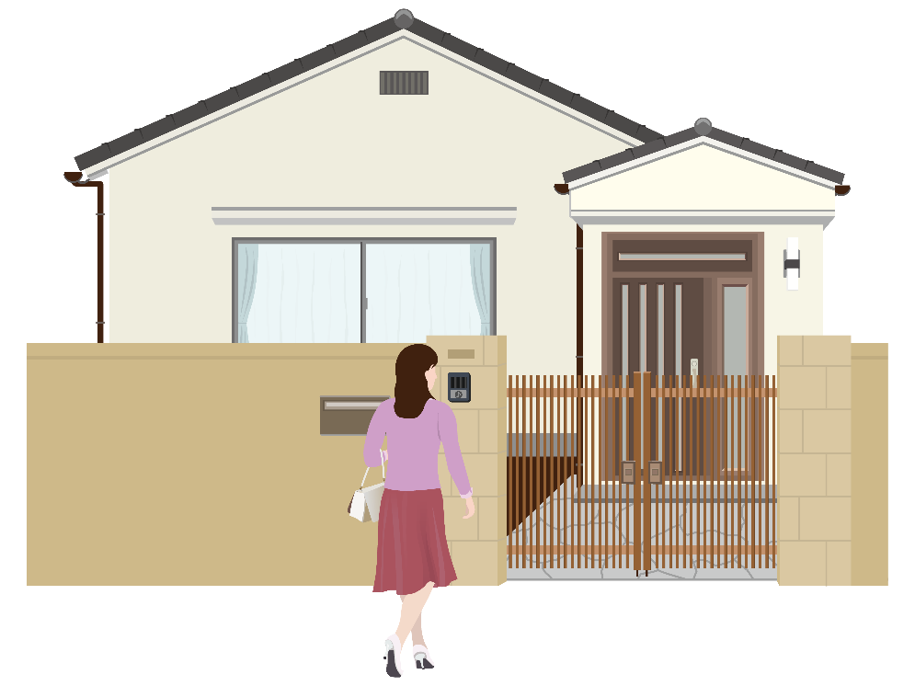
We take off our shoes
when we enter a house.

Slide 28
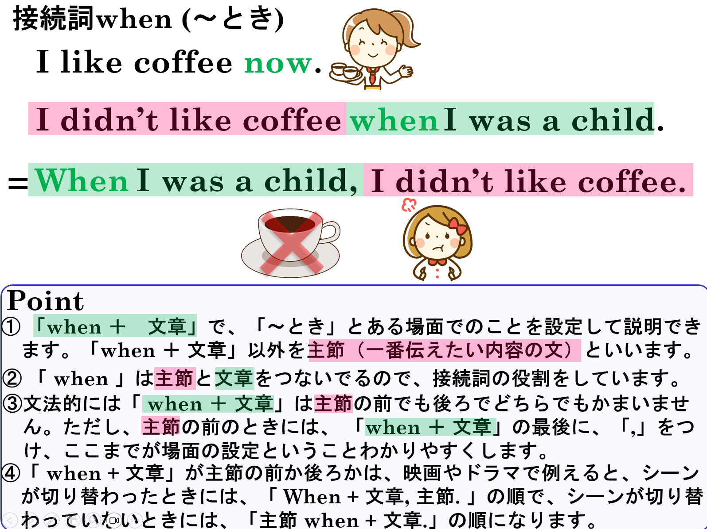

Slide 29
接続詞 when
～のときは

