Slide 1
Because
理由「（なぜなら）～だから（ので）」
理由を説明する表現

Slide 2
English riddles

Slide 3
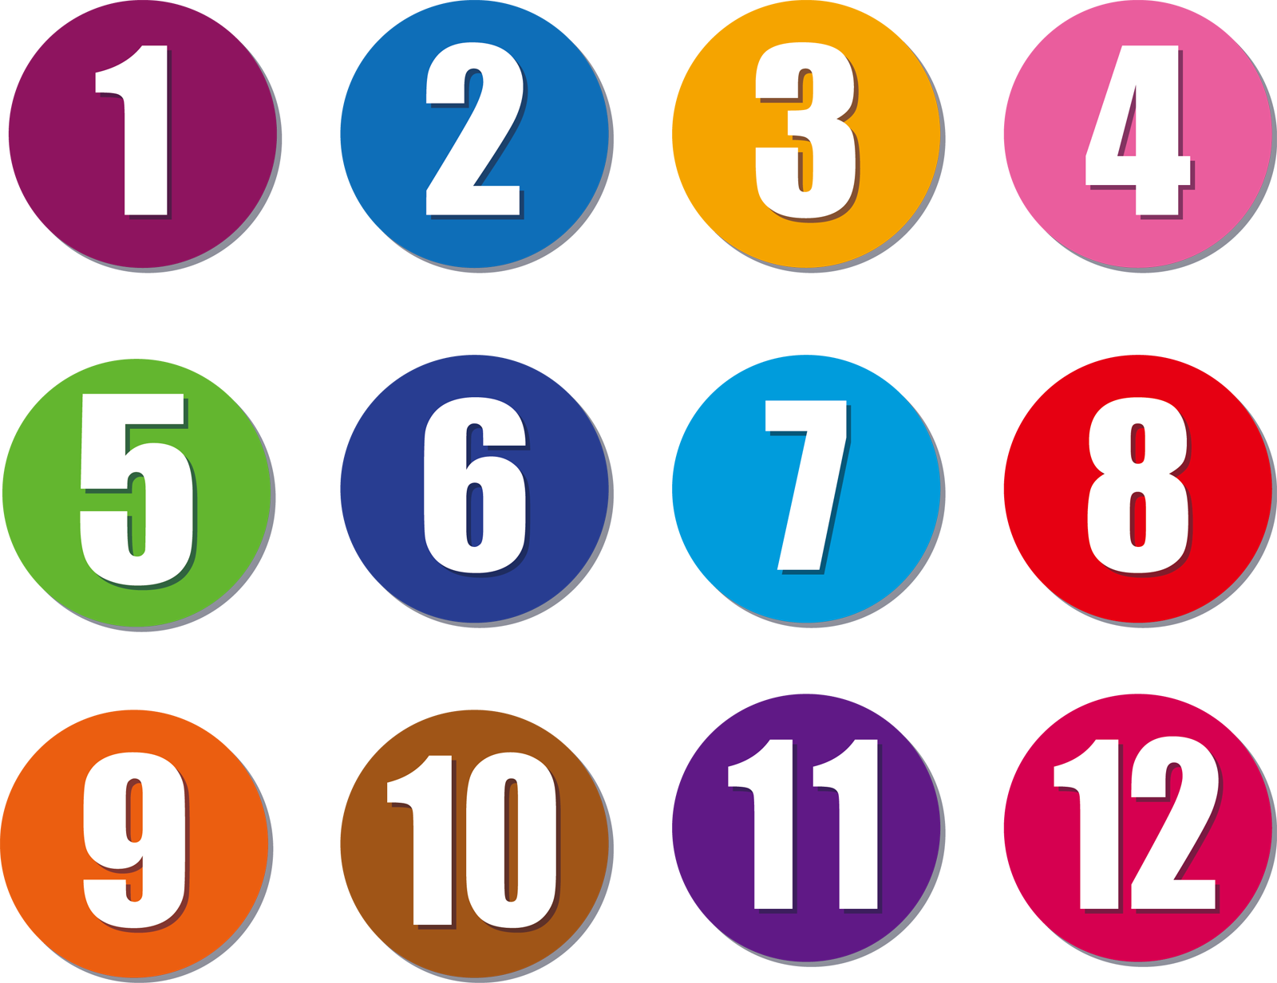

10 is always scared at 7.

Slide 4
Why is 10 always scared at 7?
Hint!
1
2
3
4
5
6
7
8
8
9
10
Because 7 ate 9.
10 is always scared at 7
because 7 ate 9.

Slide 5
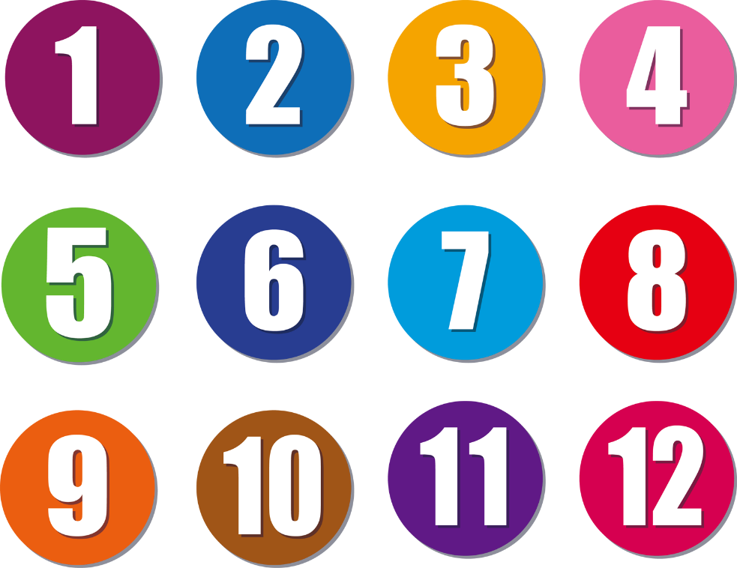
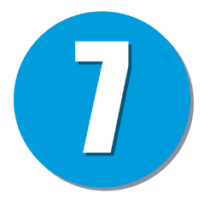
接続詞 because（（なぜならば）～だから（ので）：理由）
10 is always scared at 7
because
7 ate 9.
=
Because
7 ate 9,
10 is always scared at 7.
Why is 10 always scared at 7?
7 ate 9.
Because
Point
①「because ＋ 文章」で、「（なぜなら）～だから（ので）」
と理由を説明して、話をすることができます。
「because ＋ 文章」以外を主節といいます。
② 「 because ＋ 文章」は主節の前でも後ろでもかまいません。
ただし、主節の前のときには、 「because ＋ 文章」の最後
に、「,」をつけ、ここまでが理由と言うことを表します。
「 Why ～?」の質問に対して、「Because ＋ 文章」で答えることができます。このときだけ、 「Because ＋ 文章」が単独で使えます。通常は必ず主節と一緒に使います。

Slide 6
English riddles

Slide 7
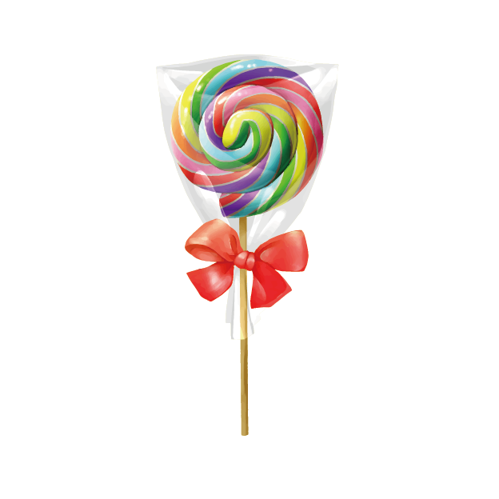
Why can you make “candy”
from 2 letters?
Hint!
Because candy is C and Y.
You can make candy from 2 letters
because candy is C and Y.
Notes:
lettersは文字という説明はしたほうがいいです。

Slide 8
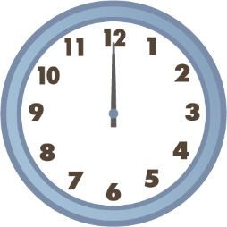
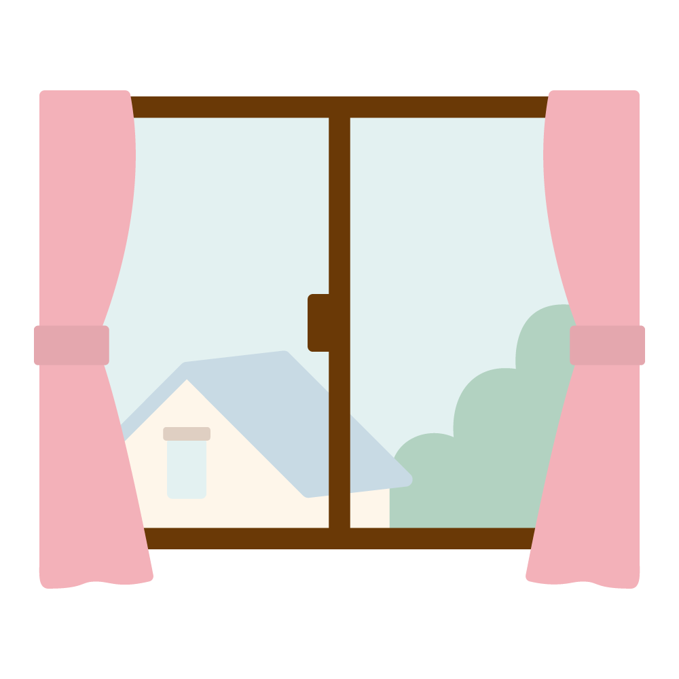
Why is the letter “A” like noon?
Hint!
day
Because it’s in the middle of the day.
The letter “A” like noon
because it’s in the middle of the day.

Slide 9
Because
理由「（なぜなら）～だから（ので）」
理由を説明する表現

Slide 10

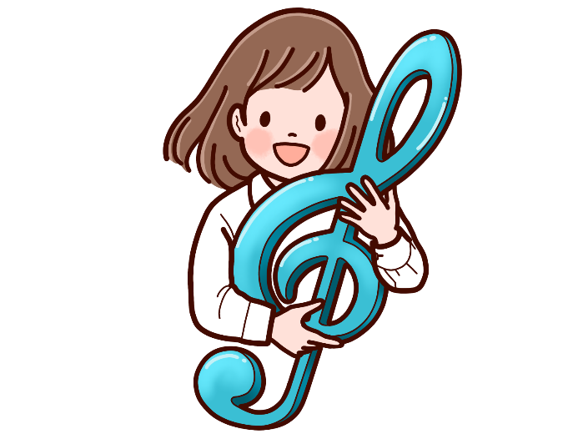
I listened to music yesterday
because
I like music.

Slide 11
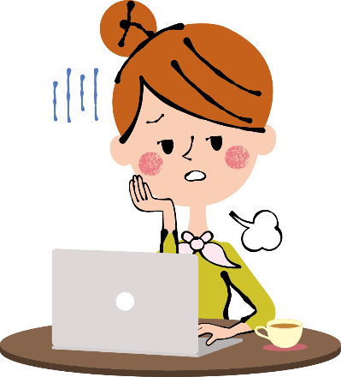
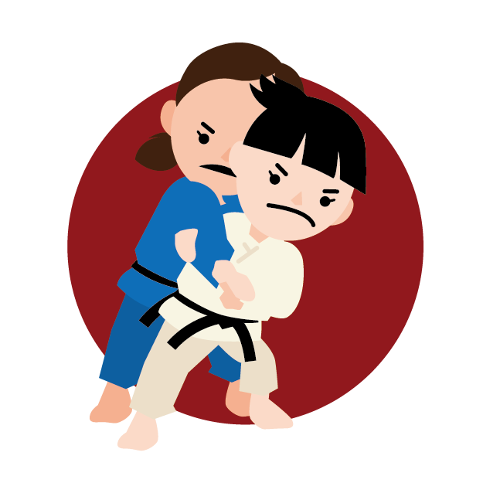
I am tired
because
I practiced judo
very hard yesterday.

Slide 12

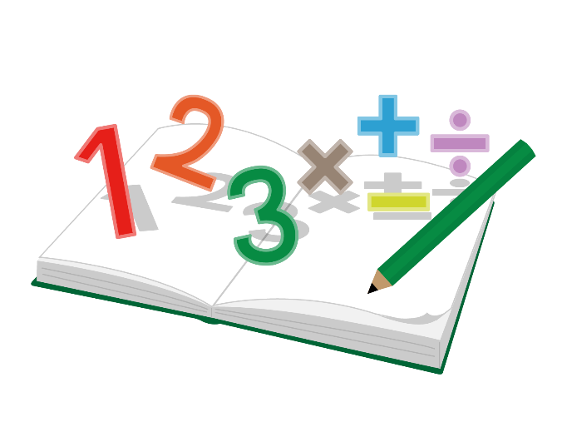

I studied math last night
because
I have a math test today.

Slide 13
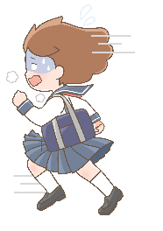
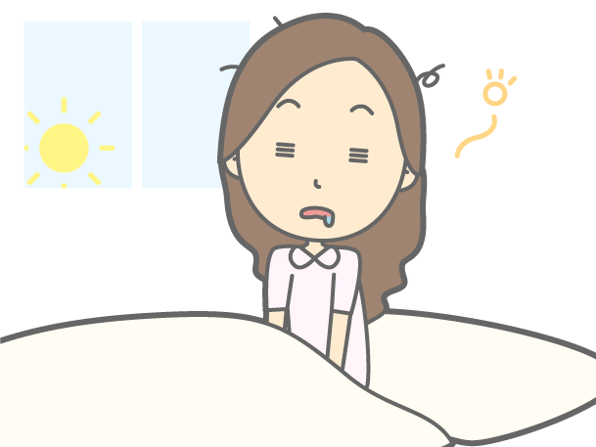
I came to school late yesterday
because
I got up late.

Slide 14
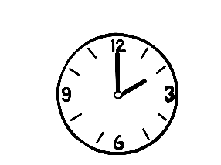
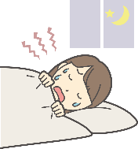
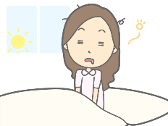
Because
I went to bed at two o’clock last night,
I got up late this morning.

Slide 15
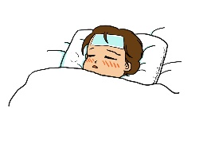
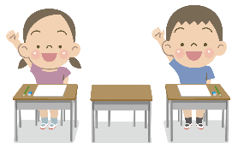
Because
I was sick,
I was absent from school yesterday.

Slide 16
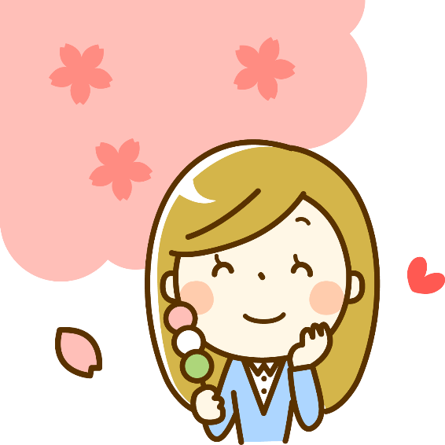
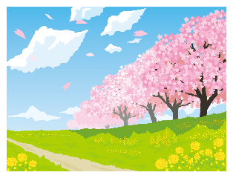
Because
I can enjoy beautiful flowers,
I like spring.

Slide 17
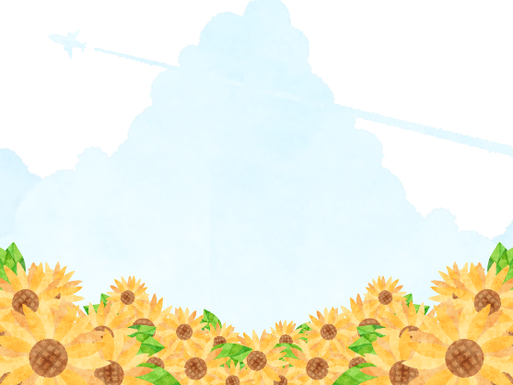
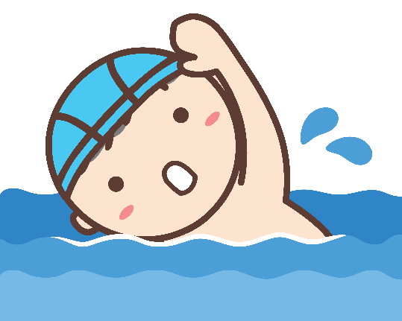
Why
do you like summer?
Because
I can enjoy swimming.

Slide 18
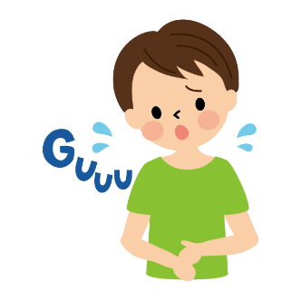
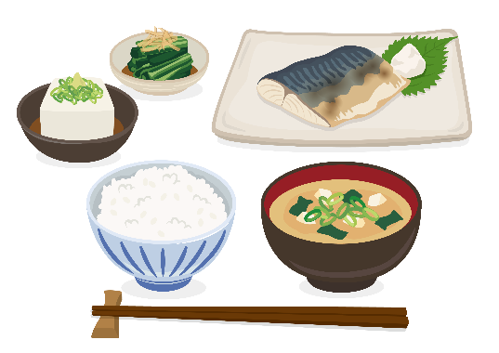
Why
are you hungry now?
Because
I didn’t have breakfast this morning.
×

Slide 19



Why
do you like the book?
Because
the story is exciting.

Slide 20
English riddles

