Slide 1
Superlative
most

Slide 2
もっとも～、一番～
3つ以上のものを 比較する

Slide 3
３つ以上のものを比べてみよう
友だちの考えは？

Slide 4
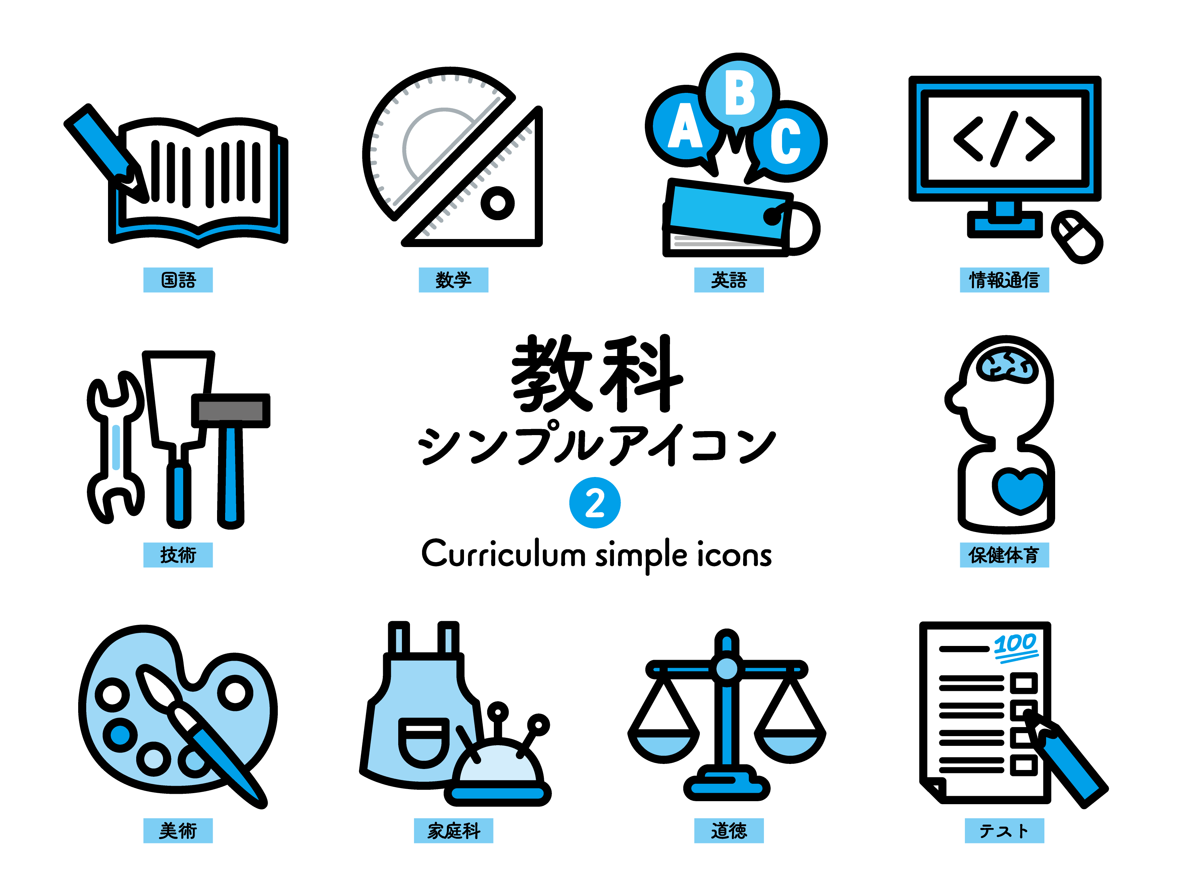
Math
English
Science
Japanese
difficult

Slide 5

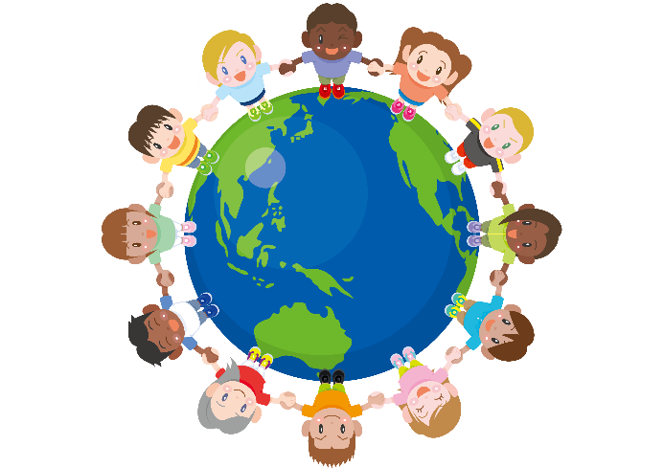


Time
Money
Friends
Dreams
important

Slide 6
Skiing
Skating
Snowboarding
Snowball fight
exciting

Slide 7
Baseball
Basketball
Soccer
Tennis
popular

Slide 8
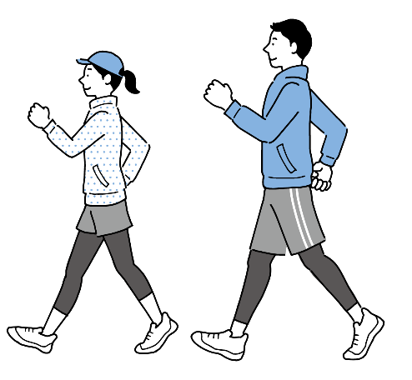


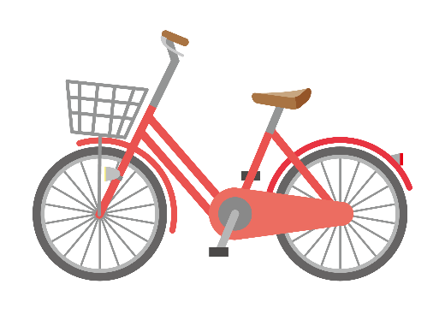
Trains
Buses
Bikes
Walking
useful

Slide 9




Animation movies
Romance
movies
Action movies
Science fiction movies
moving

Slide 10
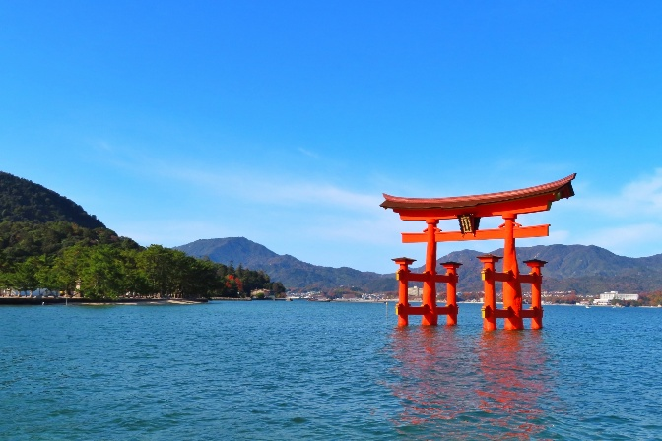
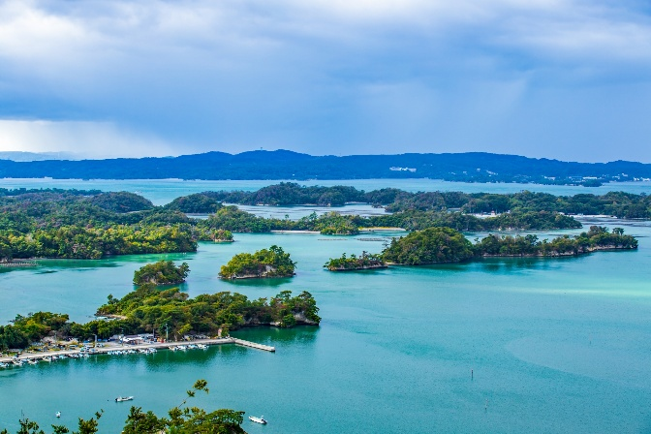
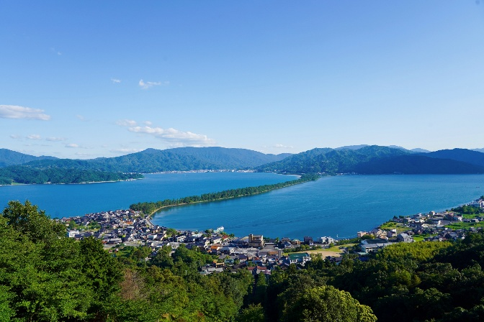
Miyajima
Matsushima
Amanohashidate
beautiful

Slide 11
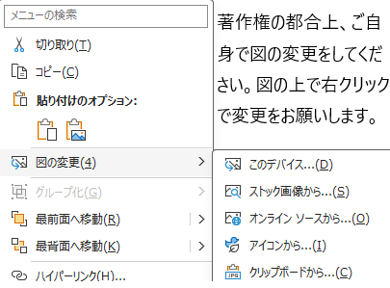
LINE
X
YouTube
Instagram
TikTok
interesting
Notes:
図をそれぞれのアイコンに変更してください。

Slide 12
３つ以上のものを比べてみよう
友だちの考えは？

Slide 13
Math
English
Science
Japanese
difficult
Math is the most difficult of the four.
English is the most difficult of the four.
Science is the most difficult of the four.
Japanese is the most difficult of the four.

Slide 14
Time
Money
Friends
Dreams
important
Time is the most important of the four.
Money is the most important of the four.
Friends are the most important of the four.
Dreams are the most important of the four.

Slide 15
Skiing
Skating
Snowboarding
Snowball fight
exciting
Skiing is the most exciting of the four.
Skiing is the most exciting in winter sports.

Slide 16
いくつかの中で最も（最上級表現） （形容詞・副詞の綴りが長いもの）
Skiing is exciting.
×
スキーはワクワクするんだ。
Skiing is the excitingest.
Skiing is the most exciting.
スキーはもっともワクワクするんだ。
何と比べて？
Skiing is the most exciting
of
the four.
スキーはその４つの中でもっともワクワクするんだ。
Skiing is the most exciting
in
winter sports.
スキーはウインタースポーツの中でもっともワクワクするんだ。
Point
①比較級で「more」を使う形容詞・副詞は、「最も・一番」という表現にするときに、
形容詞や副詞の前に「most」を加えます。これを最上級と言います。
②最も・一番は、一つに限られるので、mostの前に the もつけます。
③何と比べて一番なのかを表すために
in 比較の範囲を表す場所や組織、集団
of 複数の名詞
を使います。

Slide 17
Baseball
Basketball
Soccer
Tennis
popular
Baseball is the ( most ) popular of the four.
most
Basketball is the ( most )( popular ) of the four.
most
popular

Slide 18
Trains
Buses
Bikes
Walking
useful
Trains are ( the )( most )( useful )( of ) the four.
the
most
useful
of

Slide 19
Animation movies
Romance
movies
Action movies
Science fiction movies
moving
Animation movies are ( the )( most )( moving )
( of ) the four.
the
most
moving
of

Slide 20
Miyajima
Matsushima
Amanohashidate
beautiful
Miyajima is ( the )( most )( beautiful )
( of ) the three.
the
most
beautiful
of

Slide 21
LINE
X
YouTube
Instagram
TikTok
interesting
Instagram is ( the )( most )( interesting )
( of ) the ( four ).
the
most
interesting
of
five
Notes:
図をそれぞれのアイコンに変更してください。

Slide 22
more, the mostをつかう形容詞・副詞
原級 | 比較級 | 最上級 | 意味
important |  |  | 重要な
difficult |  |  | 難しい
popular |  |  | 人気のある
useful |  |  | 役に立つ
interesting |  |  | おもしろい
exciting |  |  | わくわくする
beautiful |  |  | 美しい
famous |  |  | 有名な
quickly |  |  | 速く
slowly |  |  | ゆっくりと
easily |  |  | 簡単に
carefully |  |  | 注意深く
more important
the most important
more difficult
the most difficult
more popular
the most popular
more useful
the most useful
more interesting
the most interesting
more exciting
the most exciting
more beautiful
the most beautiful
more famous
the most famous
more quickly
the most quickly
more slowly
the most slowly
more easily
the most easily
more carefully
the most carefully
Notes:
一気にすべて覚える必要はないです。

Slide 23
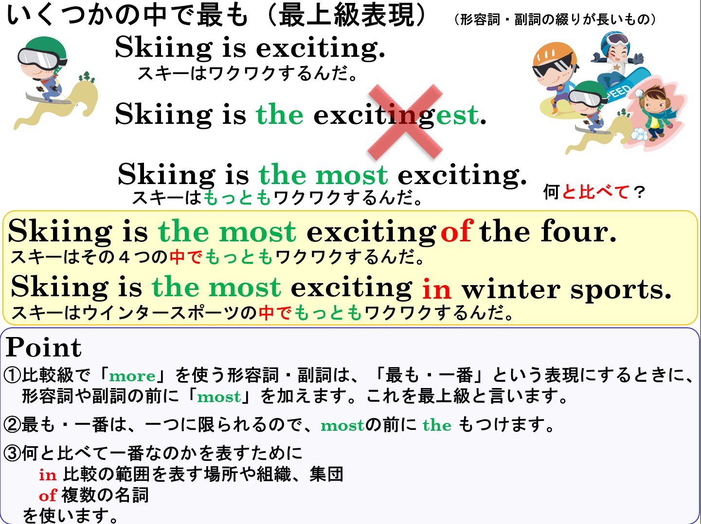

Slide 24
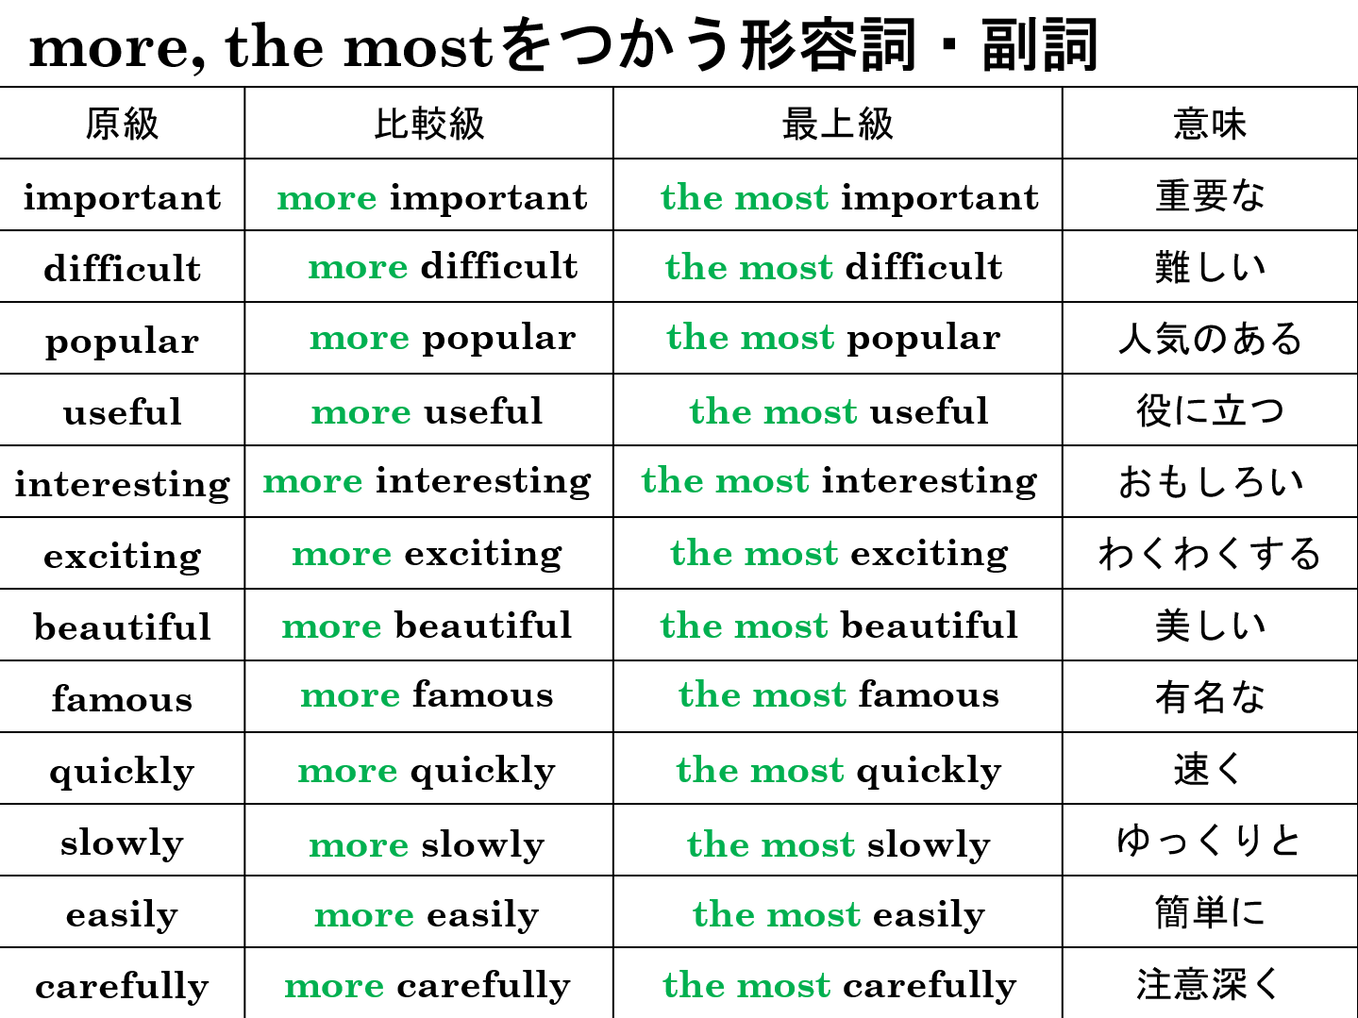

Slide 25
Superlative
most

