Slide 1
comparative
equality

Slide 2
二つのものを比べてみよう
同等比較

Slide 3
A
B
Which is longer , A or B?

Slide 4
A
B
B is longer than A.

Slide 5
A
B
Which is longer , A or B?

Slide 6
A
B
A is as long as B.

Slide 7
A
B
Which is longer , A or B?

Slide 10
A
B
A is as long as B.

Slide 11
A
B
Which is longer , A or B?

Slide 12
A
B
A is as long as B.

Slide 13
同等比較（2つのものが同じくらいのとき）
A
A is long.
B
A is as long.
Aは同じくらい長いんだ。
何と比べて？
as
A is as long as B.
B.
AはBと比べて同じくらい長いんだ。
AとBは同じくらい長いです。
Point
①同じくらいという意味を加えるために「 as 」を形容詞や副詞の
前につけます。形容詞や副詞は変化せず、元の形のままです。
②だれ（何）と比べてなのかを表すために「 as 」を使います。
③前のasと後ろのasは同じように見えますが、役割が違います。
④基本的に比較の対象は相手が知っている情報になります。
Notes:
前のasは副詞
後ろのasは接続詞（前置詞）

Slide 14

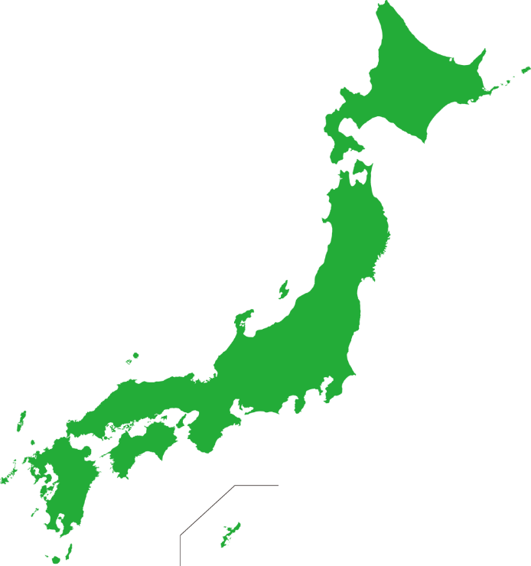


Germany
Japan
large
Germany is ( as ) large ( as ) Japan.
as
as

Slide 15



the moon
Australia
wide
as
wide
as
The moon is ( as )( wide )( as ) Australia.

Slide 16
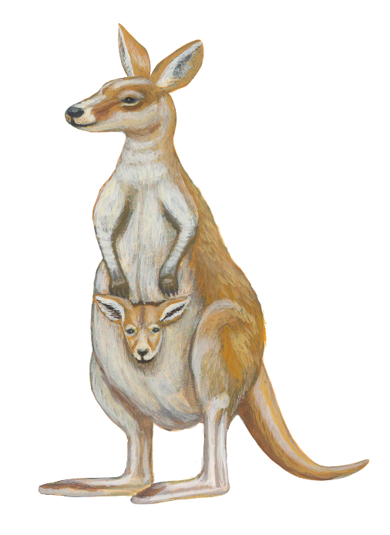

a kangaroo
a person
tall
A kangaroo is ( as )( tall )( as ) a person.
as
tall
as

Slide 17


a hummingbird
a hornet
small
as
small
as
A hummingbird is ( as )( small )( as ) a hornet.
Notes:
ハチドリと蜂（スズメバチ）

Slide 18


a smartphone
three eggs
heavy
A smartphone is ( as )( heavy ) ( as ) three eggs.
as
heavy
as

Slide 19
二つのものを比べてみよう
否定の同等比較

Slide 20
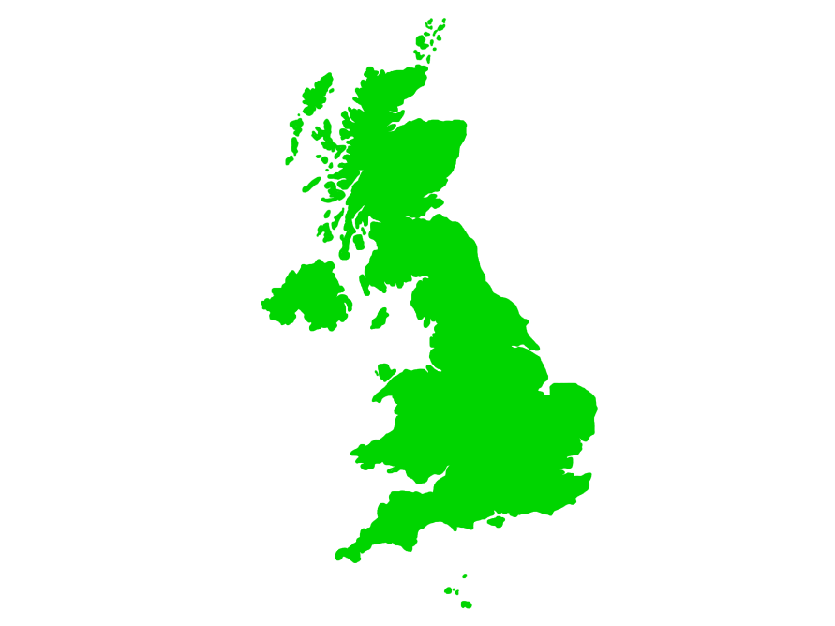



What country
is this?
It is the United Kingdom of Great Britain
and Northern Ireland.
The UK is
not
large.
The UK is
not
as
large
as
Japan.

Slide 21


同等比較の否定
The UK is
not
large.
The UK is
not
as
large.
イギリスは同じくらい大きくはないんだ。
何と比べて？
The UK is
not
as
large
as
Japan.
イギリスは日本と比べて同じくらい大きくはないです。
イギリスは日本ほど大きくはないです。
Point
①同等比較に「not」があるときには、2つ目のas～の前の部分
を考えましょう。as～の前の部分が伝えたいことです。その伝
えたいことをわかりやすく伝えるためにas～の部分があります。
②「～と比べて、形容詞・副詞ではない」ということになります。

Slide 22
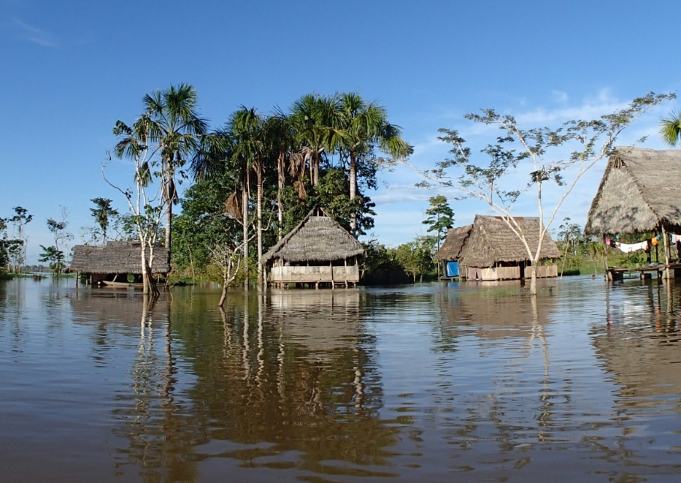

the Amazon
the Nile
×
long
The Amazon is ( not )( as )( long )( as ) the Nile.
not
as
long
as

Slide 23


cheetahs
lions
×
heavy
as
heavy
as
Cheetahs are ( not )( as )( heavy )( as ) lions.
not

Slide 24
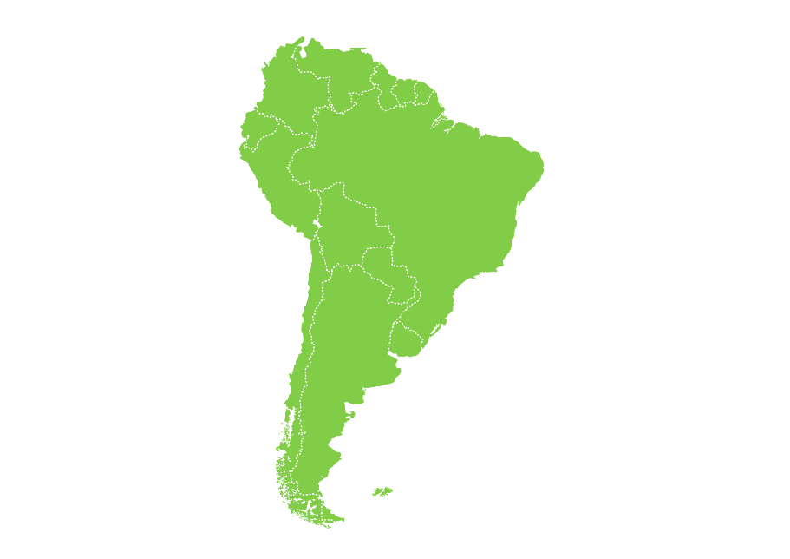

South America
Africa
×
large
South America is ( not )( as )( large )( as ) Africa.
not
as
large
as

Slide 25
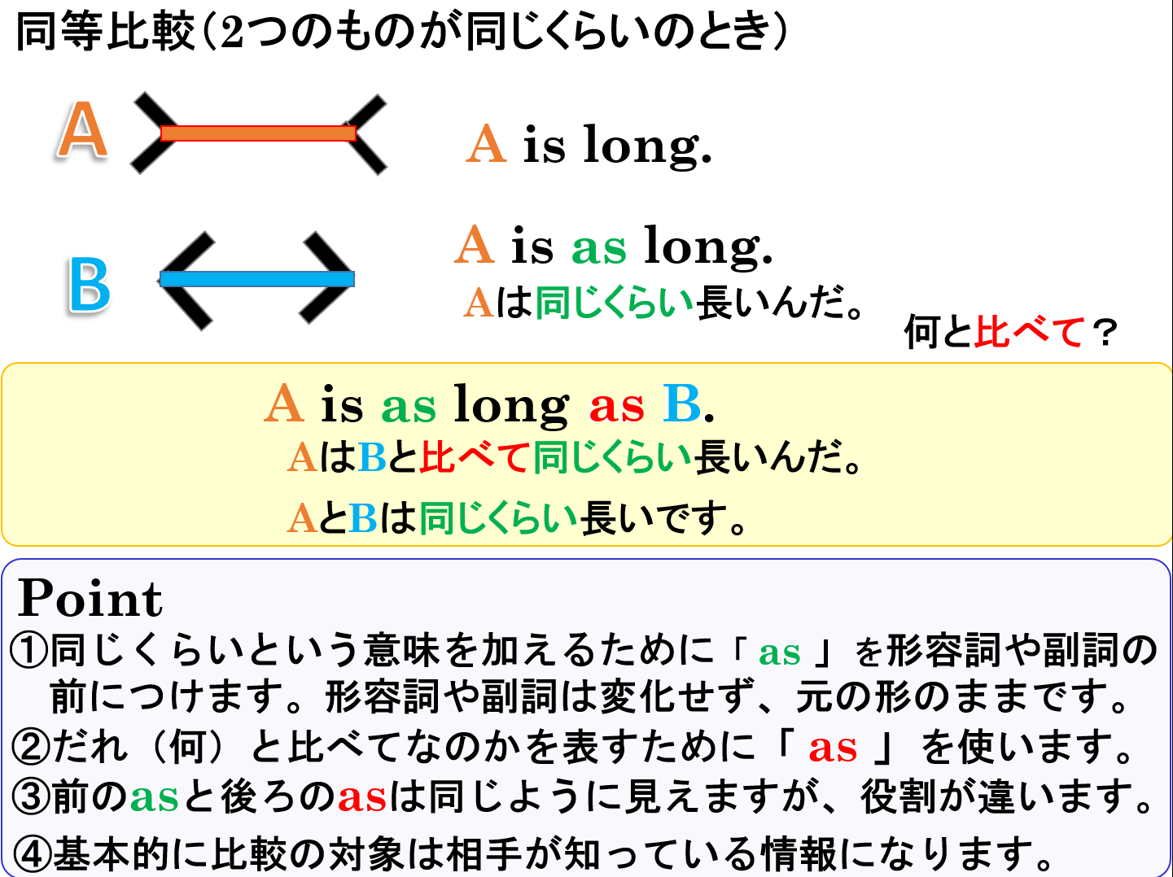

Slide 26
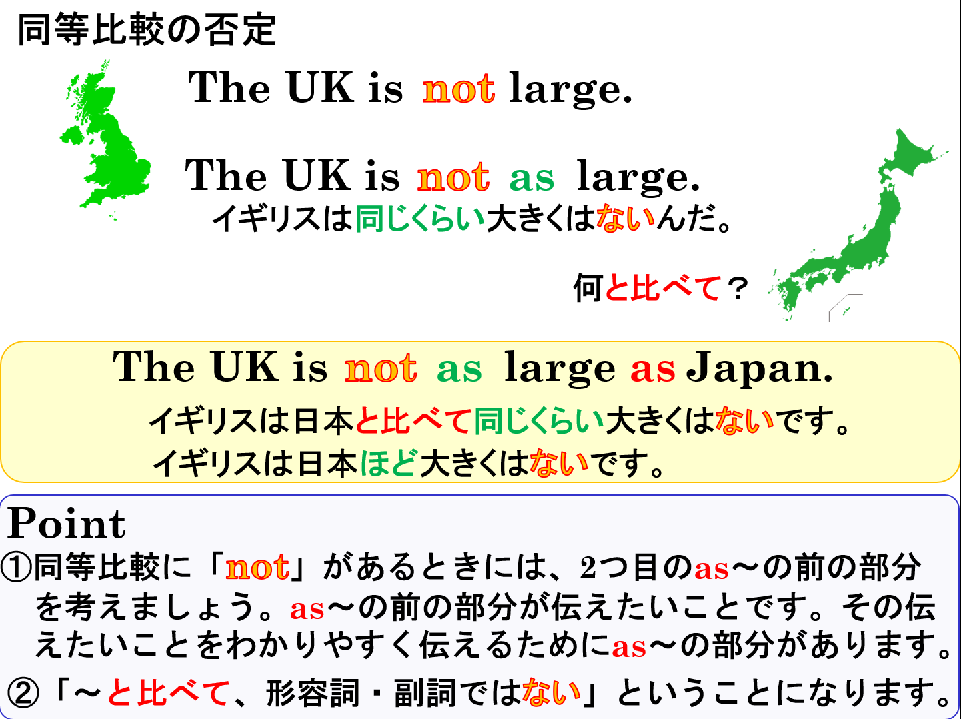

Slide 27
comparative
equality

