Slide 1
Call & Name
SVOC

Slide 2
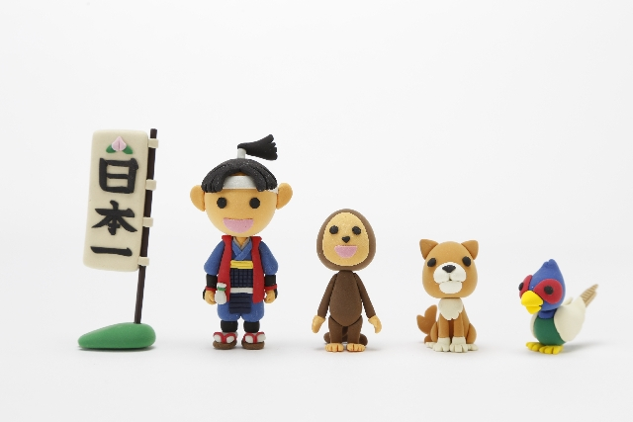
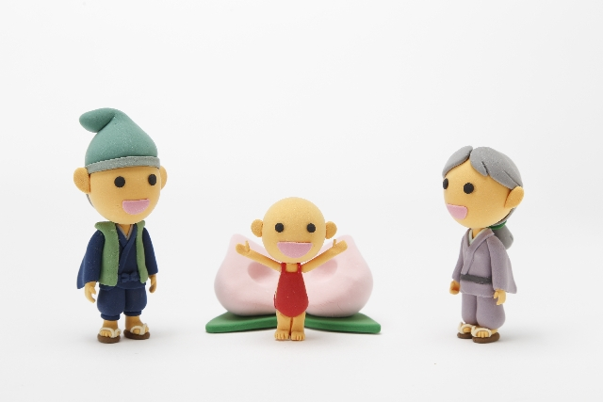
We call
him
Momotaro.
They named
him
Momotaro.

Slide 3
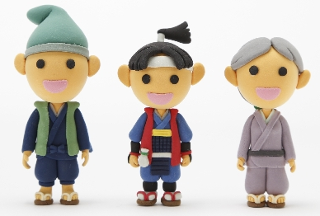
Call and Name
We call
him
Momotaro.
They named
him
Momotaro.
Point
①callは「～電話をする、大声で呼ぶ」以外に「AをBと呼ぶ」と言う
使い方をします。
call
A＜人・もの＞
B＜どのように呼ぶか＞
②nameは、名詞として「名前・氏名」といった使い方以外に動詞とし
て使って、「AをBと名付ける」という使い方をします。
name
A＜人・もの＞
B＜名前＞
③ともにAに代名詞を使うときには目的格の形（me, you, it, him,
her, us, them）を使います。

Slide 4
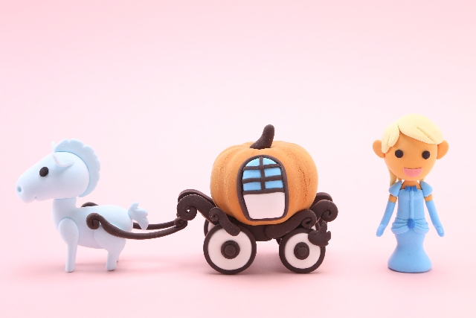
We ( call ) her ( Cinderella ).
call
Cinderella

Slide 5
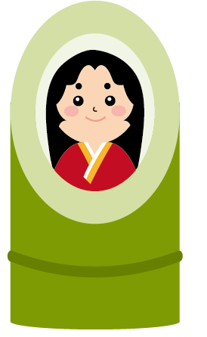
Kaguyahime
We call ( her )( Kaguyahime ).
her

Slide 6
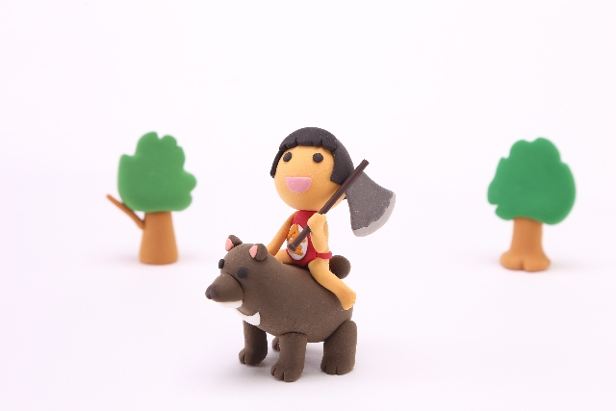
We call ( him )( Kintaro ).
him
Kintaro

Slide 7
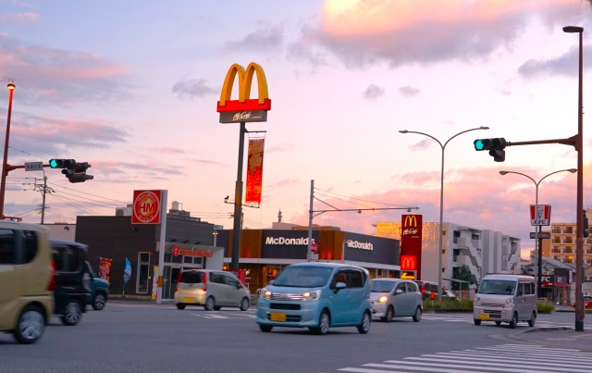
People in Kansai
( call ) McDonald’s ( McDo ).
call
McDo

Slide 8
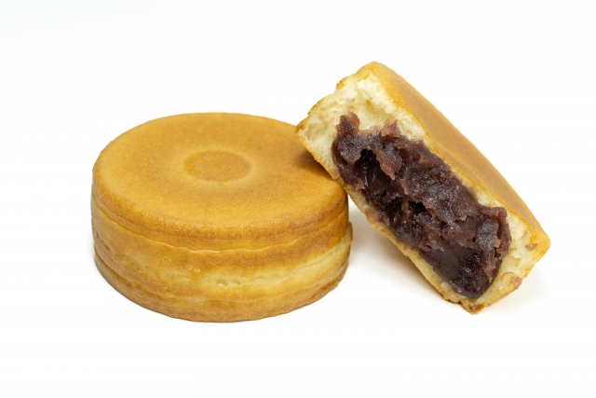
People in Hokkaido
( call ) ( Imagawayaki ) ( Oyaki).
call
Imagawayaki
Oyaki

Slide 9
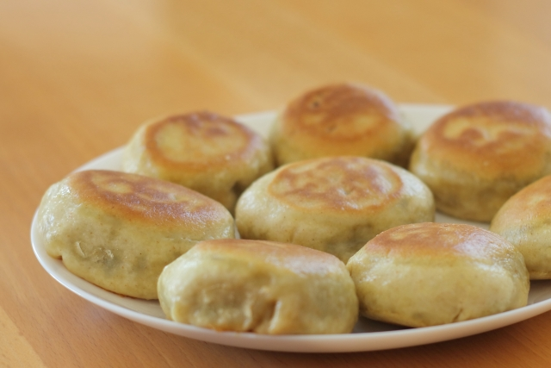
People in Nagano
( call ) this ( Oyaki ).
call
Oyaki

Slide 10
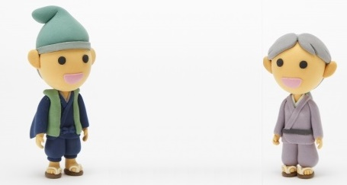

One day, they found a little, little baby.
him
They ( named ) ( him ) Issunboushi.
named

Slide 11
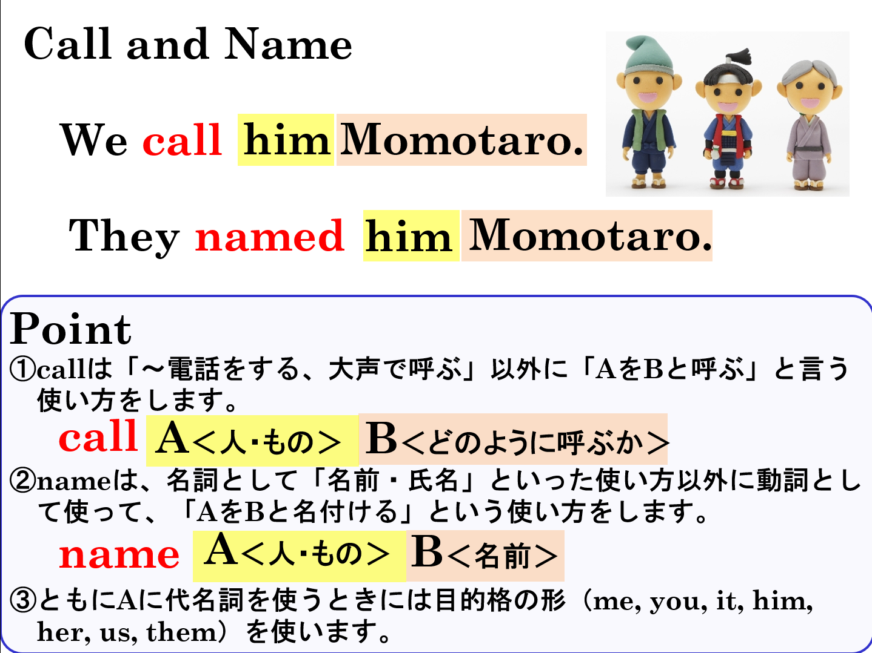

Slide 12
Call & Name
SVOC

