Slide 1
There + be動詞 + 主語
is / are / was / were

Slide 2
浦島太郎

Slide 3
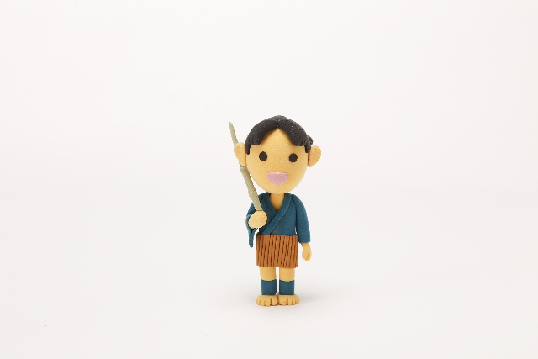
Long ago, there was a young fisherman.
The fisherman was Taro.

Slide 4
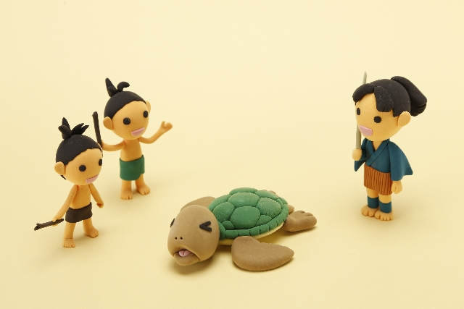
He found a turtle.
Children bothered the turtle.
He saved the turtle.

Slide 5
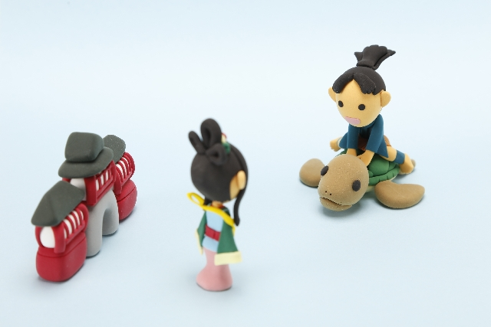
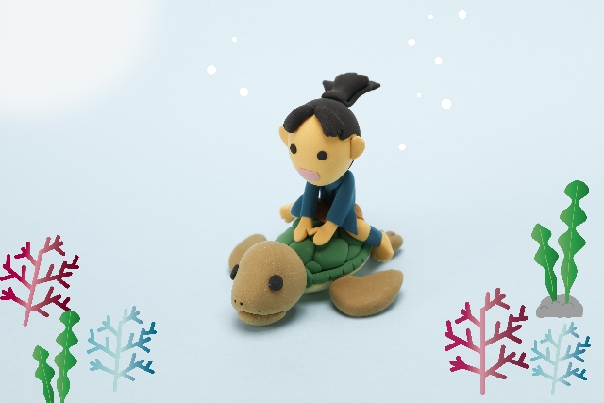
The turtle took him to the Ryugujo.

Slide 6
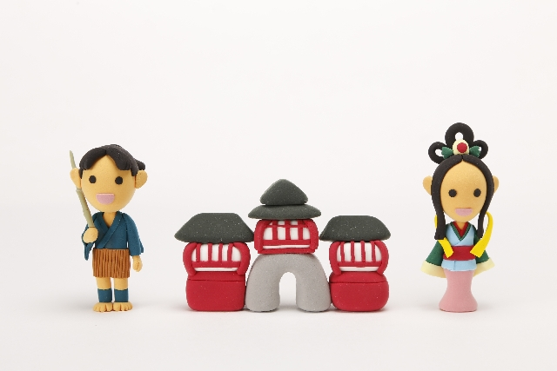
He had a special time there.
But he wanted to go back home.

Slide 7
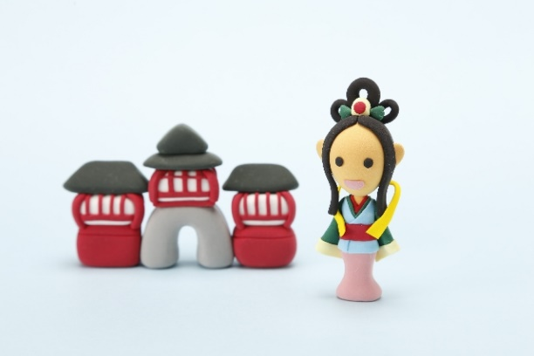
The princess, Otohime gave him a special box.
She said, “You must not open the box.”

Slide 8
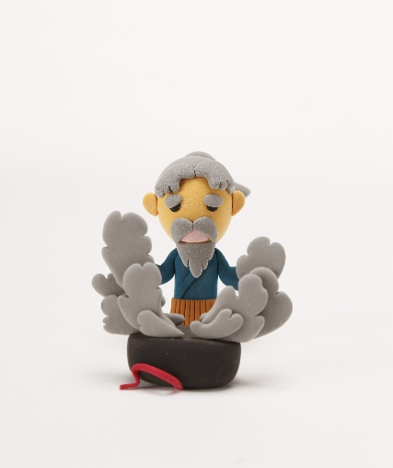
When he came back, he opened the box.
He became old.

Slide 9
There + be動詞 + 主語
is / are / was / were

Slide 10
Long ago, there was a young fisherman.
The fisherman was Taro.

Slide 11
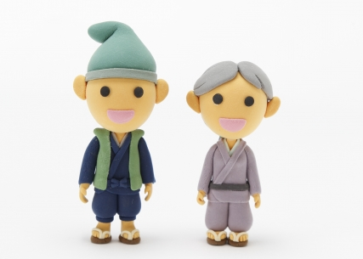
There were an old man and an old woman
in a village.
The grandfather went to a mountain.
The grandmother went to a river.

Slide 12
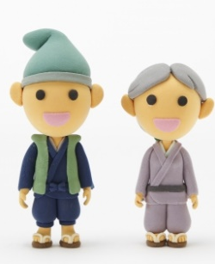
There + be +主語
There was
a young fisherman.
There were
an old man and an old woman
in a village.
Point
①初めて話に出てくる、聞いている人がどこの誰なのか、誰のものなのか分ら
ない人や物（不特定のもの）が「いる」「ある」ことを伝えるときには次の
表現を使います。
There + be動詞 + 不特定のもの（主語）（+場所）
②主語と時間に合わせてbe動詞が変化します( is, are, was , were)。
③初めて話に出てくる、聞いている相手がわからない人や物のことをいきなり
言うと、聞いている相手にわかりにくいので、Thereから文を始めます。
Thereは心の準備をするために使っているので場所の意味はありません。
④人や物が特定される「固有名詞、代名詞、the+名詞など」は、相手が分かっ
ていることなので、心の準備は必要が無いため、この表現は使いません。
⑤場所を表す言葉を加えるときには主語の後に加えます。

Slide 13
Practice there～

Slide 14
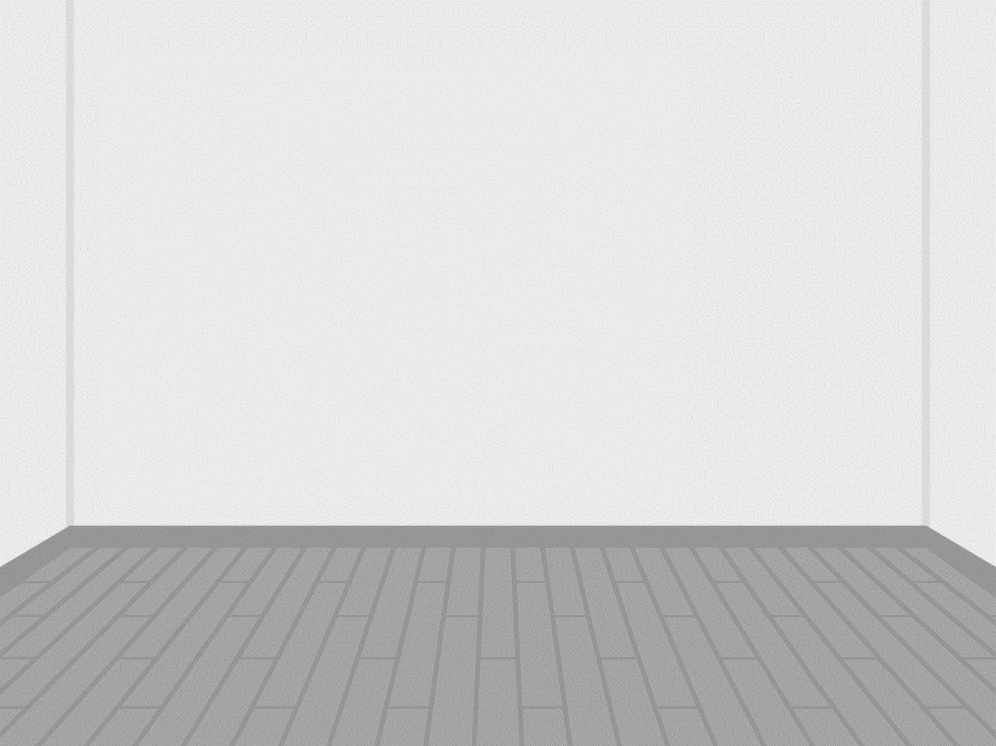

There is a room.

Slide 15
is
( There )( is )( a )( clock )( on ) the wall.
There
a
clock
on

Slide 16
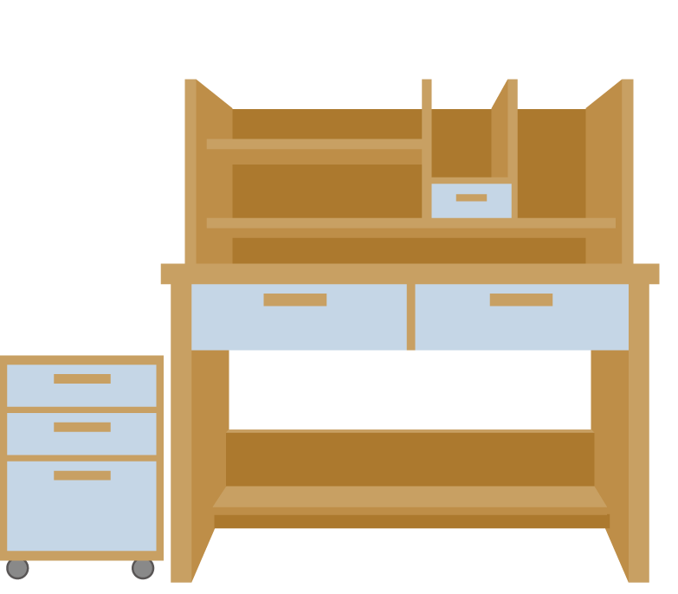
is
( There )( is )( a )( desk )( in ) the room.
There
a
desk
in

Slide 17
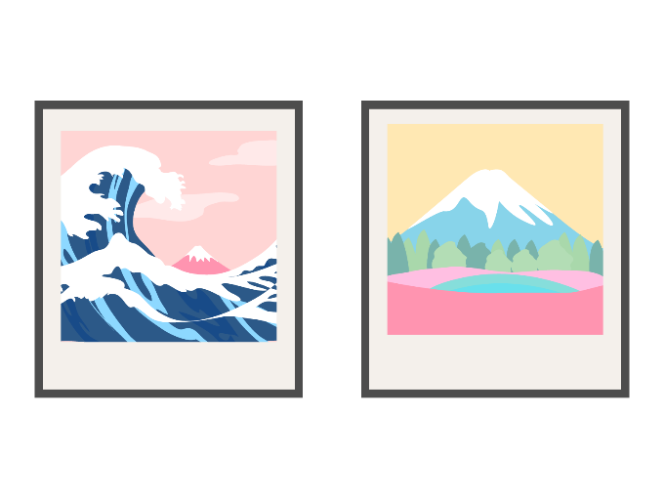
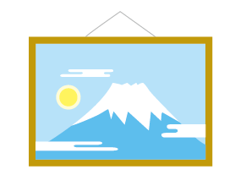
are
( There )( are )( three )( pictures )( on ) the wall.
There
three
pictures
on

Slide 18

is
( There )( is )( a )( cup )( on ) the desk.
There
a
cup
on

Slide 19

are
( There )( are )( five )( books )( on ) the desk.
There
five
books
on

Slide 20
is
( There )( is )( a )( table )( in ) the room.
There
a
table
in

Slide 21


are
on
( There )( are )( four )( pens )( on ) the table.
There
four
pens

Slide 22
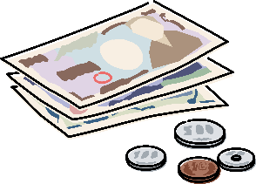
is
on
( There )( is )( money )( on ) the table.
There
money

Slide 23

is
( There )( is ) a ( box ) ( by ) the table.
There
box
by

Slide 24
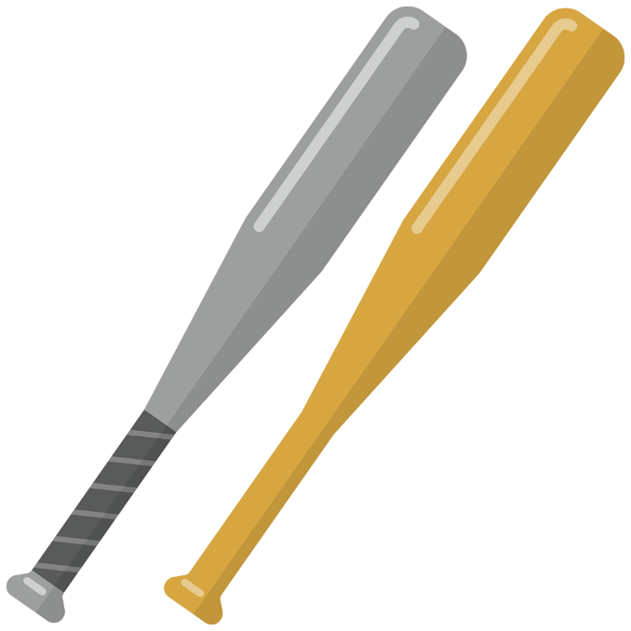
are
( There )( are )( two )( bats ) ( near ) the box.
There
two
bats
near

Slide 25


are
two
( There )( are )( two )( balls )( by ) the bats.
There
balls
by

Slide 26
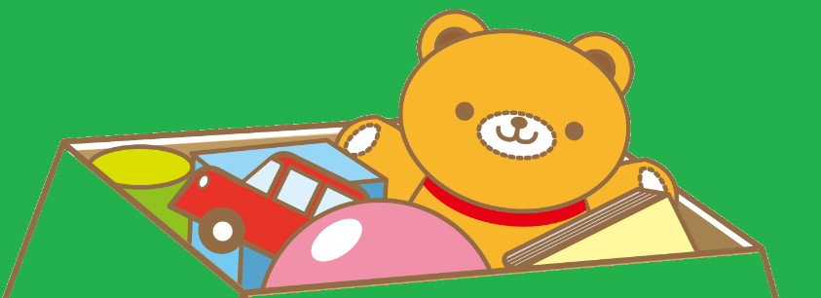
are
in
( There )( are )( many )( toys ) ( in ) the box.
There
many
toys

Slide 27
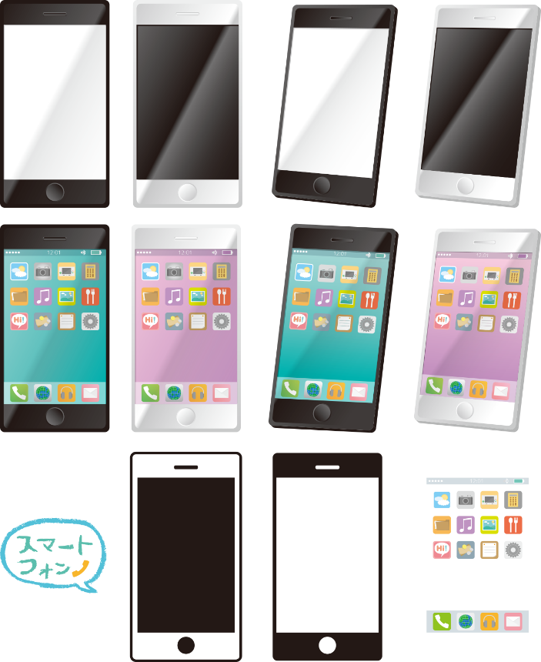
is
( There )( is ) a ( smartphone ) ( under ) the table.
There
smartphone
under

Slide 28

There
under
( There )( is ) a ( cat ) ( under ) the desk.
is
cat

Slide 30
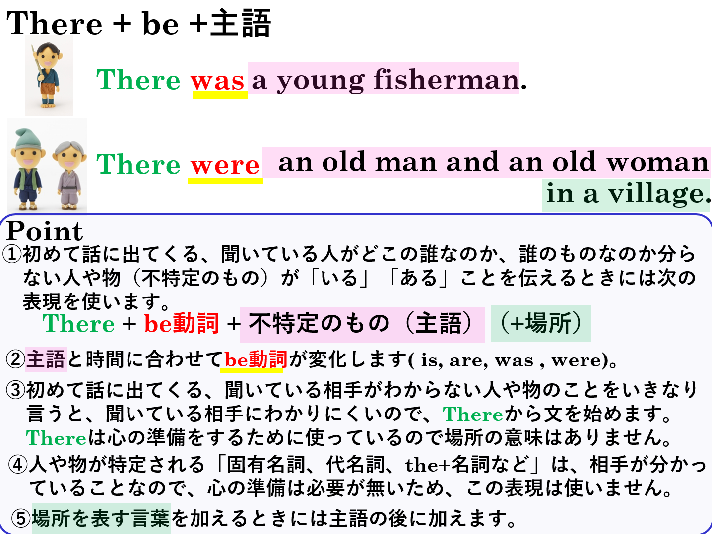

Slide 31
There + be動詞 + 主語
is / are / was / were

