Slide 1
現在進行形の否定文
be not ～ing

Slide 2
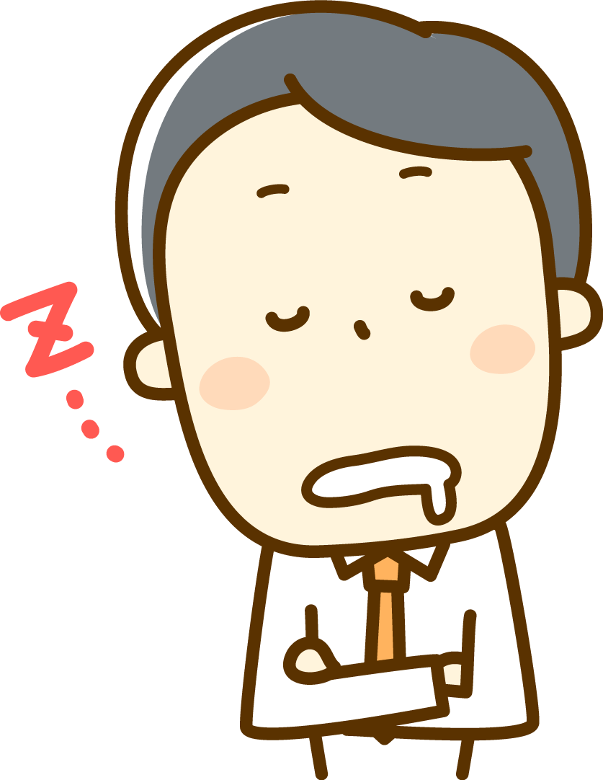
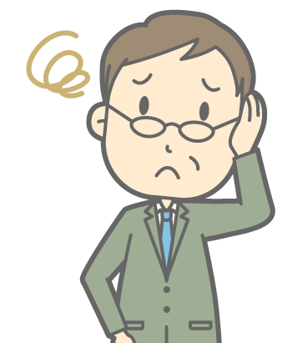
He is sleeping.

Slide 3
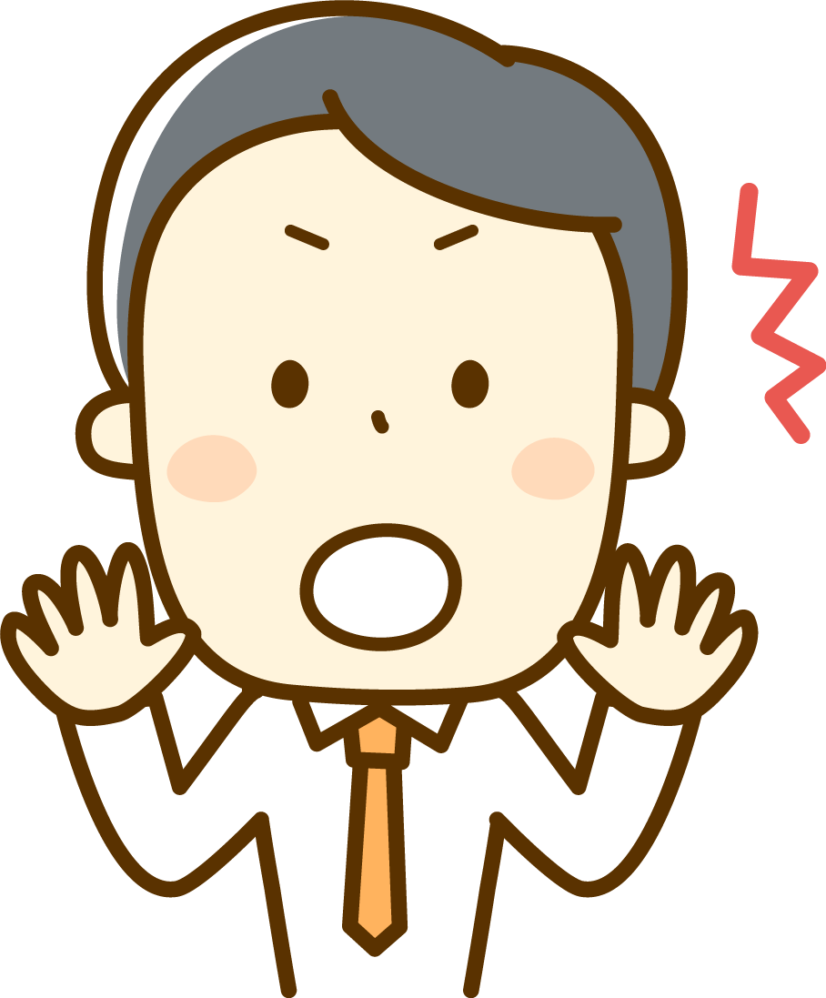
I am not sleeping.
You are not working.

Slide 4

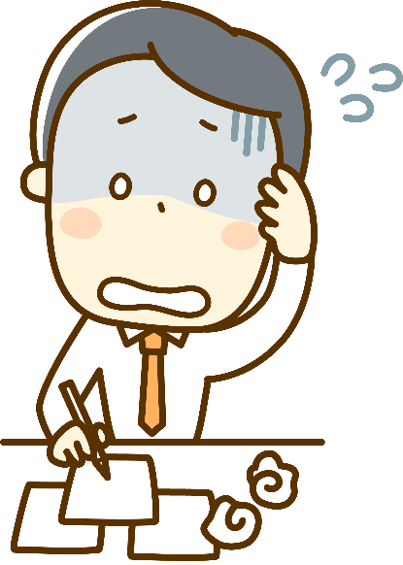
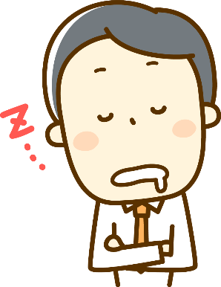
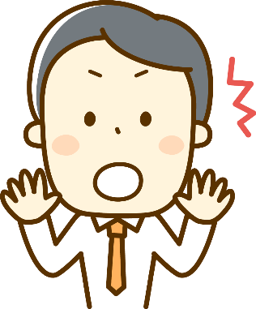
現在進行形の否定文
×
not
I am
happy.
×
not
I am
sleeping.
Point
①現在進行形と言っても否定文の形も今までのbe動詞
がある文と同じ。be動詞の後ろにnotをつける。
② notは基本的に後ろを否定する。
Notes:
I am sleeping.という場面はあまりないですね。寝言かな。

Slide 5
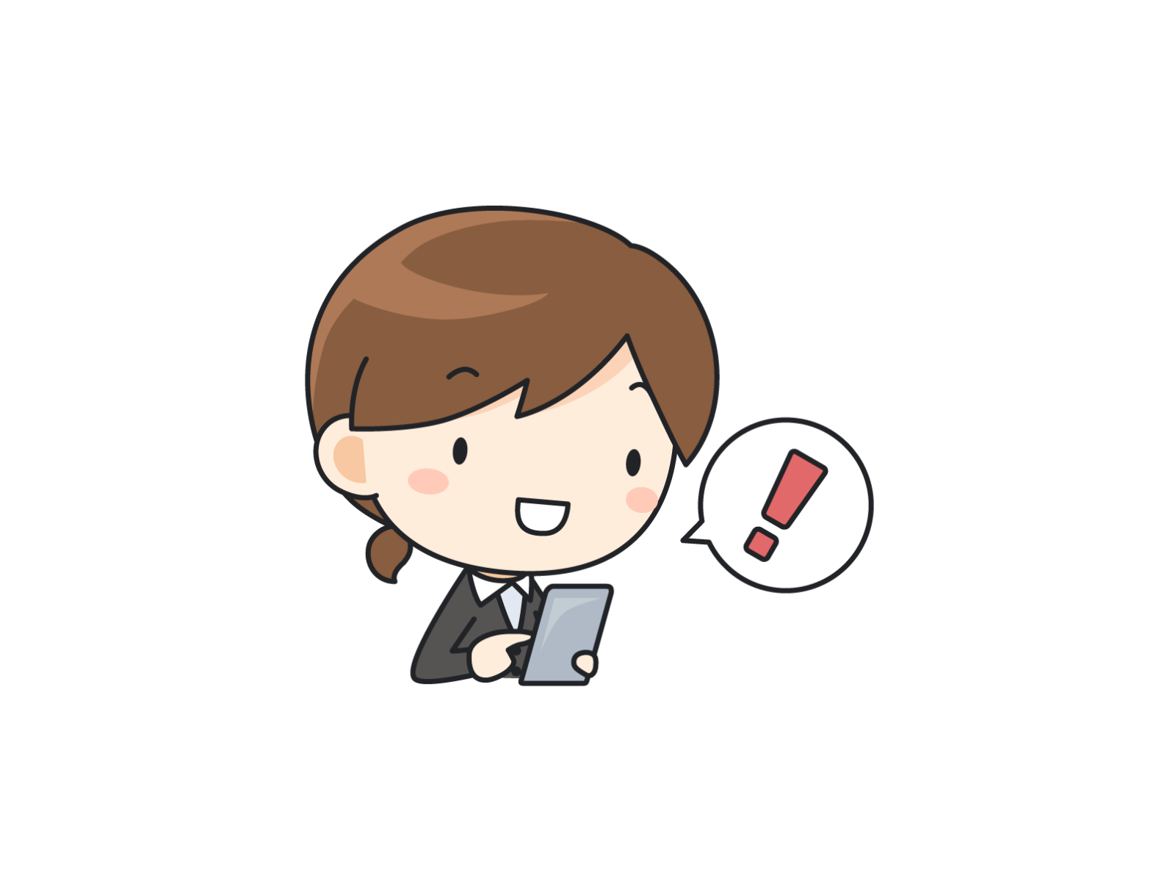
×
I am playing games.
not
playing
I ( am )( not )( playing ) games.
am
I’m studying now.

Slide 6


×
You are drinking tea.
are
not
drinking
You ( are )( not )( drinking ) tea.
You are dinking coffee now.

Slide 7
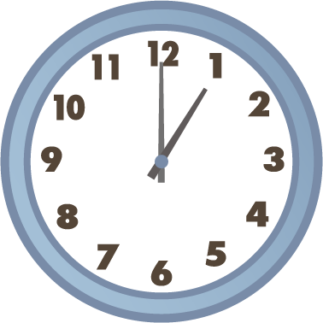

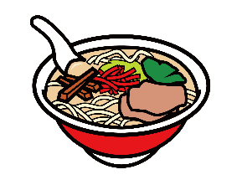
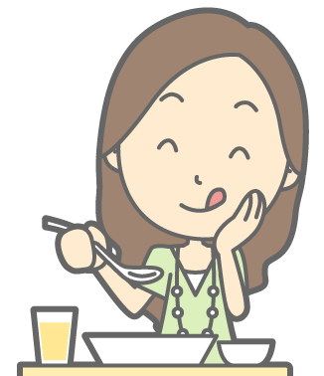
×
Ken is having lunch.
Ken ( is )( not )( having ) lunch.
is
not
having
He is working now.

Slide 8


×
Yumi is working.
Yumi ( is )( not )( working ) .
is
not
working
She is having lunch now.

Slide 9
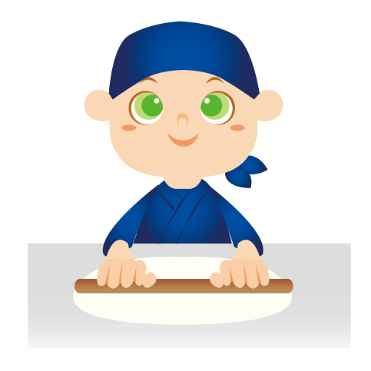
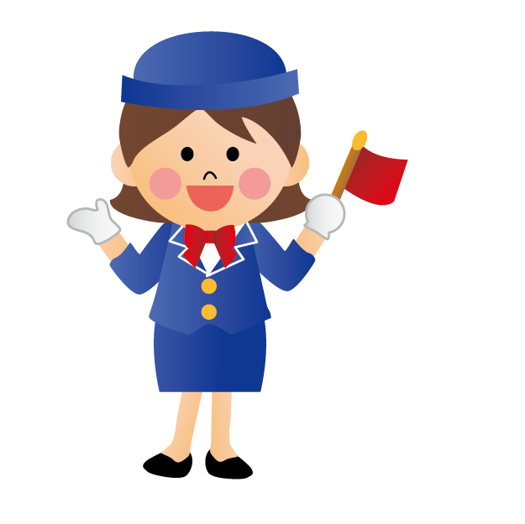
×
He is making ramen.
He ( is )( not )( making ) ramen.
is
not
making
He is making udon now.

Slide 10



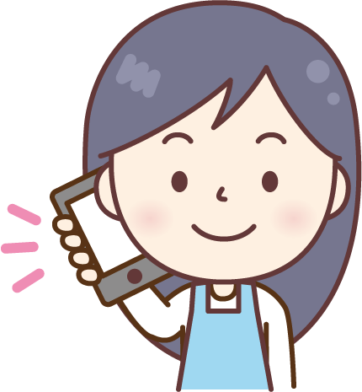
×
She is doing her homework.
She ( is )( not )( doing )
her homework.
is
not
doing
She is watching TV now.

Slide 11
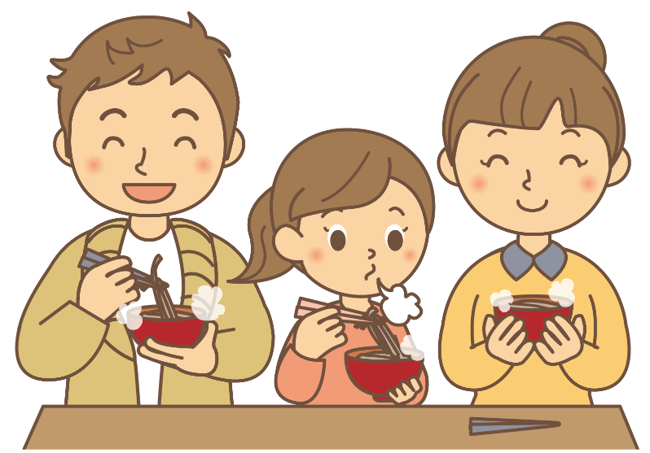
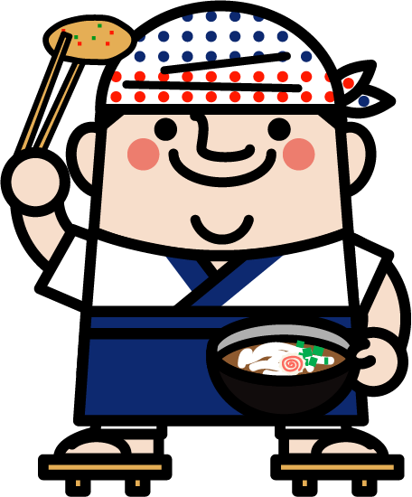
×
They are eating udon.
They ( are )( not )( eating ) udon.
are
not
eating
They are eating soba now.

Slide 12
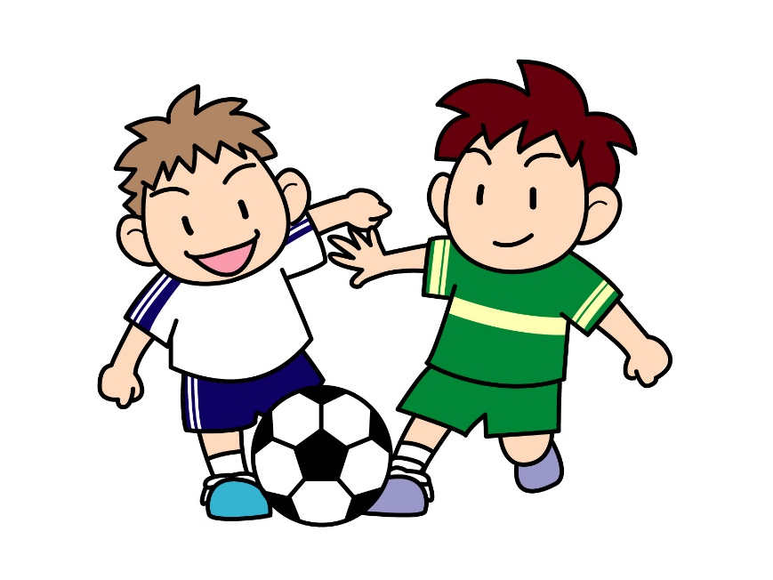
×
We are playing soccer.
We ( are )( not )( playing ) soccer.
are
not
playing
We are playing futsal now.

Slide 13
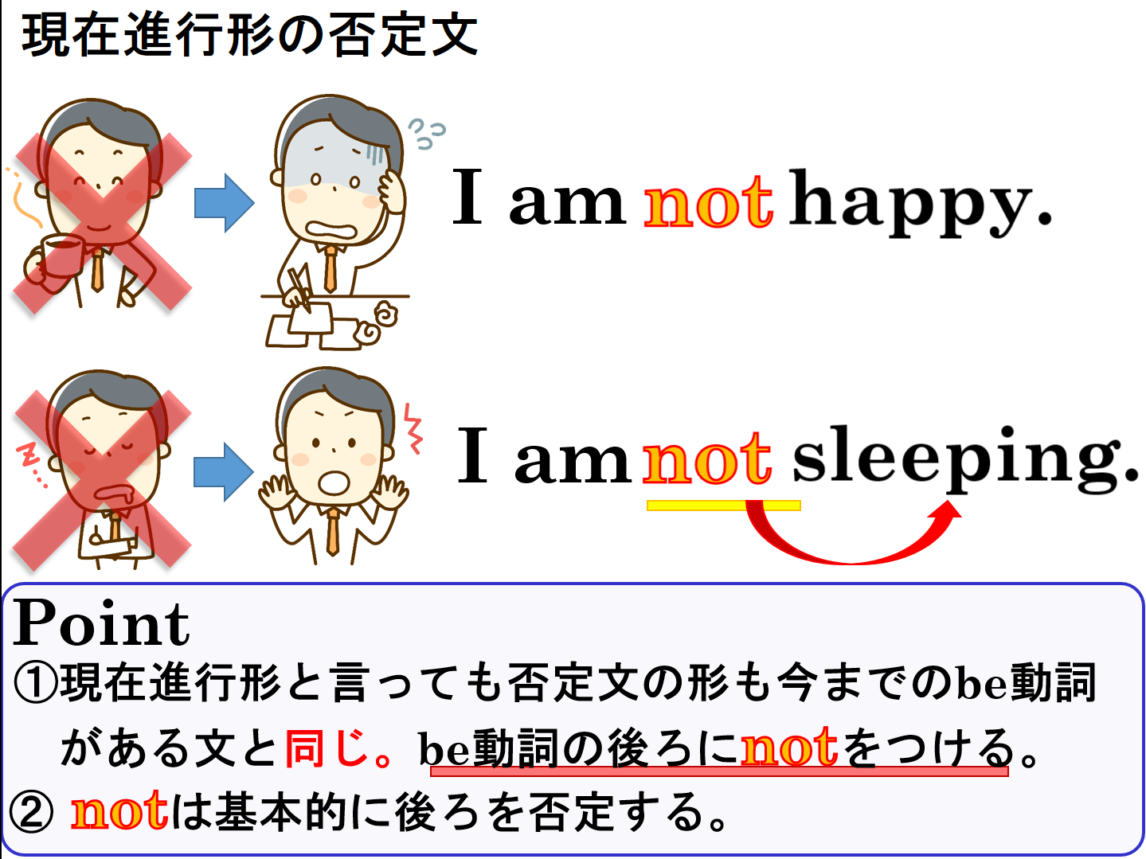

Slide 14
現在進行形の否定文
be not ～ing

