Slide 1
～している：現在進行形
am, are,is + ～ing
Notes:
このPowerPointでは動画が挿入されていて、音声が出るので、音声が出る環境にして授業を行ってください。

Slide 2
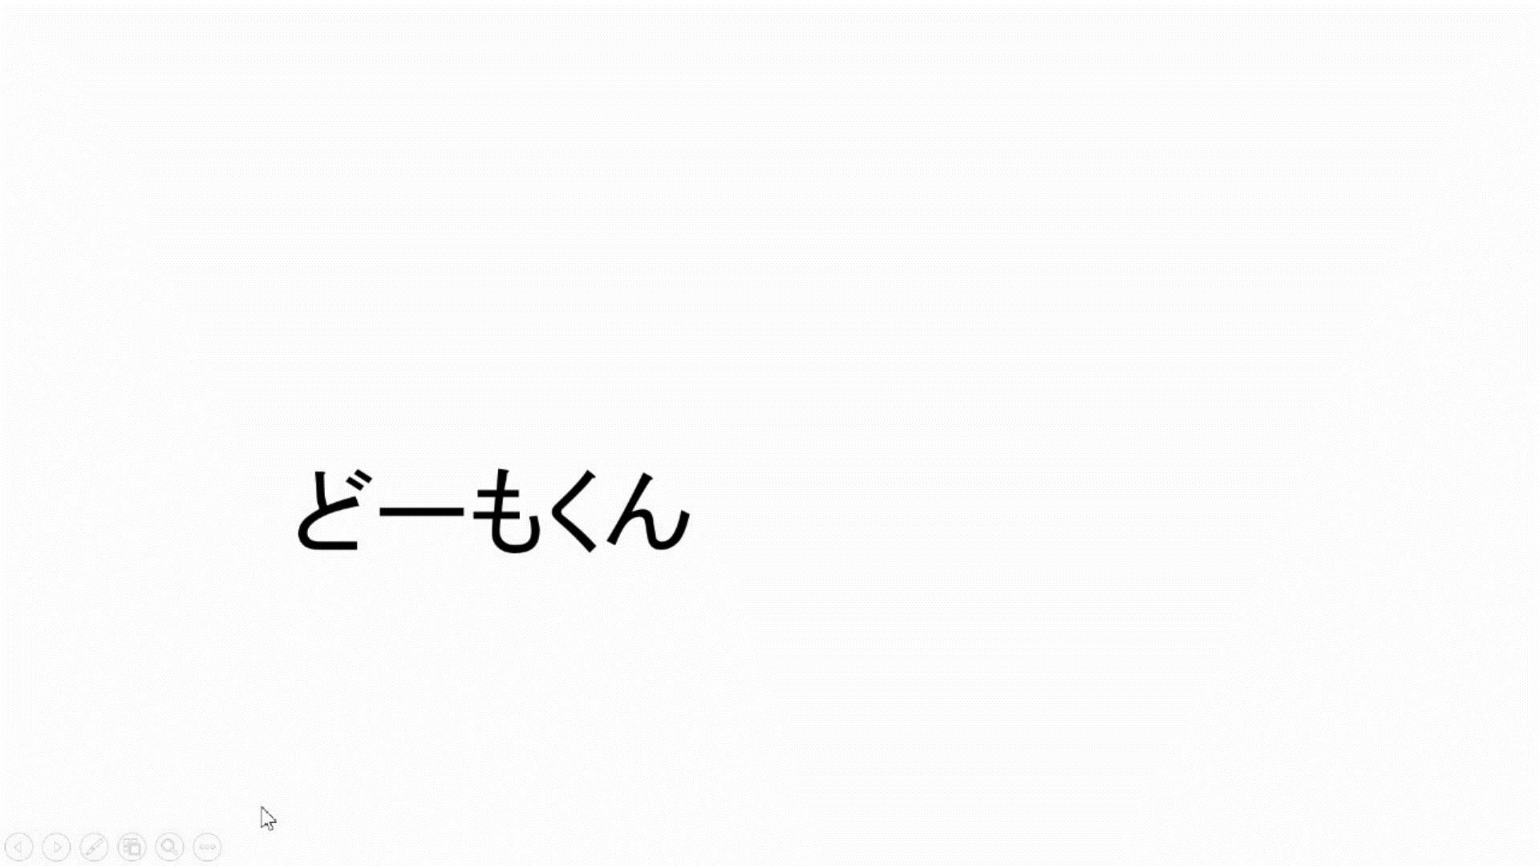

Slide 3
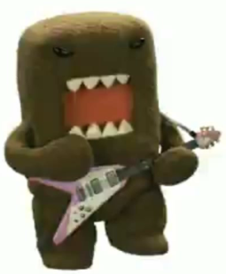
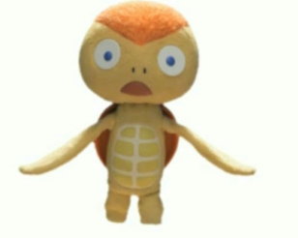
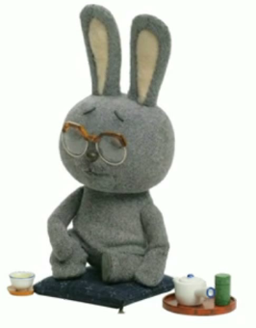
現在進行形（be動詞 ＋ 動詞ing）
（Ｃ）ＮＨＫ・ＴＹＯ
I play the guitar.
I
am
playing
the guitar.
You play the guitar.
You
are
playing
the guitar.
He plays the guitar.
He
is
playing
the guitar.
Point
①「 be動詞＋動詞ing」の形で｢（今）～しています。｣と表現できます。
② 「be動詞」とは｢am, are, is｣です。使い分けに注意しよう。
③ 3単現の｢s｣の｢s｣は現在進行形の表現では無くなります。
※主語に合わせてbe動詞がisに変化しているため、 ｢s｣の変化は必要なくなります。
④｢動詞＋ing｣で発音の関係から変化に注意する単語があります。

Slide 4
動詞ingを練習しよう
Practice ～ing
Notes:
動名詞の練習としてもいい部分です。

Slide 5
reading a book
ing

Slide 6
studying
ing

Slide 7
eating ice-cream
ing

Slide 8
having
havein ramen

Slide 9
ing
skiing

Slide 10
playing soccer
ing

Slide 11
ning
running

Slide 12
playing the piano
ing

Slide 13
sleeping
ing

Slide 14
playing golf
ing

Slide 15
playing the violin
ing

Slide 16
swimming
ming

Slide 17
playing baseball
ing

Slide 18
playing basketball
ing

Slide 19
playing the guitar
ing

Slide 20
playing table tennis
ing

Slide 21
playing volleyball
ing

Slide 22
playing badminton
ing

Slide 23
driving
drivein a car

Slide 24
cook
ing

Slide 25
～ingのつけ方
動詞にそのままingをつける
play
→
playing
watch
→
watching
動詞の最後の文字がeならeを取ってingをつける
drive
→
driving
make
→
making
*see
→
*seeing
※ seeは例外
run
→
running
動詞の最後の3文字が
「子音 - 短母音 - 子音」となっている場合、最後の子音字を2回重ねてing
swim
→
swimming
sit
→
sitting
stop
→
stopping
get
→
getting
動詞の最後がieで終わっているものはieをyにかえてingをつける
lie
→
lying
tie
→
tying
Notes:
現在進行形だけでなく、動名詞のときも同一です。
ieで終わるものにはdie→dyingもありますが、現在進行形を学習している時点ではieの単語がほとんど出てこないです。
seeも現在進行形の部分ではほとんど出てこない単語です。

Slide 26
現在進行形を練習しよう
Practice ～ing
Notes:
次のスライドでは、主語を提示してその後を生徒に言わせます。いくつか例を示しながら徐々に慣れさせていきます。

Slide 27
play table tennis
I
am
playing
table tennis.
You
are
playing
table tennis.

Slide 28
play the piano
I
am
playing
the piano.
You
are
playing
the piano.

Slide 29
read a book
I
am
reading
a book.
You
are
reading
a book.
He
is
reading
a book.

Slide 30
play soccer
I
am
playing
soccer.
You
are
playing
soccer.
We
are
playing
soccer.

Slide 31
study
I
am
studying.
You
are
studying.
She
is
studying.

Slide 32
eat ice-cream
Yuki
is
eating
ice-cream.
My sister
is
eating
ice-cream.
They
are
eating
ice-cream.

Slide 33
have ramen
Kenji
is
having
ramen.
His father
is
having
ramen.
They
are
having
ramen.

Slide 34
ski
She
is
skiing.
He
is
skiing.
They
are
skiing.

Slide 35
run
I
am
running now.
You
are
running now.
We
are
running now.

Slide 36
I am playing soccer.
You are playing soccer.
He is playing soccer.
She is playing soccer.
We are playing soccer.
They are playing soccer.
の違いはどこから来るの?
の違い→主語の違い

Slide 37
Be動詞（am / is / are ）の使い分け
話をするときに 出てくる人 |  | 単数 （１人、１つ） |  | 複数 （２人以上、２つ以上）
１人称 | 話す人
２人称 | 聞く人
３人称 | その他の 人や物
I
am
We
are
You
are
You
are
He
She
It
They
are
is

Slide 38
Practice more

Slide 39
I play the violin.
I（ am ）（ playing ） the violin.
am
playing

Slide 40
You play baseball.
are
playing
You （ are ）（ playing ） baseball.

Slide 41
You cook.
cooking
You （ are ）（ cooking ）.
are

Slide 42
She plays badminton.
playing
She （ is ）（ playing ） badminton.
is

Slide 43
My father drives a car.
driving
My father （ is ）（ driving ） a car.
is

Slide 44
Emi plays golf.
playing
Emi （ is ）（ playing ） golf.
is

Slide 45
Ben swims.
swimming
Ben （ is ）（ swimming ）now.
is

Slide 46
I play basketball.
I（ am ）（ playing ） basketball now.
am
playing

Slide 47
We play volleyball.
playing
We（ are ）（ playing ） volleyball now.
are

Slide 48
Tom and Mark play the guitar.
Tom and Mark
（ are ）（ playing ） the guitar now.
are
playing

Slide 49
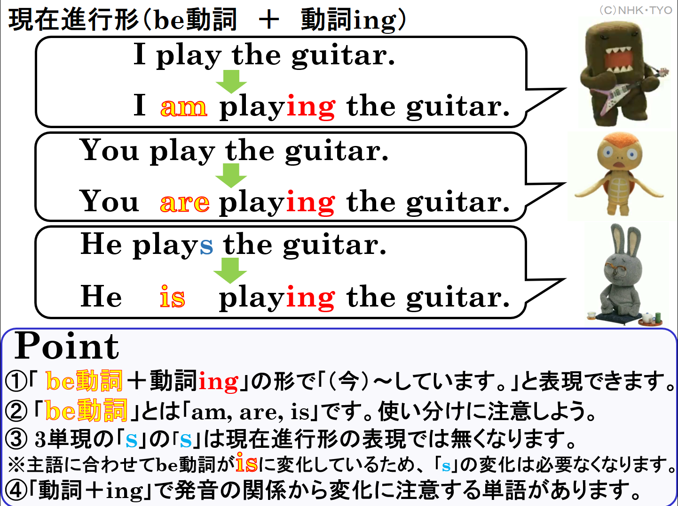

Slide 50
～している：現在進行形
am, are,is + ～ing

