Slide 1
Past Tense
過去形

Slide 2


You watch
Kohaku Uta Gassen every year.
I watch it every year.
I watched it last year.
I enjoyed it very much.

Slide 3
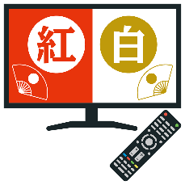

過去形（規則動詞）
I watch Kohaku every year.
毎年、私は紅白を見ます。
I watched Kohaku last year.
昨年、私は紅白を見ました。
She watched Kohaku last year.
Point
①日本語では「～ます」が「～しました」になるように英語では
「動詞」の形が変わって「動詞＋ed」の形になって、過去のこ
とを表します。
②過去形は主語が何であっても「動詞＋ed」(過去形)となります。
③「動詞＋ed」で注意が必要な動詞があります。
④「動詞＋ed」のedの発音は何種類かあります。

Slide 4
過去形を練習しよう
～ed
Notes:
先の説明の③、④については後で。
まずは、練習

Slide 5
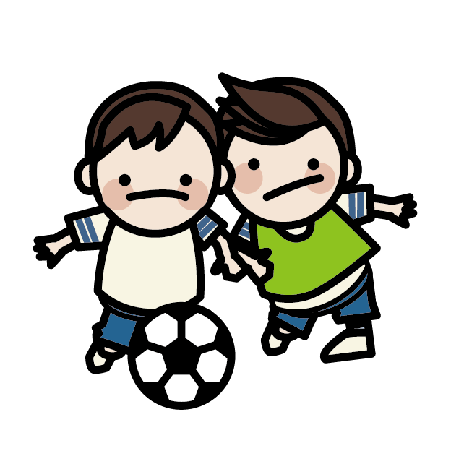
played soccer
played soccer

Slide 6
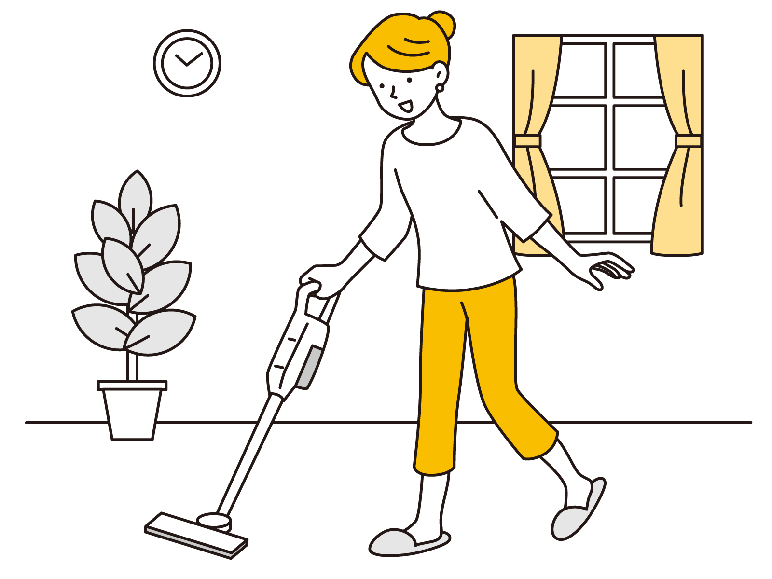
cleaned the room
cleaned the room

Slide 7
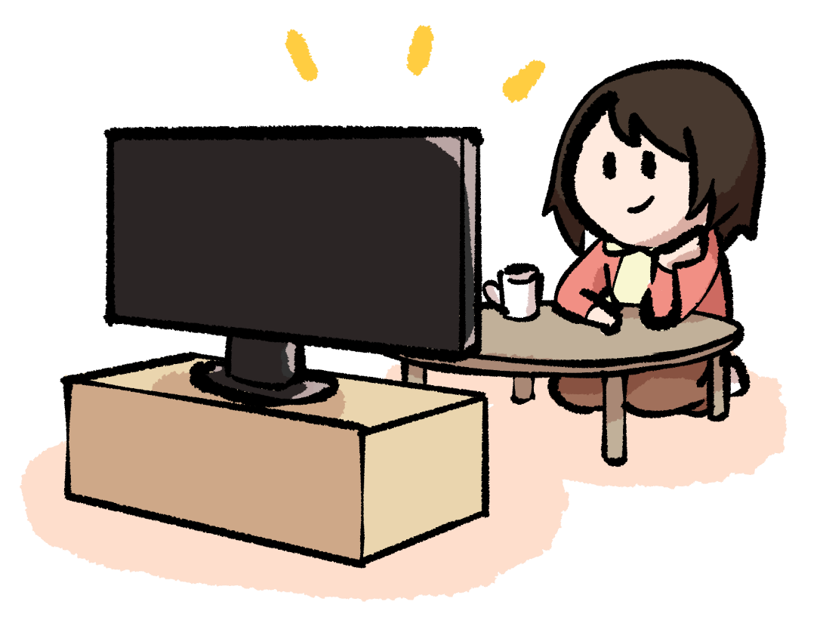
watched TV
watched TV

Slide 8


visited the USA
visited the USA

Slide 9

studyed math
ied

Slide 10
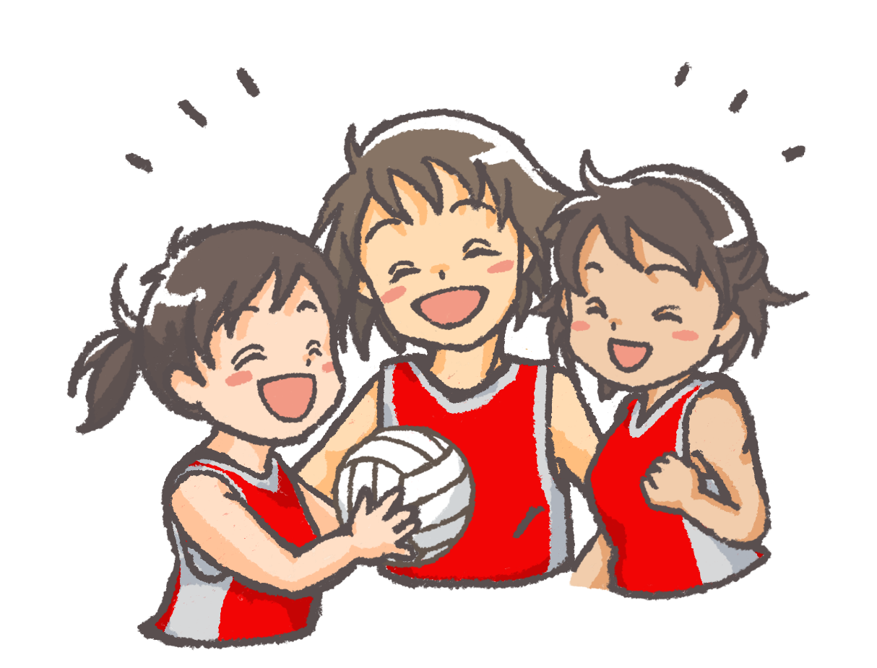
enjoyed volleyball
enjoyed volleyball

Slide 11
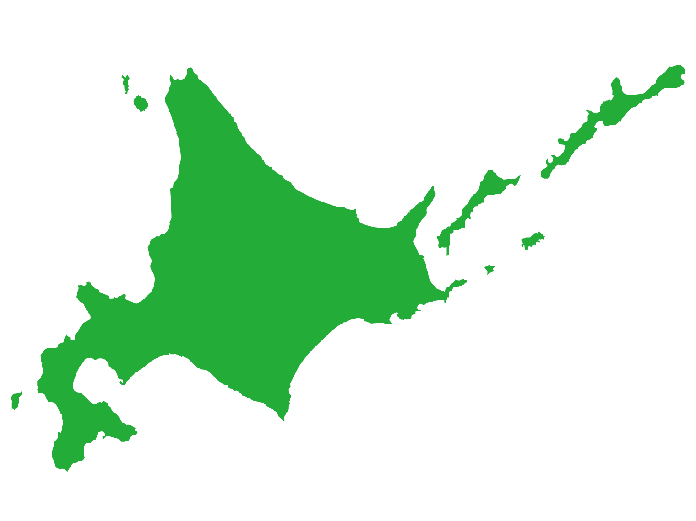

lived in Hokkaido
lived in Hokkaido

Slide 12
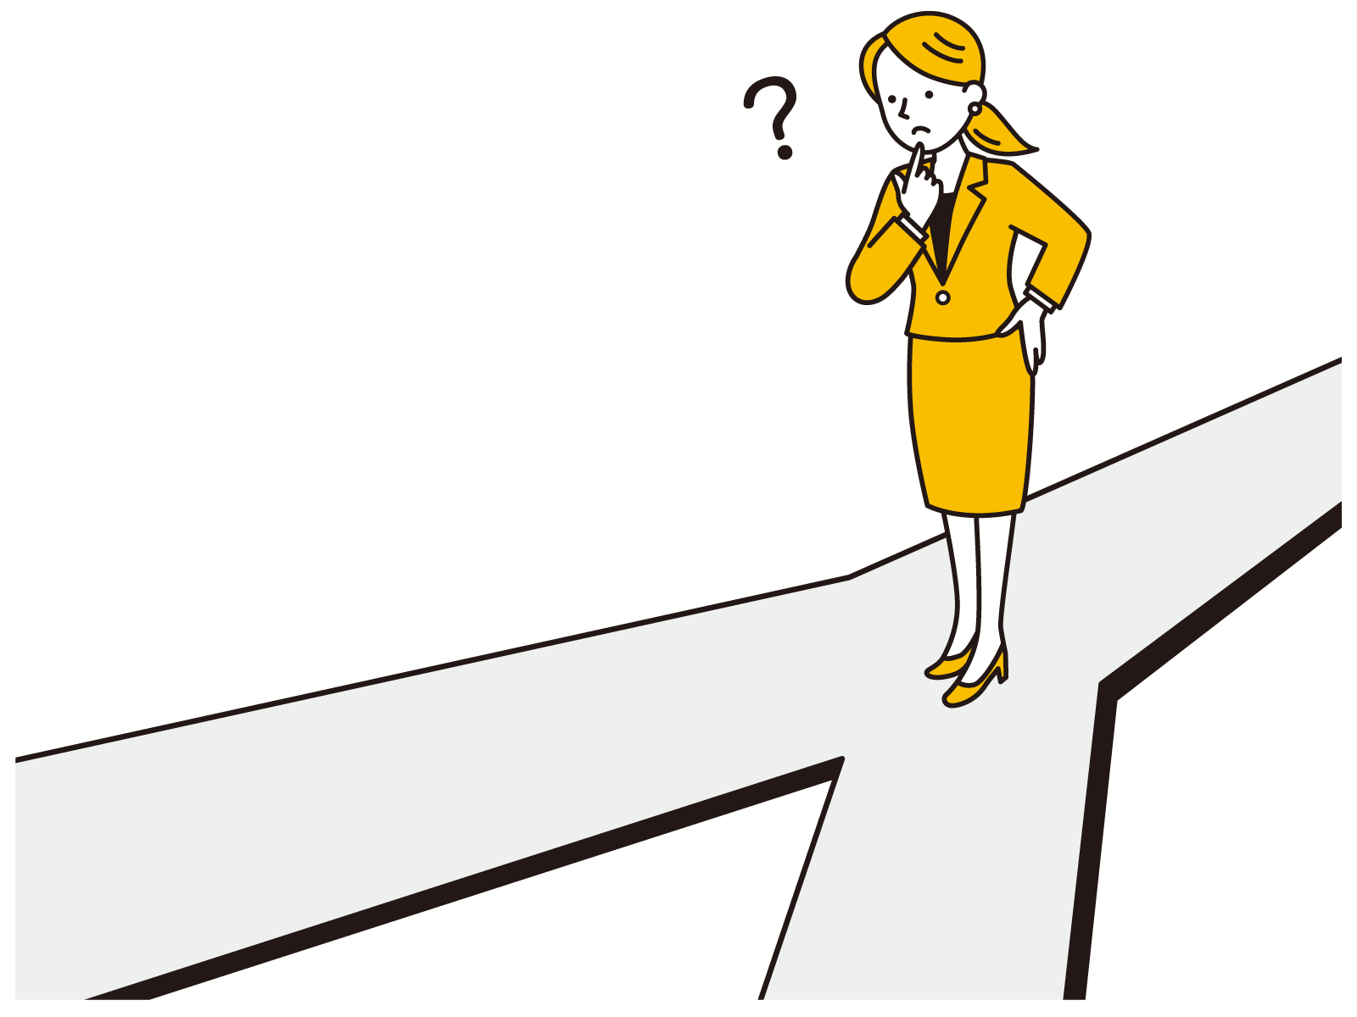
stopped
stopped

Slide 13
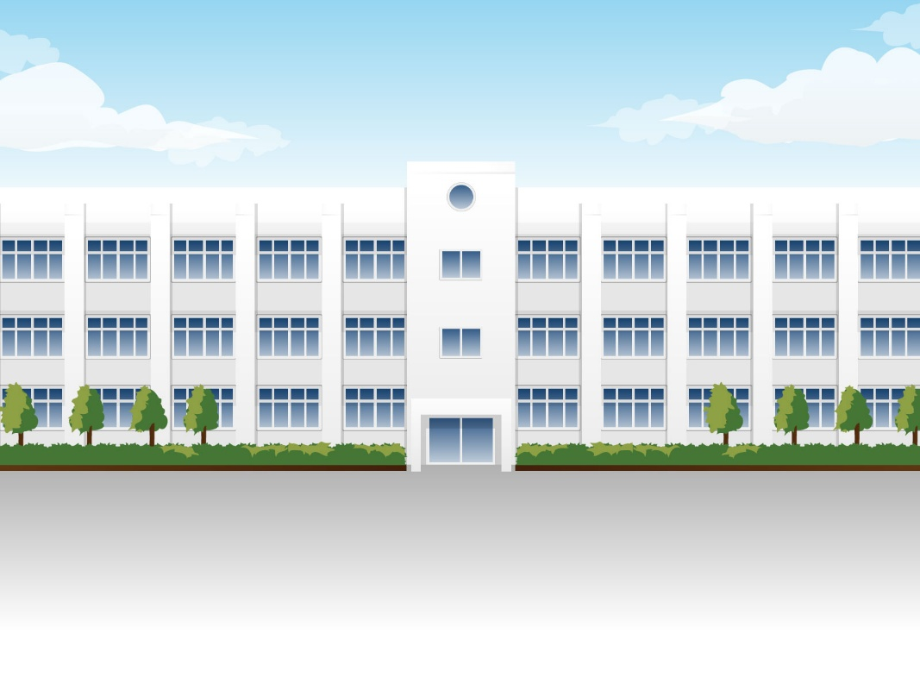
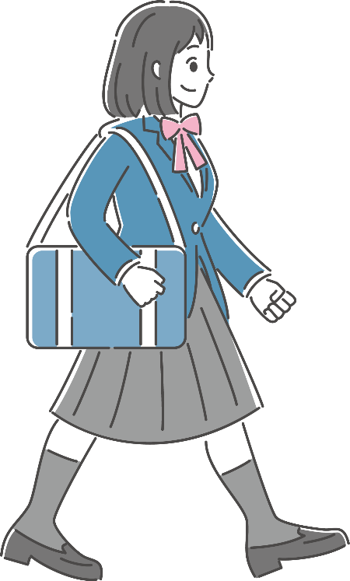
walked to school
walked to school

Slide 14
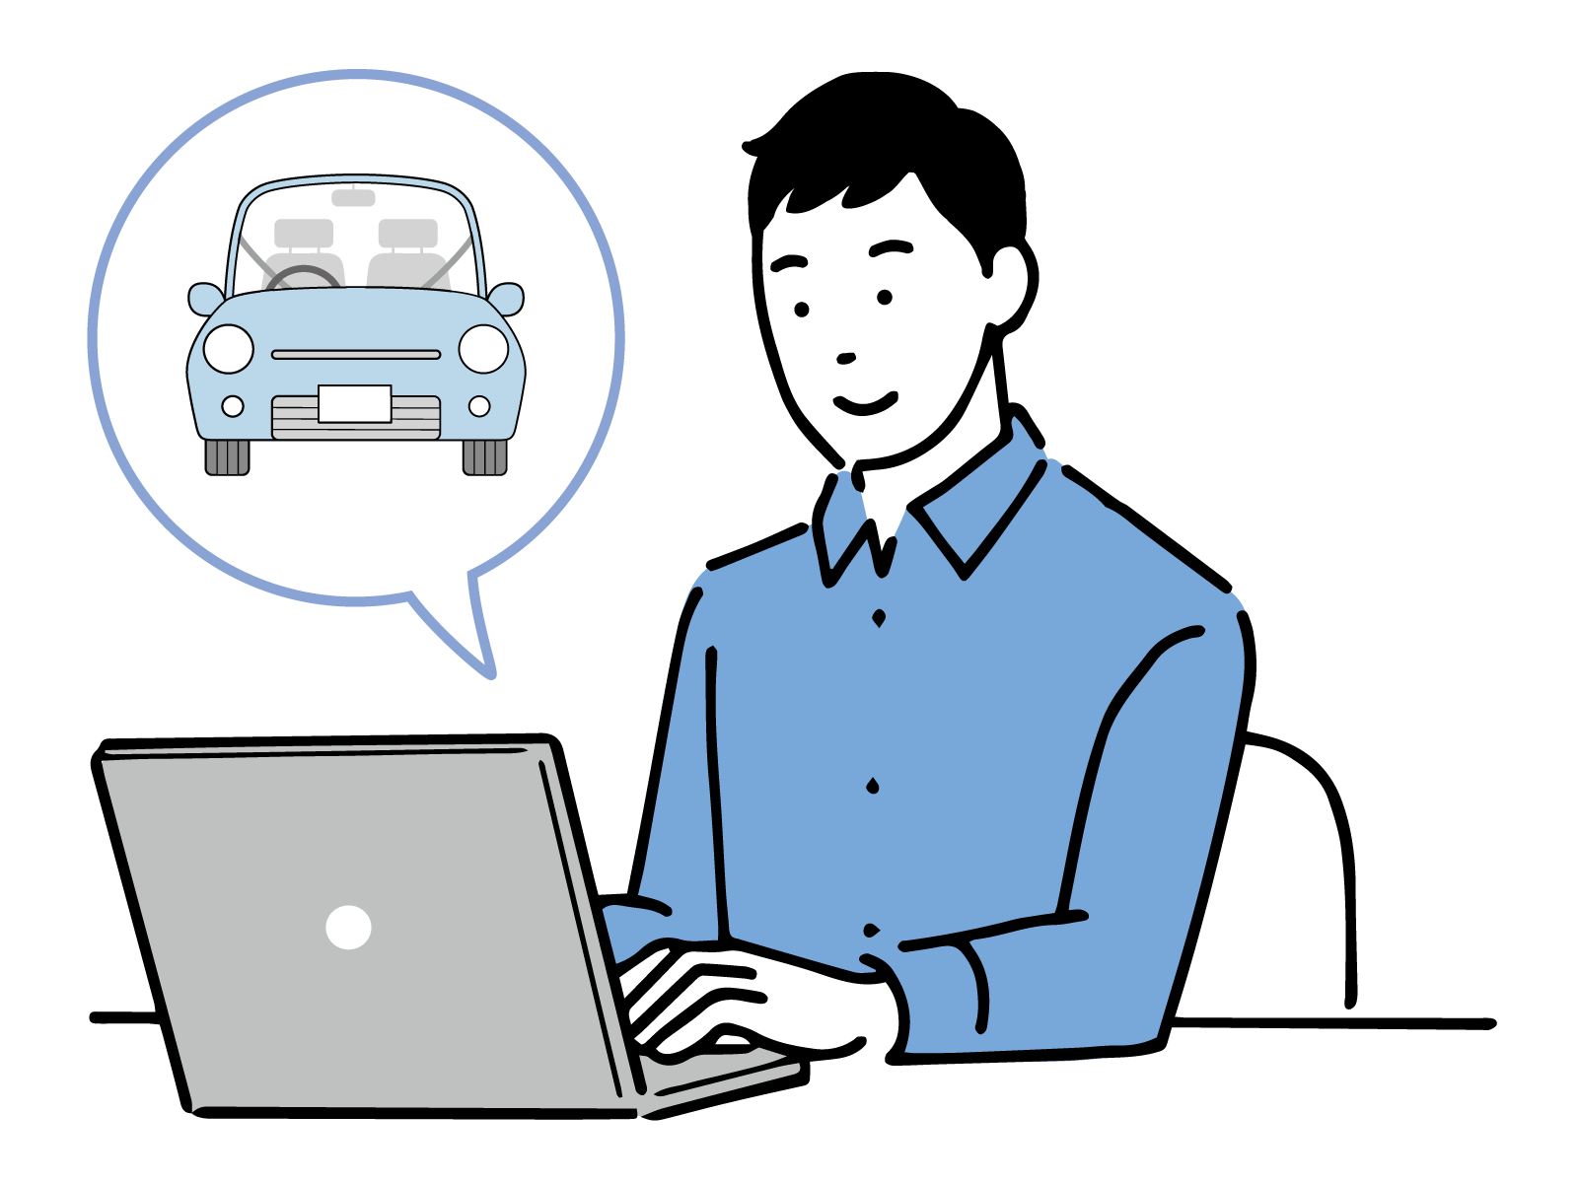
wanted a car
wanted a car

Slide 15

used a tablet
used

Slide 16

listened to music
listened to music

Slide 17
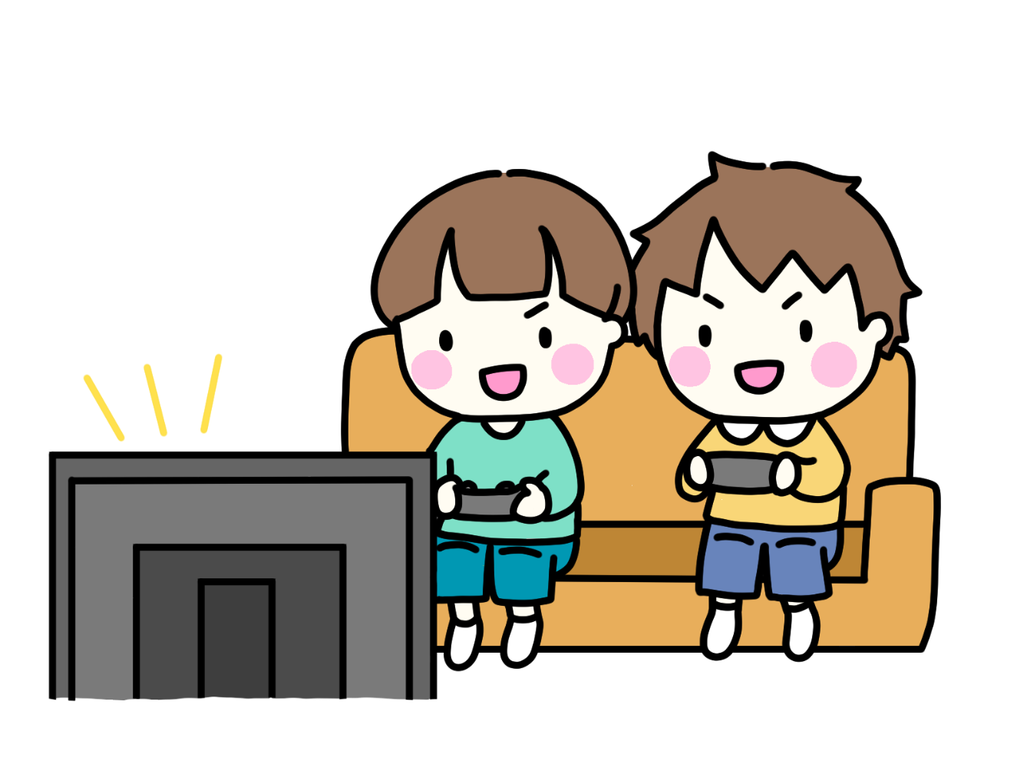
played a video game
played a video game

Slide 18

looked at the blackboard
looked at the blackboard
English

Slide 19
過去形を練習しよう
その前に
～ed

Slide 20
過去を表す言葉
yesterday
昨日
last Monday
この前の月曜日
last week
この前の週・先週
last month
この前の月・先月
last year
昨年・去年
last ～
この前の～
two days ago
2日前
two weeks ago
2週間前
～ago
～前
then
その時

Slide 21
play soccer
I ( played ) soccer yesterday.
played

Slide 22
clean
I ( cleaned ) the room yesterday.
cleaned

Slide 23
watch TV
watched
You ( watched ) TV yesterday.

Slide 24
visit the USA
Sho ( visited ) the USA last week.
visited

Slide 25
study math
Yui ( studied ) ( math ) yesterday.
studied
math

Slide 26
enjoy volleyball
They ( enjoyed )( volleyball ) last month.
enjoyed
volleyball

Slide 27
live
We ( lived ) in Hokkaido last year.
lived

Slide 28
I stop there then.
I ( stopped ) there then.
stopped

Slide 29
You walk to school.
to
You ( walked )( to ) school yesterday.
walked

Slide 30
He wants a car.
He ( wanted ) a car last year.
wanted

Slide 31
Yuka uses a tablet.
Yuka ( used ) a tablet yesterday.
used

Slide 32
She listens to music.
She ( listened ) ( to )( music ) last night.
listened
to
music

Slide 33
They play a video game
They ( played ) a video game last Sunday.
played

Slide 34
We look at the blackboard.
We ( looked )( at )( the )( blackboard ) then.
looked
at
the
blackboard
English

Slide 35
動詞＋ed の 変化のまとめ（発音にも注意）
動詞の語尾にedをつける
watch
watched
基本通りのもの
visit
visited
want
wanted
動詞の語尾にdをつける
live
lived
動詞がeで終わっているもの
love
loved
like
liked
yの前がa,i,u,e,oのもの
動詞の語尾にedをつける
play
played
enjoy
enjoyed
動詞がyで終わっていて、
yの前がa,i,u,e,o以外のもの
yをiにかえて、edをつける
study
studied
carry
carried
（運ぶ）
子音を重ねてedをつける
stop
stopped
動詞の最後が「短母音＋子音」のもの
plan
planned

Slide 36
Past Tense
過去形

Slide 37
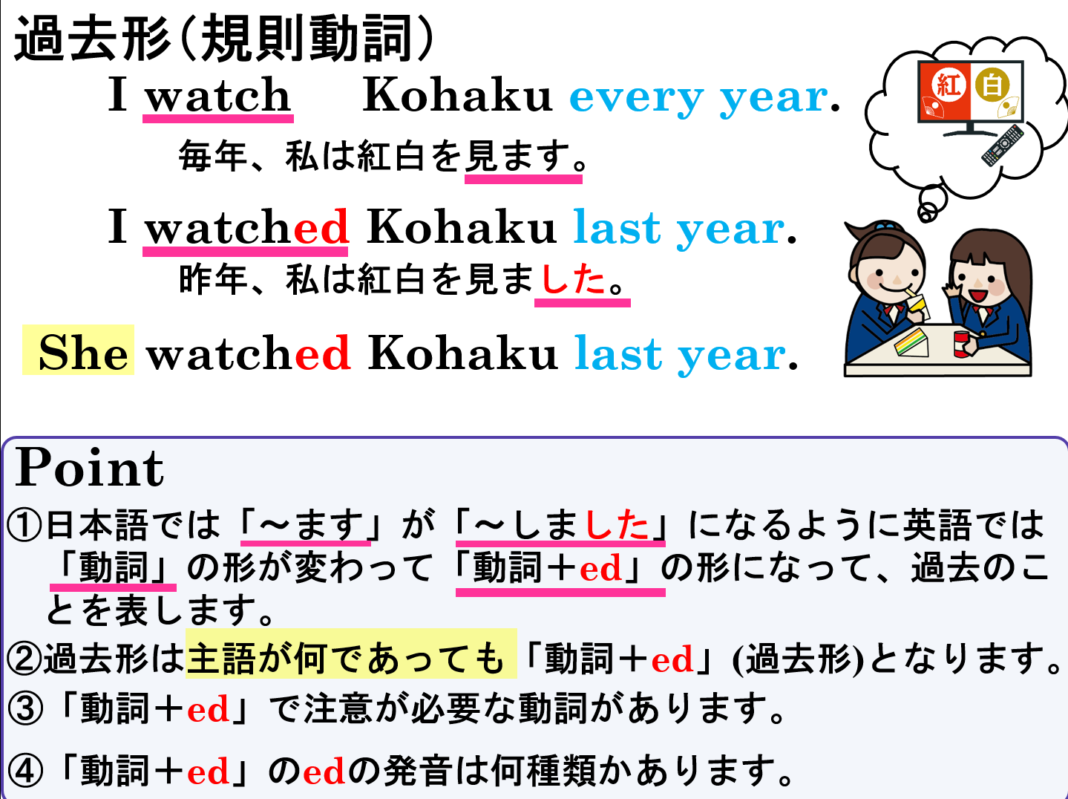

Slide 38
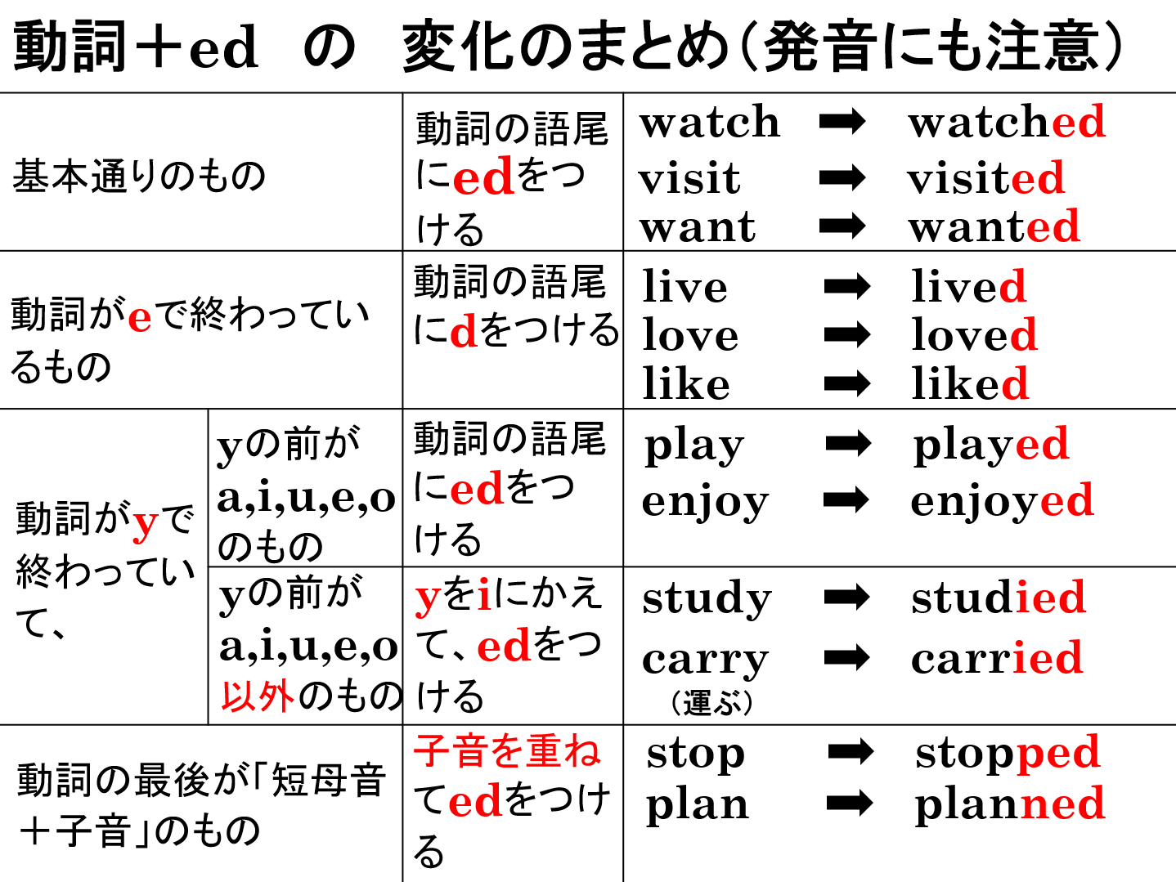

Slide 39
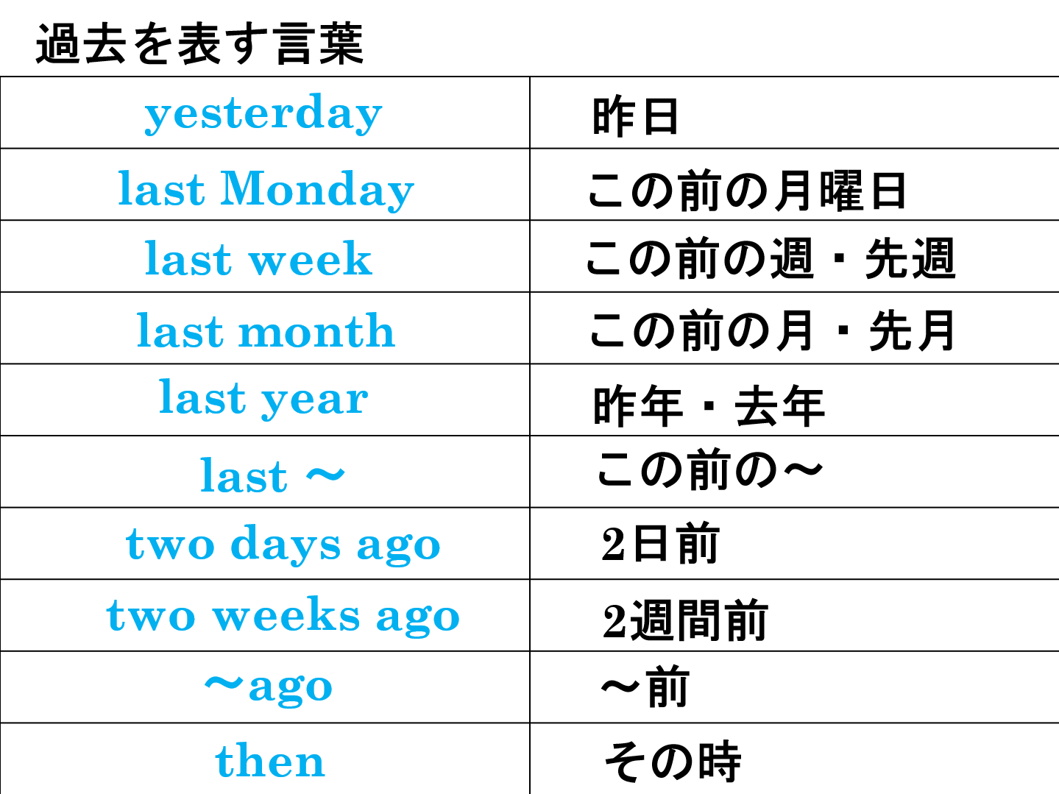

Slide 40
Past Tense
過去形

