Slide 1
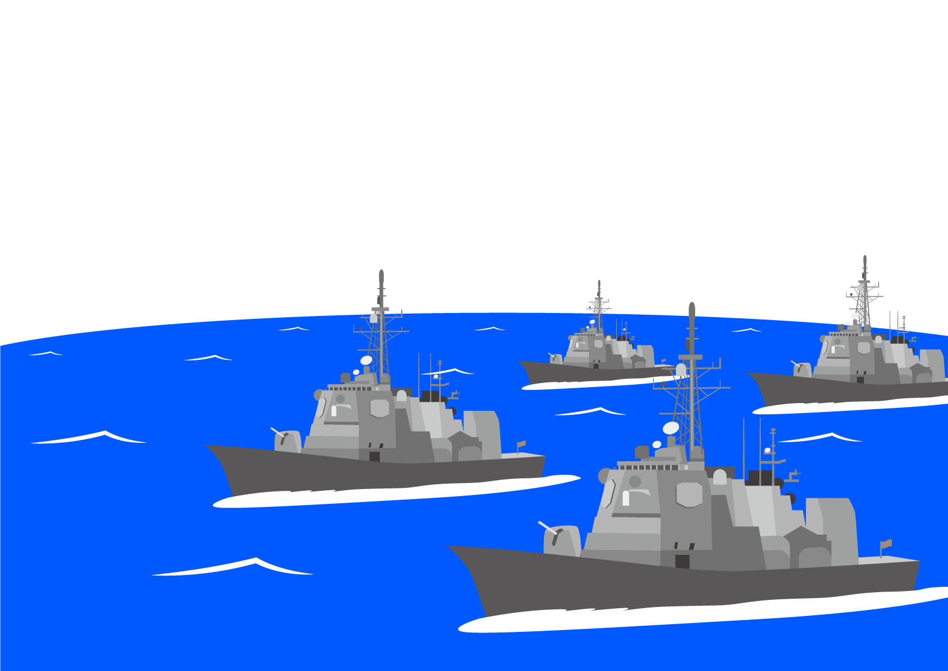
Battle Ships
説明

Slide 2
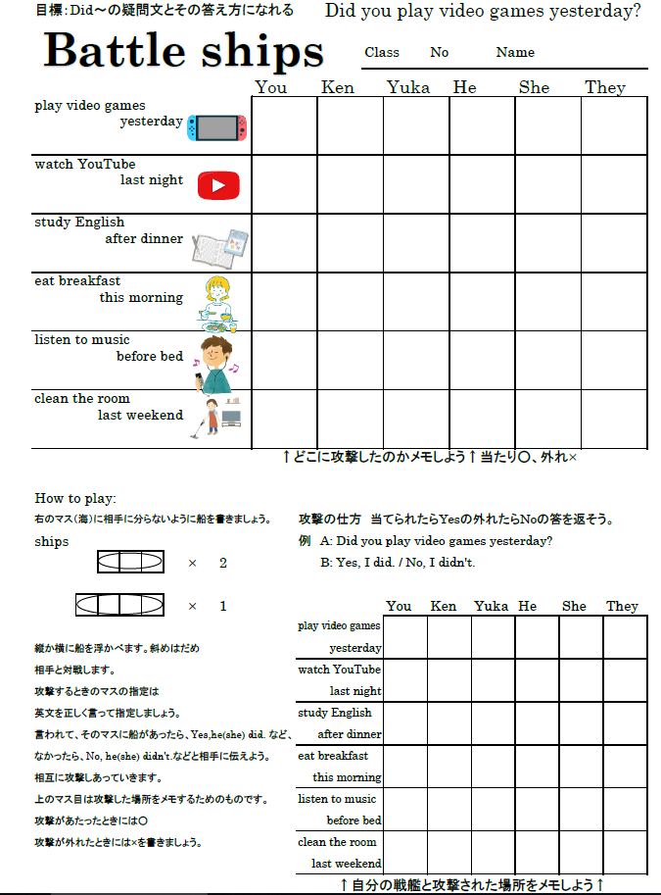

Slide 3
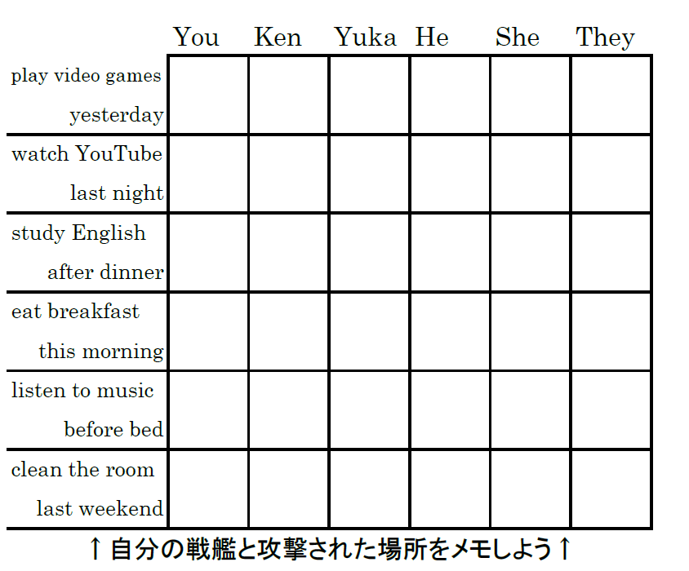

Slide 5
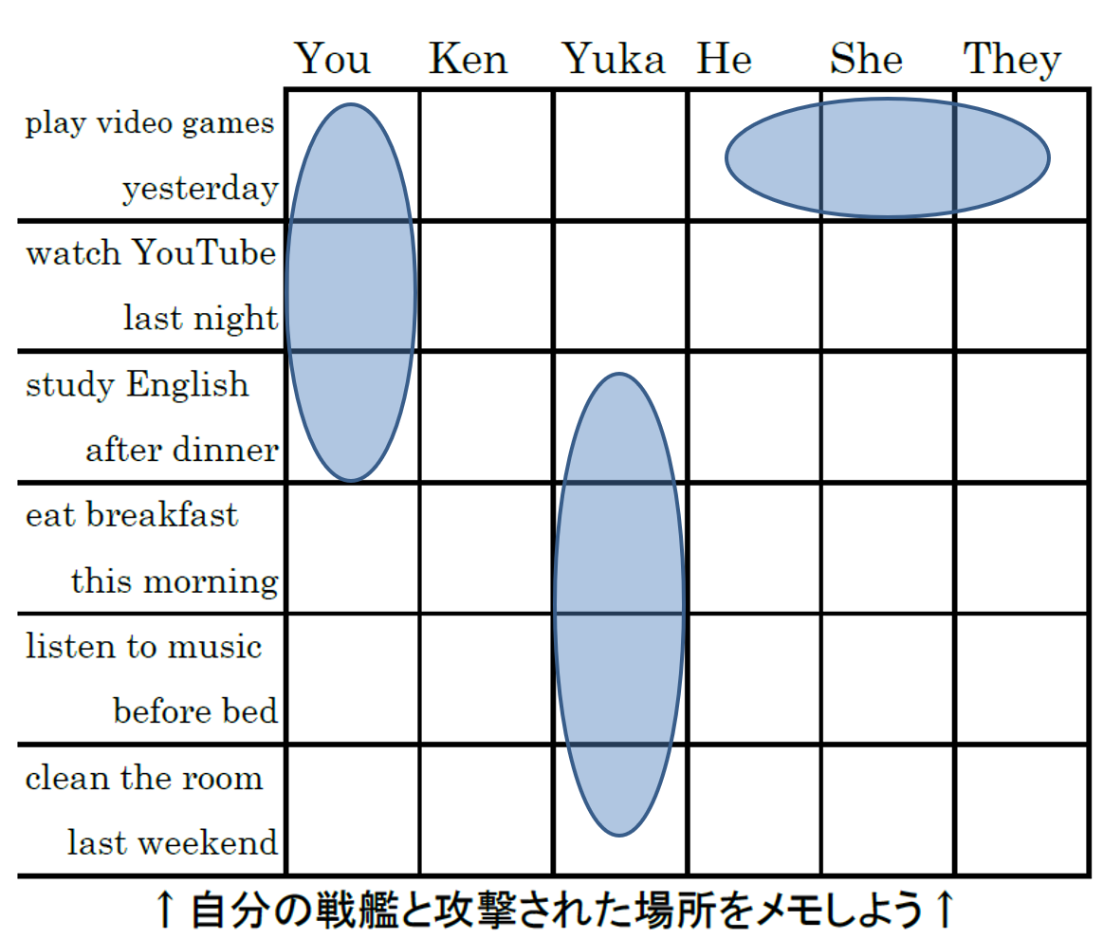
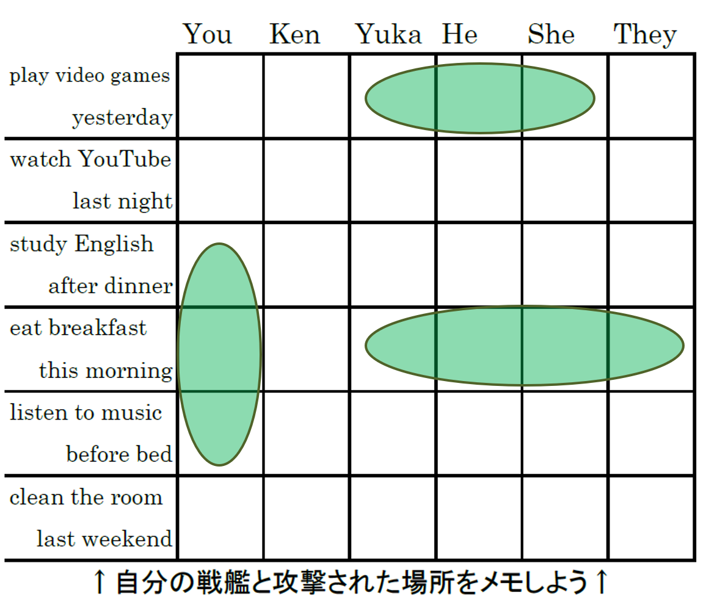
B : Did he play video
games yesterday?
A: Yes, he did.
A: Did you play video
games yesterday?
B: No, I didn’t.

Slide 6
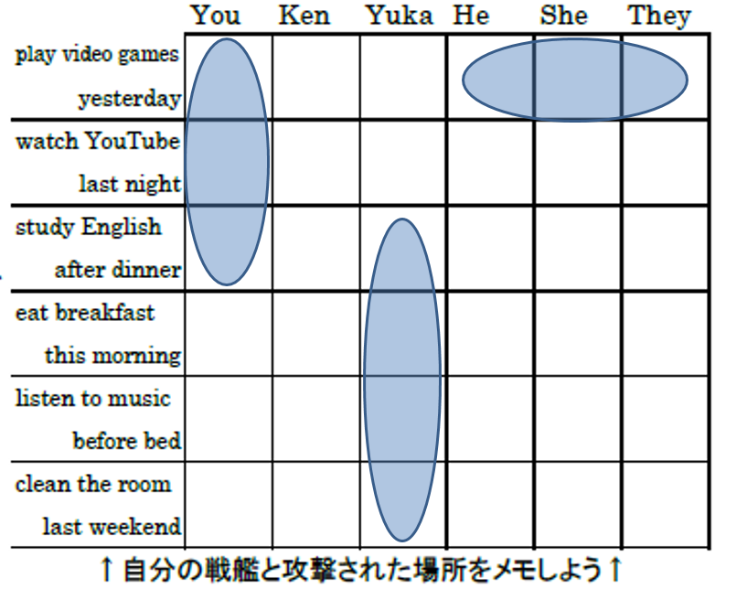
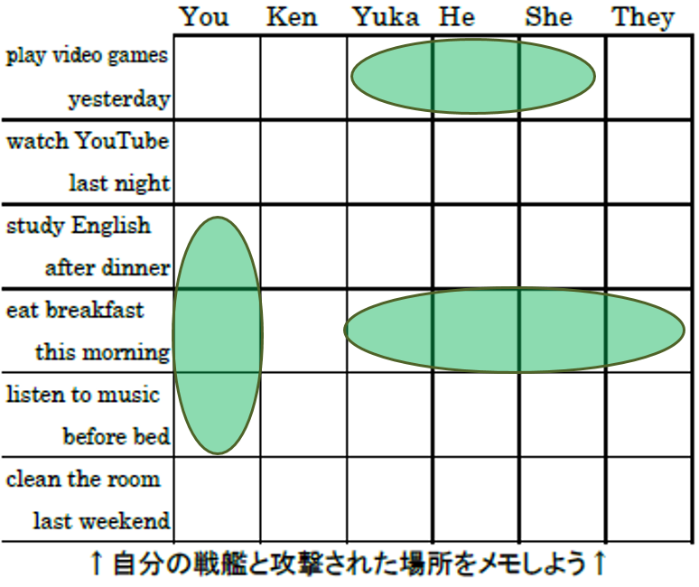
←This ship sank!

Slide 7
○
相手への
攻撃の
メモ
当たり
×
外れ
自分へ
の攻撃
メモ

Slide 8
Fire!

