Slide 1
Past Tense
過去形の疑問文

Slide 2
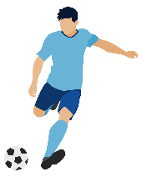
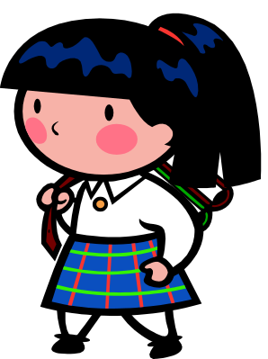
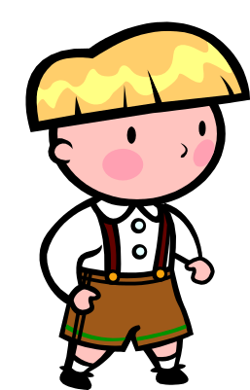
?
You play soccer.
Do
you
play soccer
?
Yes, I do.
No, I don’t ( do not ).
Notes:
左はのび太
右はドラえもん
の画像

Slide 3
?
You played soccer yesterday.
ed
Did
Do
you
play soccer yesterday
ed
?
Yes, I did.
No, I didn’t（did not）.
Notes:
左はのび太
右はドラえもん
の画像

Slide 4
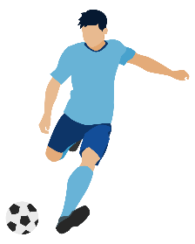
過去形の疑問文（規則動詞）
?
You played soccer yesterday.
ed
Did
play soccer yesterday
Do
you
ed
?
Yes, I did.
No, I didn’t ( did not ).
Point
① 過去を表す形の「動詞ed」のedが、たずねるときに使うdoと
くっついてdidになります。
② 「動詞ed」のedはdoとくっついてdidになっているので、動詞
にはedがつきません。元の形（原形）にもどります。
③ Didで質問しているので、答えるときにもdidを使います。
Notes:
左はのび太
右はドラえもん
の画像

Slide 5
過去形の疑問文を練習しよう1
Did～?

Slide 6
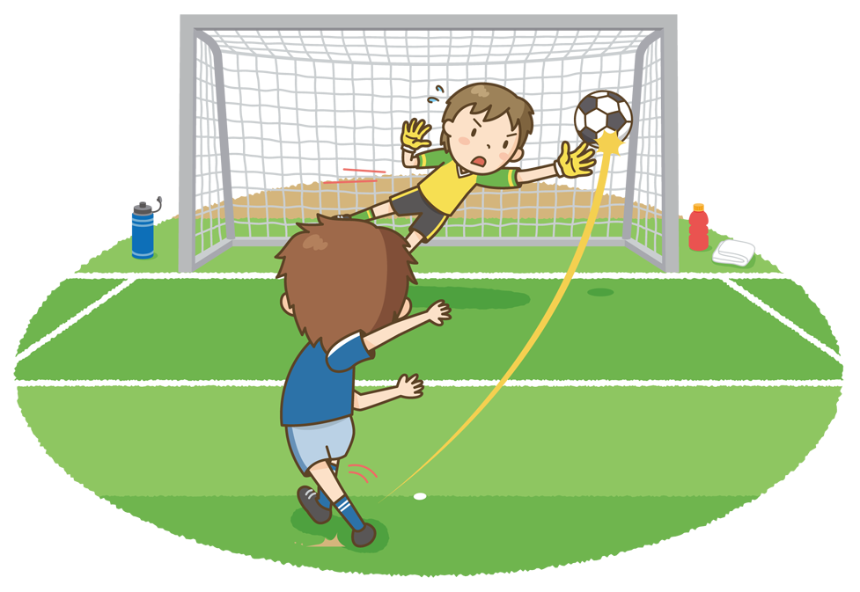
Did you play soccer yesterday?
Yes, I did. / No, I didn’t.

Slide 7
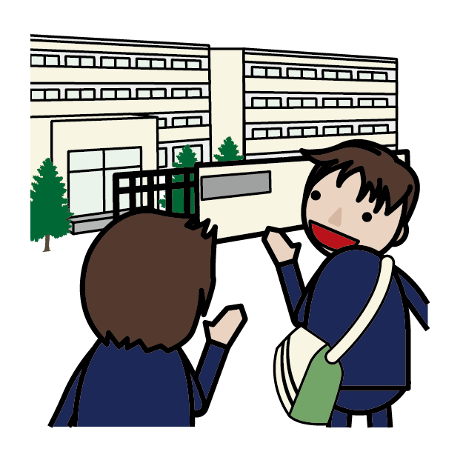
Did you walk to school yesterday?
Yes, I did. / No, I didn’t.

Slide 8
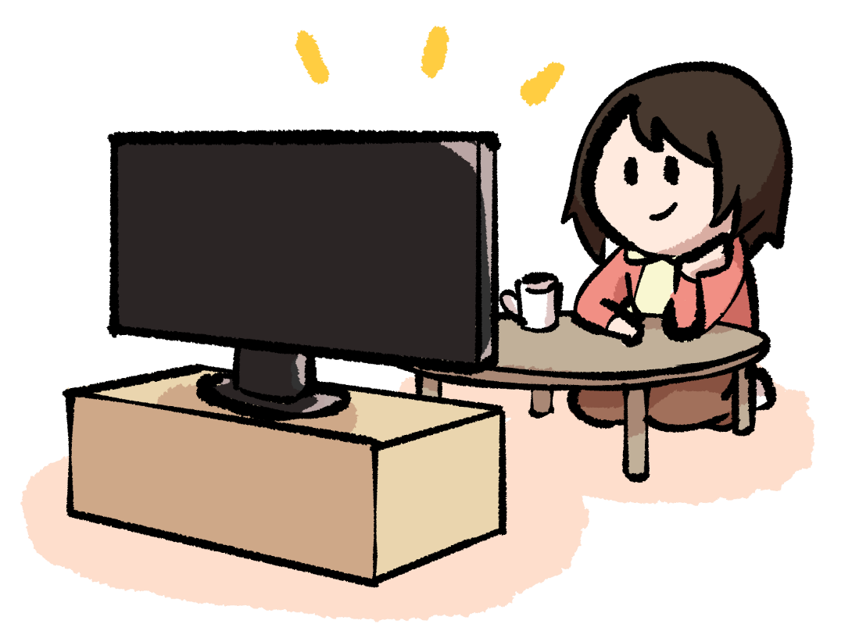
Did she watch TV yesterday?
Yes, she did. / No, she didn’t.

Slide 9
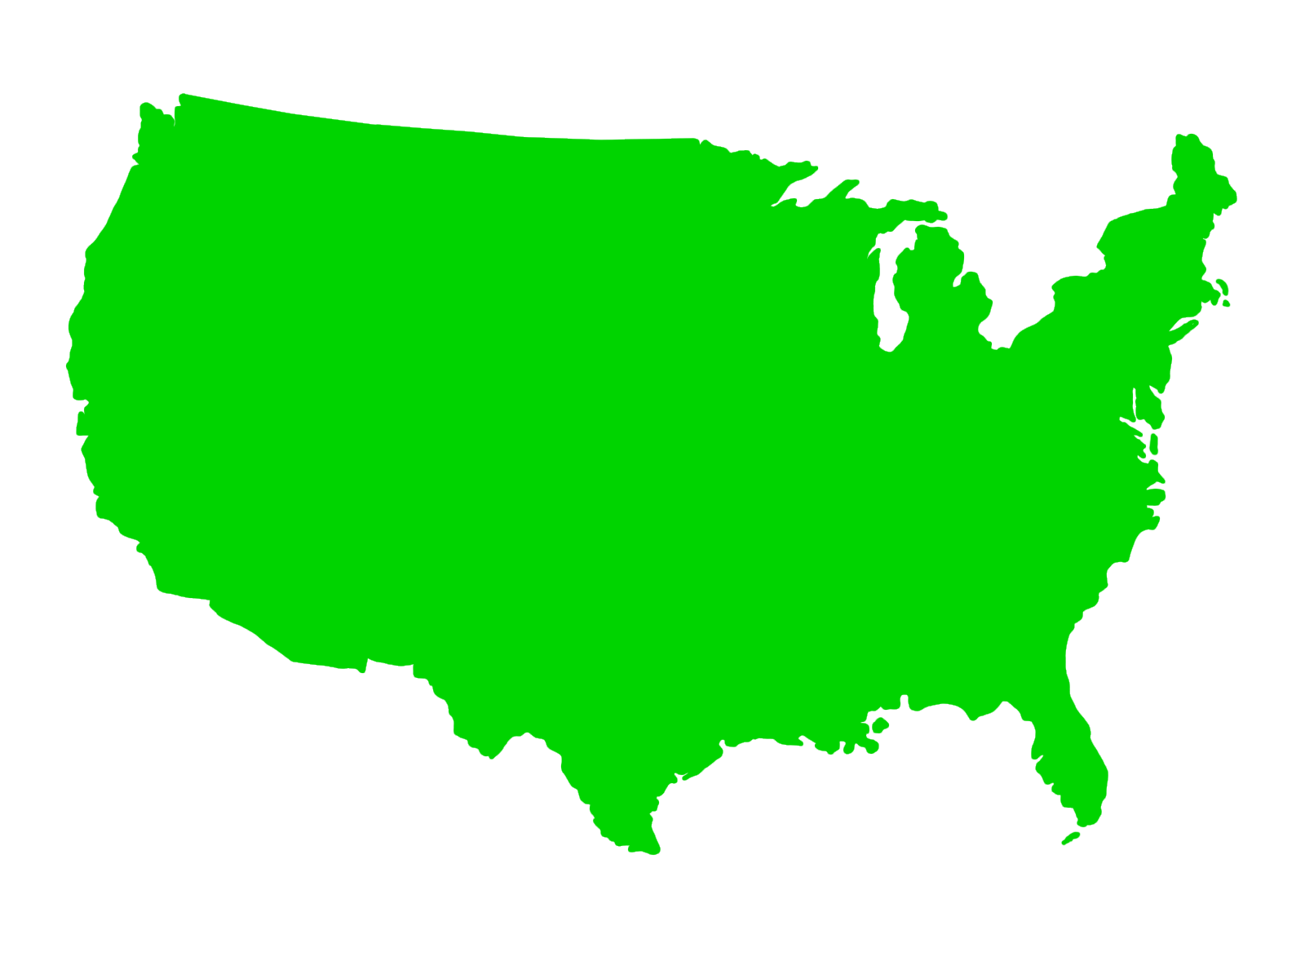

Did he visit the USA last week?
Yes, he did. / No, he didn’t.

Slide 10
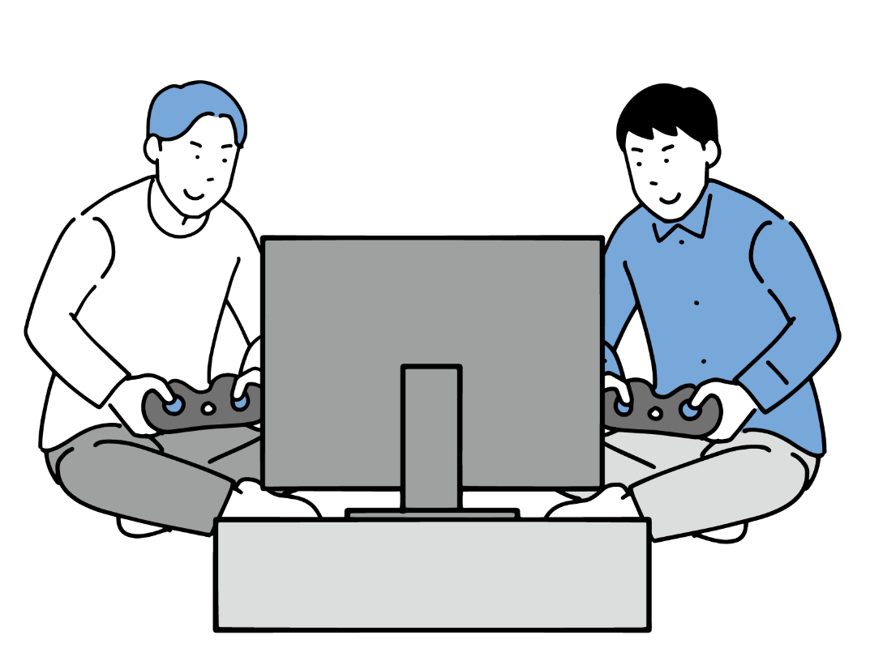
Did they play a video game last Sunday?
Yes, they did. / No, they didn’t.

Slide 11
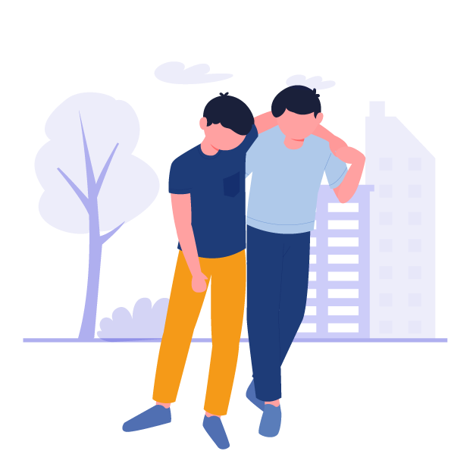
Did he help a man three days ago?
Yes, he did. / No, he didn’t.

Slide 12
過去形の疑問文を練習しよう2
Did～?

Slide 13
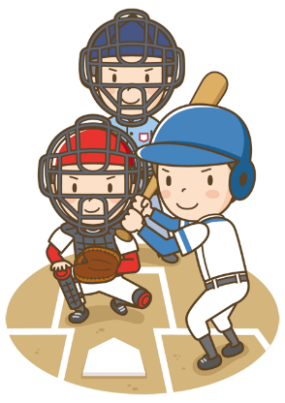
You played baseball yesterday.
?
Do
ed
+
Did
( Did ) you ( play) baseball yesterday?
play
Yes, ( I )( did ).
I
did
No, ( I )( didn’t ).
I
didn’t
No, ( I )( did )( not ).
I
did
not

Slide 14
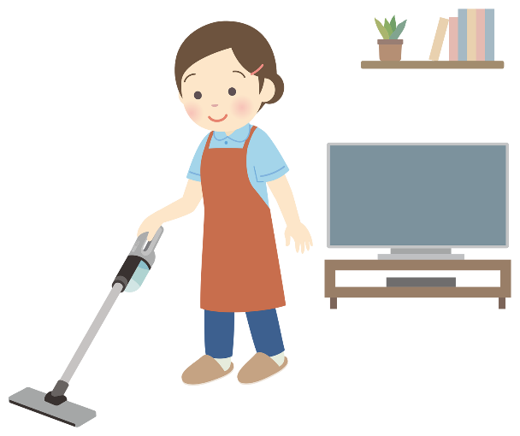
You cleaned the room yesterday.
?
Do
ed
+
Did
clean
( Did ) you ( clean ) the room yesterday?
Yes, ( I )( did ).
I
did
No, ( I )( didn’t ).
I
didn’t
No, ( I )( did )( not ).
I
did
not

Slide 15
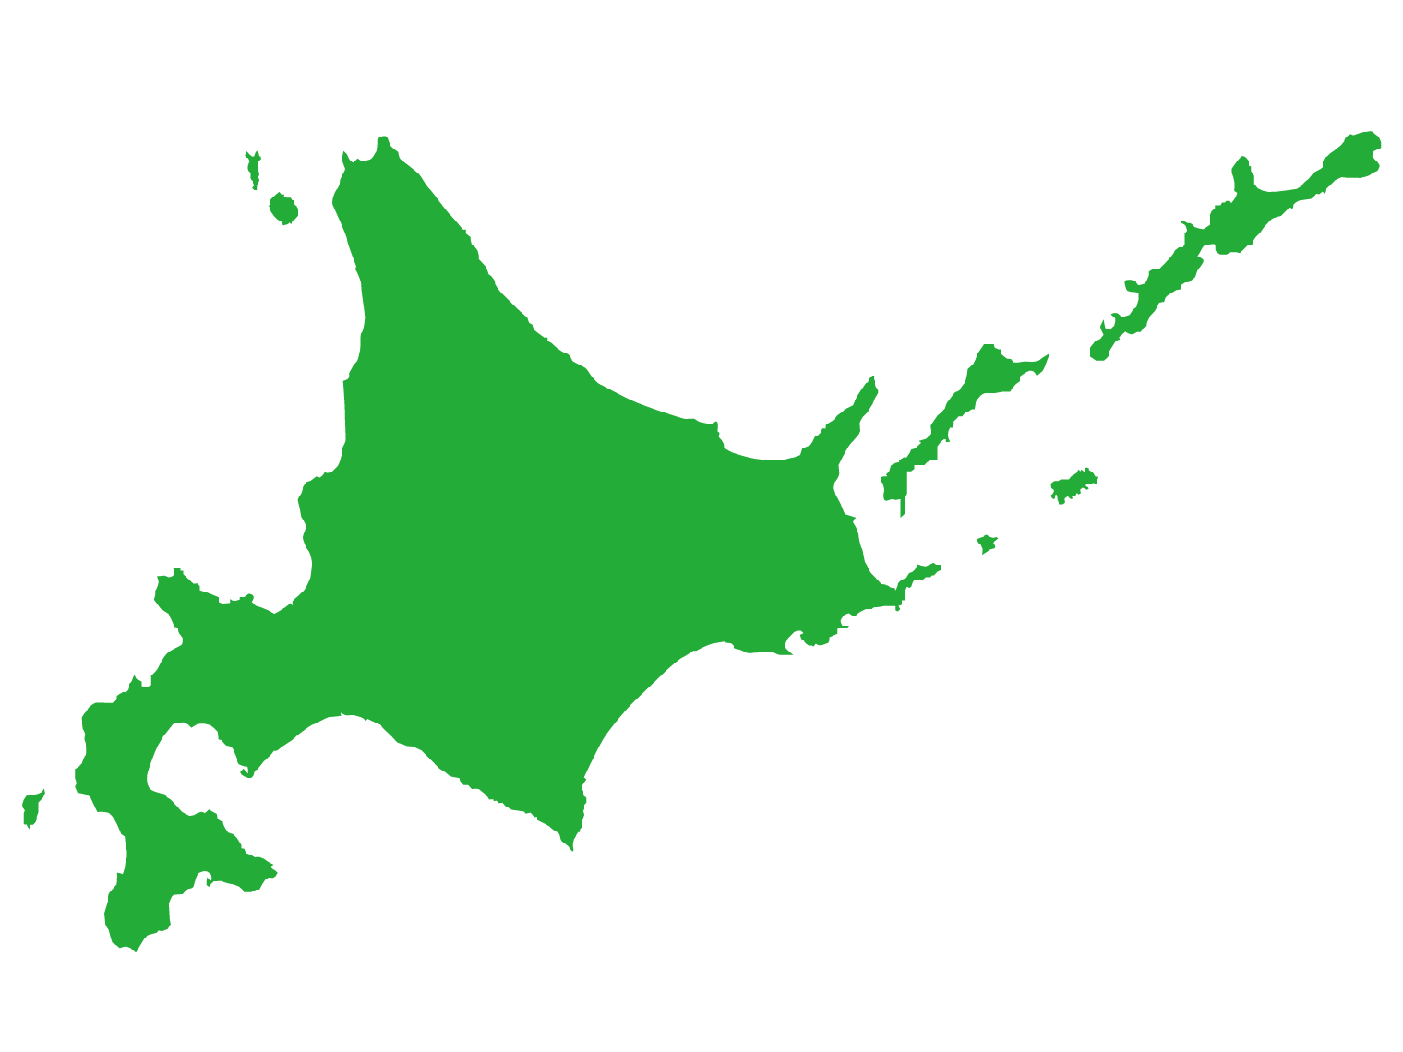
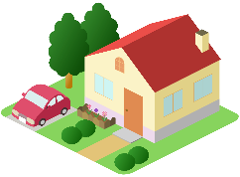
Kenji lived in Hokkaido three years ago.
?
Do
ed
+
( Did ) Kenji ( live ) in Hokkaido three years ago?
Did
live
Yes, ( he )( did ).
he
did
No, ( he )( didn’t ).
he
didn’t
he
No, ( he )( did )( not ).
did
not

Slide 16
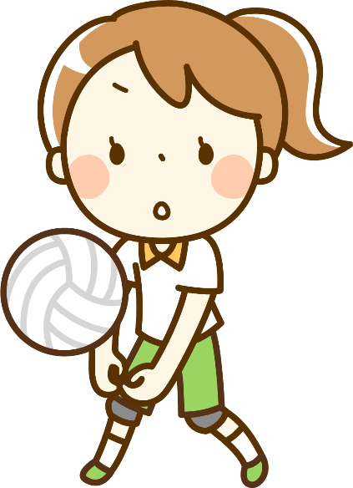
Yumi enjoyed volleyball last week.
?
Do
ed
+
Did
( Did ) Yumi ( enjoy ) volleyball last week?
enjoy
Yes, ( she )( did ).
she
did
No, ( she )( didn’t ).
she
didn’t
she
No, ( she )( did )( not ).
did
not

Slide 17
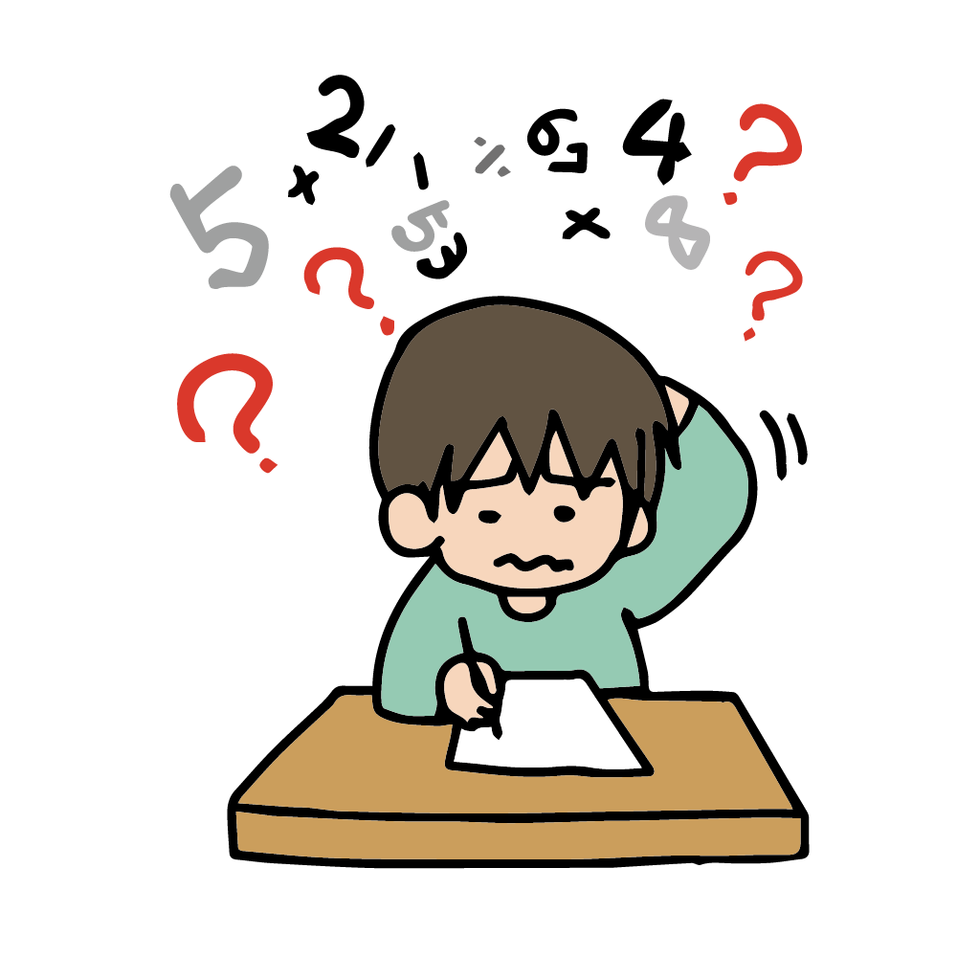
He studied math last Monday.
?
Do
ed
+
( Did ) he ( study ) math last Monday?
Did
study
Yes, ( he )( did ).
he
did
No, ( he )( didn’t ).
he
didn’t
he
No, ( he )( did )( not ).
did
not

Slide 18
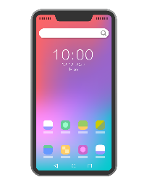
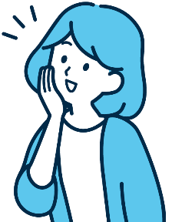
She wanted a smartphone last year.
?
Do
ed
+
Did
want
( Did ) she ( want) a smartphone last year?
Yes, ( she )( did ).
she
did
No, ( she )( didn’t ).
she
didn’t
she
No, ( she )( did )( not ).
did
not

Slide 19
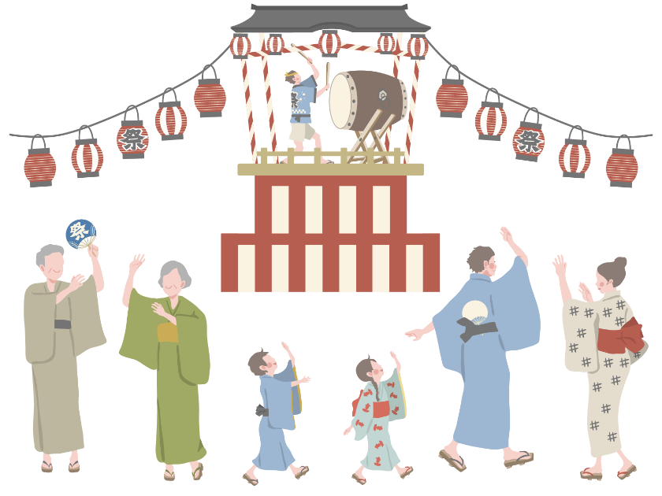
They danced at the summer festival this year .
?
Do
ed
+
dance
( Did ) they ( dance ) at the summer festival this year?
Did
Yes, ( they )( did ).
they
did
No, (they )( didn’t ).
they
didn’t
they
No, (they )( did )( not ).
did
not

Slide 20
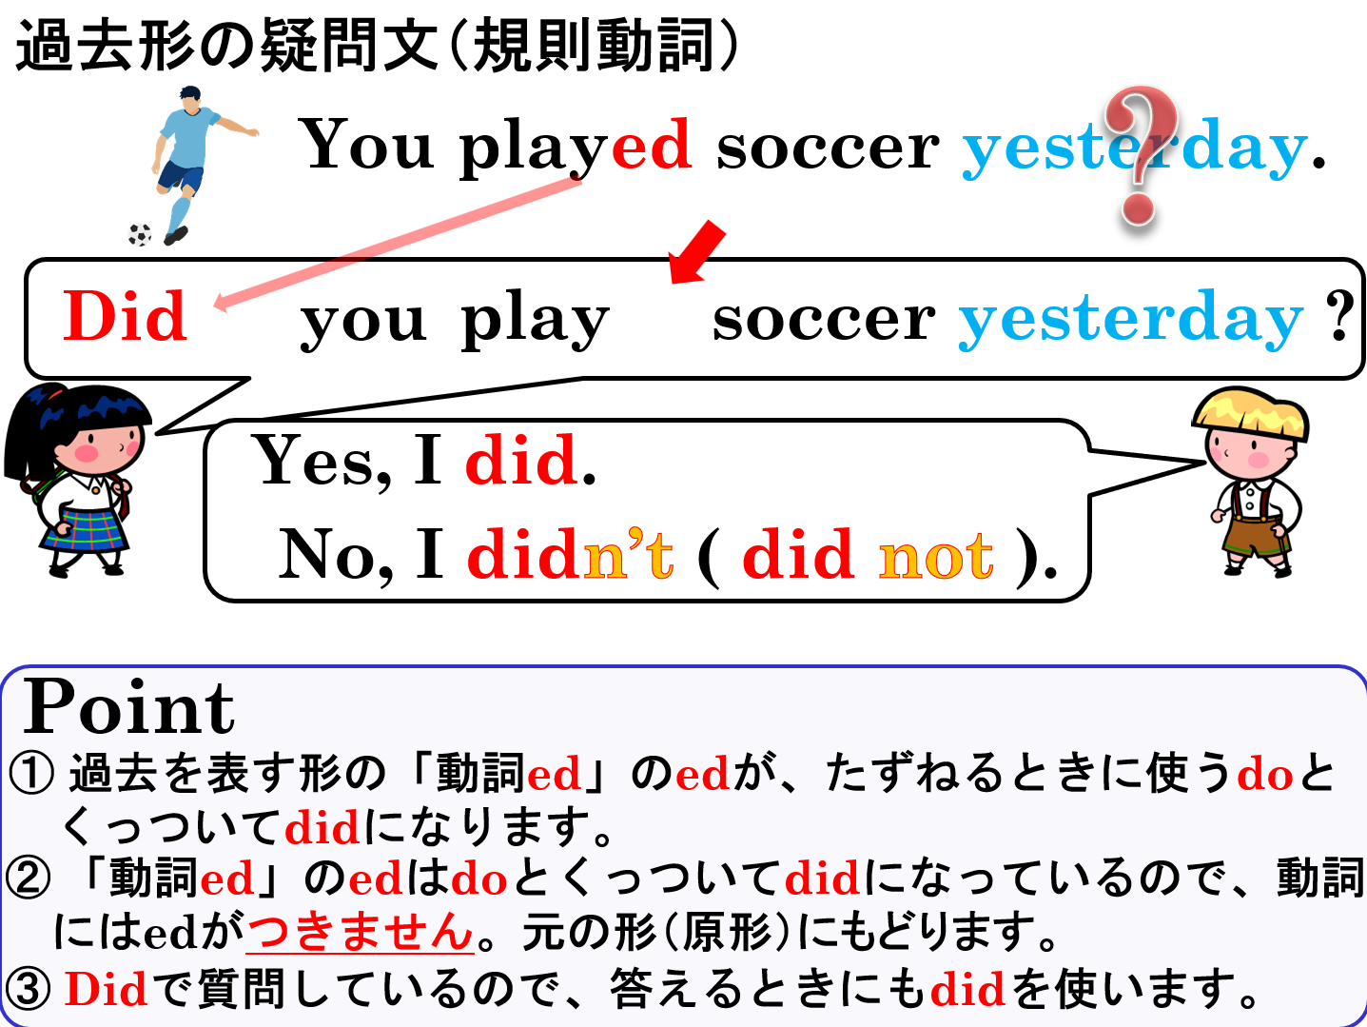

Slide 21
Past Tense
不規則動詞の過去形の疑問文

Slide 22
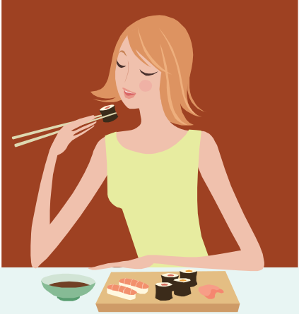
過去形の疑問文（不規則動詞）
?
Do
Did
you eated sushi?
ed
You ateed sushi.
Yes, I did.
No, I didn’t ( did not ).
Notes:
ここでは、明示的に ate＝eat＋ed、ed＋do＝did として示し、過去の時制の担い手が一般動詞から did に移ることを視覚的にわかりやすくするため、このようにしています。

Slide 23
過去形の疑問文（不規則動詞）
?
You ateed sushi.
You eated sushi.
Do + ed you eat sushi?
Did you eat sushi?
Yes, I did.
No, I didn’t ( did not ).
Point
①不規則変化の動詞の過去形も「動詞の原形+ed」と考えて、過
去を表すedの部分が、たずねるときに使うdoとくっついてdid
になると考えましょう。
②動詞は元の形（原形）になることを忘れないようにしましょう。

Slide 24
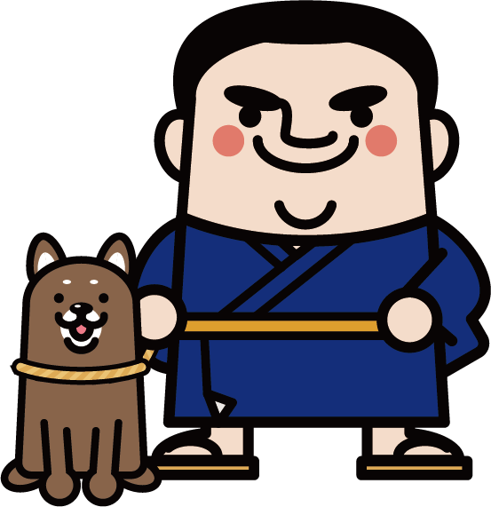
You had a dog two years ago.
?
Do
ed
+
Did
( Did ) you ( have ) a dog two years ago?
have
Yes, ( I )( did ).
I
did
No, ( I )( didn’t ).
I
didn’t
No, ( I )( did )( not ).
I
did
not

Slide 25
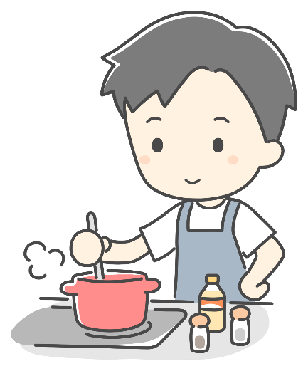
Your father made dinner yesterday.
?
Do
ed
+
make
( Did ) your father ( make ) dinner yesterday?
Did
Yes, ( he )( did ).
he
did
No, ( he )( didn’t ).
he
didn’t
he
No, ( he )( did )( not ).
did
not

Slide 26
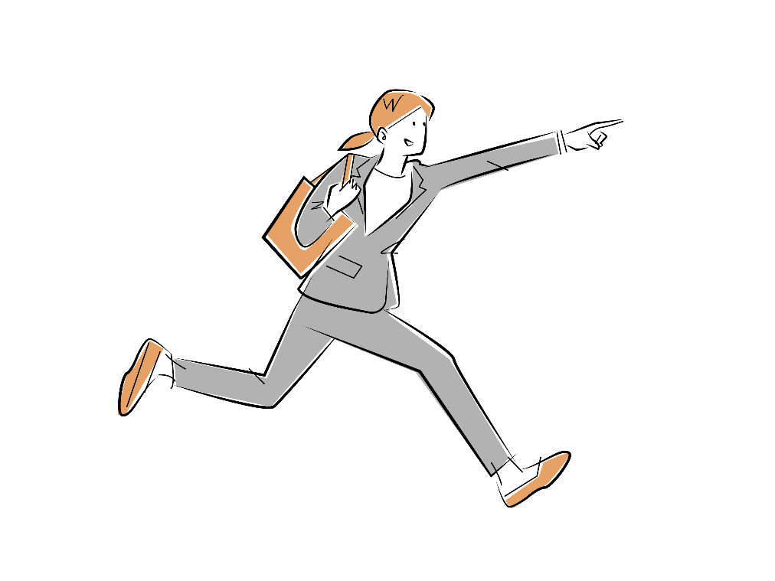
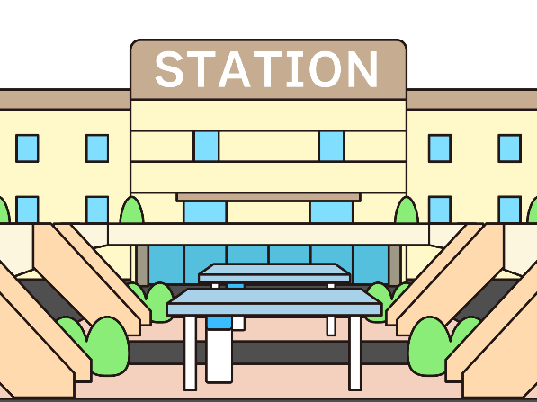
Mai ran to the station this morning.
?
Do
ed
+
run
( Did ) Mai ( run ) to the station this morning?
Did
Yes, ( she )( did ).
she
did
No, ( she )( didn’t ).
she
didn’t
she
No, ( she )( did )( not ).
did
not

Slide 27
He came to school yesterday.
?
Do
ed
+
come
( Did ) he ( come ) to school yesterday?
Did
Yes, ( he )( did ).
he
did
No, ( he )( didn’t ).
he
didn’t
he
No, ( he )( did )( not ).
did
not

Slide 28

She bought many things last Sunday.
?
Do
ed
+
( Did ) she ( buy ) many things last Sunday?
Did
buy
Yes, ( she )( did ).
she
did
No, ( she )( didn’t ).
she
didn’t
she
No, ( she )( did )( not ).
did
not

Slide 29
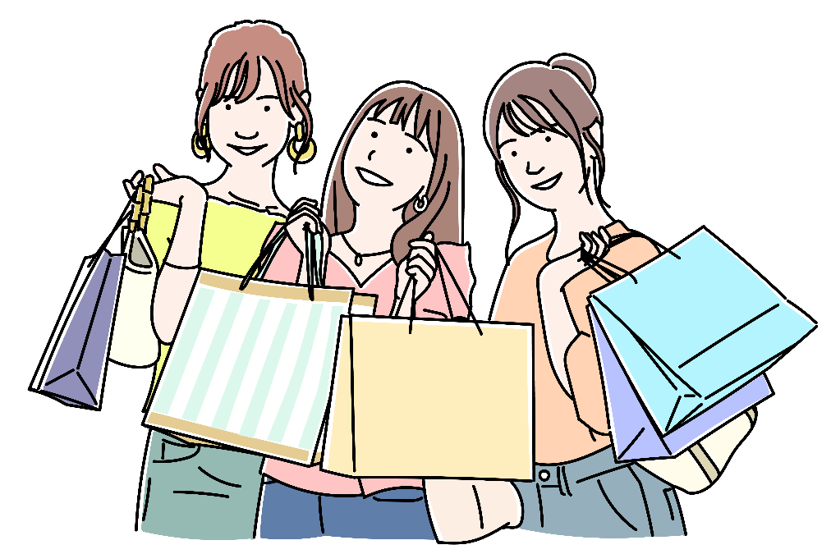
They went shopping last weekend.
?
Do
ed
+
go
( Did ) they ( go ) shopping last weekend?
Did
Yes, ( they )( did ).
they
did
No, (they )( didn’t ).
they
didn’t
they
No, (they )( did )( not ).
did
not

Slide 30
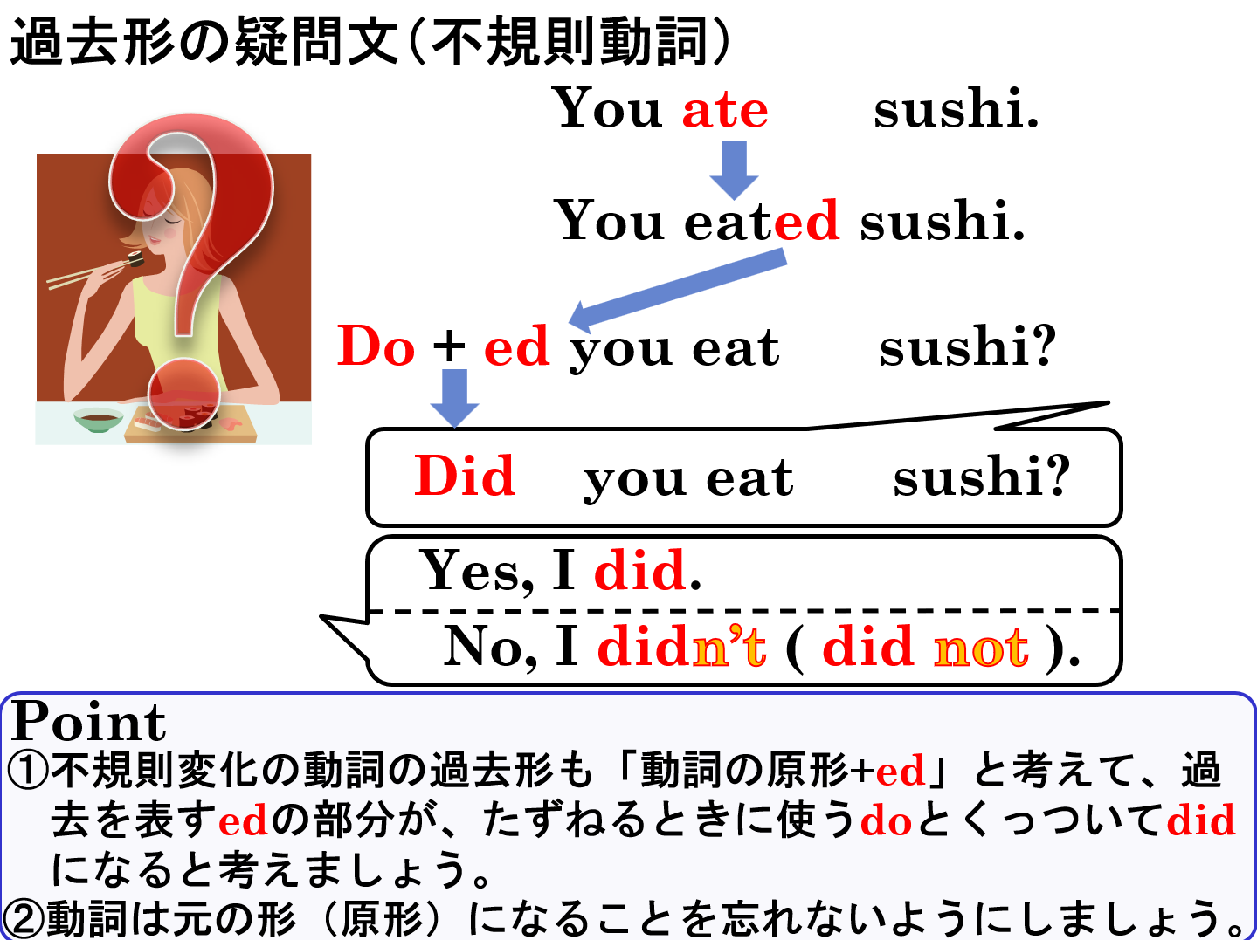

Slide 31
Past Tense
過去形の疑問文

