Slide 1
Past Tense
過去形-否定文

Slide 2
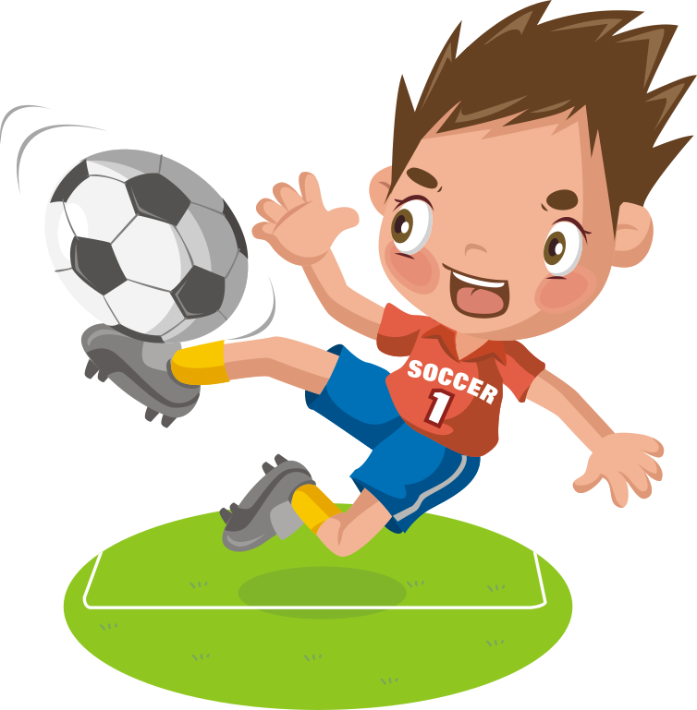

否定文
×
do
not
I
play soccer.
do
not
I
played soccer.
did
ed
×
do
not
I
ate sushi.
did
ed
eat sushi.

Slide 3
×
過去形の否定文
I not played soccer.
do
ed
do＋
ed
I did not play soccer.
I didn’t play soccer.
I did not eat sushi. (eat-ate)
Point
①「動詞ed」のedが、否定文のときに使うdoとくっついて did
になります。
②「動詞ed」のedは否定文のときに使うdoとくっついてdidに
なっているので、動詞にはedがつきません。
③不規則動詞も過去を表す部分が否定文のときに使うdoとくっつ
き、didになるために、動詞はもとの形（原形）に戻ります。
④ did not の短縮形didn’tです。

Slide 4
過去形を練習しよう
否定文

Slide 5
I played soccer yesterday.
I ( didn’t )( play ) soccer yesterday.
didn’t
play
×

Slide 6
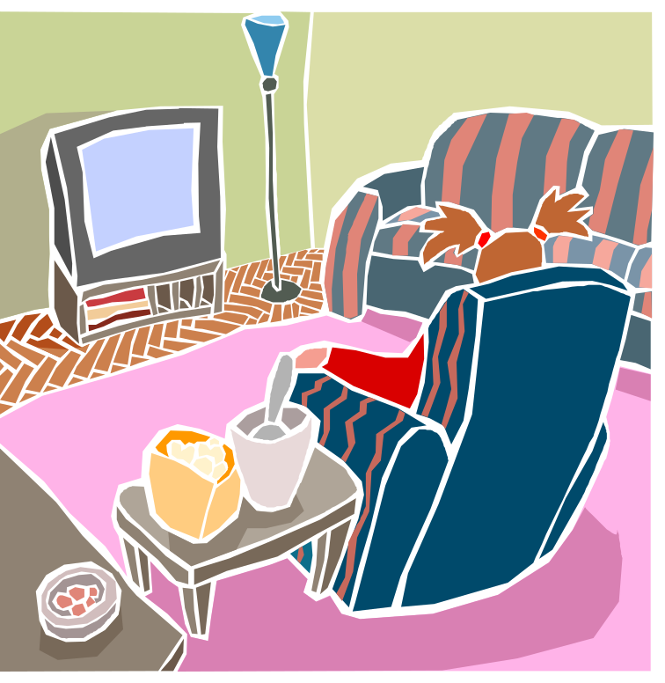
She watched TV yesterday.
She ( didn’t )( watch ) TV yesterday.
didn’t
watch
×

Slide 7
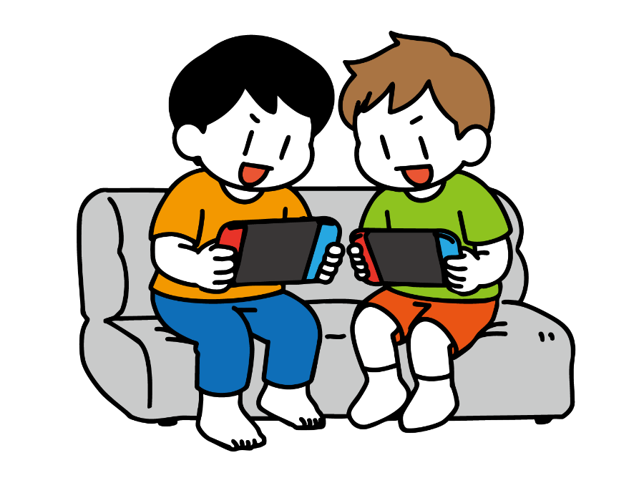
They played a video game last Sunday.
They ( didn’t )( play ) a video game
last Sunday.
didn’t
play
×

Slide 8
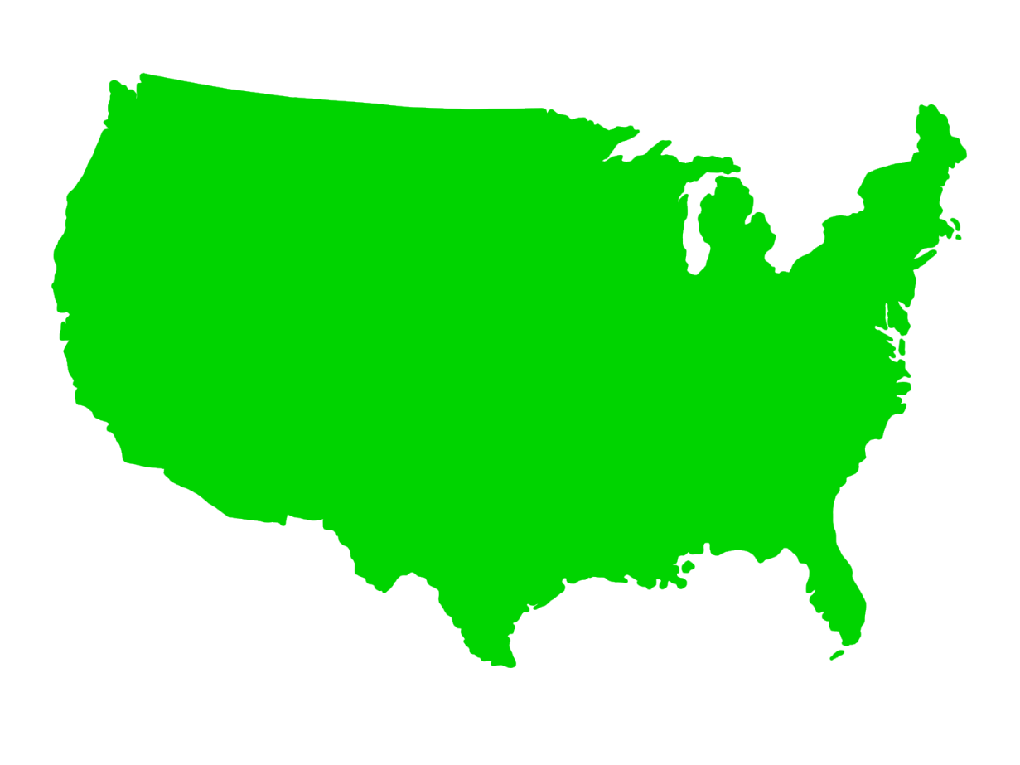
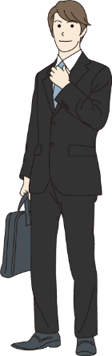
I went to the USA last week.
I ( didn’t )( go ) to the USA last week.
didn’t
go
×

Slide 9
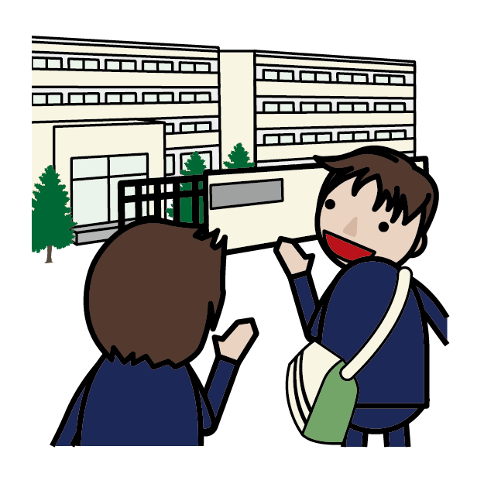
He came to school yesterday.
He ( didn’t )( come) to school yesterday.
didn’t
come
×

Slide 10
She ate sushi last night.
She ( didn’t )( eat ) sushi last night.
didn’t
eat
×

Slide 11
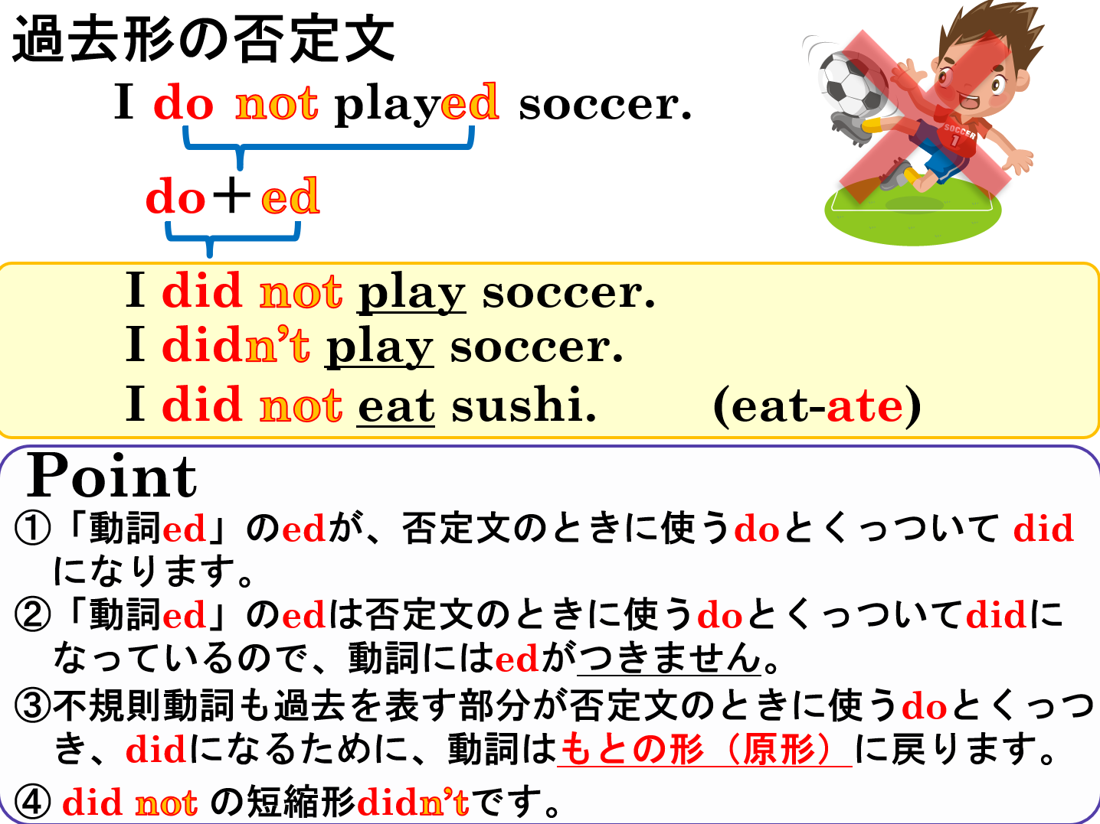

Slide 12
Past Tense
過去形-否定文

