Slide 1
Past Progressive
過去進行形

Slide 2
過去のある一時点のことを
表す表現
～していました。
「過去進行形」

Slide 3
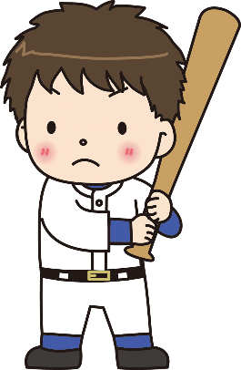

I am playing baseball now.
I was playing baseball then.
then
future
（未来）
now
past
（過去）

Slide 4
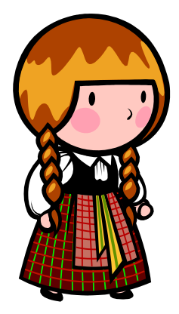
now
future
（未来）
past
（過去）
then
He is playing baseball now.
He was playing baseball then.

Slide 5

過去進行形（過去のある一時点のことを表す表現）
I am playing baseball now.
I was playing baseball then.
past
（過去）
future
（未来）
then
now
Point
①進行形は 「be動詞 + 動詞ing 」を使って表します。
②過去のある一時点のことを表す場合、 be動詞を過去形にして、
was
were
＋ 動詞ing の形を使って表します。
③主語が「I, He, She, It」のときに、was、「You, We, They」
のときに、wereを使います。

Slide 6
Be動詞（am / is / are ）の使い分けー現在
話をするときに 出てくる人 |  | 単数 （１人、１つ） |  | 複数 （２人以上、２つ以上）
１人称 | 話す人
２人称 | 聞く人
３人称 | その他の 人や物
I
am
We
are
You
are
You
are
He
She
It
is
They
are

Slide 7
Be動詞（was / were）の使い分けー過去
話をするときに 出てくる人 |  | 単数 （１人、１つ） |  | 複数 （２人以上、２つ以上）
１人称 | 話す人
２人称 | 聞く人
３人称 | その他の 人や物
I
was
We
were
You
were
You
were
He
She
It
was
They
were

Slide 8
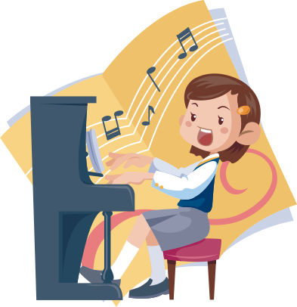

I am playing the piano now.
was
playing
I ( was )( playing ) the piano then.
then
future
（未来）
now
past
（過去）

Slide 9



past
（過去）
future
（未来）
then
now
You are cleaning now.
You ( were )( cleaning ) then.
were
cleaning

Slide 10


then
future
（未来）
now
past
（過去）
Yumi is making a cake now.
making
Yumi ( was )( making ) a cake then.
was

Slide 11


then
future
（未来）
now
past
（過去）
She is having cake now.
having
She ( was )( having ) cake then.
was

Slide 12



past
（過去）
future
（未来）
now
at three o’clock
Ken is sleeping now.
Ken ( was )( sleeping )
at three o’clock.
was
sleeping

Slide 13


past
（過去）
future
（未来）
now
at four o’clock
He is running now.
He ( was )( running )
( at ) four o’clock.
was
running
at

Slide 14
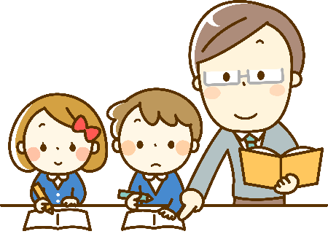

We are studying math now.
were
studying
We ( were )( studying ) math then.
then
future
（未来）
now
past
（過去）

Slide 15
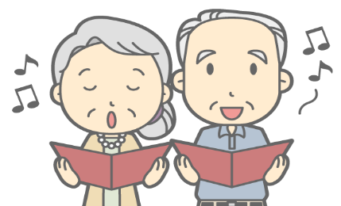
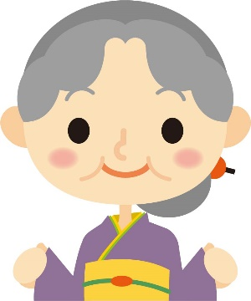
past
（過去）
future
（未来）
now
at five o’clock
They are singing now.
They ( were )( singing )
( at )( five )( o’clock ).
were
singing
at
five
o’clock

Slide 16
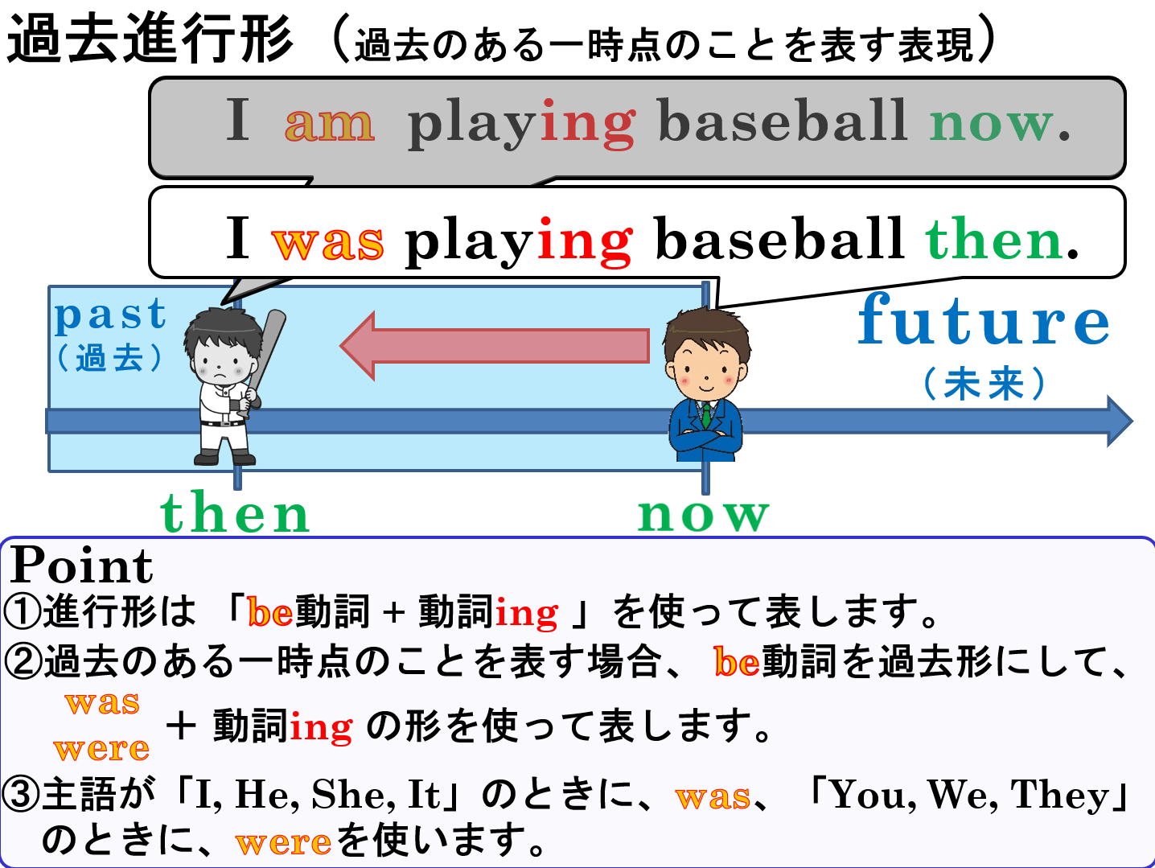

Slide 17
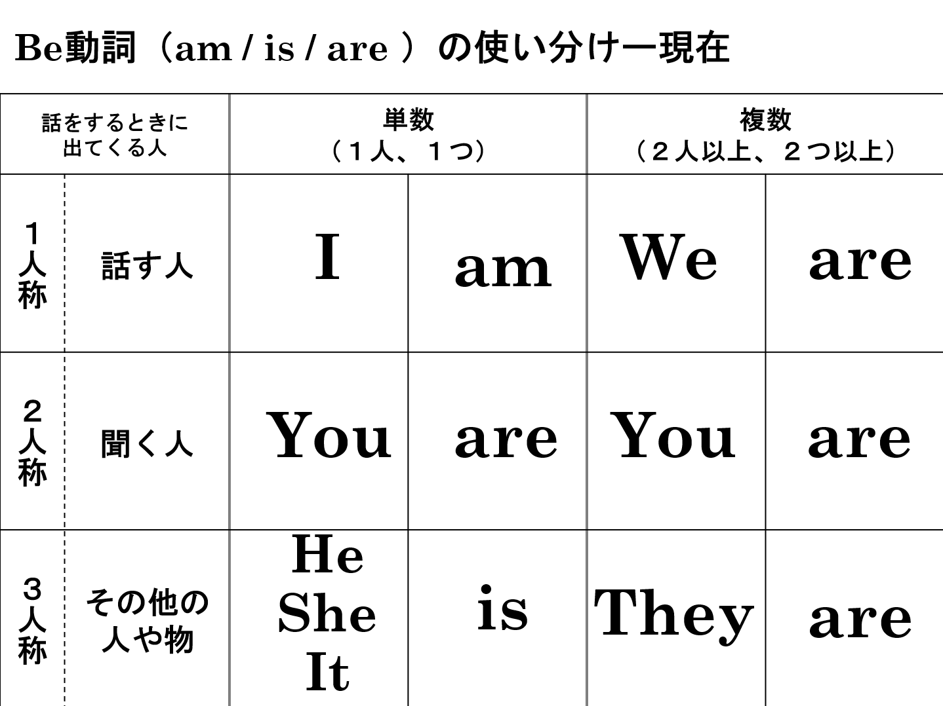
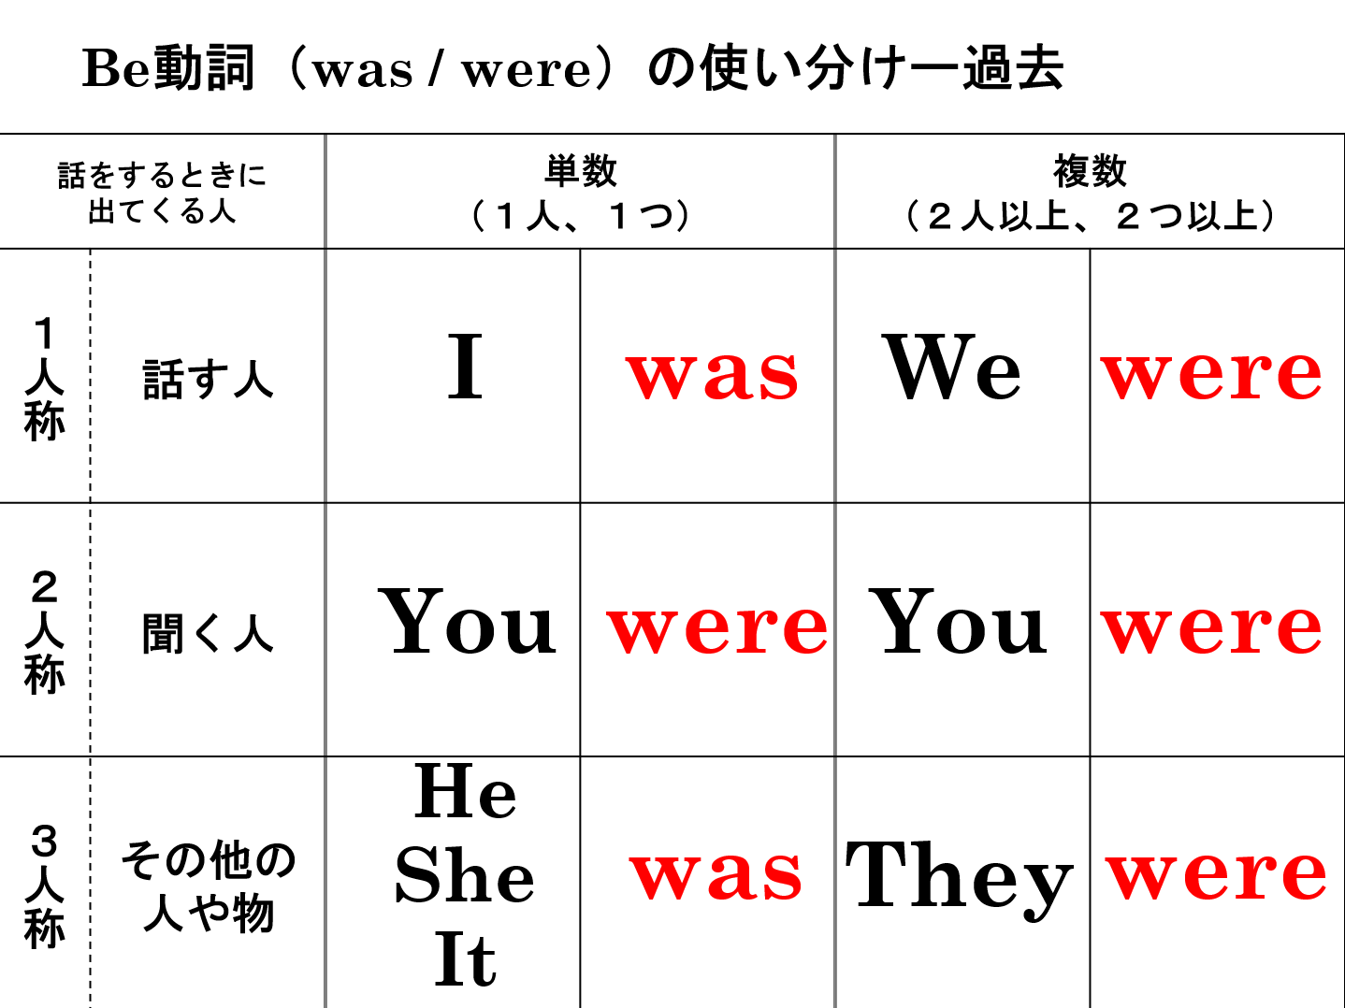

Slide 18
Past Progressive
過去進行形

