Slide 1
Where
一般動詞

Slide 2
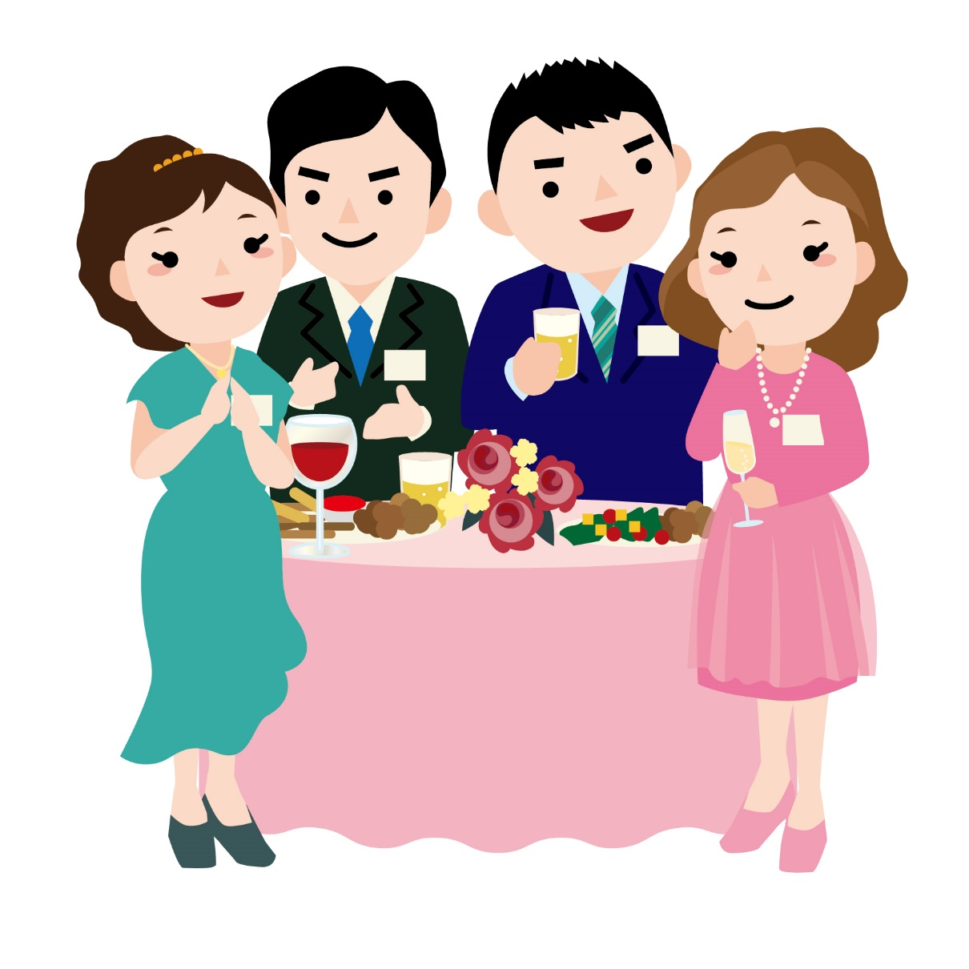
I live in Nagano city.

Slide 3
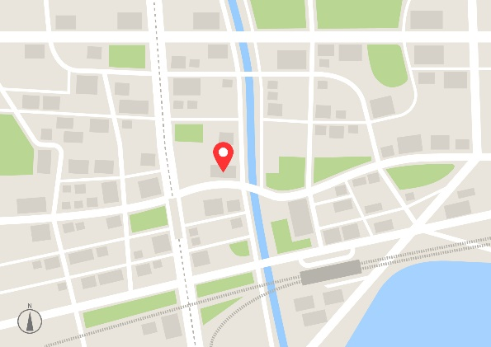

？

Slide 4
Where
do you live?
In Chikuma city.
You live in Chikuma city.

Slide 5
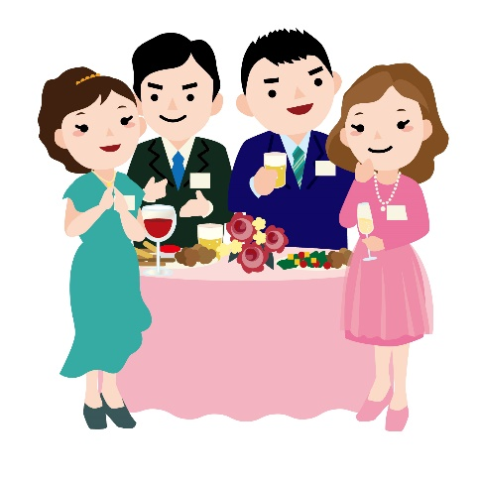
場所をたずねる Where + 一般動詞
？
Do you live in Chikuma city?
do you live in Chikuma city?
Where
?
?
In Chikuma city.
I live in Chikuma city.
Point
① どこなのか（場所）をたずねるときには、「Where」を使います。
② Whereを文の先頭に出して、その後は、Yes/Noで答える疑問文と同じ
順番で文が続きます。
③ Whereに対しての答え方は「at, in, on, to など＋場所の名前」のみで
答えるか、文＋ 「at, in, on, to など＋場所の名前」で答えます。

Slide 6
Where
一般動詞

Slide 7
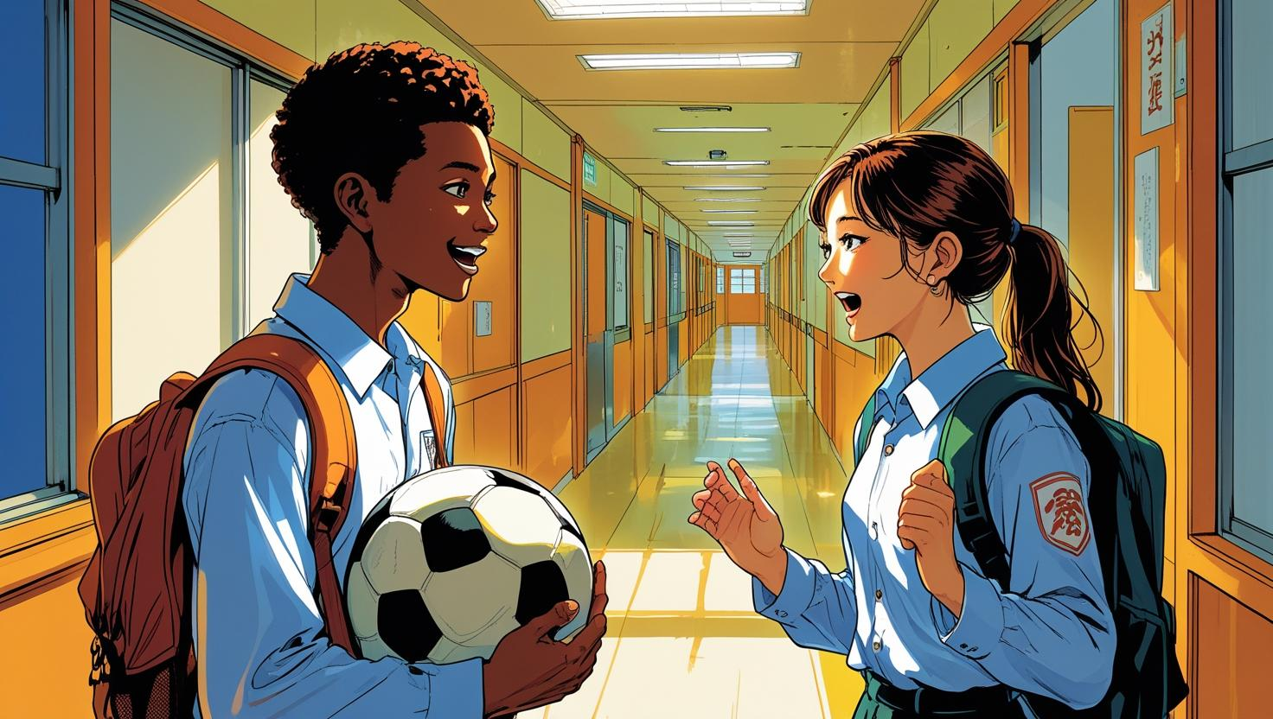
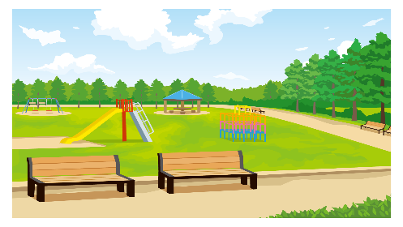
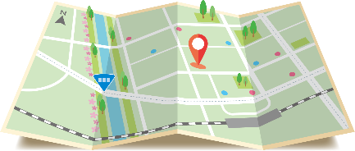
You practice soccer.
( Do ) you practice soccer?
Do
( Where ) ( do ) you practice soccer?
Where
do
？
In the park. / At the park.

Slide 8

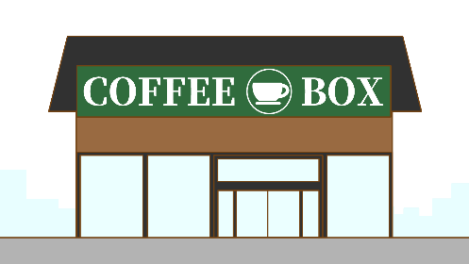
You read a book.
( Do ) you read a book?
Do
( Where ) ( do ) you ( read ) a book?
Where
do
read
？
I read it ( at ) the coffee shop.
at

Slide 9
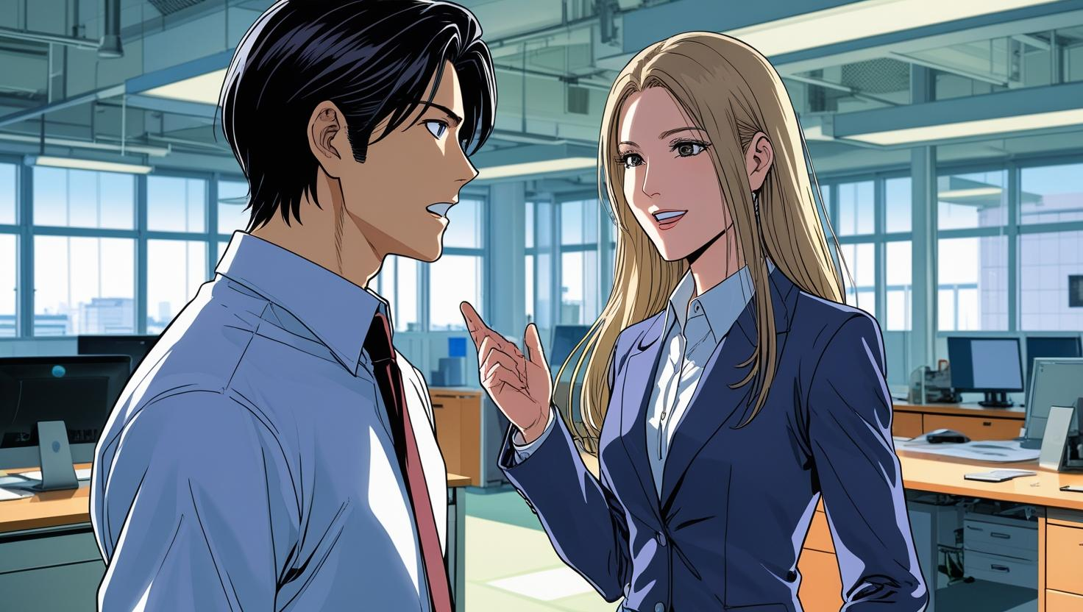
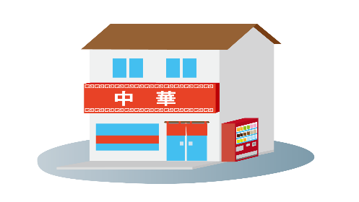
You have lunch.
( Do ) you have lunch?
Do
( Where ) ( do ) you ( have ) lunch?
Where
do
have
？
I have lunch ( at ) a Chinese restaurant.
at

Slide 10
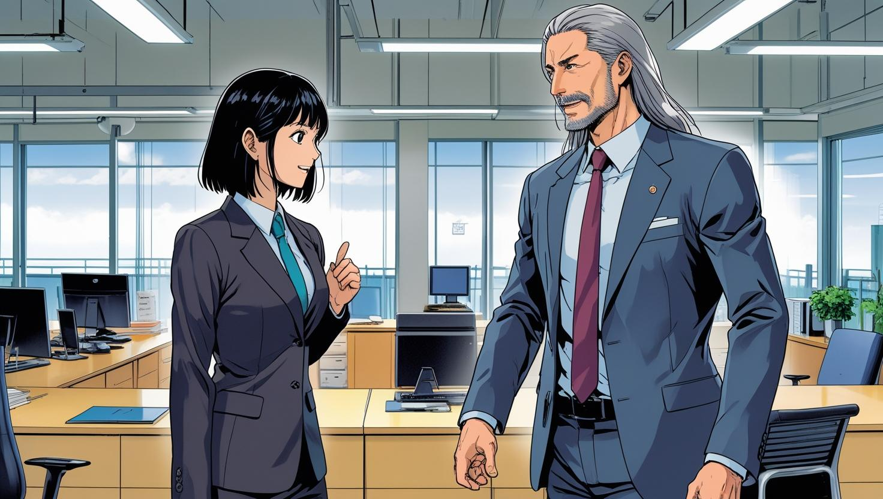

You take English lessons.
( Do ) you take English lessons?
Do
Where
do
( Where ) ( do ) you ( take ) English lessons?
take
？
take
I ( take ) it online.

Slide 11
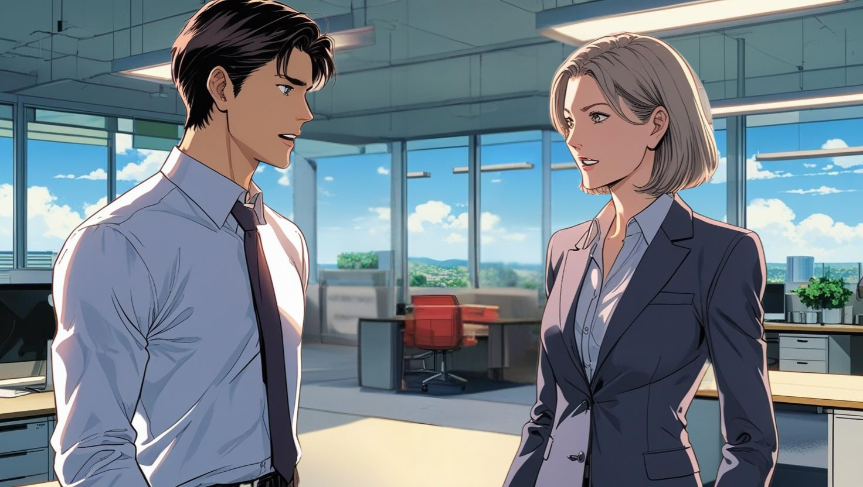
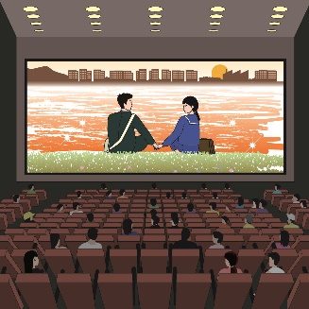
You want to go.
( Do ) you want to go?
Do
do
go
( Where ) ( do ) you ( want )( to )( go )?
Where
want
to
？
I ( want )( to )( go ) to a movie theater.
want
to
go

Slide 12
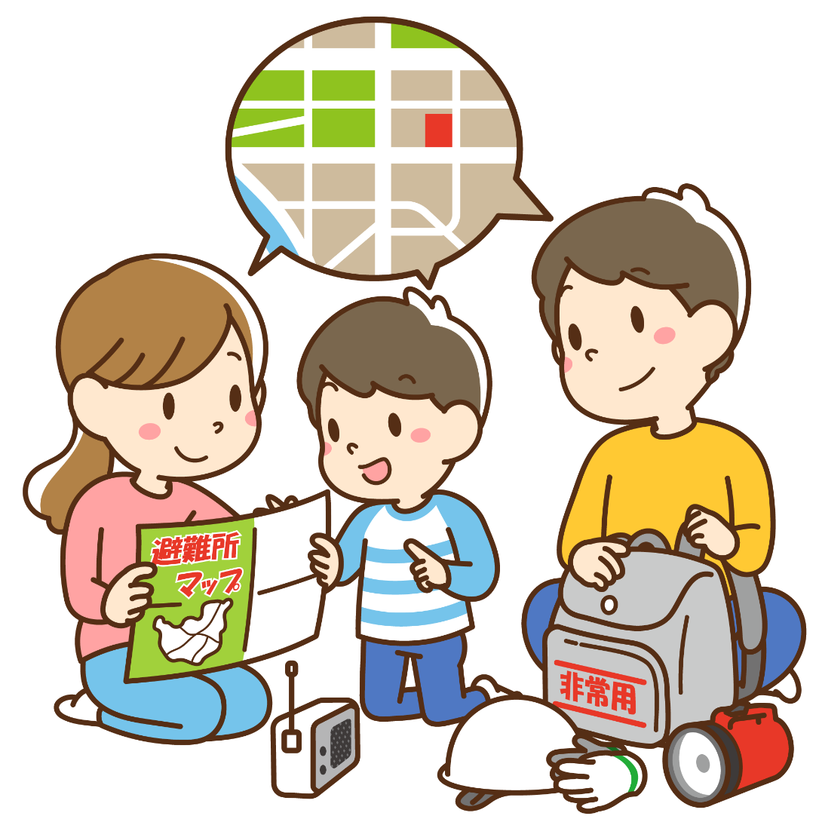
We can go in case of a disaster.
( Can ) we can go in case of a disaster?
Can
( Where ) ( can ) we ( go )
in case of a disaster?
Where
can
go
can
We ( can ) go ( to ) the park.
to

Slide 13
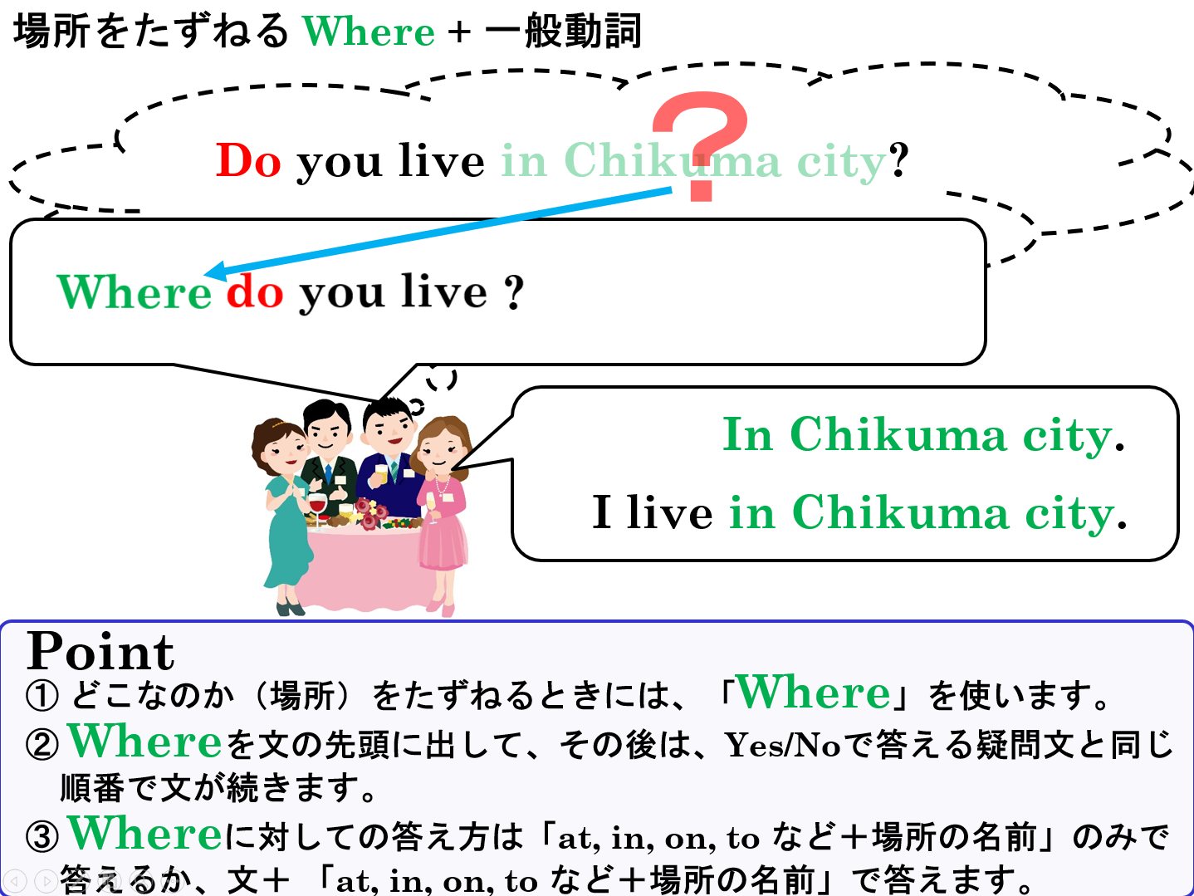

Slide 14
Where
+ 一般動詞

