Slide 1
Where
+ be動詞

Slide 2
Looking for things
物を探そう

Slide 3
What’s this?
It’s a desk.

Slide 4

What’s this?
It’s a book.

Slide 5
Where is the book?
It’s on the desk.

Slide 6
Where is the book?
It’s under the desk.

Slide 7
Where is the book?
It’s by the desk.

Slide 8
Where is the book?
It’s by the desk.

Slide 9
Where is the book?
It’s on the table.

Slide 10
Where is the book?
It’s under the table.

Slide 11
Where is the book?
It’s by the table.

Slide 12
Where is the cat?
It’s on the desk.

Slide 13
Where is the cat?
It’s under the desk.

Slide 14
Where is the cat?
It’s by the desk.

Slide 15
Where is the cat?
It’s by the box.

Slide 16
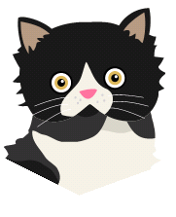
Where is the cat?
It’s in the box.

Slide 17

Where is the ball?
It’s in the box.

Slide 18

Where is my pen?
It’s in the box.

Slide 19
Where is my pen?
It’s on the desk.

Slide 20
Where is my pen?
It’s under the desk.

Slide 21
Where is my pen?
It’s by the desk.

Slide 22
Where is my pen?
It’s by the desk.

Slide 23
Where is my watch?
It’s on the desk.

Slide 24
Where is my watch?
It’s under the desk.

Slide 25
Where is my watch?
It’s by the desk.

Slide 26

Where is my watch?
It’s in the box.

Slide 27
Where

Slide 28
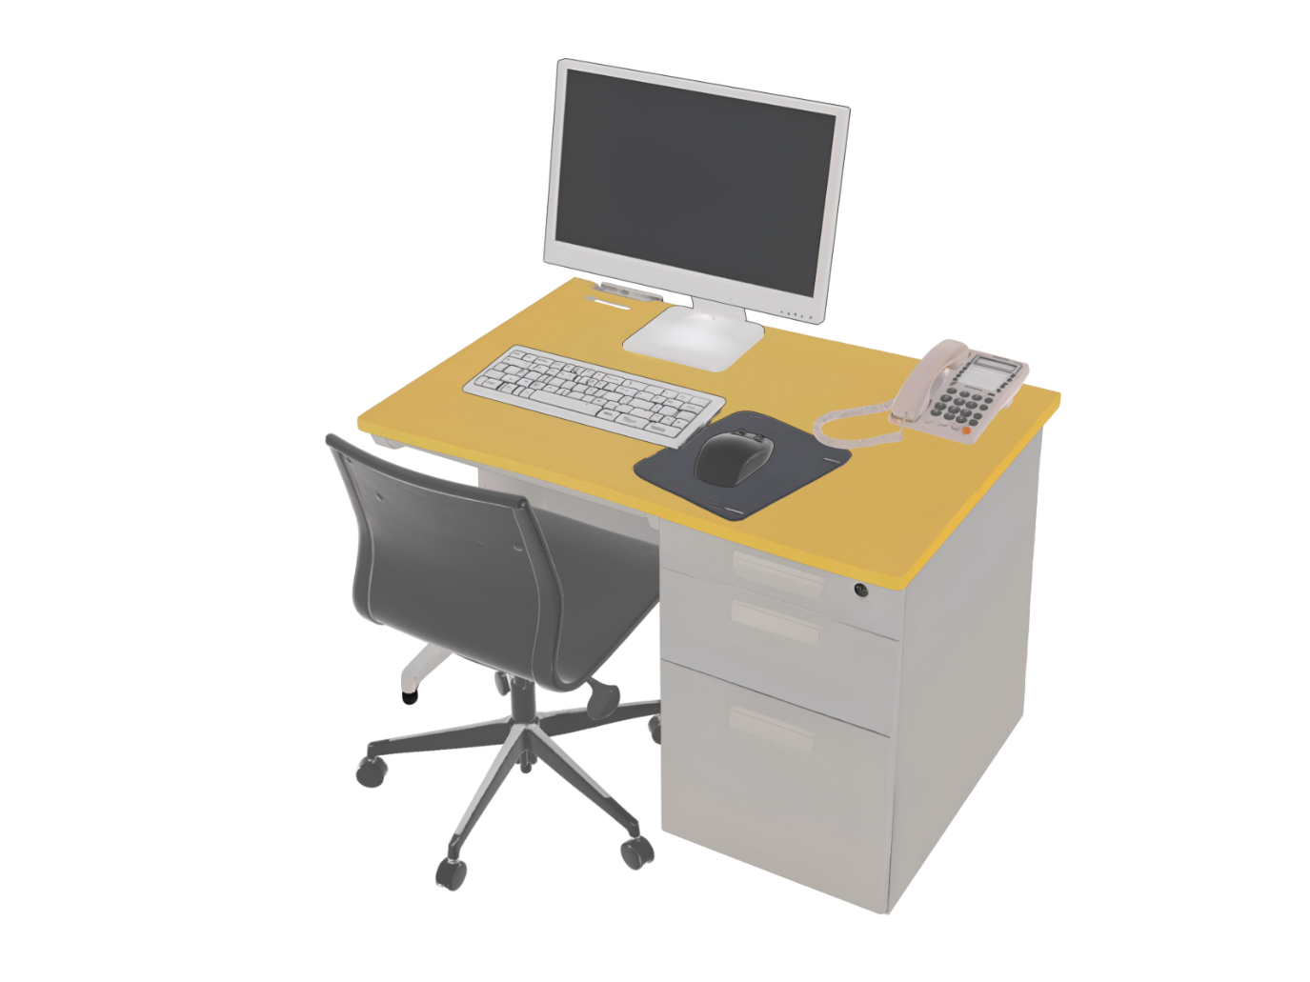
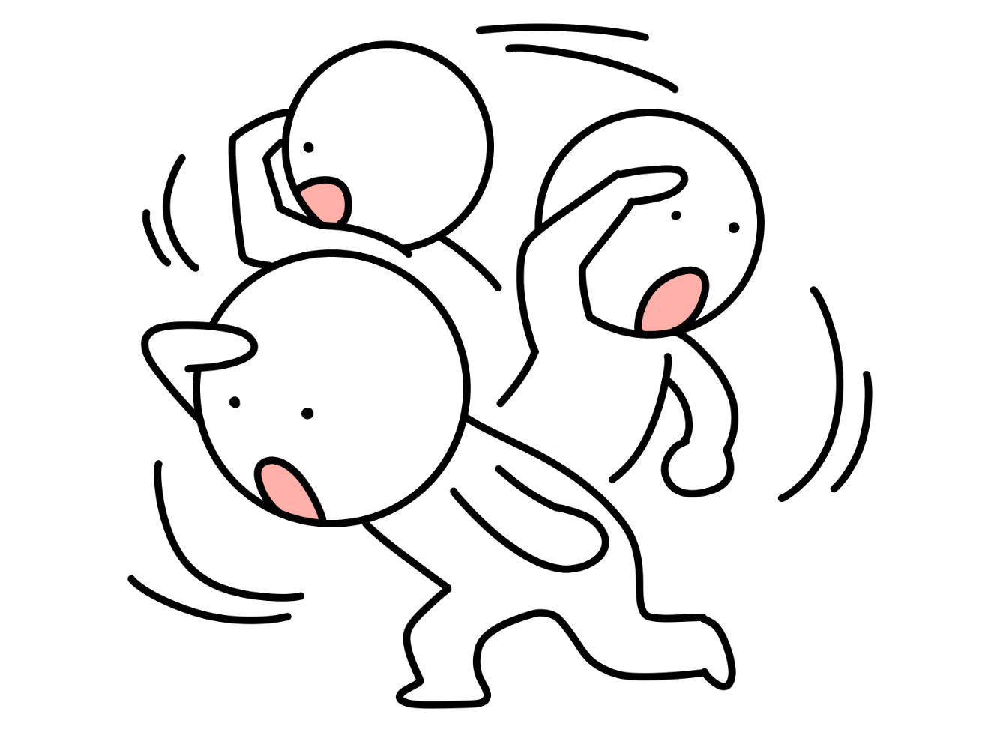

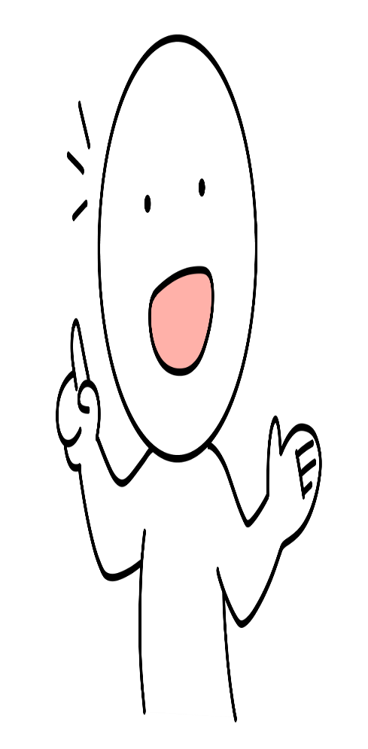
Where is the key?
It is on the desk.

Slide 29


場所をたずねる Where + be動詞
Is
the key is on the desk?
The key is on the desk.
？
is the key
Where
?
It is on the desk.
Point
① どこなのか場所をたずねるときには、「Where」を使います。
② Whereを文の先頭に出して、その後は、Yes/Noで応える疑問文と同じ語順で
文が続きます。
③ 答えるときは、場所の前置詞「in, on, under, by, near など」＋場所で答えます。
＊in ～中に, on ～の上に, under ～の下に, by ～のそばに, near ～の近くに

Slide 30
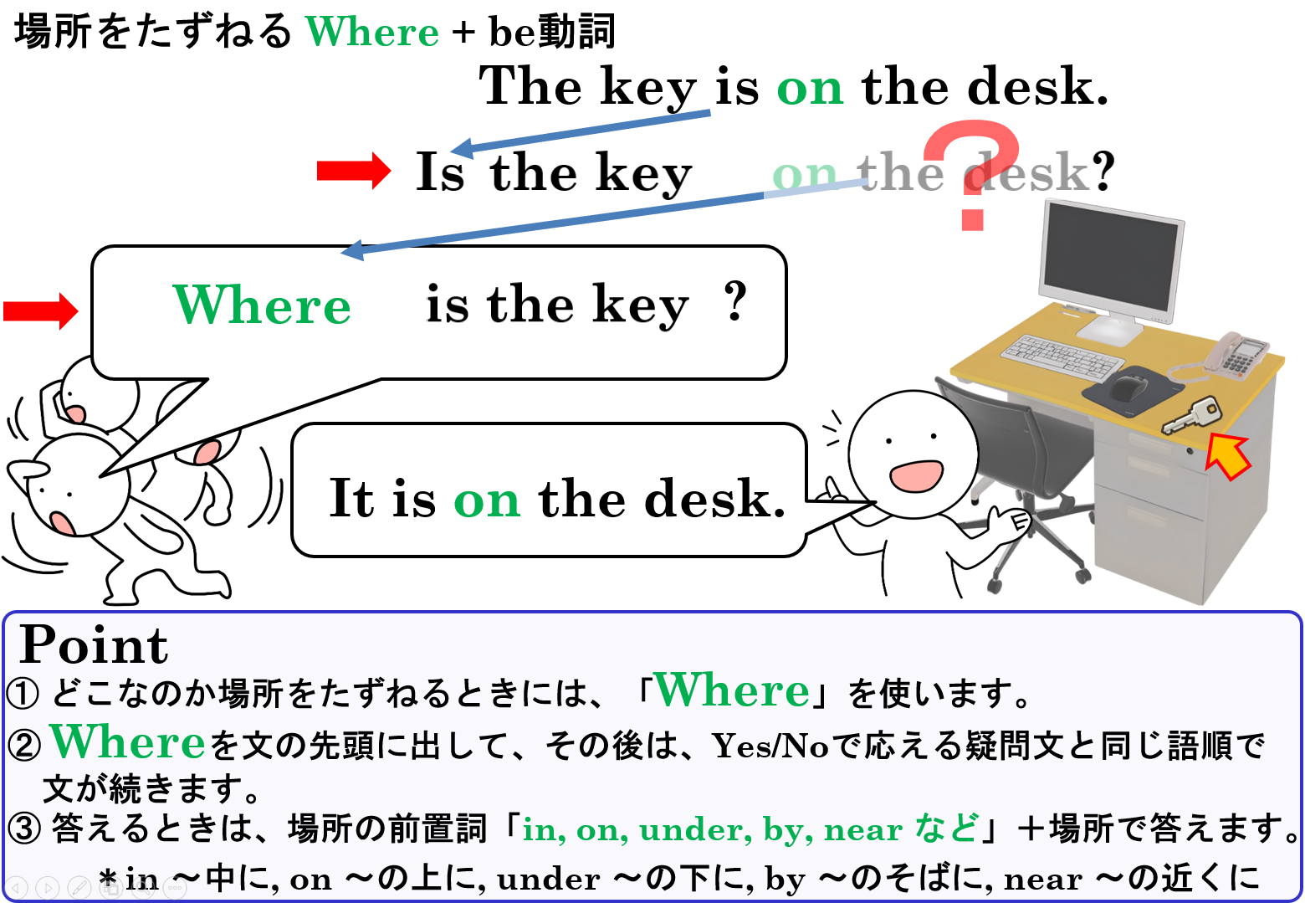

Slide 31
Where
+ be動詞

