Slide 1
When
一般動詞

Slide 2
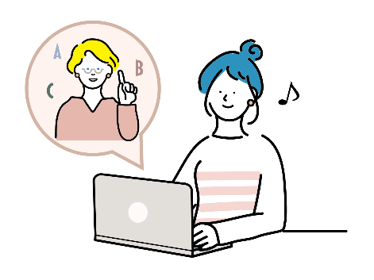
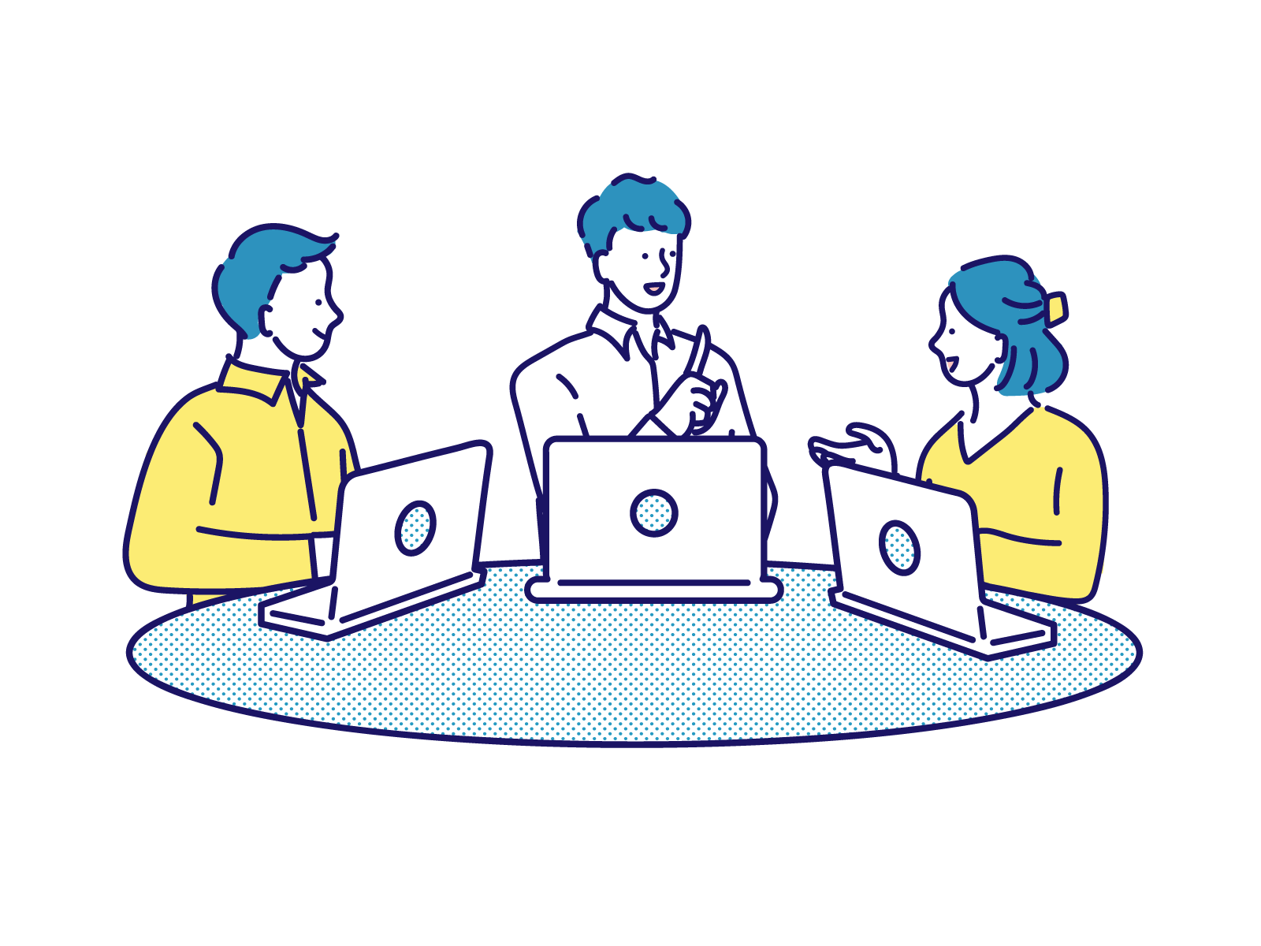
？

Slide 3
Do you have English lessons?
Yes, I do.

Slide 4
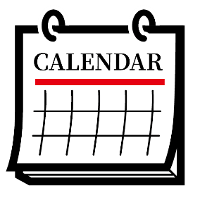
？

Slide 5
When
do you have English lessons?
On Mondays.
You have English lessons on Mondays.

Slide 6

いつなのかをたずねる When
？
When
Do you have English lessons on Mondays?
do you have English lessons on Mondays?
?
?
On Mondays.
Point
① いつなのかときをたずねるときには、「When」を使います。
② Whenを文の先頭に出して、その後は、Yes/Noで応える疑問文と同じ
順番で文が続きます。
③ Whenに対しては、時刻だけでなく、時刻以外の答え方ができます。
また、時刻を答えとして求めるのなら「What time」とたずねます。

Slide 7
When
一般動詞

Slide 8
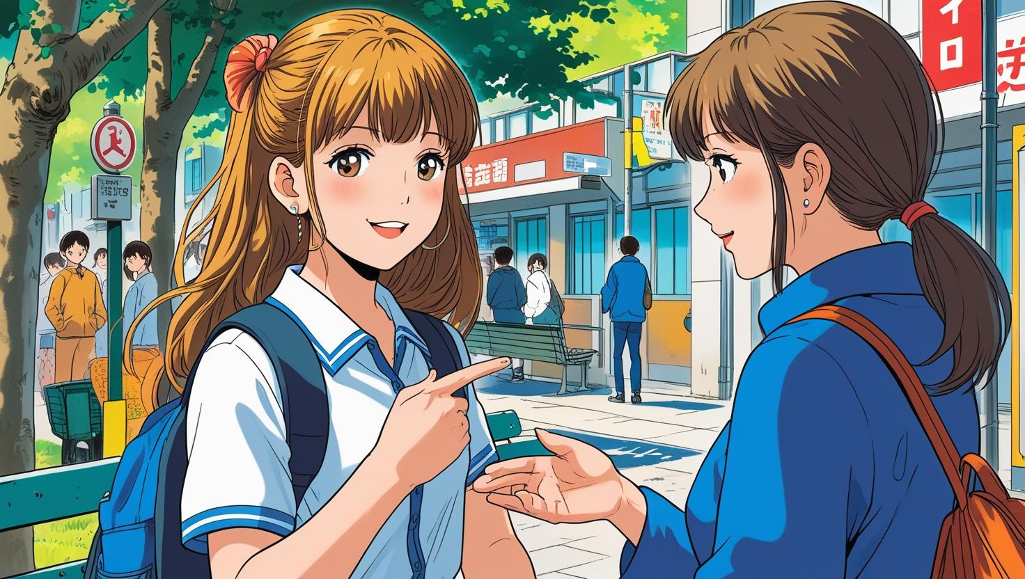
You play tennis on Sundays.
( Do ) you play tennis on Sundays?
Do
When
do
( When ) ( do ) you play tennis?
( On ) Sundays.
On

Slide 9
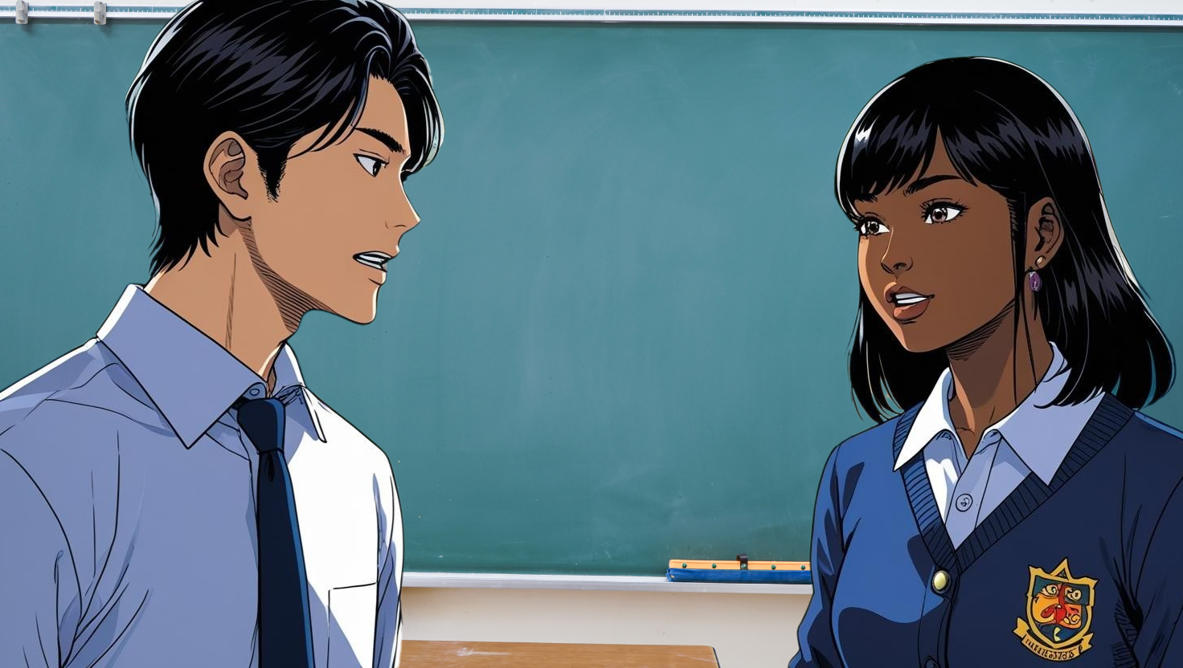
You eat breakfast at 7:00.
( Do ) you eat breakfast at 7:00?
Do
When
do
( When ) ( do ) you eat breakfast?
I ( eat ) breakfast ( at ) 7:00 .
eat
at

Slide 10
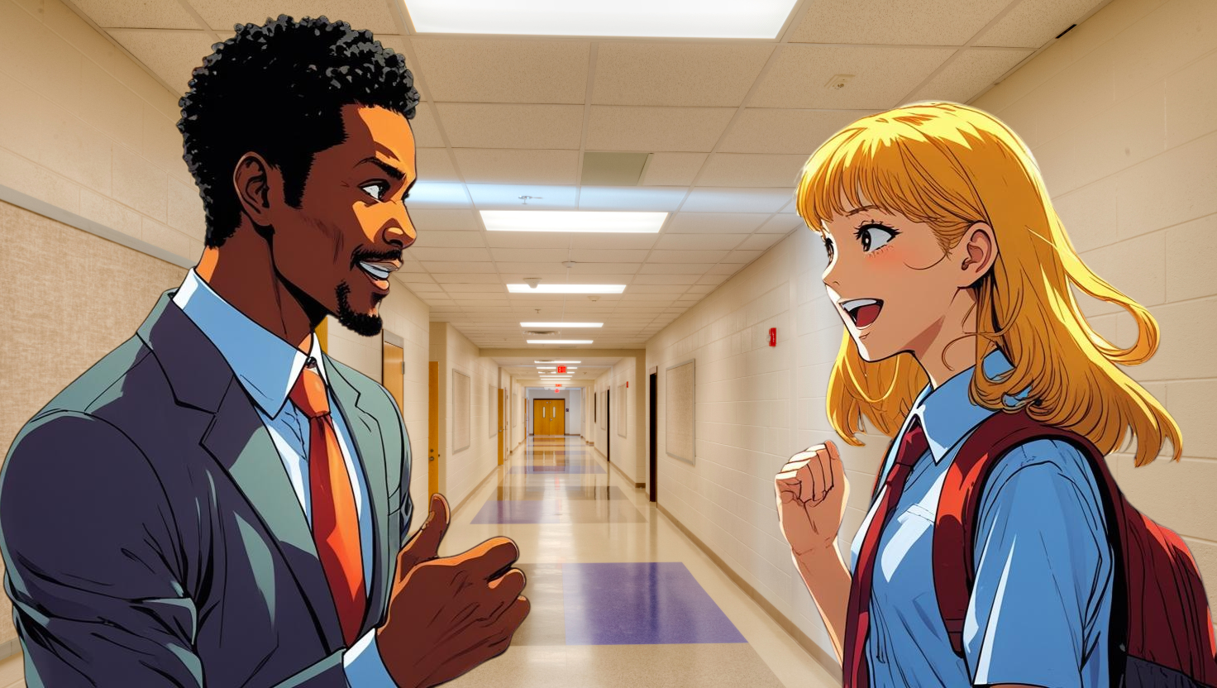
You want to visit Kyoto in autumn.
( Do ) you want to visit Kyoto in autumn?
Do
When
do
( When ) ( do ) you want to visit Kyoto?
visit
I ( want ) to ( visit ) Kyoto ( in ) autumn.
want
in

Slide 11
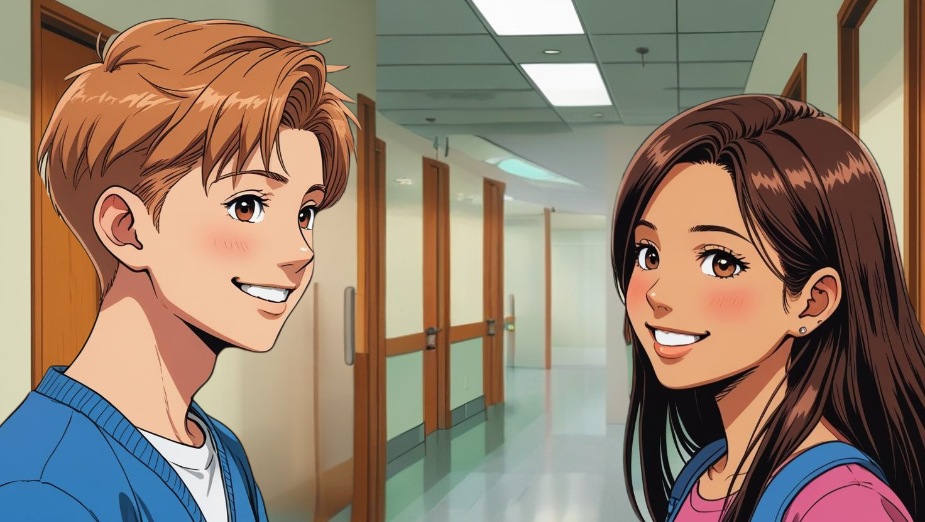
You play video games
after your homework.
( Do ) you play video games
after your homework?
Do
( When ) ( do ) you play video games?
When
do
play
I ( play ) them ( after) my ( homework ).
after
homework

Slide 12
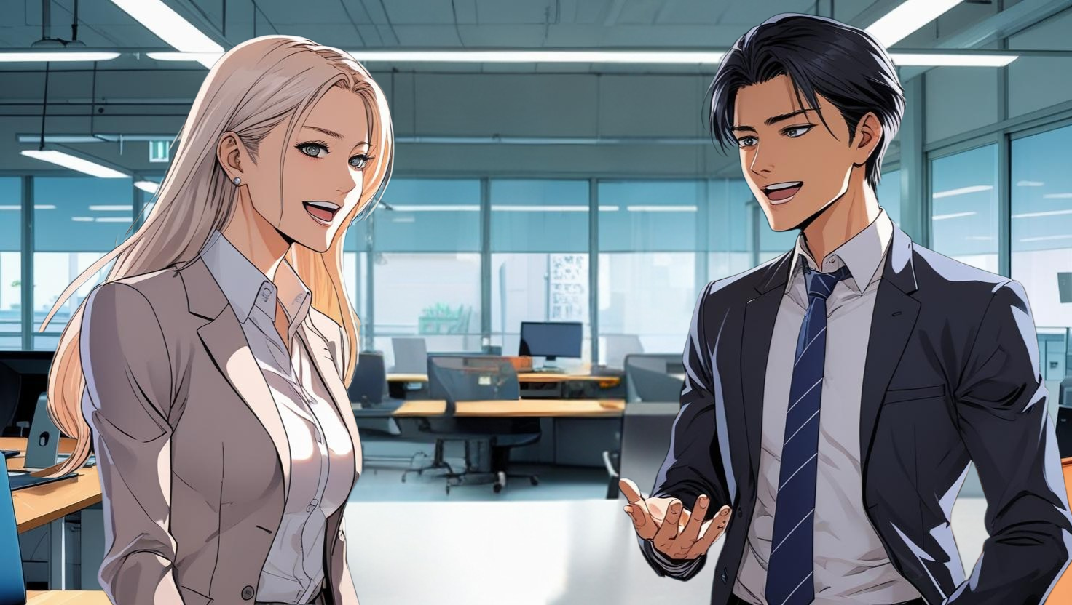
You can go to Tokyo in summer.
( Can ) you can go to Tokyo in summer?
Can
can
( When ) ( can ) you go to Tokyo?
When
can
I ( can ) ( go ) to Tokyo ( in ) summer.
go
in

Slide 13
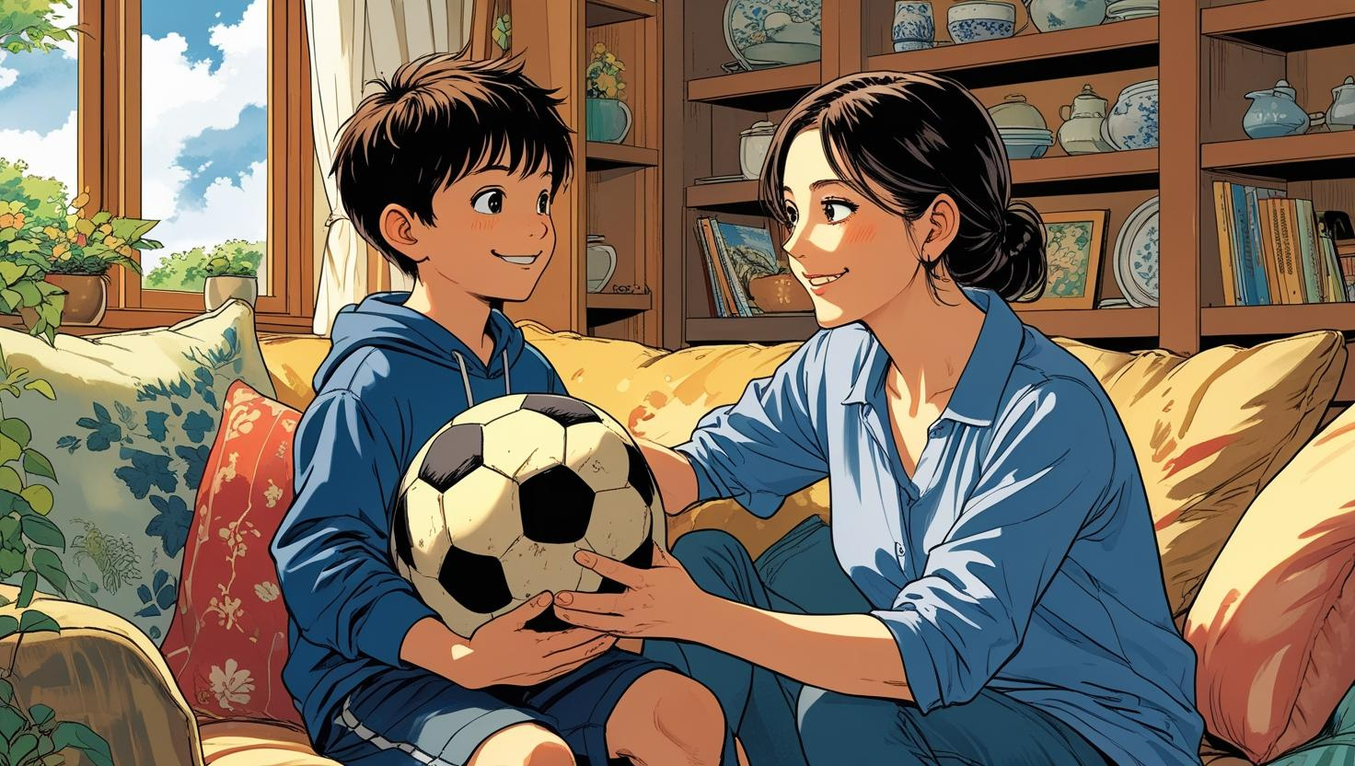
I can play soccer on Saturday afternoon.
Can
( Can ) I can play soccer on Saturday afternoon?
can
( When ) ( can ) I play soccer?
When
can
play
You ( eat ) ( play ) soccer
( on ) Saturday afternoon.
on

Slide 14
When
一般動詞

Slide 15
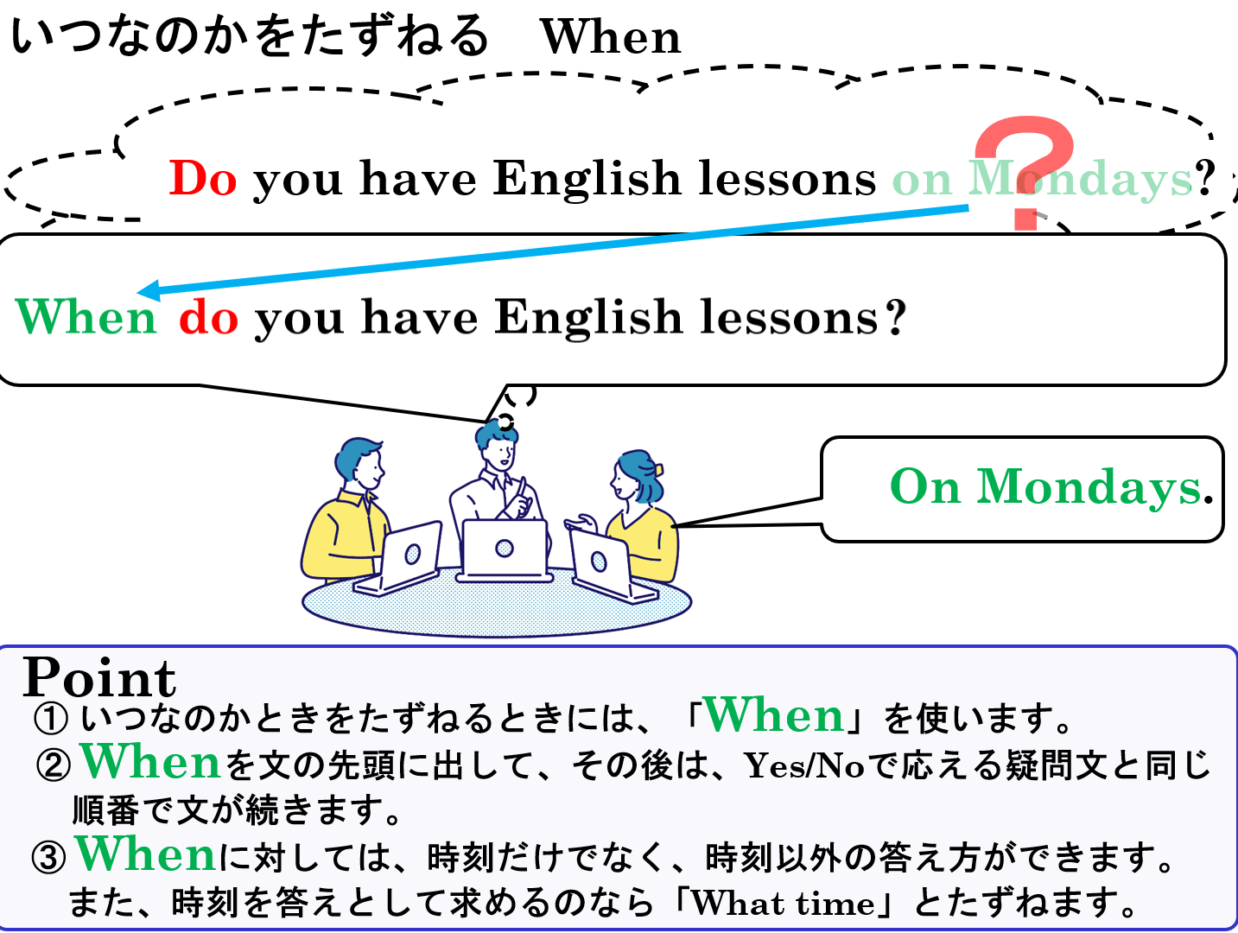

Slide 16
When
一般動詞

