Slide 1
What time
一般動詞

Slide 2
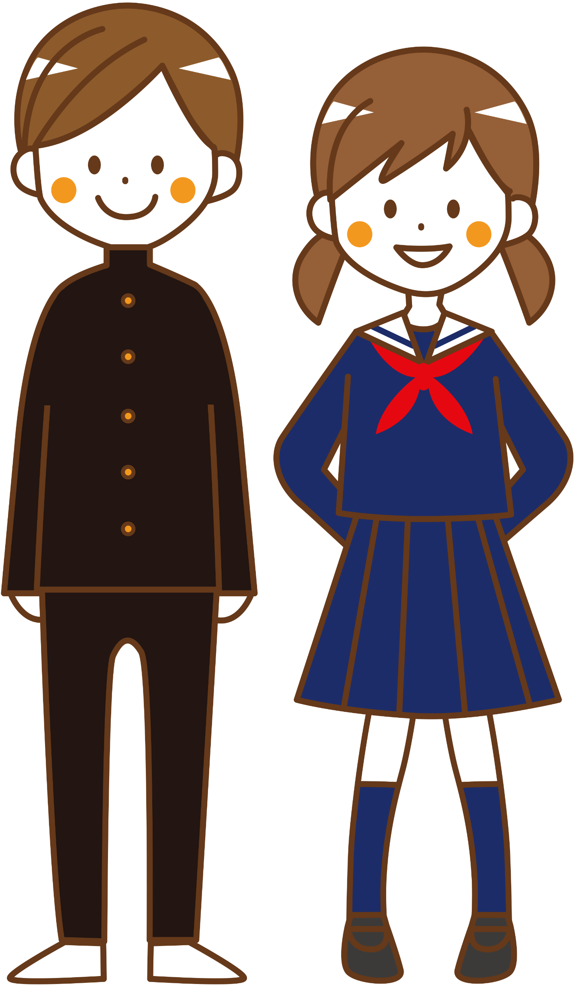
I want to leave early
tomorrow morning.

Slide 3
Do you usually get up
around six?
No, I don’t.

Slide 4
What time do you get up?
I get up at 5:30.

Slide 5
I can leave at 6:30.

Slide 6
時刻をたずねる What time（一般動詞）
?
?
Do you get up at 5:30?
do you get up
What time
I get up at 5:30.
Point
① 時刻をたずねるときには、「What time」を使います。
② What timeを文の先頭に出して、その後は、Yes/Noで応える疑問文
と同じ順番で文が続きます。
② What timeに対する答えは、At / About / Around 時刻 と時刻のみについて答えるか、または、文＋ at / about / around 時刻 と答えます。

Slide 7
What time
一般動詞

Slide 8

You eat breakfast at 6:30.
( Do ) you eat breakfast at 6:30?
Do
( What ) ( time )( do ) you eat breakfast?
What
time
do
eat
at
I ( eat ) breakfast ( at ) 6:30.

Slide 9

You leave home for school at 7:30.
( Do ) you leave home for school at 7:30?
Do
( What ) ( time )( do )
you leave home for school?
What
time
do
at
I ( want ) home for school ( at ) 7:30.
leave

Slide 10

You finish work at 18:00 today.
( Do ) you finish work at 18:00 today?
Do
( What ) ( time )( do )
you finish work today?
What
time
do
I ( finish ) work ( at ) 18:00.
finish
at

Slide 11

You want to go to bed at 23:00 on Fridays.
( Do ) you want to go to bed at 23:30 on Fridays?
Do
( What ) ( time )( do ) you want to go to bed
on Fridays?
What
time
do
want
to
at
I ( want )( to )( go ) to bed ( at ) 23:30.
go

Slide 12
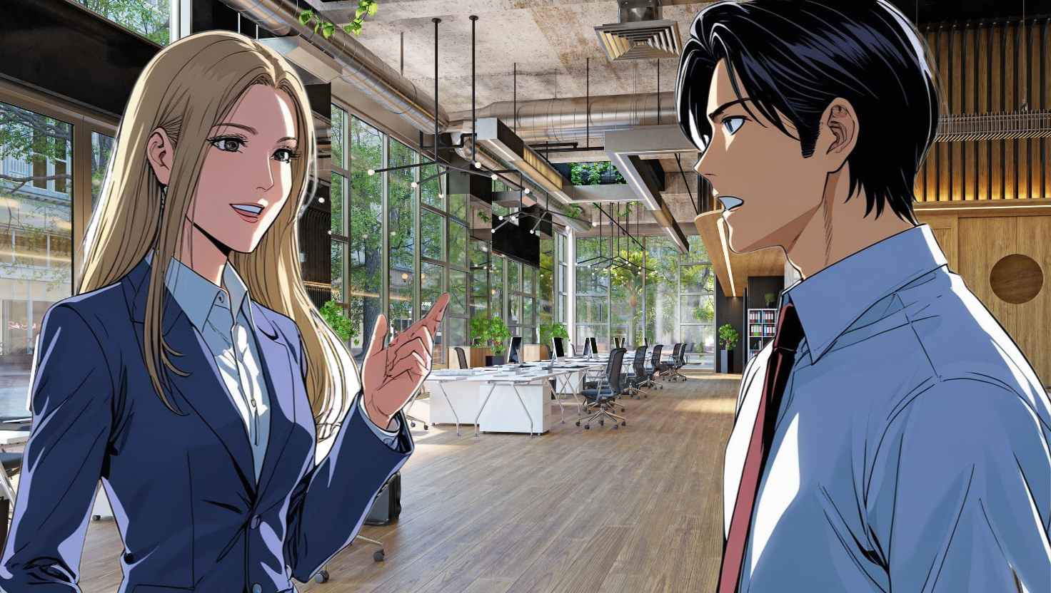
You can get up at 6:00.
( Can ) you can get up at 6:00?
Can
( What ) ( time )
( can ) you can get up?
What
time
can
can
get
up
I ( can )( get ) up ( at ) 6:00.

Slide 13
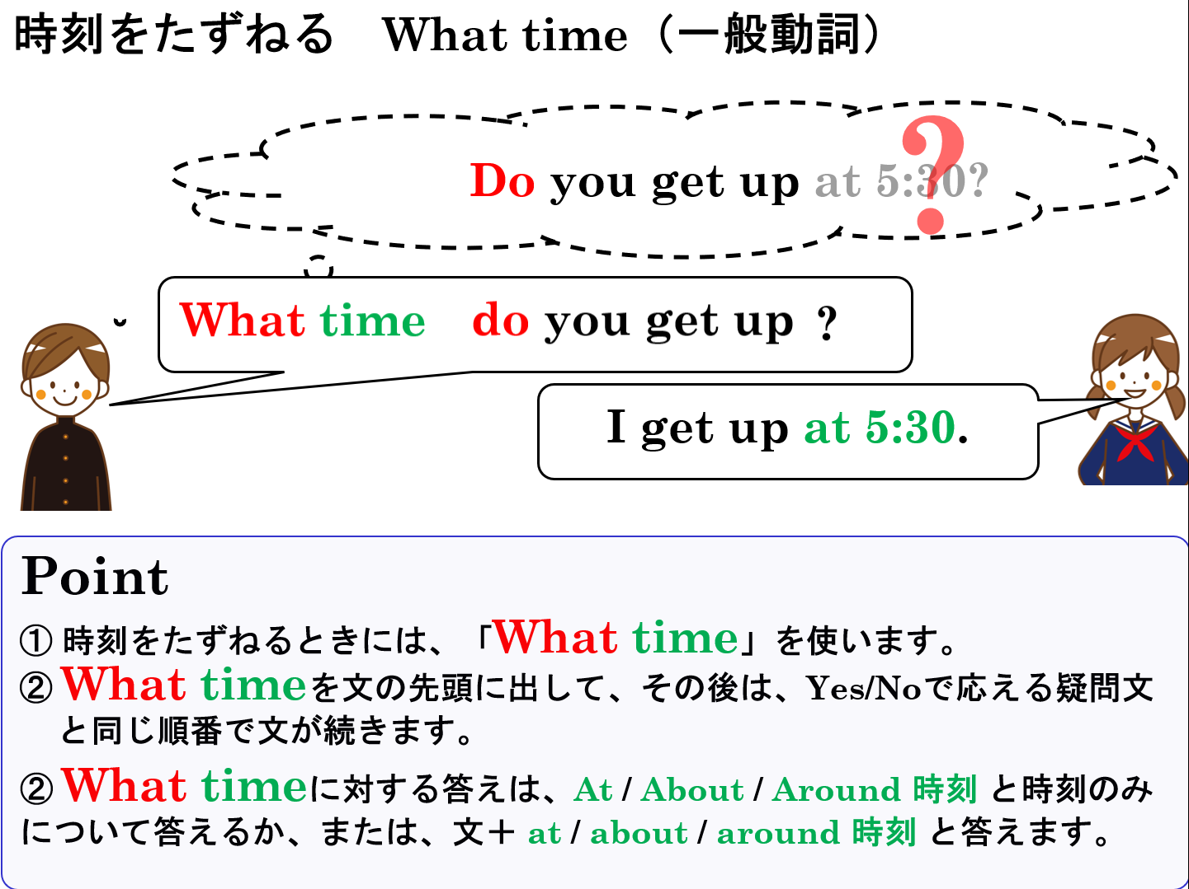

Slide 14
What time
一般動詞

