Slide 1
What time ～?
How to know the time

Slide 2
Review of Numbers

Slide 3
1 | 2 | 3 | 4 | 5 | 6 | 7 | 8 | 9 | 10
11 | 12 | 13 | 14 | 15 | 16 | 17 | 18 | 19 | 20
21 | 22 | 23 | 24 | 25 | 26 | 27 | 28 | 29 | 30
31 | 32 | 33 | 34 | 35 | 36 | 37 | 38 | 39 | 40
41 | 42 | 43 | 44 | 45 | 46 | 47 | 48 | 49 | 50
51 | 52 | 53 | 54 | 55 | 56 | 57 | 58 | 59 | 60

Slide 4
1
11
21
31
41
51

Slide 5
1 | 2
11 | 12
21 | 22
31 | 32
41 | 42
51 | 52

Slide 6
1 | 2 | 3
11 | 12 | 13
21 | 22 | 23
31 | 32 | 33
41 | 42 | 43
51 | 52 | 53

Slide 7
1 | 2 | 3 | 4
11 | 12 | 13 | 14
21 | 22 | 23 | 24
31 | 32 | 33 | 34
41 | 42 | 43 | 44
51 | 52 | 53 | 54

Slide 8
1 | 2 | 3 | 4 | 5
11 | 12 | 13 | 14 | 15
21 | 22 | 23 | 24 | 25
31 | 32 | 33 | 34 | 35
41 | 42 | 43 | 44 | 45
51 | 52 | 53 | 54 | 55

Slide 9
1 | 2 | 3 | 4 | 5 | 6
11 | 12 | 13 | 14 | 15 | 16
21 | 22 | 23 | 24 | 25 | 26
31 | 32 | 33 | 34 | 35 | 36
41 | 42 | 43 | 44 | 45 | 46
51 | 52 | 53 | 54 | 55 | 56

Slide 10
1 | 2 | 3 | 4 | 5 | 6 | 7
11 | 12 | 13 | 14 | 15 | 16 | 17
21 | 22 | 23 | 24 | 25 | 26 | 27
31 | 32 | 33 | 34 | 35 | 36 | 37
41 | 42 | 43 | 44 | 45 | 46 | 47
51 | 52 | 53 | 54 | 55 | 56 | 57

Slide 11
1 | 2 | 3 | 4 | 5 | 6 | 7 | 8
11 | 12 | 13 | 14 | 15 | 16 | 17 | 18
21 | 22 | 23 | 24 | 25 | 26 | 27 | 28
31 | 32 | 33 | 34 | 35 | 36 | 37 | 38
41 | 42 | 43 | 44 | 45 | 46 | 47 | 48
51 | 52 | 53 | 54 | 55 | 56 | 57 | 58

Slide 12
1 | 2 | 3 | 4 | 5 | 6 | 7 | 8 | 9
11 | 12 | 13 | 14 | 15 | 16 | 17 | 18 | 19
21 | 22 | 23 | 24 | 25 | 26 | 27 | 28 | 29
31 | 32 | 33 | 34 | 35 | 36 | 37 | 38 | 39
41 | 42 | 43 | 44 | 45 | 46 | 47 | 48 | 49
51 | 52 | 53 | 54 | 55 | 56 | 57 | 58 | 59

Slide 13
1 | 2 | 3 | 4 | 5 | 6 | 7 | 8 | 9 | 10
11 | 12 | 13 | 14 | 15 | 16 | 17 | 18 | 19 | 20
21 | 22 | 23 | 24 | 25 | 26 | 27 | 28 | 29 | 30
31 | 32 | 33 | 34 | 35 | 36 | 37 | 38 | 39 | 40
41 | 42 | 43 | 44 | 45 | 46 | 47 | 48 | 49 | 50
51 | 52 | 53 | 54 | 55 | 56 | 57 | 58 | 59 | 60

Slide 14
What time is it?

Slide 15
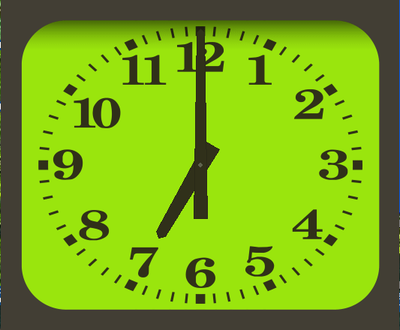
What time is it?
It’s seven.

Slide 16
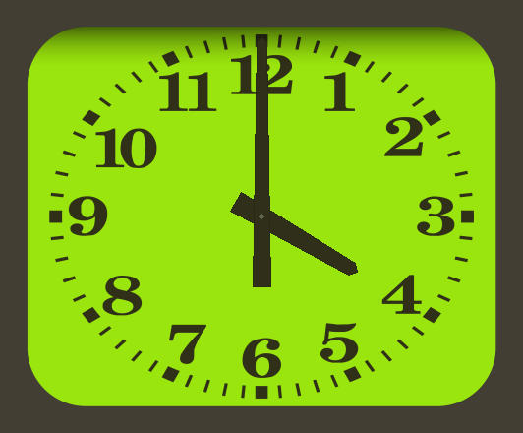
What time is it?
It’s four.

Slide 17
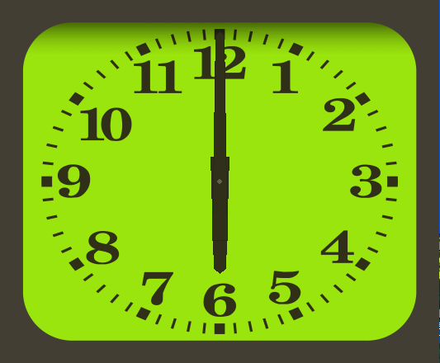
What time is it?
It’s six.

Slide 18
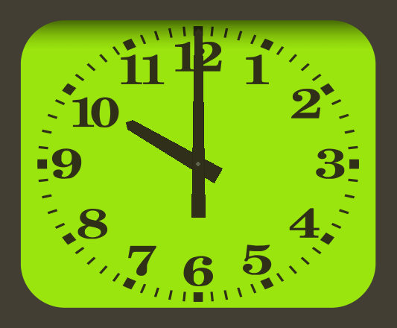
What time is it?
It’s ten.

Slide 19
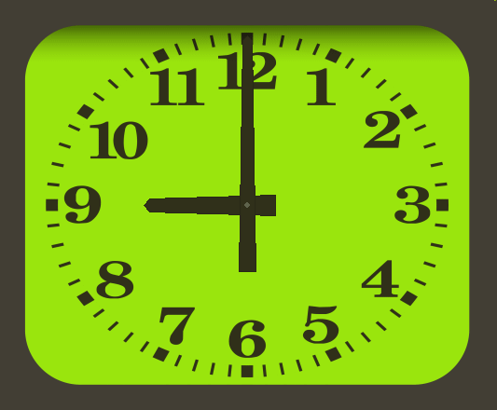
What time is it?
It’s nine.

Slide 20
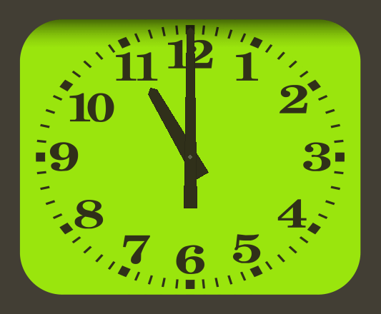
What time is it?
It’s eleven.

Slide 21
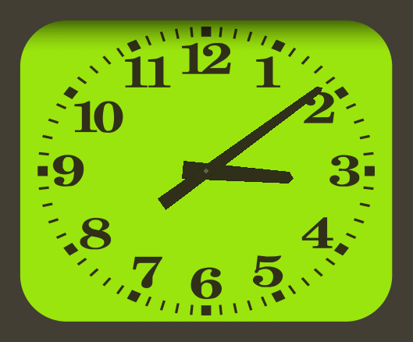
What time is it?
It’s three nine. (It’s 3:09.)

Slide 22
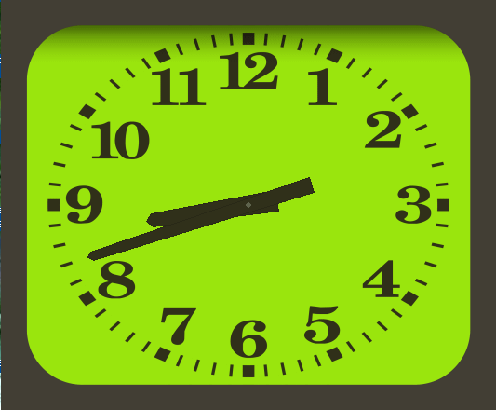
What time is it?
It’s eight forty-two. (It’s 8:42.)

Slide 23
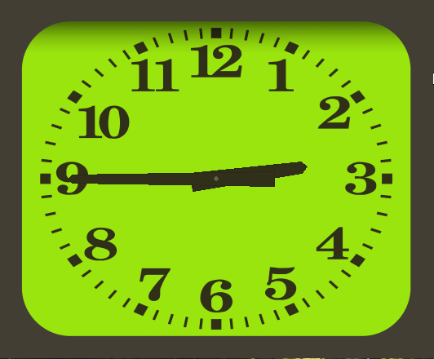
What time is it?
It’s two forty-five. (It’s 2:45.)

Slide 24
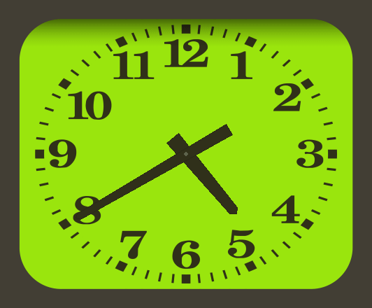
What time is it?
It’s four forty. (It’s 4:40.)

Slide 25
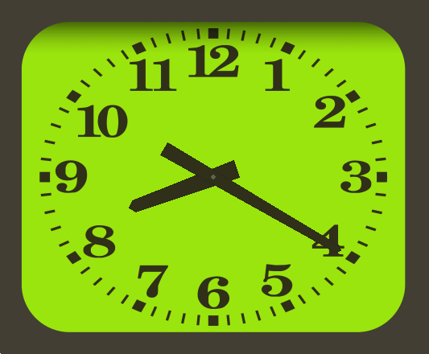
What time is it?
It’s eight twenty. (It’s 8:20.)

Slide 26
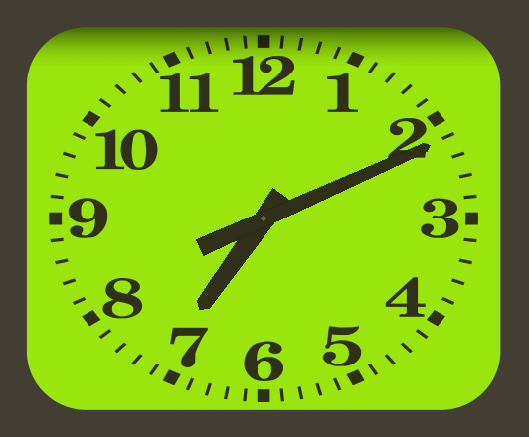
What time is it?
It’s seven eleven. (It’s 7:11.)

Slide 27
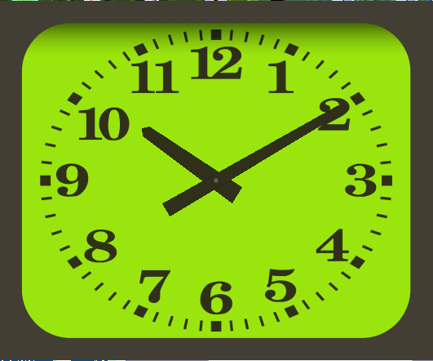
What time is it?
It’s ten ten. (It’s 10:10.)

Slide 28
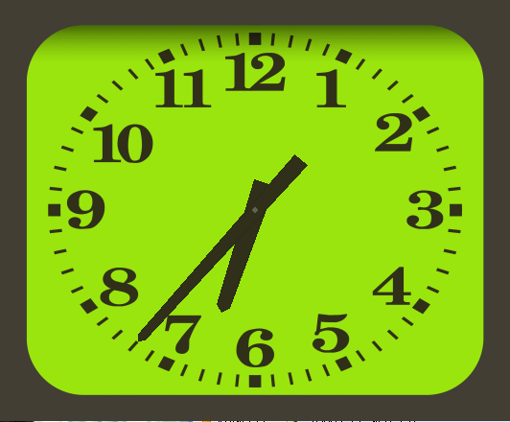
What time is it?
It’s six thirty-seven. (It’s 6:37.)

Slide 29
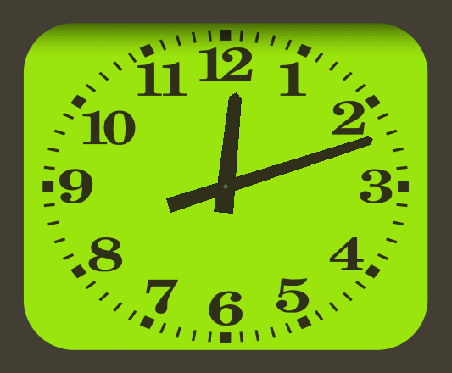
What time is it?
It’s twelve twelve. (It’s 12:12.)

Slide 30
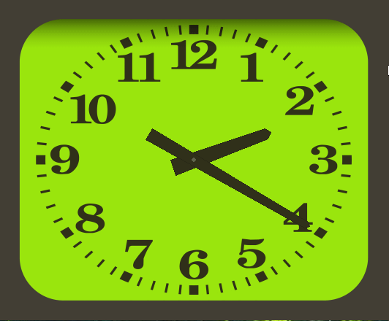
What time is it?
It’s two twenty. (It’s 2:20.)

Slide 31
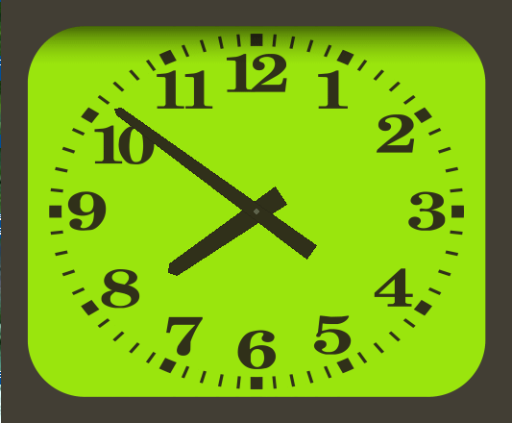
What time is it?
It’s seven fifty-one. (It’s 7:51.)

Slide 32
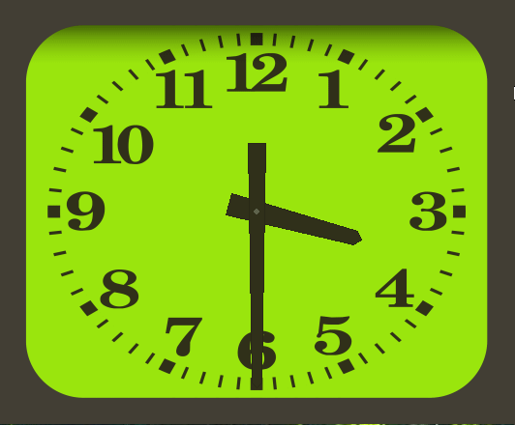
What time is it?
It’s three thirty. (It’s 3:30.)

Slide 33
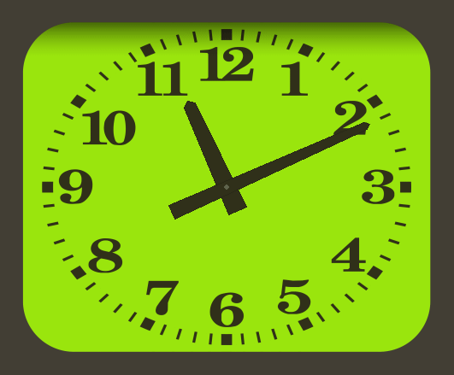
What time is it?
It’s eleven eleven. (It’s 11:11.)

Slide 34
What time is it now?
It’s __________ o’clock.
It’s __________ in the morning.
It’s __________ in the afternoon.
It’s __________ in the evening.
It’s __________ a.m.
It’s __________ p.m.

Slide 35
What time is it now?
午前
It’s four in the morning.

Slide 36
What time is it now?
午後
It’s four in the afternoon.

Slide 37
What time is it now?
午前
It’s seven in the morning.

Slide 38
What time is it now?
夕方
It’s seven in the evening.

Slide 39
What time is it?
午前
It’s six in the morning.

Slide 40
What time is it?
夕方
It’s six in the evening.

Slide 41
What time is it now?
午前
It’s ten a.m.

Slide 42
What time is it now?
午後
It’s ten p.m.

Slide 43
What time

Slide 44
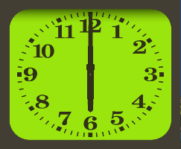
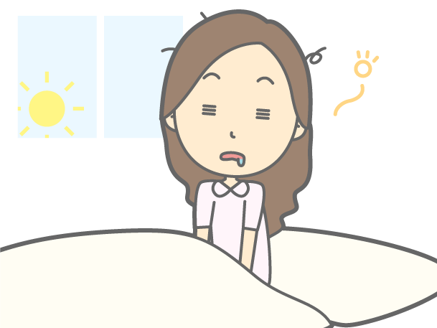

?
It is six.
Is it six?
No, it is not.

Slide 45
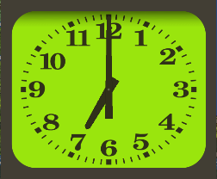
?
It is six .
it
is
What time
?
It’s seven.

Slide 46

時刻をたずねる What time
?
It is six .
it
is
What time
?
It’s seven.
Point
① 時刻をたずねるときには、「What time」を使います。
② What timeを文の先頭に出して、その後は、Yes/Noで応える疑問文
と同じ順番で文が続きます。
③ 答えるときには、「It is 時刻.」で答えます。また、時刻は数字になので、
It is three. などと答えたときに、何の数かはっきりさせるために、
「It is 時刻 o’clock.」と「o’clock」とつけることがあります。o’clockは、
on the clockの省略されたものです。
④ 時刻の後に、午前・午後などがわかるように次のものをつけることがあり
ます。 in the morning / in the afternoon / in the evening /
at night / a.m. / p.m.

Slide 47
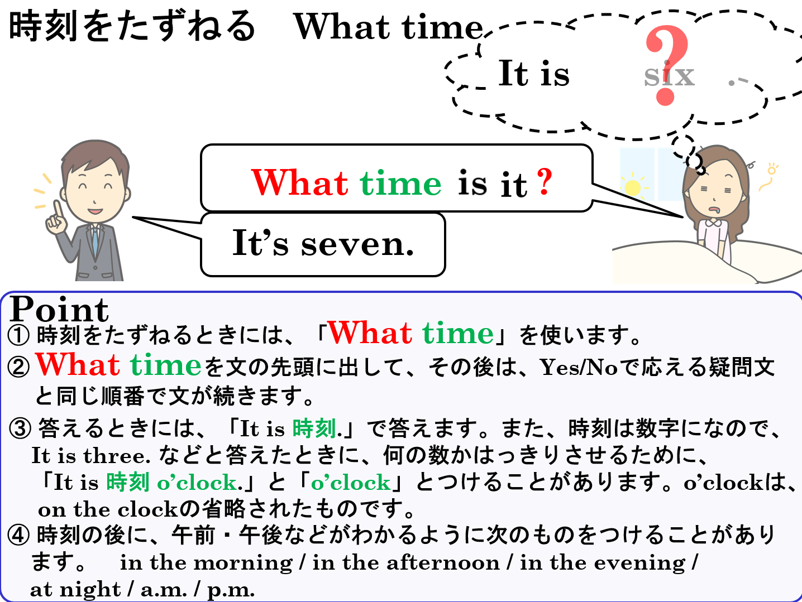

Slide 48
What time

