Slide 1
What + 名詞

Slide 2
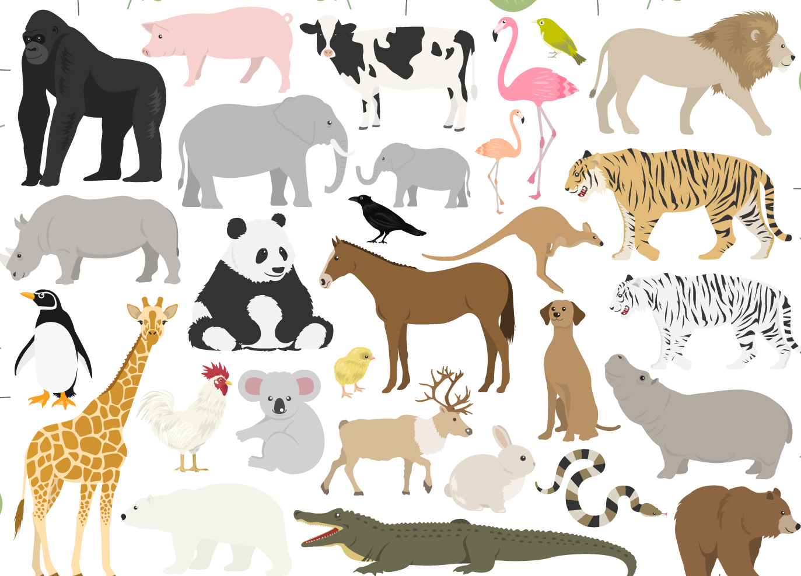
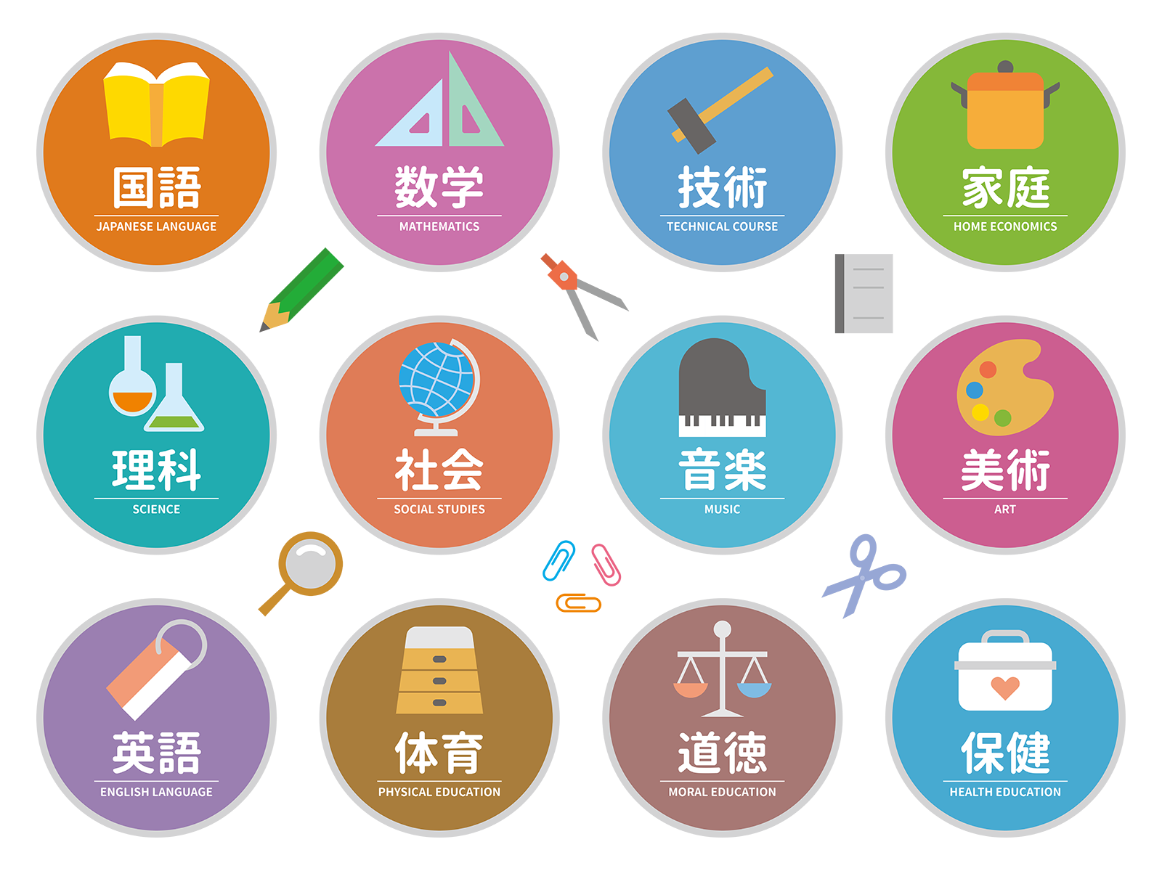

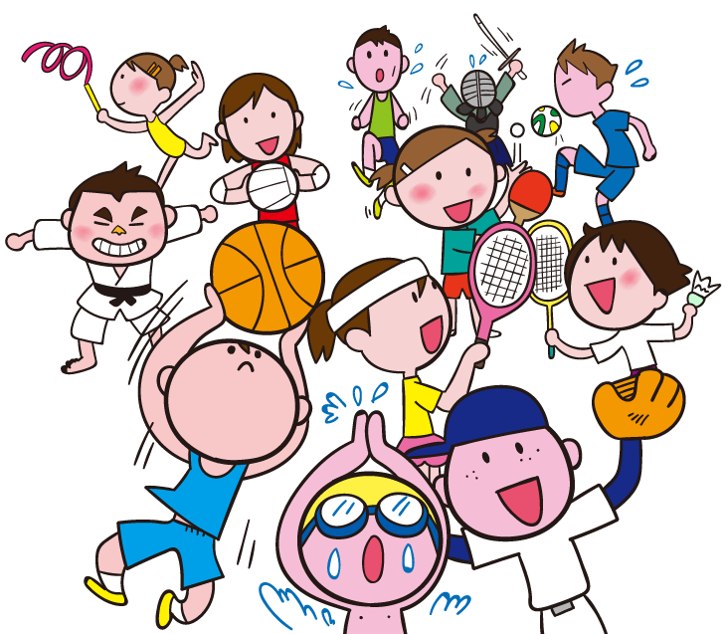
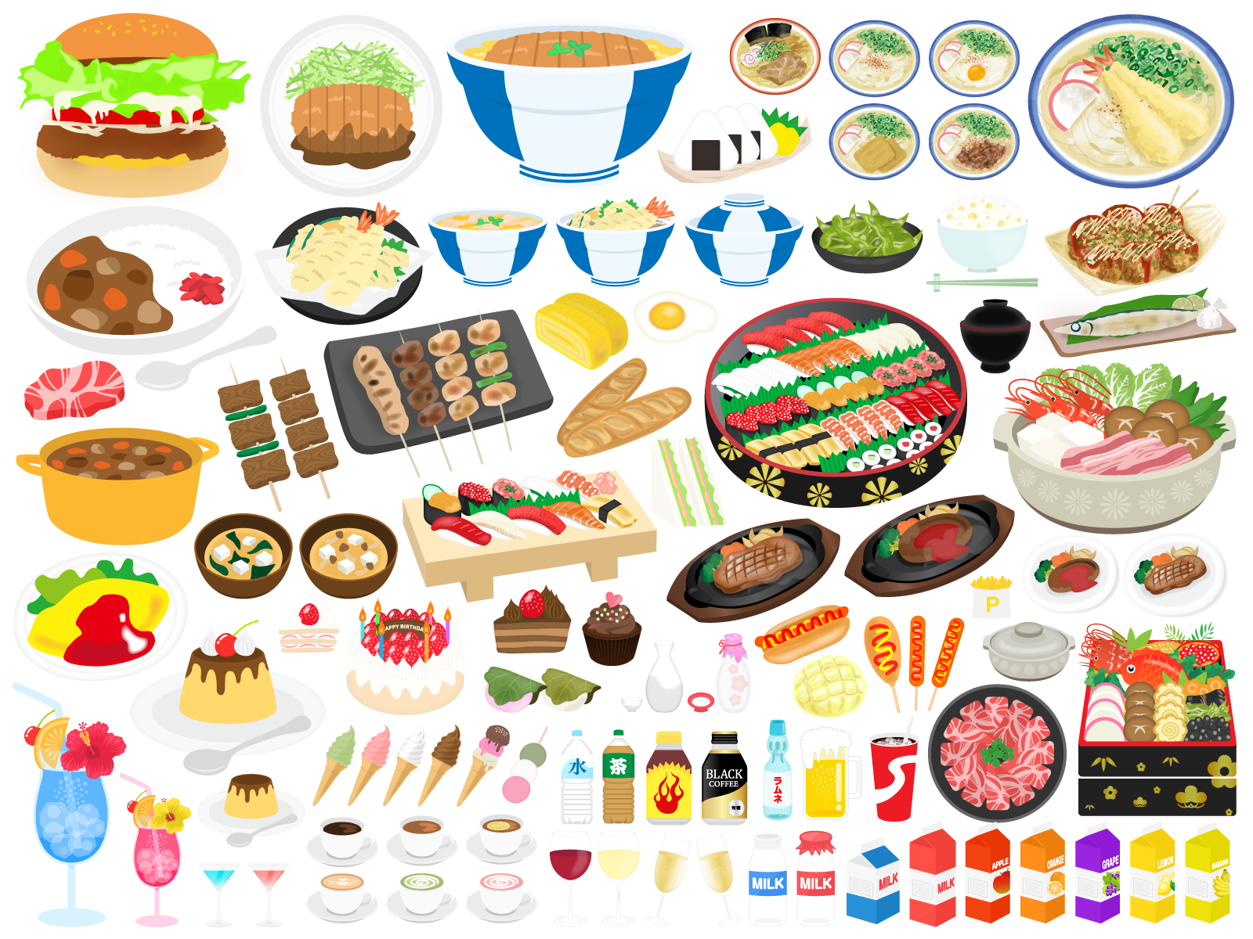

What do you like?
cats,
I like
tennis,
shushi,
PE
and so on…

Slide 5
What sport do you like?
I like tennis.

Slide 7
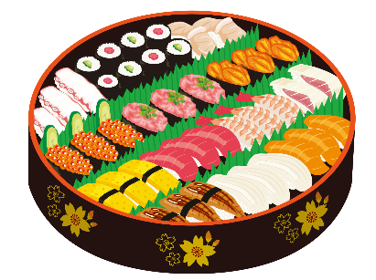

Slide 8
What food do you like?
I like sushi.

Slide 9
What + 名詞 ～? 話題のカテゴリーを指定する質問の仕方
What do you like?
I like tennis, cats, PE...
What sports do you like?
I like tennis.
Point
① 「What」で質問をすると話題の範囲が広くなってしまうので、話題の
カテゴリー（範囲）を指定した質問をするには「What + 名詞」を使います。
② 「What + 名詞」を文の先頭に出して、その後は、Yes/Noで答える疑問文
と同じ順番で文が続きます。
つまり、What + Yes / No疑問文? → What + 名詞 + Yes / No疑問文? と
なります。

Slide 10
What + 名詞

Slide 12


You like English.
( Do ) you like English?
Do
( What ) subject ( do ) you like?
What
do
like
I ( like ) English.

Slide 13

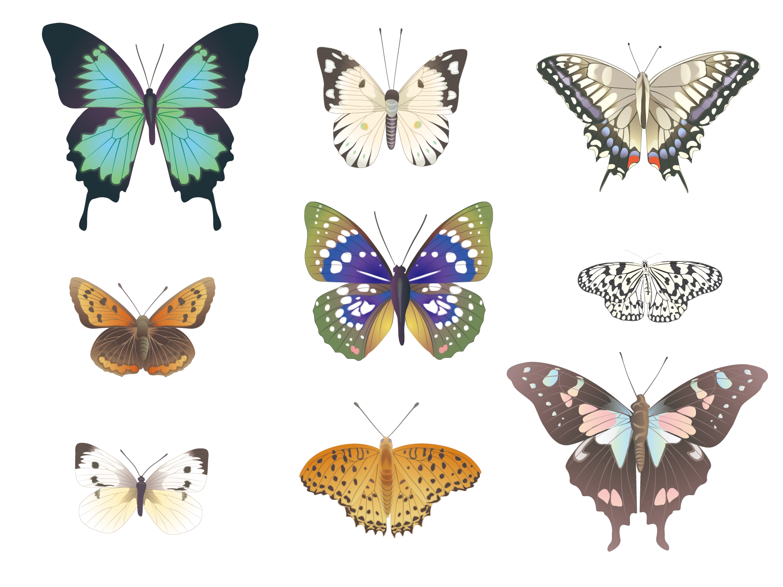
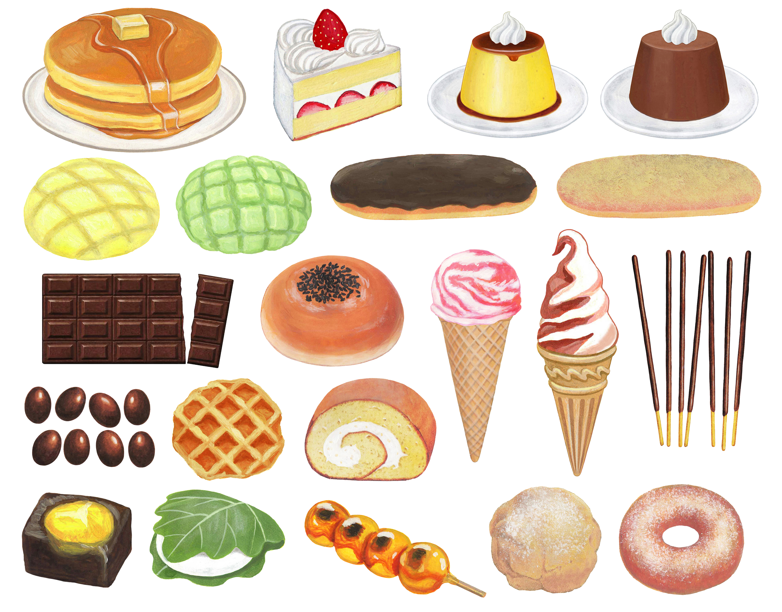


Slide 14
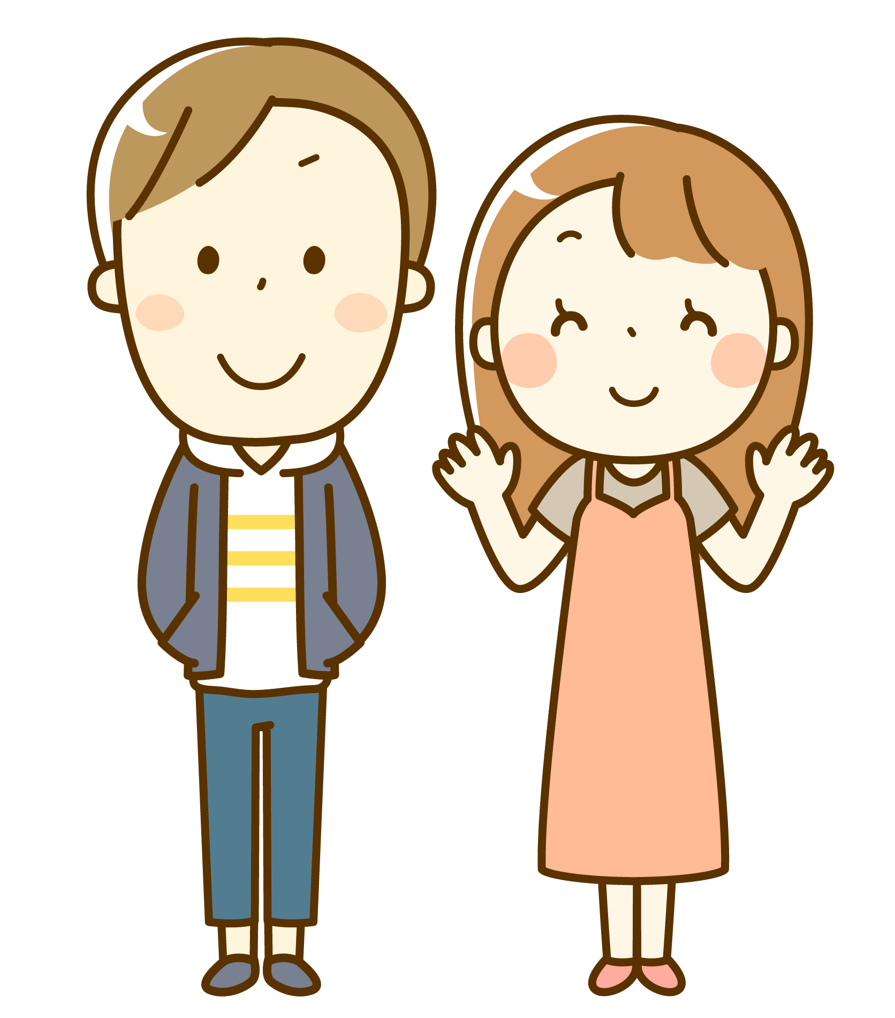
You like yellow.
( Do ) you like yellow?
Do
color
( What ) ( color )( do ) you like?
What
do
I ( like ) yellow.
like

Slide 15
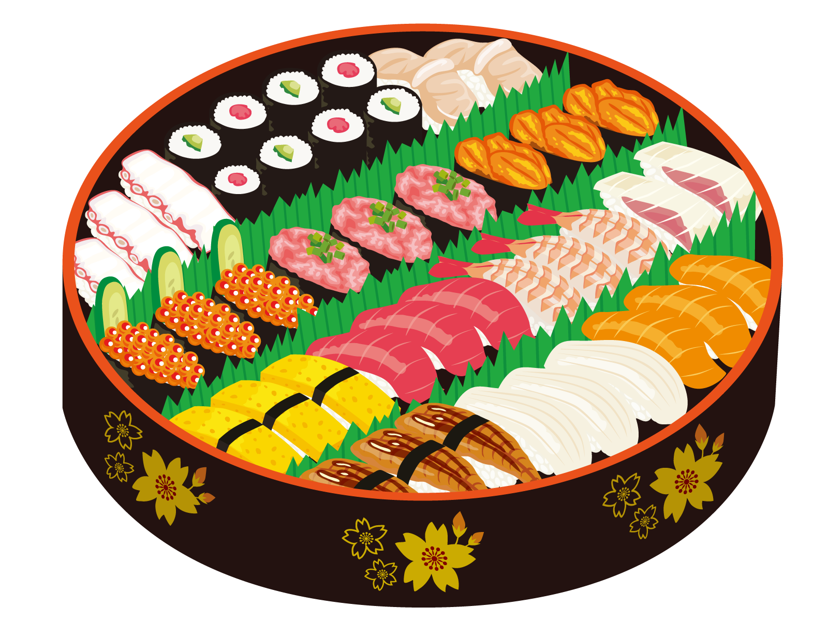
You like sushi.
( Do ) you like sushi?
Do
( What ) ( sushi )( do ) you like?
What
sushi
do
I ( like ) tsuna.
like

Slide 17
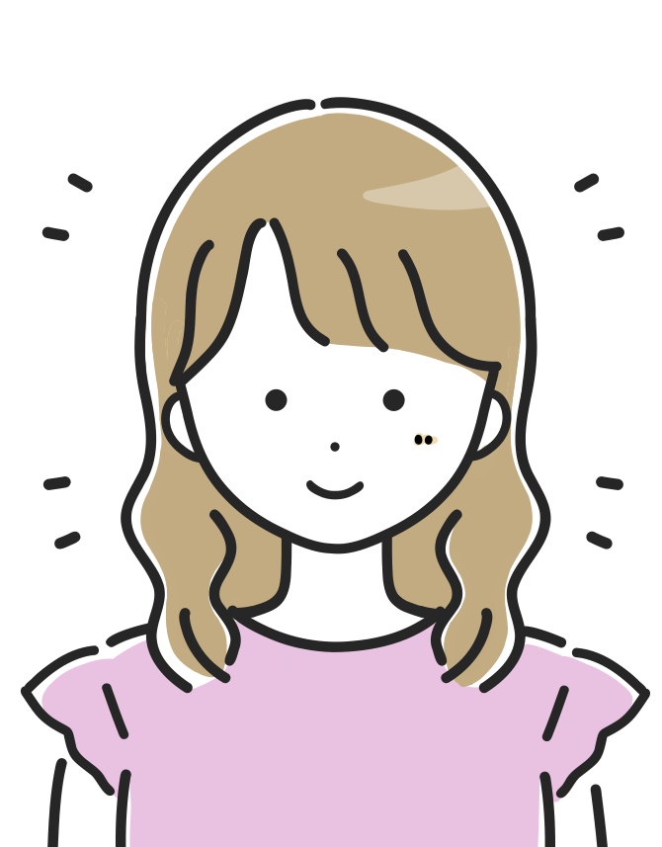

You want to eat sweets.
( Do ) you want to eat sweets?
Do
( What ) ( sweets )( do ) you want to eat?
What
sweets
do
to
eat
I ( want )( to )( eat ) cake.
want

Slide 18

You can play sports.
Can
( Can ) you can play sports?
sports
( What ) ( sports )( can) you play?
What
can
play
I ( can ) ( play ) tennis.
can

Slide 19
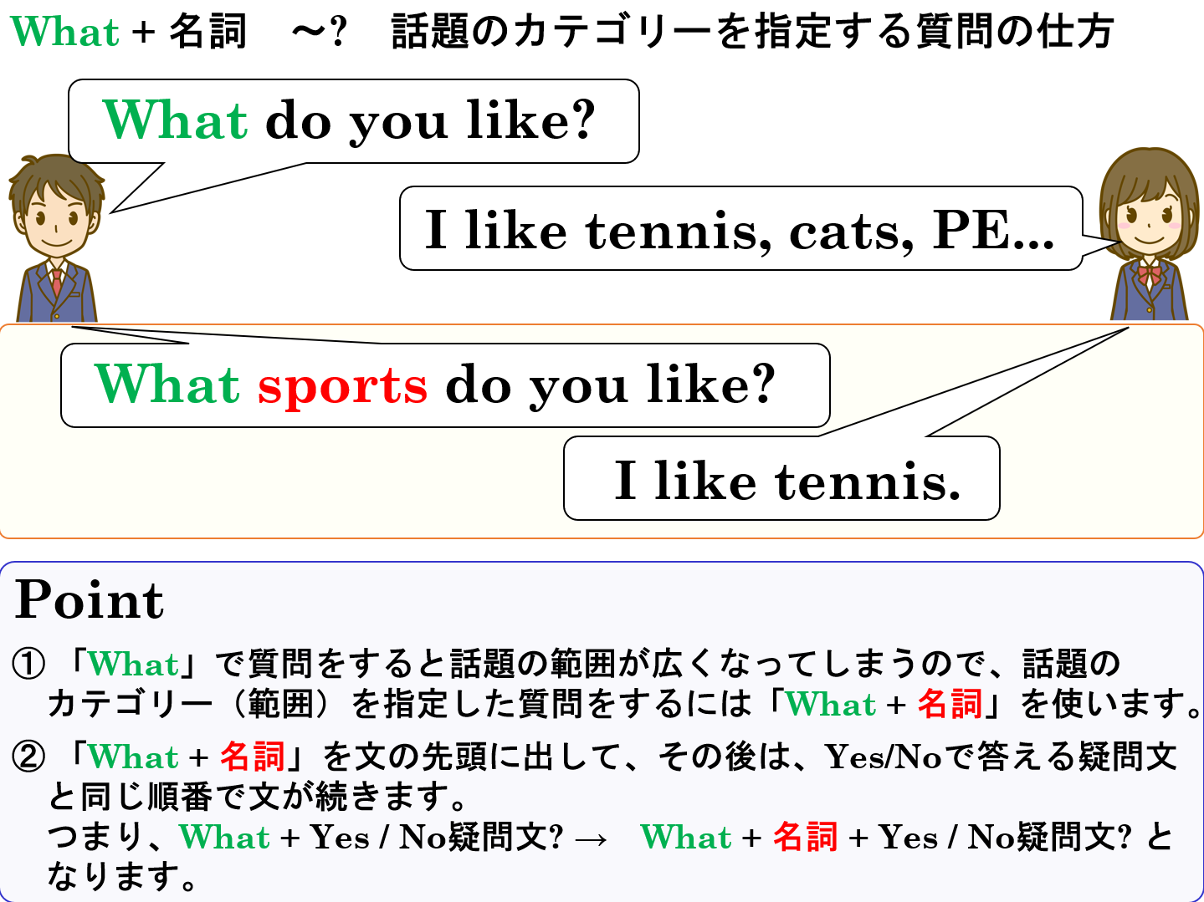

Slide 20
What + 名詞

