Slide 1
How

Slide 2
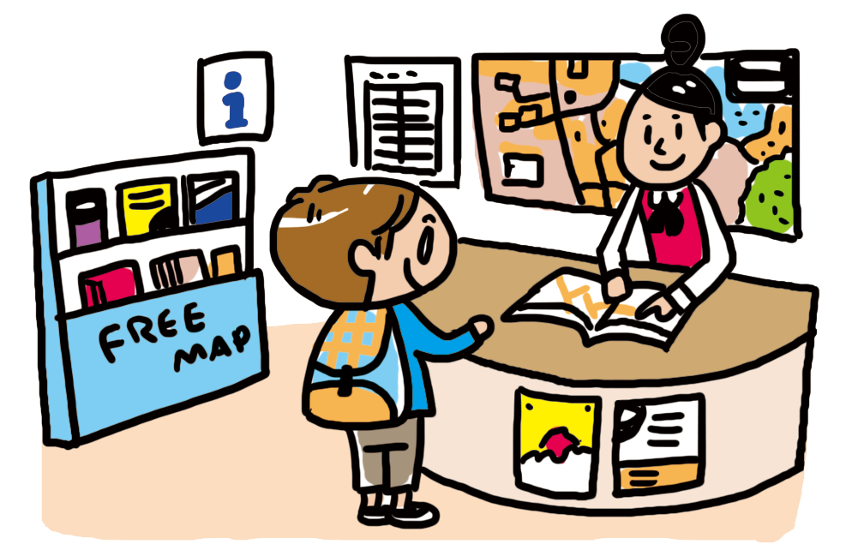
How can I go to the shrine?
By bus.
I can go to the shrine by bus.

Slide 3
方法・手段をたずねる How
？
can
by bus.
I can go to the shrine
I go to the shrine
How
?
By bus.
Point
① 方法や手段をたずねるときには、「How」を使います。
② Howを文の先頭に出して、その後は、Yes/Noで応える疑問文と同じ
順番で文が続きます。
③ 答えるときには、「by + aなどつけない乗り物名」で答えられます。

Slide 4
How

Slide 5

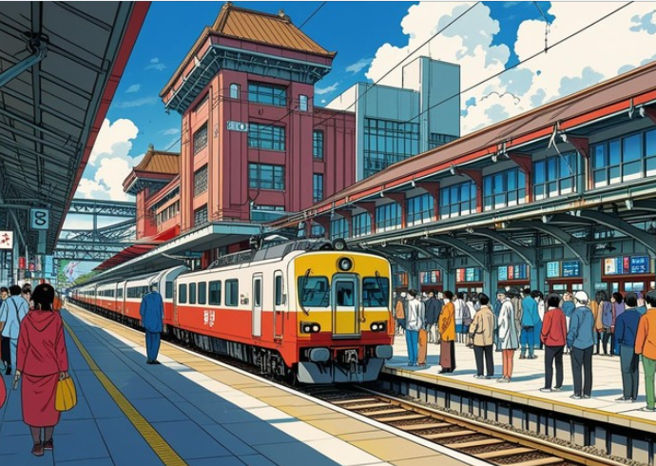
I can go to the station.
Can
( Can ) I go to the station?
can
( How ) ( can ) I go to the station?
How
( By ) bus.
By

Slide 6
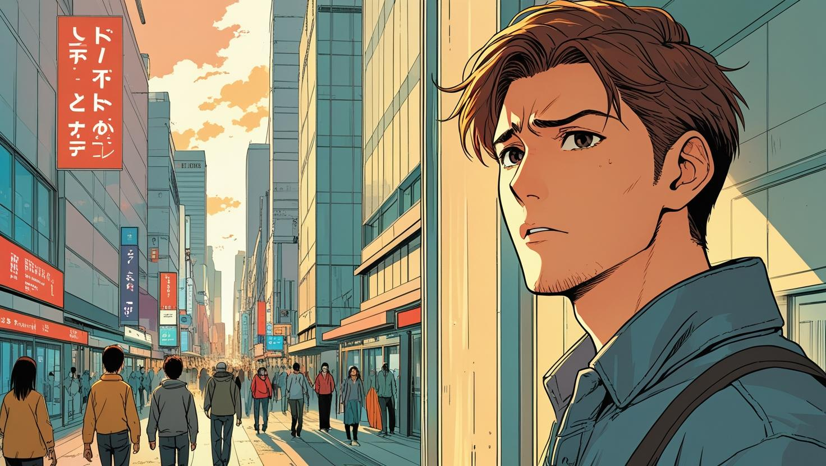
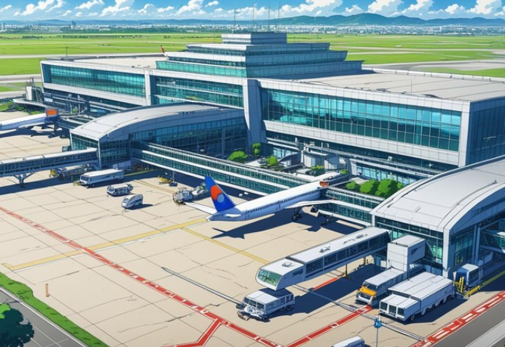
I can go to the airport.
Can
( Can ) I go to the airport?
can
( How ) ( can ) I go to the airport?
How
( By ) train.
By

Slide 7


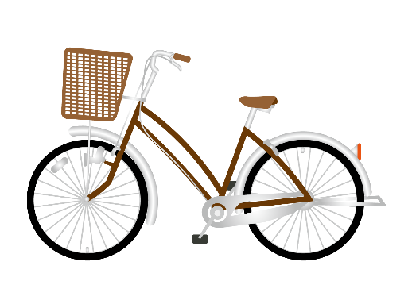
You come to school.
( Do ) you come to school?
Do
( How ) ( do ) you come to school?
How
do
bike
( By )( bike ).
By

Slide 8

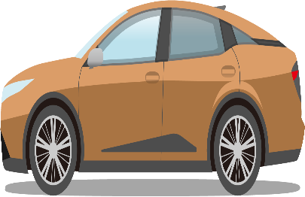
You come here.
( Do ) you come here?
Do
( How ) ( do ) you ( come )( here )?
How
do
come
here
car
( By )( car ).
By

Slide 9

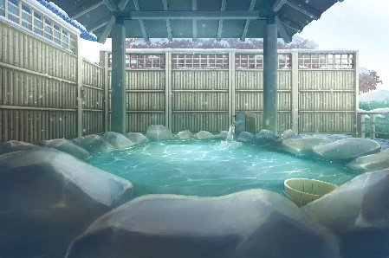
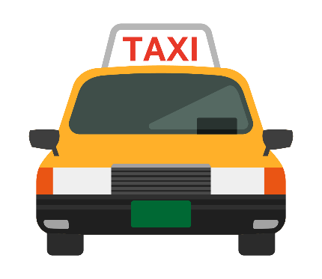
We can go to a hot spring.
( Can ) we go to a hot spring?
Can
go
( How ) ( can ) we ( go )
( to ) a hot spring?
How
can
to
taxi
You can go there ( by )( taxi ).
by

Slide 10

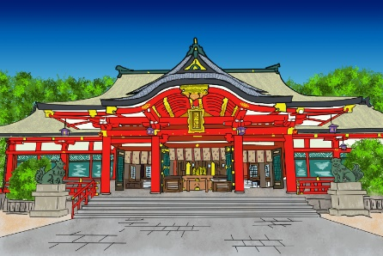

We can go to a shrine.
( Can ) we go to a shrine?
Can
can
go
( How ) ( can ) we ( go ) ( to ) a shrine?
How
to
You can ( walk ).
walk
On foot.

Slide 11
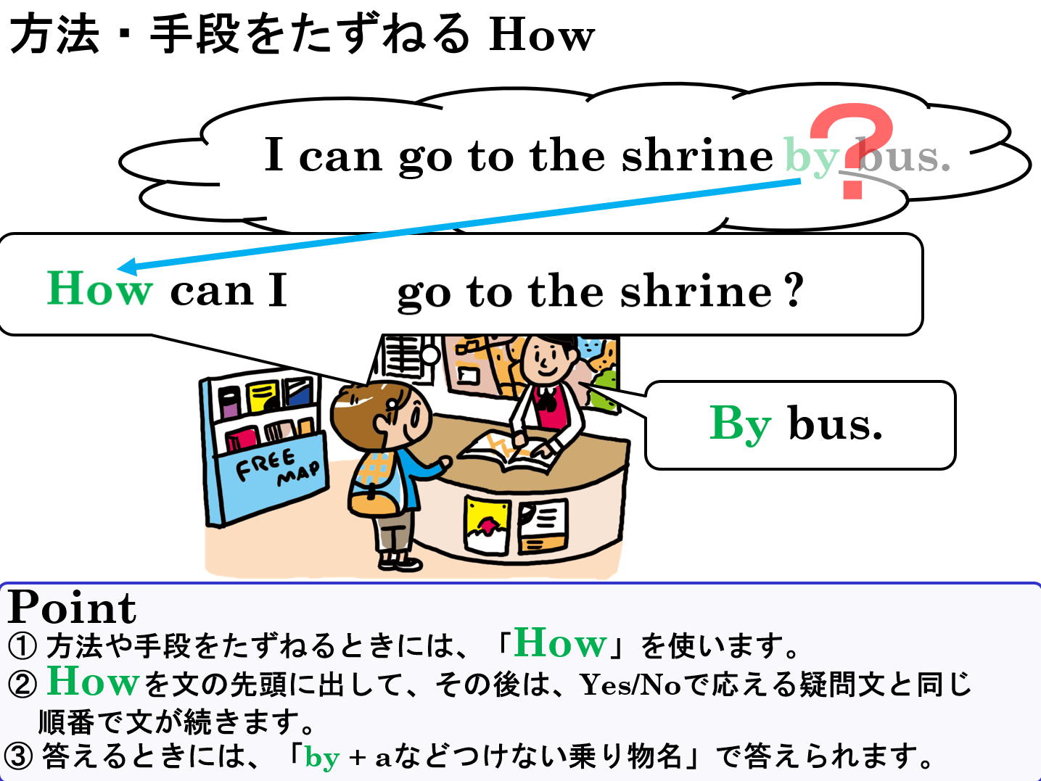

Slide 12
How

