Slide 1
3人称単数現在のs
疑問詞を使った疑問文

Slide 2



get
at
I ( get ) up ( at ) seven.

Slide 3


?
( Do ) you get up
at seven?
Do
Yes, I ( do ).
do

Slide 4
?
( When )( do )you
get up?
When
do
I get up ( at )( seven )).
at
seven

Slide 5

?
( Does ) she get up
at seven?
Does
Yes, ( she )( does ).
she
does

Slide 6
?
( When )( does )
she get up?
When
does
She ( gets ) up ( at )( seven ).
gets
at
seven

Slide 7
疑問詞を使った疑問文（3人称単数現在）
When do you get up?
When does she get up?
?
She gets up at seven.
Point
①Wh-などの疑問文でも、「does 」を使ってたずねます。
②動詞はsをつけずに原形になります。
③疑問詞を覚えましょう。

Slide 8
疑問詞を覚えよう。
いつ（時）?
When
どこ（場所）?
Where
何?
What
どの～?
What + 名詞
誰?
Who
誰の～?
Whose
いくら?
How much
いくつ?
How many

Slide 9



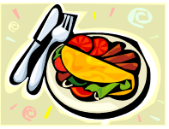


?
( What ) food
( do ) you like?
What
do
I like curry and rice.

Slide 10

?
( What ) food
( does ) Kenta like?
What
does
He ( likes ) curry and rice.
likes

Slide 11





?
( When )( subject )
( do ) you like?
What
subject
do
I like PE.

Slide 12
?
( When )( subject )
( does ) she like?
What
subject
does
She ( likes ) PE.
likes

Slide 13


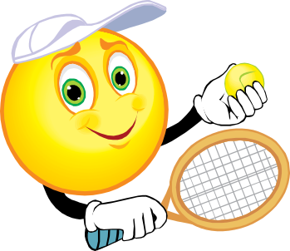



?
What
sport
( What )( sport )
( do ) you play?
do
I play tennis.

Slide 14
?
( What )( sport )
( does ) he play?
What
sport
does
He ( plays ) tennis.
plays

Slide 15

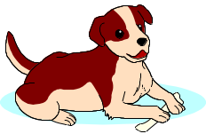


?
( When )( pet)
( do ) you have?
What
pet
do
I have a dog.

Slide 16
?
( When )( pet)
( does ) he have?
What
pet
does
He ( has ) a dog.
has

Slide 17



?
( When )( do )
you play tennis?
When
do
I play tennis on Fridays.

Slide 18
?
When
( When )( does)
he play tennis?
does
He ( plays ) tennis on Fridays.
plays

Slide 19
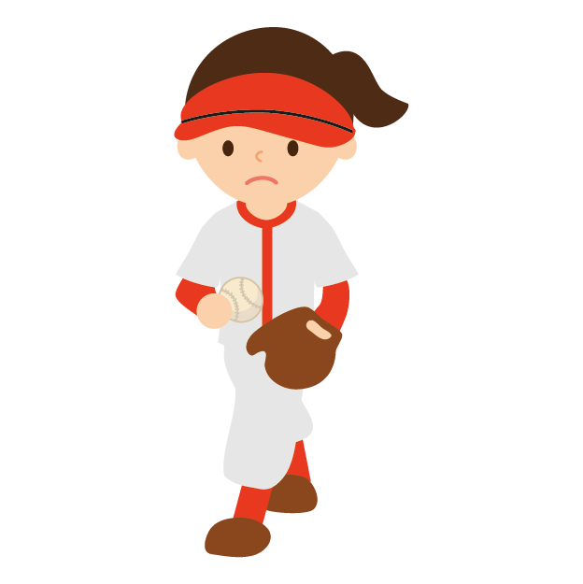


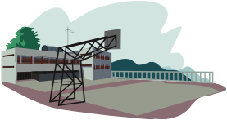


?
( Where )( do )
you play softball?
Where
do
I play it near the river.

Slide 20
?
does
( Where )( does )
she play softball?
Where
She ( plays ) it near the river.
plays

Slide 21


?
( How )( many ) cats
( do ) you have?
How
many
do
I have three cats.

Slide 22
?
( How )( many ) cats
( does ) Keiko have?
How
many
does
has
She ( has ) three cats.

Slide 23
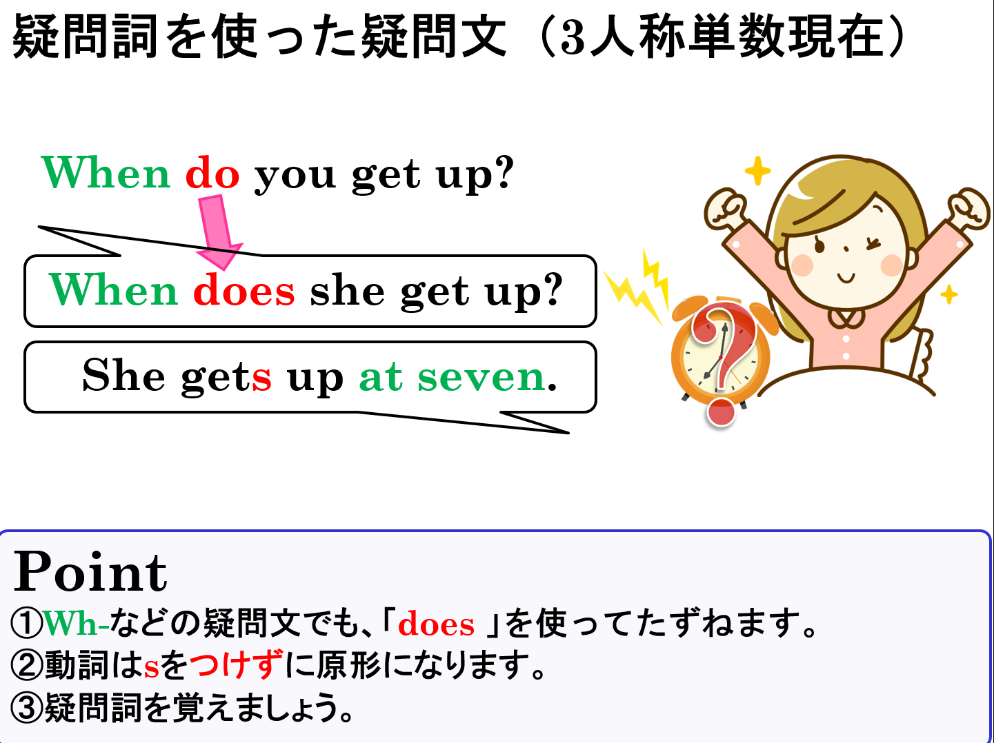

Slide 24
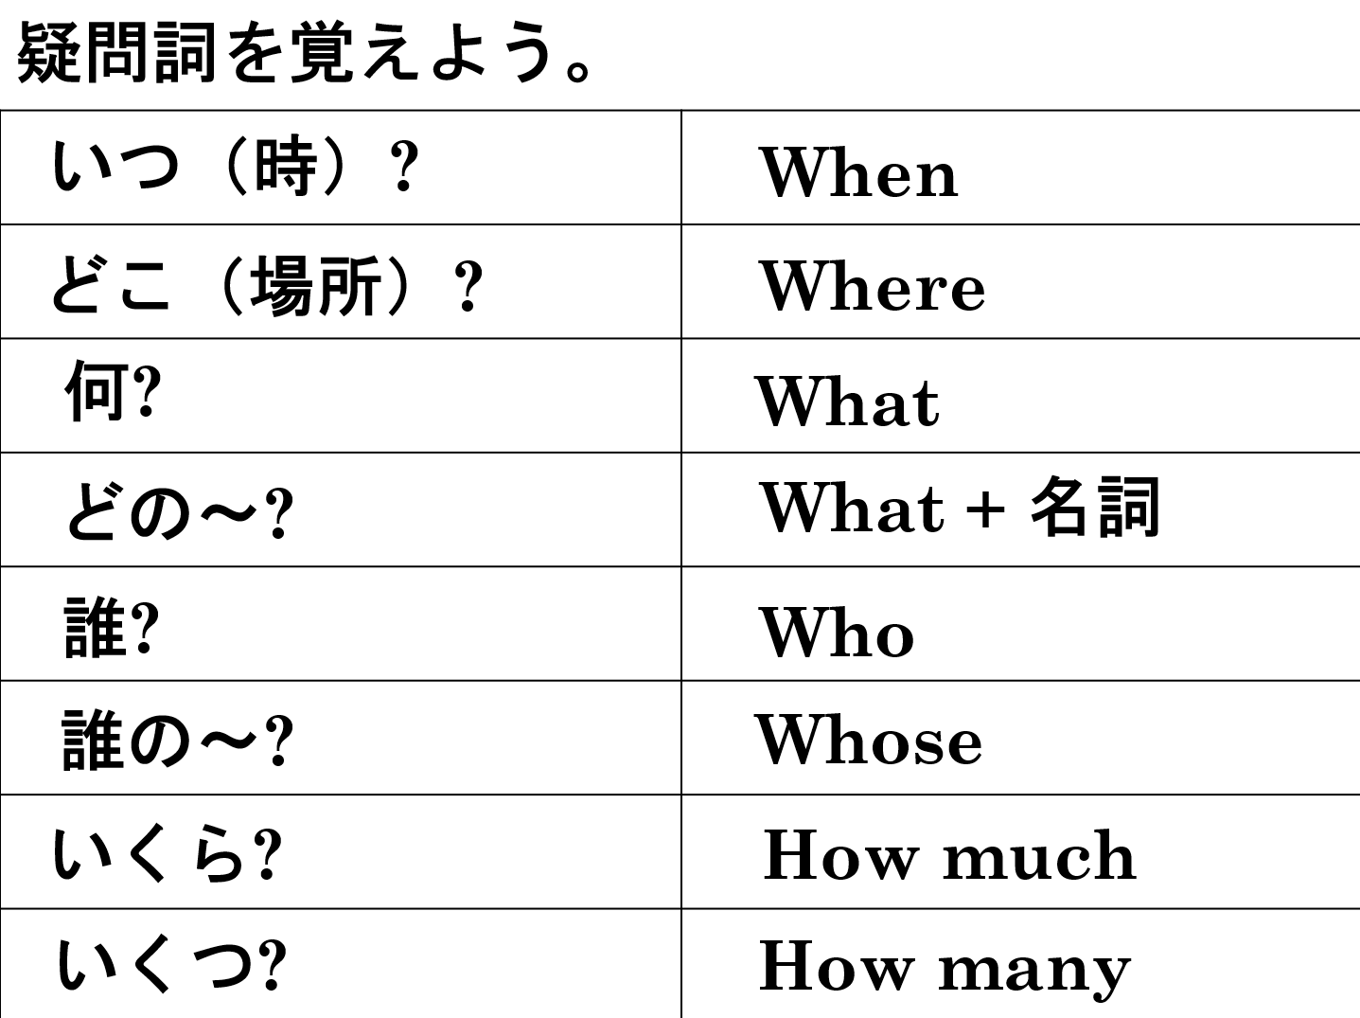

Slide 25
3人称単数現在のs
疑問詞を使った疑問文

