Slide 1
3人称単数現在形
3単現のs文の否定文

Slide 2
3人称単数現在の否定文
×
do
not
I
play soccer.
do
not
He
play soccer.
s
does

Slide 3
3人称単数現在の否定文
×
He plays soccer.
s
He
do
play soccer.
does
not
s
He doesn’t play soccer.
Point
①一般動詞の文の否定文なので「 do + not 」を使いますが、一般動
詞に使っている s は do にくっついて「 does not 」になります。
②動詞からは s がなくなり、元の形（原形）に戻ります。
③does + notの短縮形は「 doesn’t 」になります。

Slide 4
3単現のsを使った文の練習しよう
否定文

Slide 5
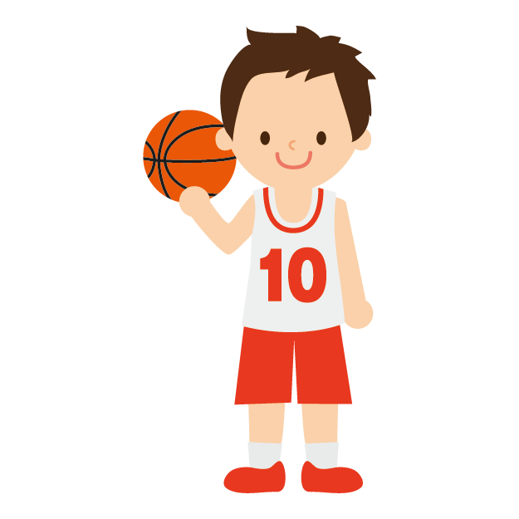
×
play
Taro ( plays ) basketball.
plays
do + not
doesn’t
play
Taro ( doesn’t ) ( plays ) basketball.

Slide 6
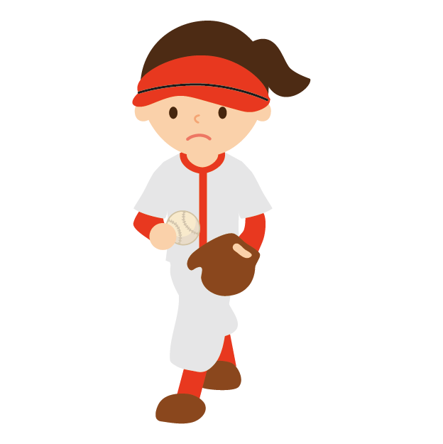
×
like
Mika ( likes ) softball.
likes
do + not
Mika ( doesn’t ) ( like ) softball.
doesn’t
like

Slide 7
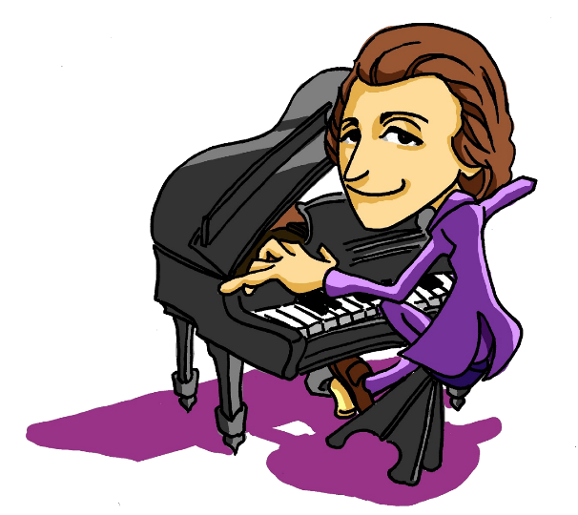
×
play
plays
He（ plays ）the piano.
do + not
play
He（ doesn’t ）（ plays ） the piano.
doesn’t

Slide 8
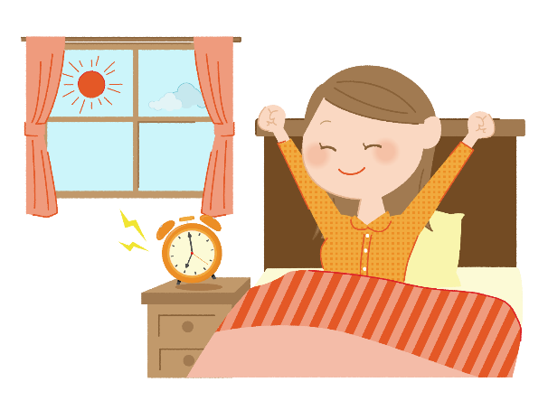
×
get up
gets up
She ( gets up ) at seven.
do + not
She ( doesn’t ) ( get up ) at seven.
doesn’t
get up

Slide 9
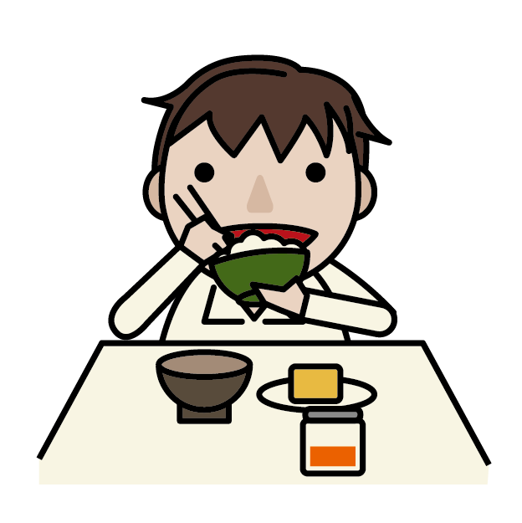
×
eat
He ( eats ) breakfast at six.
eats
do + not
He ( doesn’t ) ( eat ) breakfast at six.
doesn’t
eat

Slide 10

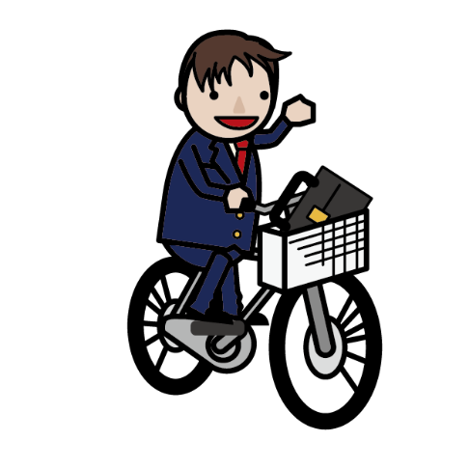
×
leave
Takashi ( leaves ) home at seven.
leaves
do + not
Takashi ( doesn’t )( leave ) home at seven.
doesn’t
leave

Slide 11
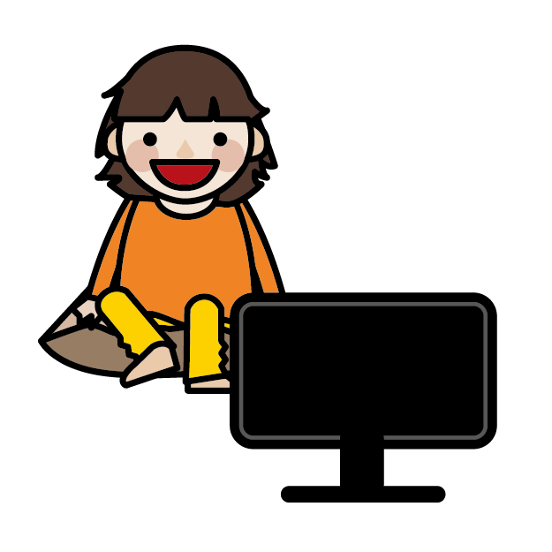
×
watch
Ken’s mother ( watches ) TV before dinner.
watches
do + not
doesn’t
Ken’s mother ( doesn’t )( watch ) TV
before dinner.
watch

Slide 12
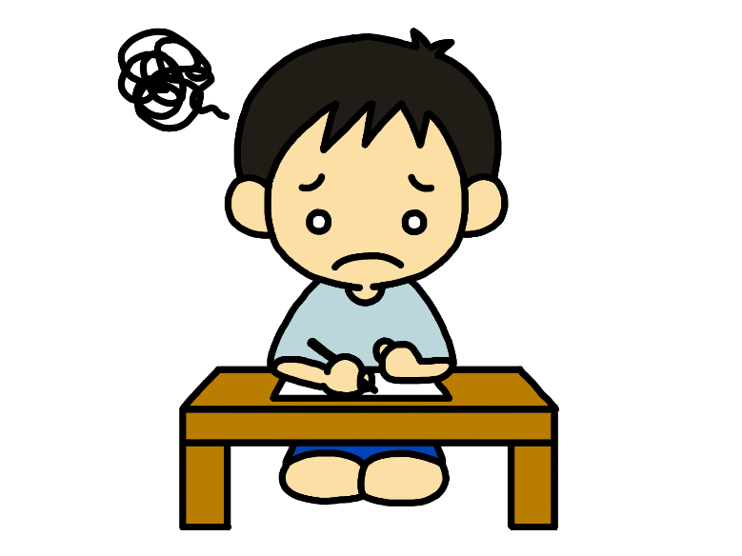
×
do
does
He ( does ) his homework.
do + not
He ( doesn’t ) ( does ) his homework.
doesn’t
do

Slide 13
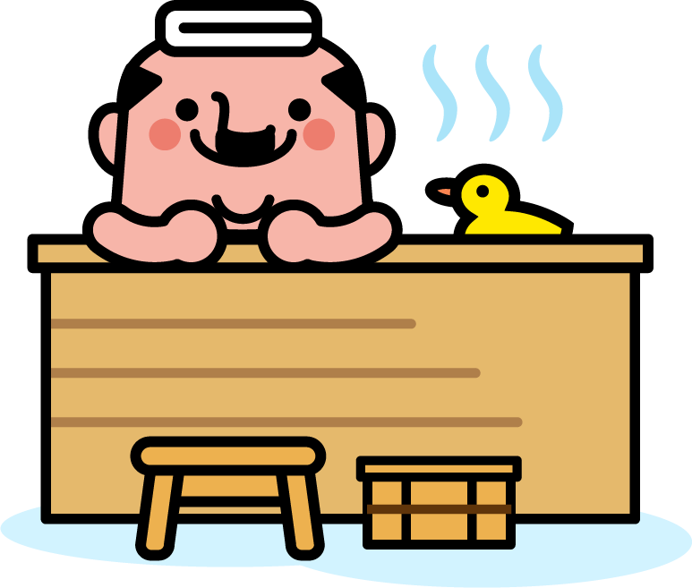
×
take
takes
My father ( takes ) a bath after dinner.
do + not
My father ( doesn’t )( take ) a bath
after dinner.
doesn’t
take

Slide 14
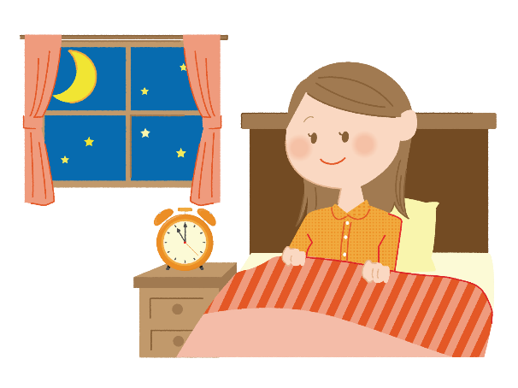
×
go
My sister ( goes ) to bed at eleven.
goes
do + not
My sister ( doesn’t )( go ) to bed at eleven.
doesn’t
go

Slide 15
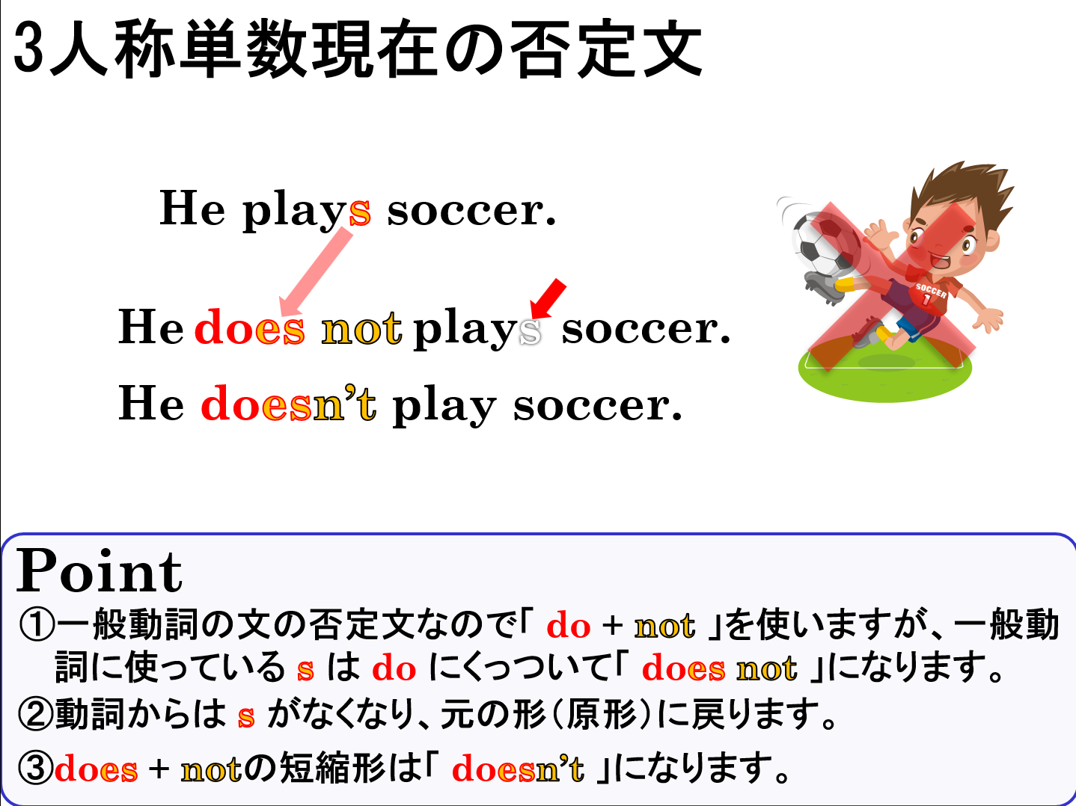

Slide 16
3人称単数現在形
3単現のs文の否定文

