Slide 1
これは～ですか。
あれは～ですか。
Is this ～?
Is that ～?

Slide 2

Is
this
your
handkerchief
?
Yes,
it
is
.

Slide 3
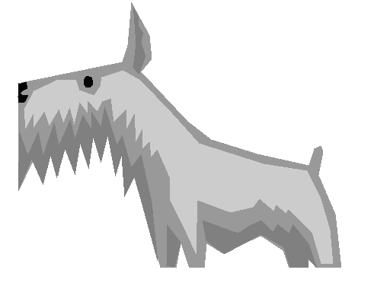
Is
this
a
dog
?
Yes,
it
is
.

Slide 4

Is
that
a
cat
?
No,
it
is
not
.

Slide 5
This
This
is
is
a
a
dog
dog
.
Is
this
?
Yes,
it
is
.
No,
it
is
not
.

Slide 6
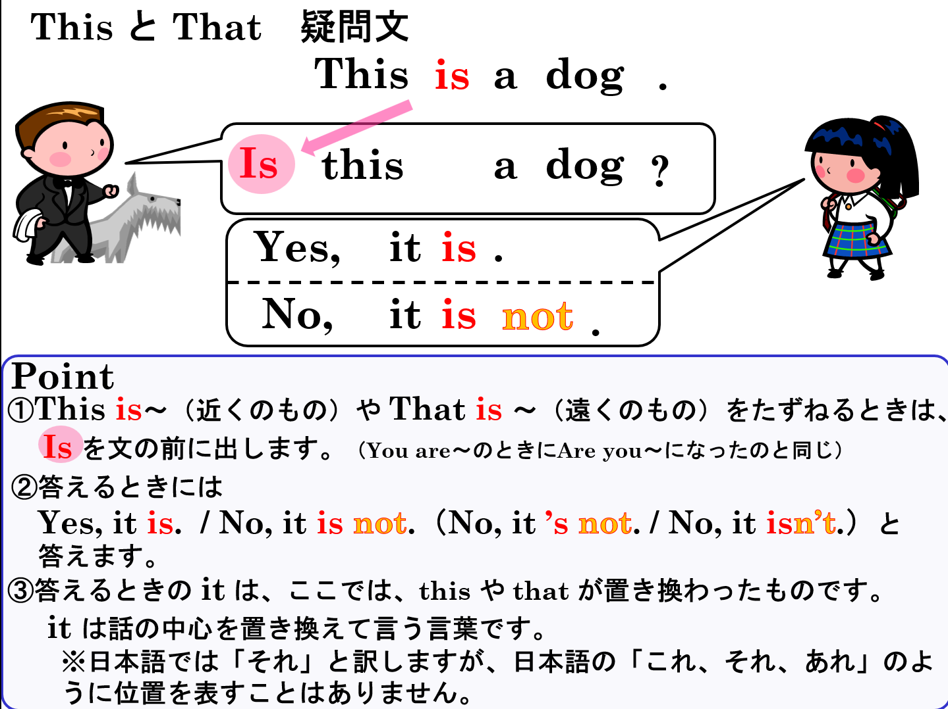
This と That 疑問文
This
a
is
dog
This
is
a
dog
.
Is
this
?
Yes,
it
is
.
No,
it
is
not
.
Point
①This is～（近くのもの）や That is ～（遠くのもの）をたずねるときは、
Is を文の前に出します。（You are～のときにAre you～になったのと同じ）
②答えるときには
Yes, it is. / No, it is not.（No, it ’s not. / No, it isn’t.）と
答えます。
③答えるときの it は、ここでは、this や that が置き換わったものです。
it は話の中心を置き換えて言う言葉です。
※日本語では「それ」と訳しますが、日本語の「これ、それ、あれ」のよ
うに位置を表すことはありません。

Slide 7

?
watch
( Is )( this ) a watch?
Is
this
Yes, ( it )( is ).
it
is

Slide 8
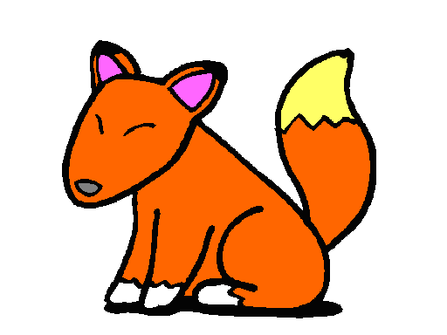
?
dog
( Is )( this ) a dog?
Is
this
not
No,( it )( is )( not ).
it
is

Slide 9
?
fox
( Is )( this ) a fox?
Is
this
Yes, ( it )( is ).
it
is

Slide 10

?
horse
Is
( Is )( this ) a horse?
this
not
( No ), ( it )( is )( not ).
No
it
is

Slide 11

?
guitar
Is
( Is )( that ) a guitar?
that
it
No,( it )( is )( not ).
is
not

Slide 12
?
Is
violin
( Is )( that ) a violin?
that
Yes, ( it )( is ).
it
is

Slide 13
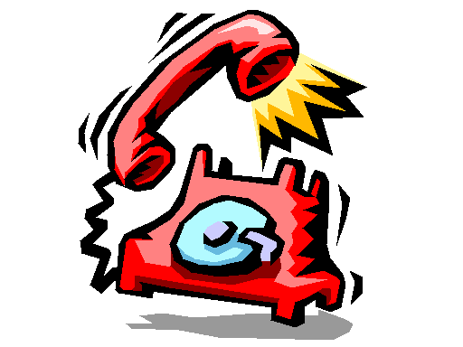
?
( Is )( that ) a clock?
clock
Is
that
not
No, ( it )( is )( not ).
it
is

Slide 14
?
phone
that
( Is )( that ) a phone?
Is
Yes, ( it )( is ).
it
is

Slide 16
これは～ですか。
あれは～ですか。
Is this ～?
Is that ～?

Slide 17
これは～ではありません。
あれは～ではありません。
This is not～.
That is not～.

Slide 18
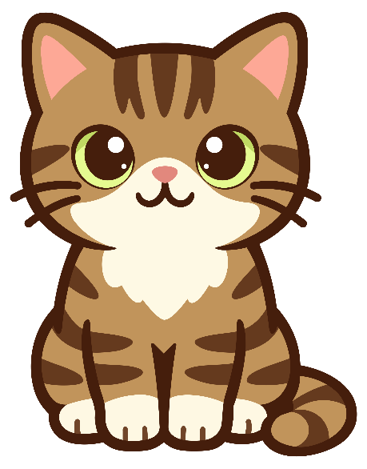
This
is
a
cat
.

Slide 19

This
is
not
a
cat
.

Slide 20


This と That 否定文
This
is
a cat.
×
not
This
is
a cat.
Point
①「これは～ではありません。」、「あれは～ではありません。」と表すとき
には、is の後に「not」をつけます。
②「 not 」は後ろを否定します。

Slide 21
This ( is )( not ) a dog.
is
not

Slide 22
not
This ( is )( not ) a horse.
is

Slide 23
( That )( is )( not ) my book.
That
is
not
×
my book

Slide 24
That
( That )( is )( not ) your bag.
is
not
×
your bag

Slide 25
( This )( is )( not ) my watch.
This
is
not
×
my watch

Slide 26
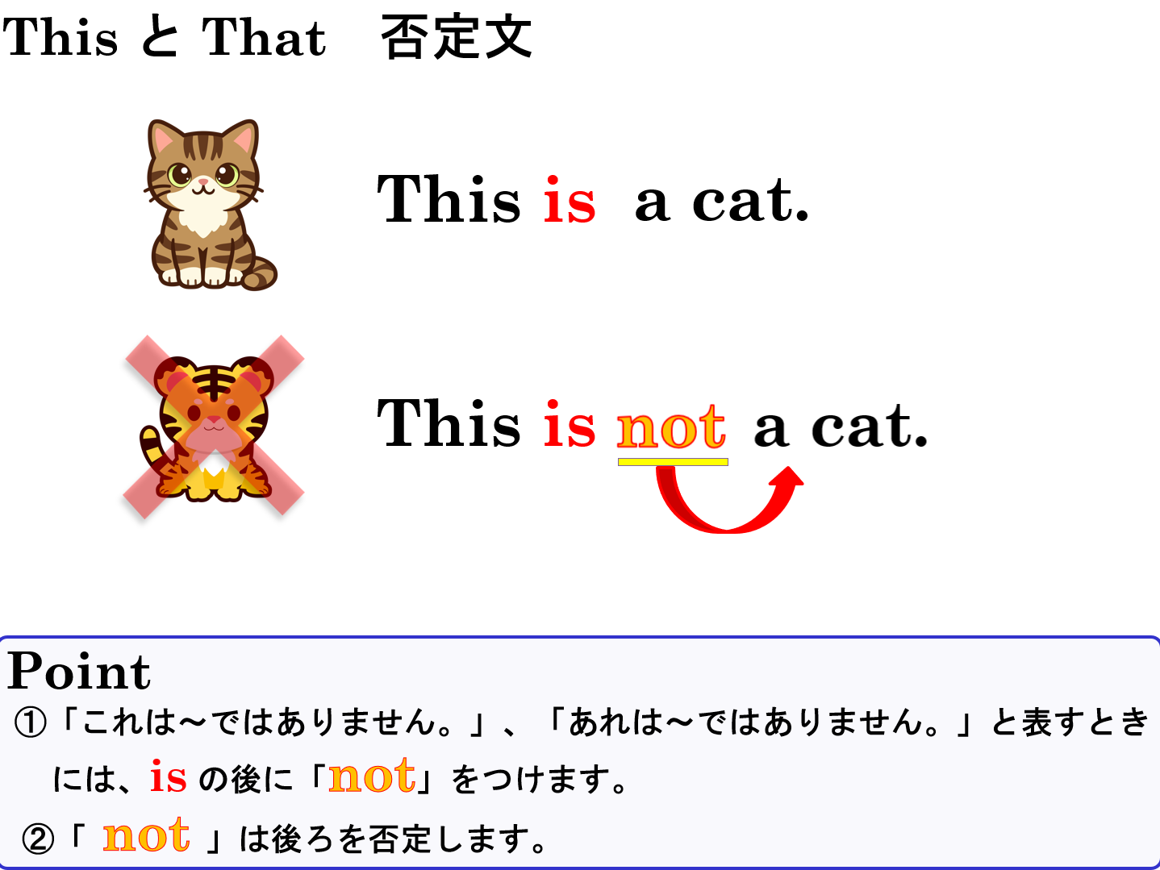

Slide 27
これは～ではありません。
あれは～ではありません。
This is not～.
That is not～.

