Slide 1
Be動詞 is
He & She

Slide 2






This is my father.
He is a doctor.
This is my mother.
She is a teacher.

Slide 3
He・She とis
He is a doctor.
She is a teacher.
Point
①話している人と聞いている人以外の男性を表す言葉は「He」、女性を表す
言葉は「She」です。
②「 He 」や「 She 」など、話している人・聞いている人以外の1人（1つ）
の主語に対して使う「be動詞 」は、「 is 」になります。
He is ～.
She is ～.
のように使います。

Slide 4

This is my father.
( He ) ( is ) a doctor.
He
is

Slide 5

This is my mother.
is
( She ) ( is ) a teacher.
She

Slide 6

( This ) is my brother.
This
( He ) ( is ) cool.
He
is

Slide 7

is
This ( is ) my sister.
( She ) ( is ) a baker.
She
is

Slide 8

( He ) ( is ) happy.
He
is

Slide 9
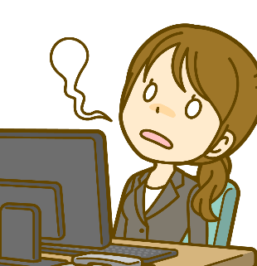
( She ) ( is ) tired.
She
is

Slide 10
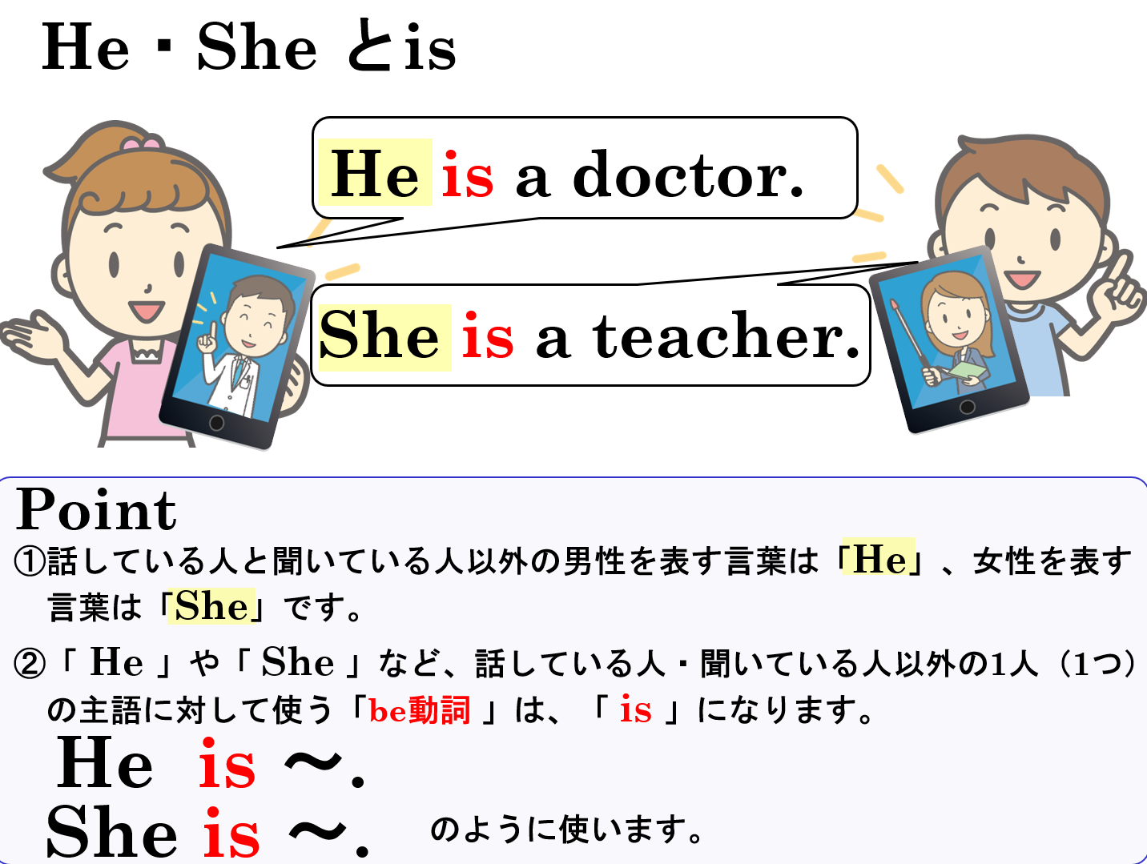

Slide 11
Be動詞 is
He & She

