Slide 1
Areの疑問文

Slide 2
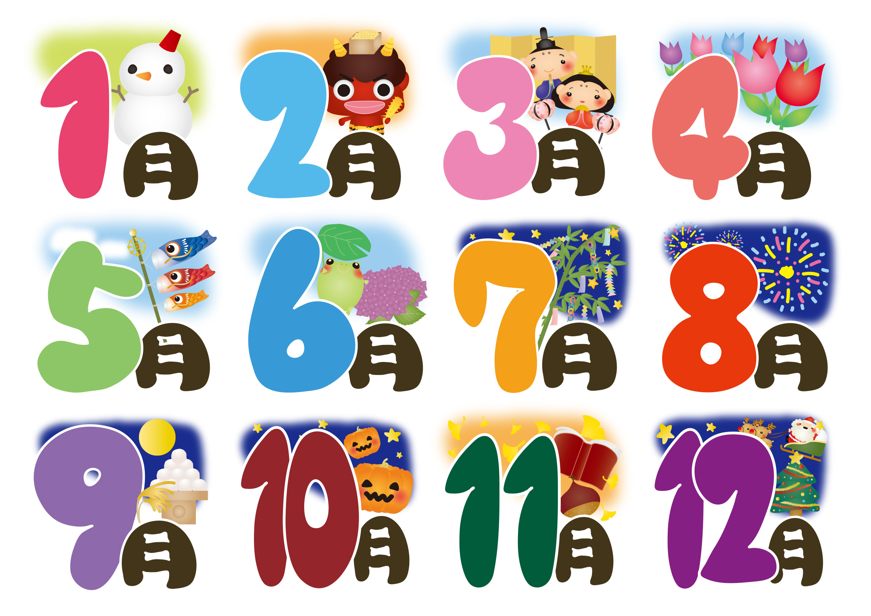

Slide 3


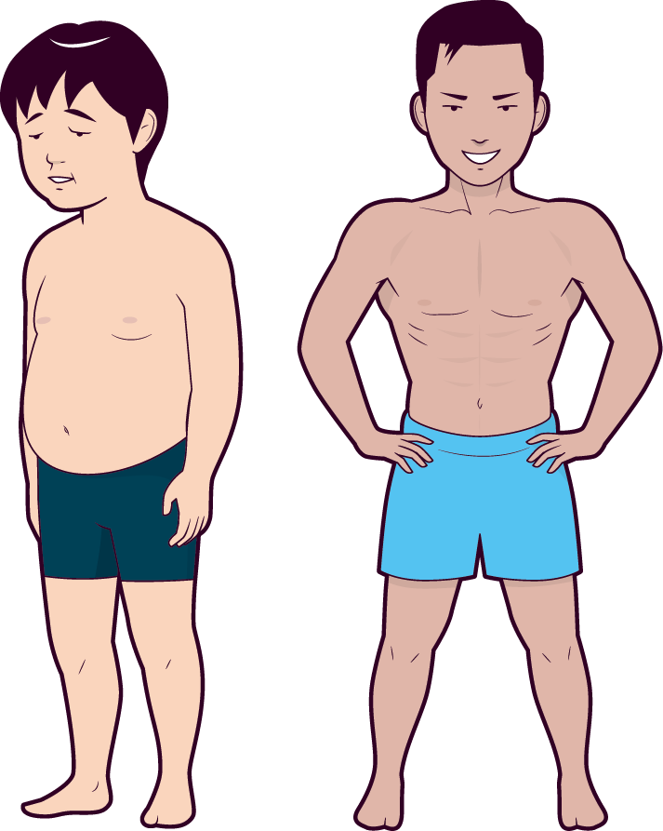
Hi, Ken.
What’s up?

Slide 6


Ken!?
Are you Ken?
Yes, I am.

Slide 7


areの疑問文
You
You
are
You
are
Ken.
Ken.
are
Ken.
Are
you
Ken?
Yes, I am.
No, I am not.
Point
① areがある文は、たずねるときに、areが文頭に出ます。
たずねるときは、驚きや不思議だなと心がみだれるので、
語順もみだれます。最後は?で上がり口調です。
② 答えるときはたずねられた人は、自分のことを答えるので、Yes, No
の後は「I」、Yes, I am. / No, I am not. (No, I’m not.)と答えま
す。
Notes:
心の乱れるときには、4つの文の乱れを生みます。動揺するとちゃんと文がいえないということ
①省略
②倒置
③置換
④付加
Be動詞の疑問文は、②の倒置

Slide 8
Areの疑問文
練習

Slide 9
?
You are Yuki.
you
( Are )( you ) Yuki?
Are
Yes, ( I )( am ).
I
am
I’m
not
No, ( I’m )( not ).
am
not
No, ( I )( am )( not ).
I

Slide 10
?
You are Mark.
you
( Are )( you ) Mark?
Are
Yes, ( I )( am ).
I
am
I’m
not
No, ( I’m )( not ).
am
not
No, ( I )( am )( not ).
I

Slide 11
?
You are happy.
Are
you
( Are )( you ) happy?
Yes, ( I )( am ).
I
am
I’m
not
No, ( I’m )( not ).
am
not
No, ( I )( am )( not ).
I

Slide 12
?
You are sad.
you
( Are )( you ) sad?
Are
Yes, ( I )( am ).
I
am
I’m
not
No, ( I’m )( not ).
am
not
No, ( I )( am )( not ).
I

Slide 13
?
You are tired.
you
( Are )( you ) tired?
Are
Yes, ( I )( am ).
I
am
I’m
not
No, ( I’m )( not ).
am
not
No, ( I )( am )( not ).
I

Slide 14
?
You are from Kyoto.
you
( Are )( you ) from Kyoto?
Are
Yes, ( I )( am ).
I
am
I’m
not
No, ( I’m )( not ).
am
not
No, ( I )( am )( not ).
I

Slide 15
?
You are from America.
you
( Are )( you ) from America?
Are
Yes, ( I )( am ).
I
am
I’m
not
No, ( I’m )( not ).
am
not
No, ( I )( am )( not ).
I

Slide 16
?
You are from Australia.
you
( Are )( you ) from Australia?
Are
Yes, ( I )( am ).
I
am
I’m
not
No, ( I’m )( not ).
am
not
No, ( I )( am )( not ).
I

Slide 17
?
You are a student.
Are
you
( Are )( you ) a student?
Yes, ( I )( am ).
I
am
I’m
not
No, ( I’m )( not ).
am
not
No, ( I )( am )( not ).
I

Slide 18
?
You are a teacher.
Are
you
( Are )( you ) a teacher?
Yes, ( I )( am ).
I
am
I’m
not
No, ( I’m )( not ).
am
not
No, ( I )( am )( not ).
I

Slide 19
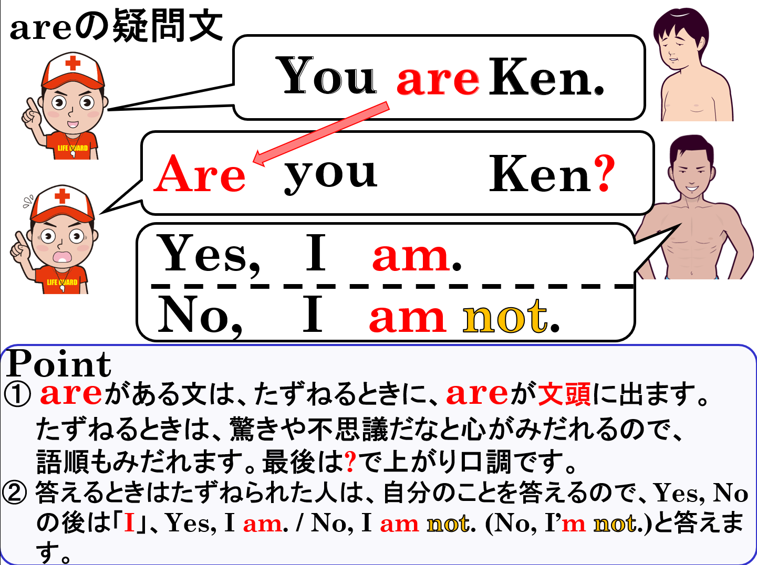

Slide 20
Areの疑問文

