Slide 1
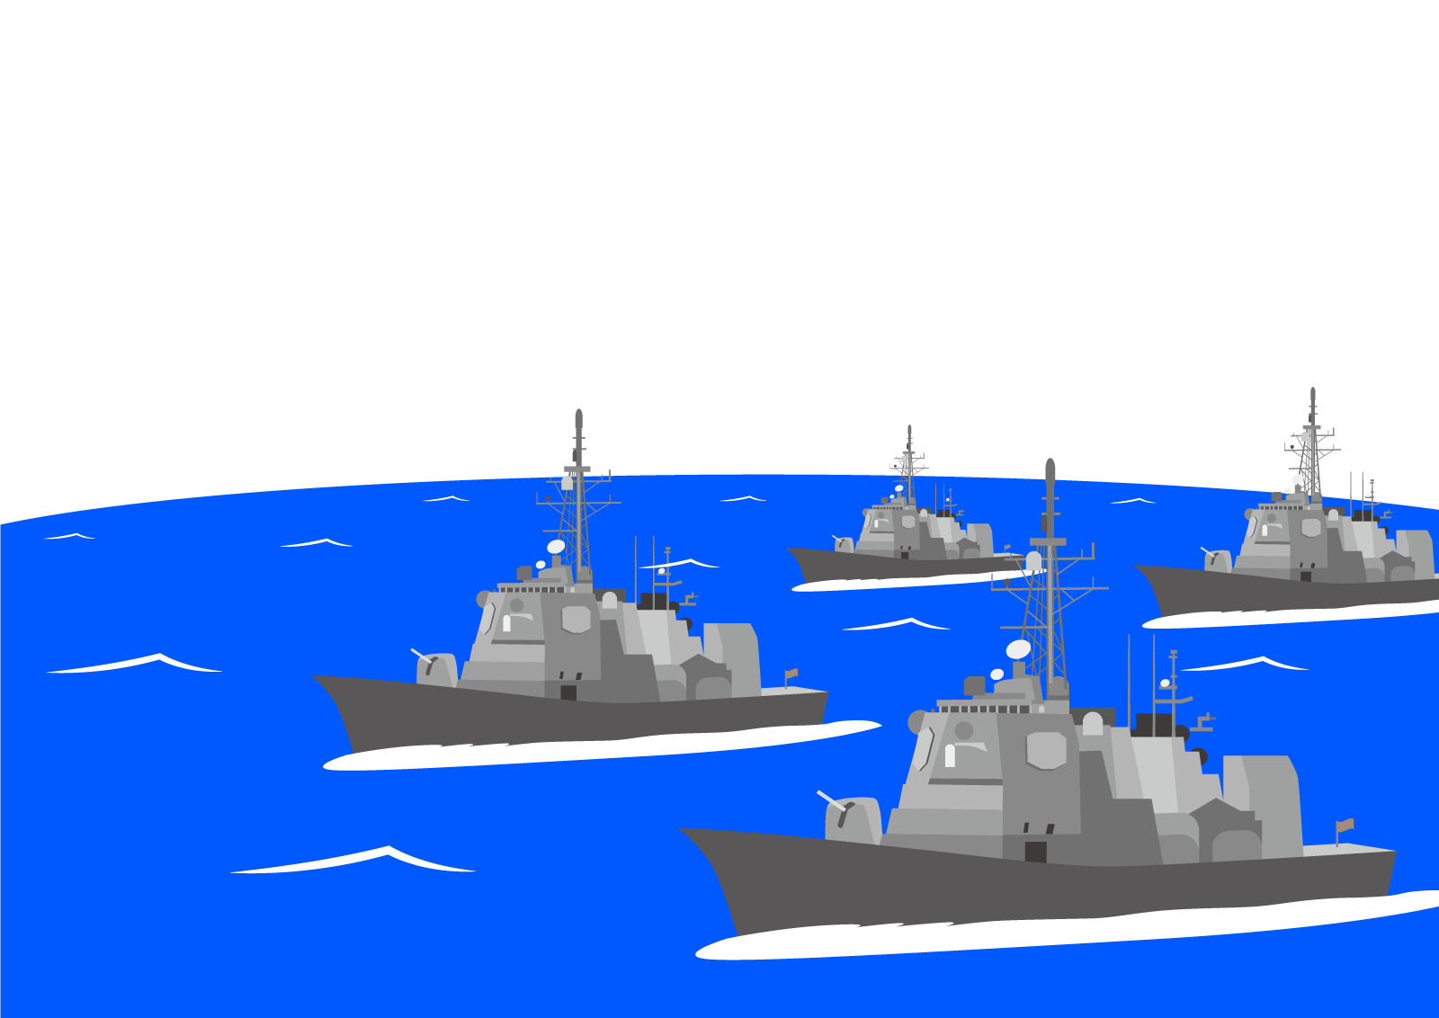
Battle Ships
説明
Notes:
Does用

Slide 2
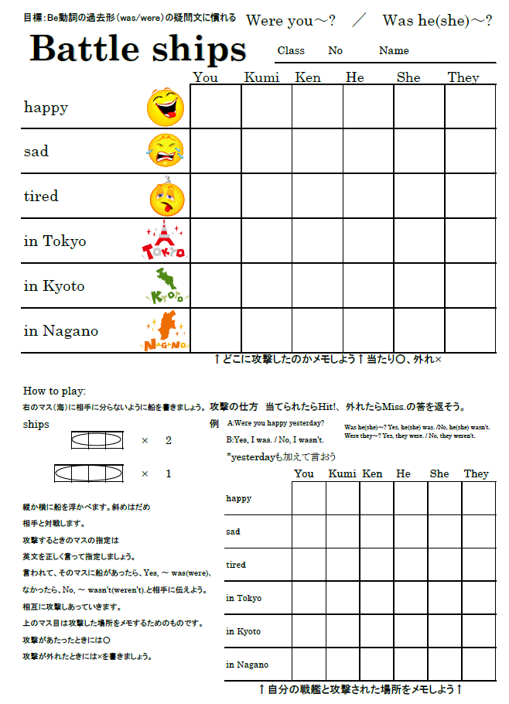

Slide 3
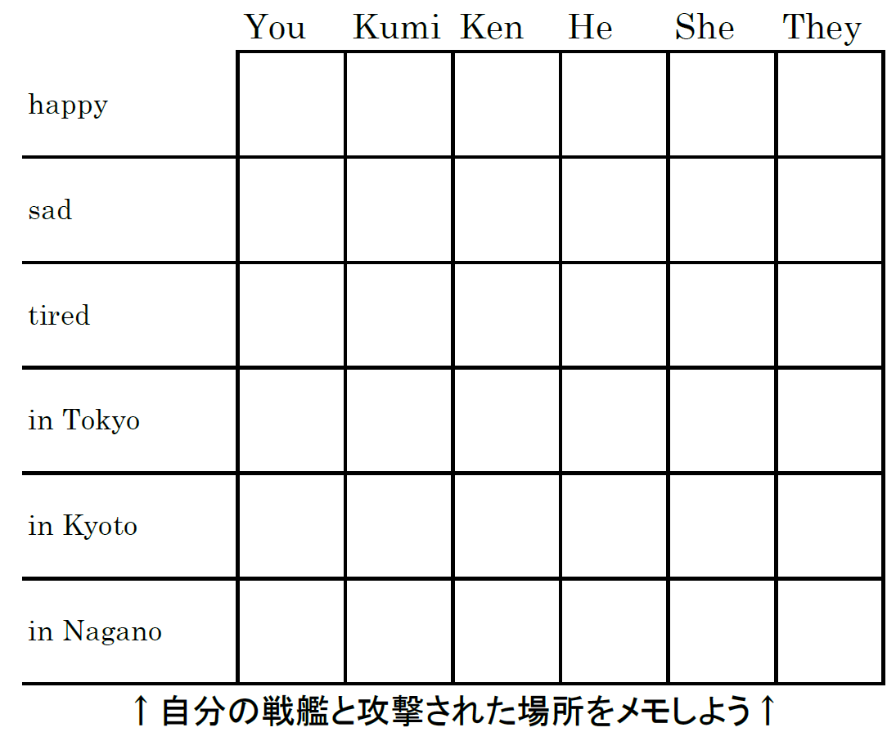

Slide 5
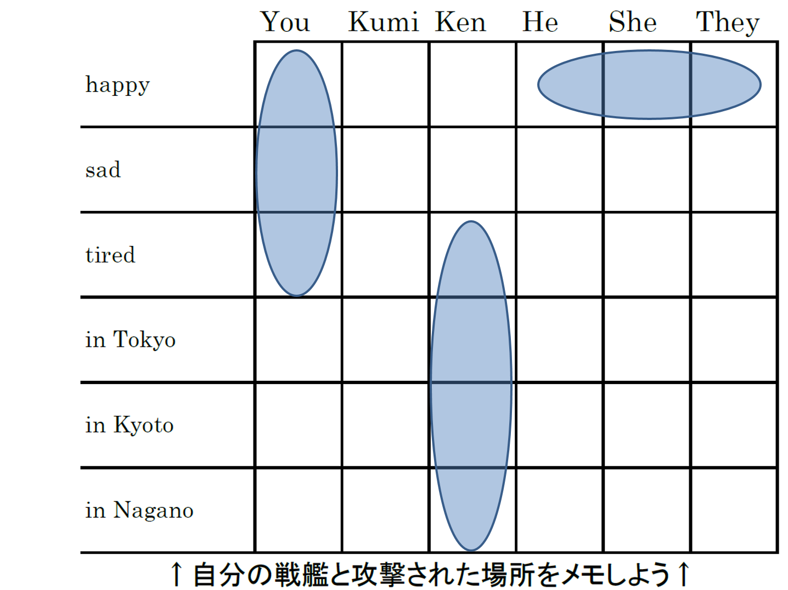
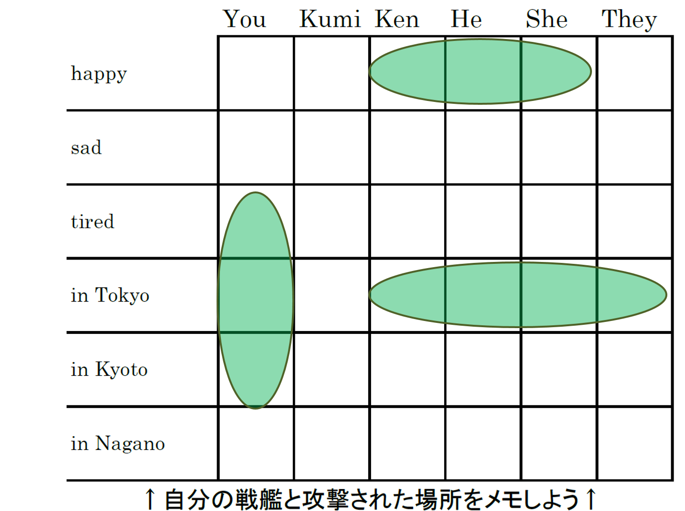
A: Were you happy yesterday?
B: Yes, I was.
B : Were you happy
yesterday?
A: No, I wasn’t.

Slide 6
This ship sank!

Slide 7
○
相手への
攻撃の
メモ
当たり
×
外れ
自分へ
の攻撃
メモ

Slide 8
Fire!

