Slide 1
Past Tense
be動詞の過去形

Slide 2
be動詞の過去形の疑問文
Practice Was～? / Were～?

Slide 3



?
past
（過去）
future
（未来）
now
You are happy now.
You are happy now.
are
Are
you
now?
Yes, I am.
No, I am not ( I’m not).

Slide 4

?
past
（過去）
future
（未来）
yesterday
now
were
You were happy yesterday.
You were happy yesterday.
Were
you
yesterday?
Yes, I was.
No, I wasn’t (was not).

Slide 5




be動詞の過去形の疑問文
past
（過去）
?
future
（未来）
yesterday
now
You were happy yesterday.
were
You were happy yesterday.
Were
you
yesterday?
Yes, I was.
No, I wasn’t (was not).
Point
①be動詞の過去形の疑問文は、今までの現在形のbe動詞がある文
と同じで、be動詞が前にでます。
②答え方も今までの現在形のbe動詞の疑問文と同じ答え方になり
ます。（時間が過去になって、be動詞が過去形になるだけです。）

Slide 6
be動詞の過去形の疑問文
Practice Was～? / Were～?

Slide 7
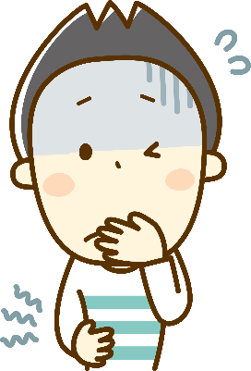

?
past
（過去）
future
（未来）
yesterday
now
You were sick yesterday.
you
( Were )( you ) sick yesterday?
Were
Yes, ( I ) ( was ).
I
was
wasn’t
No, I ( wasn’t ).
was
No, I ( was )( not ).
not

Slide 8


?
past
（過去）
future
（未来）
yesterday
now
Ken was in Tokyo yesterday.
Ken
( Was )( Ken ) in Tokyo yesterday?
Was
Yes, ( he ) ( was ).
he
was
wasn’t
No, he ( wasn’t ).
was
No, he ( was )( not ).
not

Slide 9
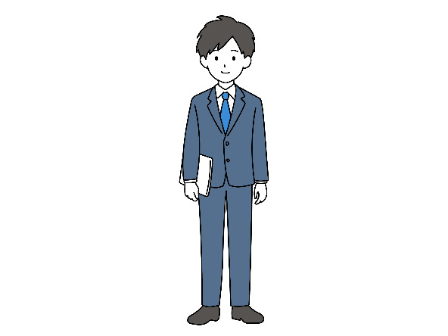


?
past
（過去）
future
（未来）
last week
now
He was in America last week.
he
( Was )( he ) in America last week?
Was
Yes, ( he ) ( was ).
he
was
wasn’t
No, he ( wasn’t ).
was
No, he ( was )( not ).
not

Slide 10

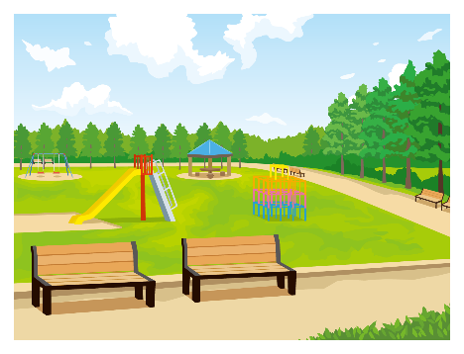
?
past
（過去）
future
（未来）
three days ago
now
Yuki was in the park three days ago.
Yuki
( Was )( Yuki ) in the park three days ago?
Was
Yes, ( she ) ( was ).
she
was
wasn’t
No, she ( wasn’t ).
No, she ( was )( not ).
was
not

Slide 11
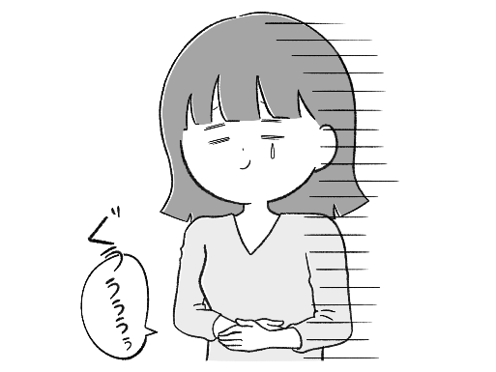
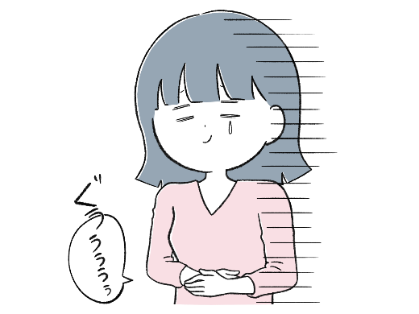
?
past
（過去）
future
（未来）
yesterday
now
She was hungry yesterday.
she
( Was )( she ) hungry yesterday?
Was
Yes, ( she ) ( was ).
she
was
wasn’t
No, she ( wasn’t ).
No, she ( was )( not ).
was
not

Slide 12



?
past
（過去）
future
（未来）
yesterday
now
Your bag was in the room yesterday.
Was
bag
( Was )( your )( bag ) in the room yesterday?
your
Yes, ( it ) ( was ).
it
was
wasn’t
No, it ( wasn’t ).
was
No, it ( was )( not ).
not

Slide 13


?
past
（過去）
future
（未来）
yesterday
now
It was rainy yesterday.
it
( Was )( it ) rainy yesterday?
Was
Yes, ( it ) ( was ).
it
was
wasn’t
No, it ( wasn’t ).
was
No, it ( was )( not ).
not
Notes:
自分が昨日その場にいなかった（外の様子を知らない）」ときに、過去の状態（was）を相手に確認する表現です。

Slide 14






?
past
（過去）
future
（未来）
yesterday
now
They were sad last night.
they
( Were )( they ) sad last night?
Were
were
Yes, ( they ) ( were ).
they
No, they ( weren’t ).
weren’t
were
No, they ( were )( not ).
not

Slide 15
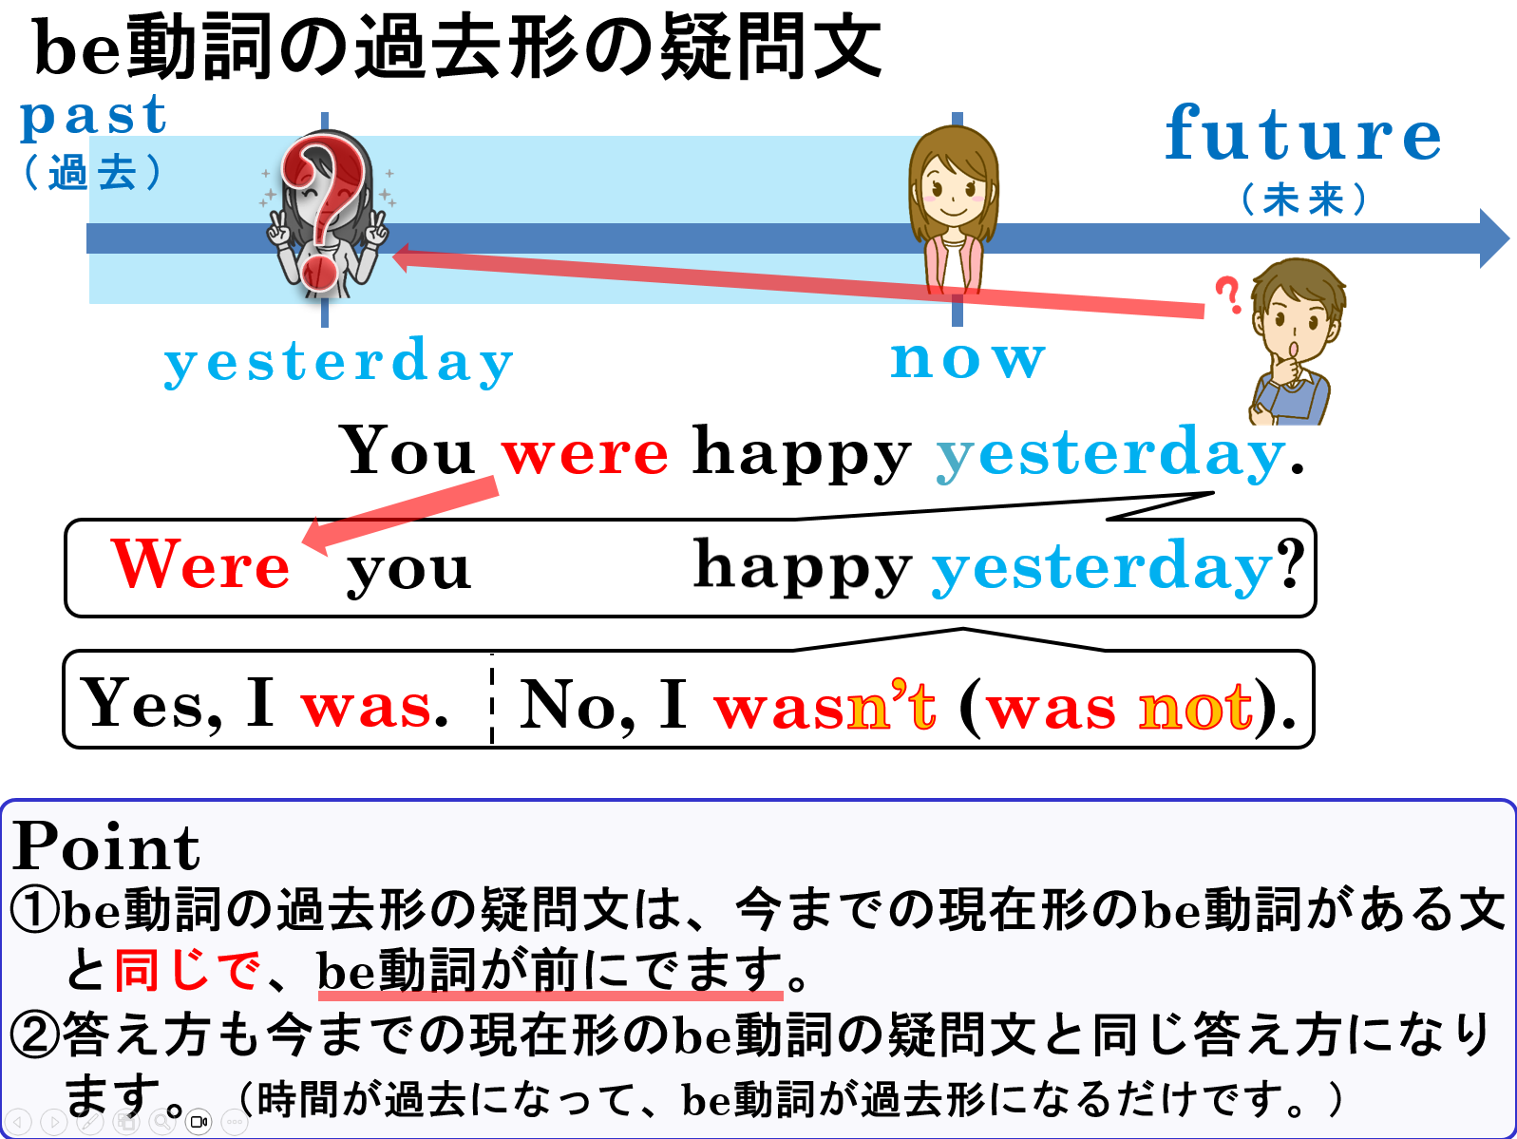

Slide 16
be動詞の過去形の否定文
Practice was not , were not

Slide 17


be動詞の過去形( was, were )の否定文
I was
happy.
not
I was
happy.
Point
①be動詞の過去形の文の否定文の形も今までのbe動詞がある文と
同じです。つまりbe動詞の後ろにnotをつけます。
②notは基本的に後ろを否定します。be動詞は否定しません。
③短縮形は「was not」を短縮して「wasn’t」、were notを短
縮して「weren’t 」と短縮します。
Notes:
be動詞を否定しない→not busyで忙しくない
be動詞を否定すると、存在しないとなってしまいます。

Slide 18

I was sad yesterday.
×
was
not
sad
I ( was )( not )( sad ) yesterday.

Slide 19


I was in America last year.
×
I ( wasn’t )( in ) America last year.
wasn’t
in

Slide 20

You were sick yesterday.
×
were
You ( were )( not )( sick ) yesterday.
not
sick

Slide 21


She was angry this morning.
She ( was )( not ) angry this morning.
was
not

Slide 22

×
He was in Australia last year.
He ( was )( not )( in ) Australia last year.
was
not
in

Slide 23

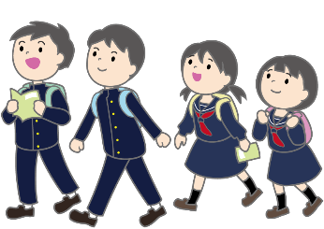
×
They were in Kyoto last week.
were
not
They ( were )( not )( in ) Kyoto last week.
in

Slide 24


We were happy yesterday.
We ( weren’t ) happy yesterday.
weren’t

Slide 25
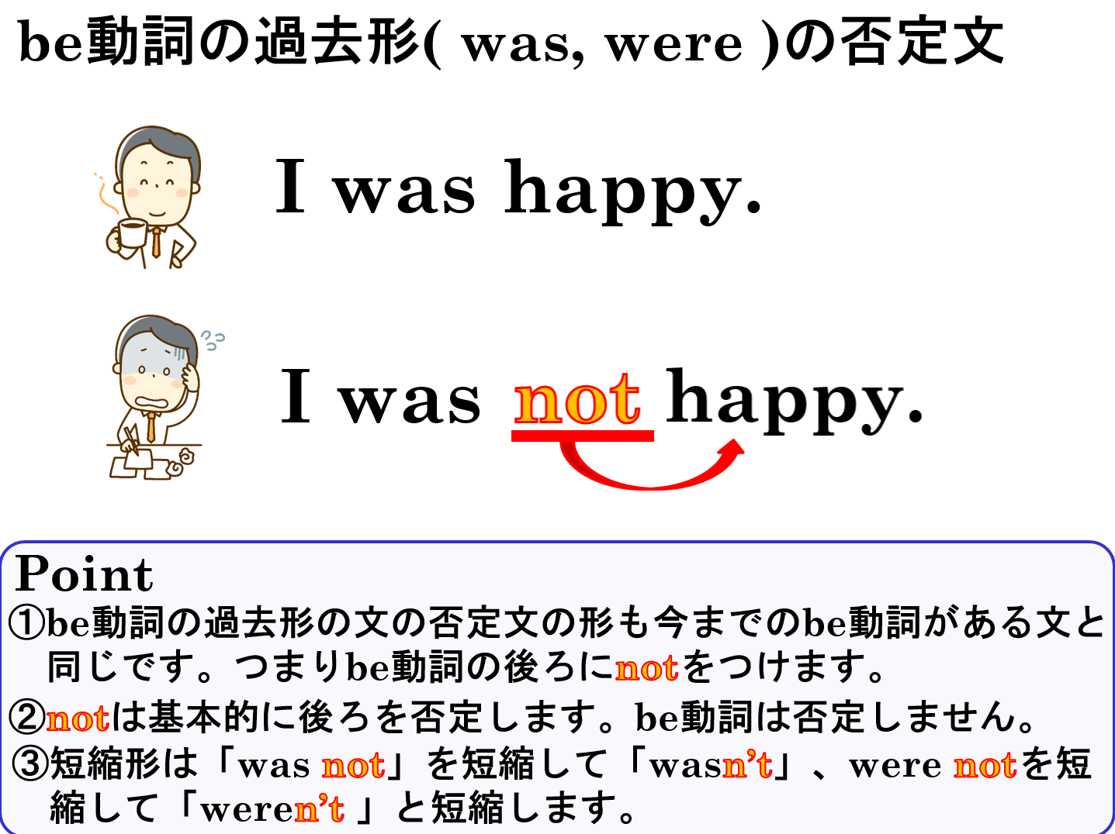

Slide 26
Past Tense
be動詞の過去形

