Slide 1
Why did I become able to understand English?

Slide 2
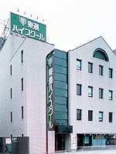
After I was graduated from high school,
I went to Toshin high school.

Slide 3
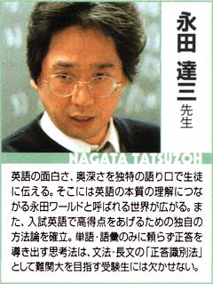
I met a Toshin high school teacher.

Slide 4
He taught me,
“Go to bed” means “sleep.”
Why is “go to bed” “sleep”?

Slide 5
Why don’t they use “a” to go to bed?”
Because bed is not a bed.
≠

Slide 6
Bed without “a” means
our image about “bed.”
Our image about “bed” is sleeping.
We can’t count our image.

Slide 7
So they don’t use “a” to “go to bed.”
Please think below.
① Taro went to school yesterday.
② Kenji went to a school yesterday.
What is the difference
between ① and ②?

Slide 8
Taro is studying.
Taro
Kenji
Kenji is Taro’s father.
Kenji isn’t studying.

Slide 9
Please think below.
① Ken went there by bus.
② Yuka stood by a bus.
What is the difference
between ① and ②?

Slide 10
Ken
Ken moved.
Yuka
Yuka was taken by her mother.

Slide 11

It becomes easier to memorize this.
“at home”
What does it mean in Japanese?
①在宅して、家に
②くつろいで、気軽に
③精通して、熟達して、慣れて
You can imagine the meaning easily without memorizing the meaning.

Slide 12
I started to learn English when I knew that idea.
You know one way to think in English.
Now I am standing in front of you as an English teacher after I was a boy who was not good at English at all.
So let’s enjoy English!

