Slide 1
疑問詞＋ to 動詞の原形

Slide 2
I know
how to do a special magic.

Slide 3
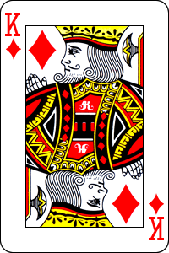
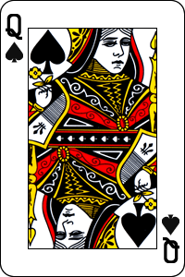
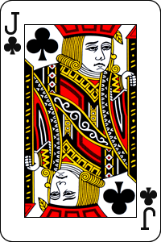
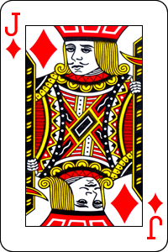
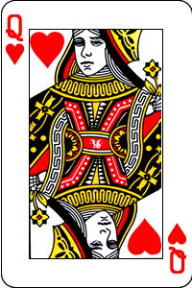
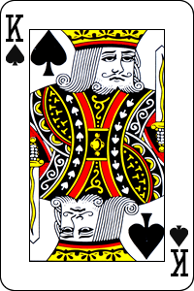
Please memorize one of these.
I’ll pull the one.
And I’ll turn down
other five cards.

Slide 4
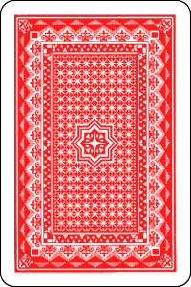
I’ll turn up five cards.

Slide 5
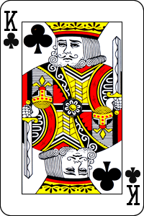
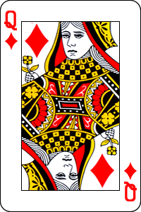
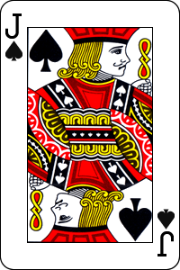
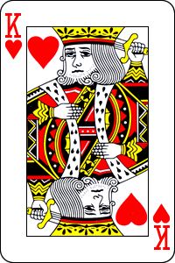
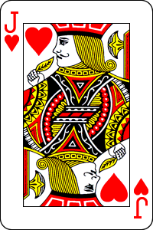
Can you find your card?
You cannot find the card
which you chose.

Slide 6
Do you find out
how to trick you?

Slide 7
疑問詞 + to動詞の原形

Slide 8
You know ＜how to read this kanji＞.
You know ＜how to read this kanji＞.
You know ＜how to play koma＞.
You know ＜how to play koma＞.
独楽
Notes:
Can you read this kanji?
こま
Oh,you know how to read this kanji.
Can you play koma?
Yes. You can play koma. So you know how to play koma.

Slide 9

You know ＜how to read this kanji＞.
You know ＜how to read this kanji＞.
You know ＜how to use it＞.
You know ＜how to use it＞.
You know ＜when to use it＞.
You know ＜when to use it＞.
沈魚落雁閉月羞花
Notes:
Can you read this jukugo?
ちんぎょらくがんへいげつしゅうか
Oh,you know how to read this jukugo.
Do you know the meaning?
Do you want to know the meaning?
It is “very beautiful”.
Now you know the meaning.
And you know how to use this jukugo.

Slide 10
You know ＜how to read this kanji＞.
You know ＜how to read this kanji＞.
You know ＜how to say it in English＞.
You know ＜how to say it in English＞.
You know ＜when to use it＞.
You know ＜when to use it＞.
You know ＜where to use it＞.
You know ＜where to use it＞.
案山子
scarecrow
Notes:
Can you read this kanji?
かかし
Oh,you know how to read this kanji.
And you know how to use this thing.
How do you say kakashi in English?
It’s scarecrow.
Now you know how to say kakashi in English.
When do you use a scarecrow?
You know when to use it.
You know where to use it.

Slide 11
疑問詞 to 動詞の原形
案山子
You know ＜how to read this＞.
You know ＜when to use it＞.
You know ＜where to use it＞.
Point
①＜疑問詞＋to 動詞の原形＞の表現には次のようなものがあります。
＜how＋to 動詞の原形＞どのように～すべきか、～する方法、
～のし方
＜what＋to 動詞の原形＞なにを～すべきか
＜when＋to 動詞の原形＞いつ～すべきか、～する時
＜where＋to 動詞の原形＞どこで・へ～すべきか、～する場所
＜which＋to 動詞の原形＞どちらの～すべきか
②思う・分かる・気づく・知るなどの動詞と一緒に出てくることが多いです。
know, think, say, tell, askなど

Slide 12
疑問詞 + to動詞の原形
Practice

Slide 13
No 1
Do you know
how to play the guitar
?

Slide 14
No 2
Do you know
how to make good coffee
?

Slide 15
No 3
Do you know
how to play soccer very well
?

Slide 16
No 4
Do you know
?
how to say “I love you” in Chinese

Slide 17
吃逆
No 5
Do you know
how to read this kanji
?
Notes:
吃逆・・・しゃっくり

Slide 18
No 6
Do you know
how to run the fastest
?

Slide 19
No 7
write – wrote - ?
Do you know
how to write
past participle of write
?

Slide 20
No 8
Do you know
how to make
many boy or girl friends
?

Slide 21
No 9
Do you know
how to fly in the sky
?

Slide 22
No 10
Do you know
what to give
my girl or boy friend
?

Slide 23
No 11
Do you know
what to do now
?

Slide 24
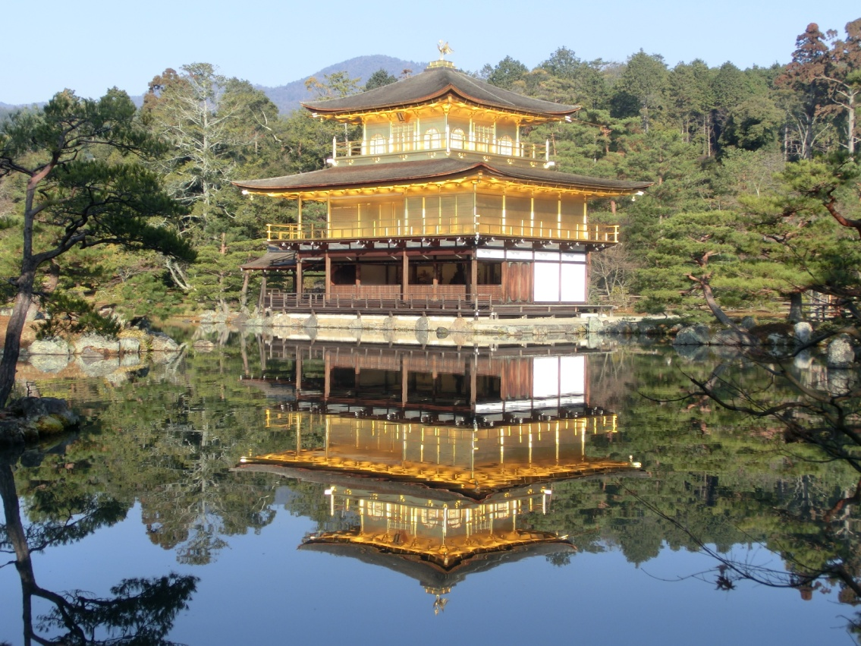
No 12
Do you know
when to visit Kyoto
?

Slide 25
No 13
Do you know
when to study math
?

Slide 26
No 14
Do you know
where to go on a date
?

Slide 27
No 15
Do you know
where to have dinner
?

Slide 28
No 16
Do you know
which book to buy
?
Notes:
このスライドには、その時売れている本2冊の写真を入れてください。

Slide 29
疑問詞 to 動詞の原形
案山子
You know ＜how to read this＞.
You know ＜when to use it＞.
You know ＜where to use it＞.
Point
①＜疑問詞＋to 動詞の原形＞の表現には次のようなものがあります。
＜how＋to 動詞の原形＞どのように～すべきか、～する方法、
～のし方
＜what＋to 動詞の原形＞なにを～すべきか
＜when＋to 動詞の原形＞いつ～すべきか、～する時
＜where＋to 動詞の原形＞どこで・へ～すべきか、～する場所
＜which＋to 動詞の原形＞どちらの～すべきか
②思う・分かる・気づく・知るなどの動詞と一緒に出てくることが多いです。
know, think, say, tell, askなど

