Slide 1
受け身の疑問文
Practice ～ed・・・？

Slide 2
Quiz

Slide 3
I’ll ask you some questions.
Please go to the left side
when you think “Yes”.
Please go to the right side
when you think “No”.
○
×

Slide 4
If you are wrong,
go back please.
Who is the last person
to answer?
○
×

Slide 5
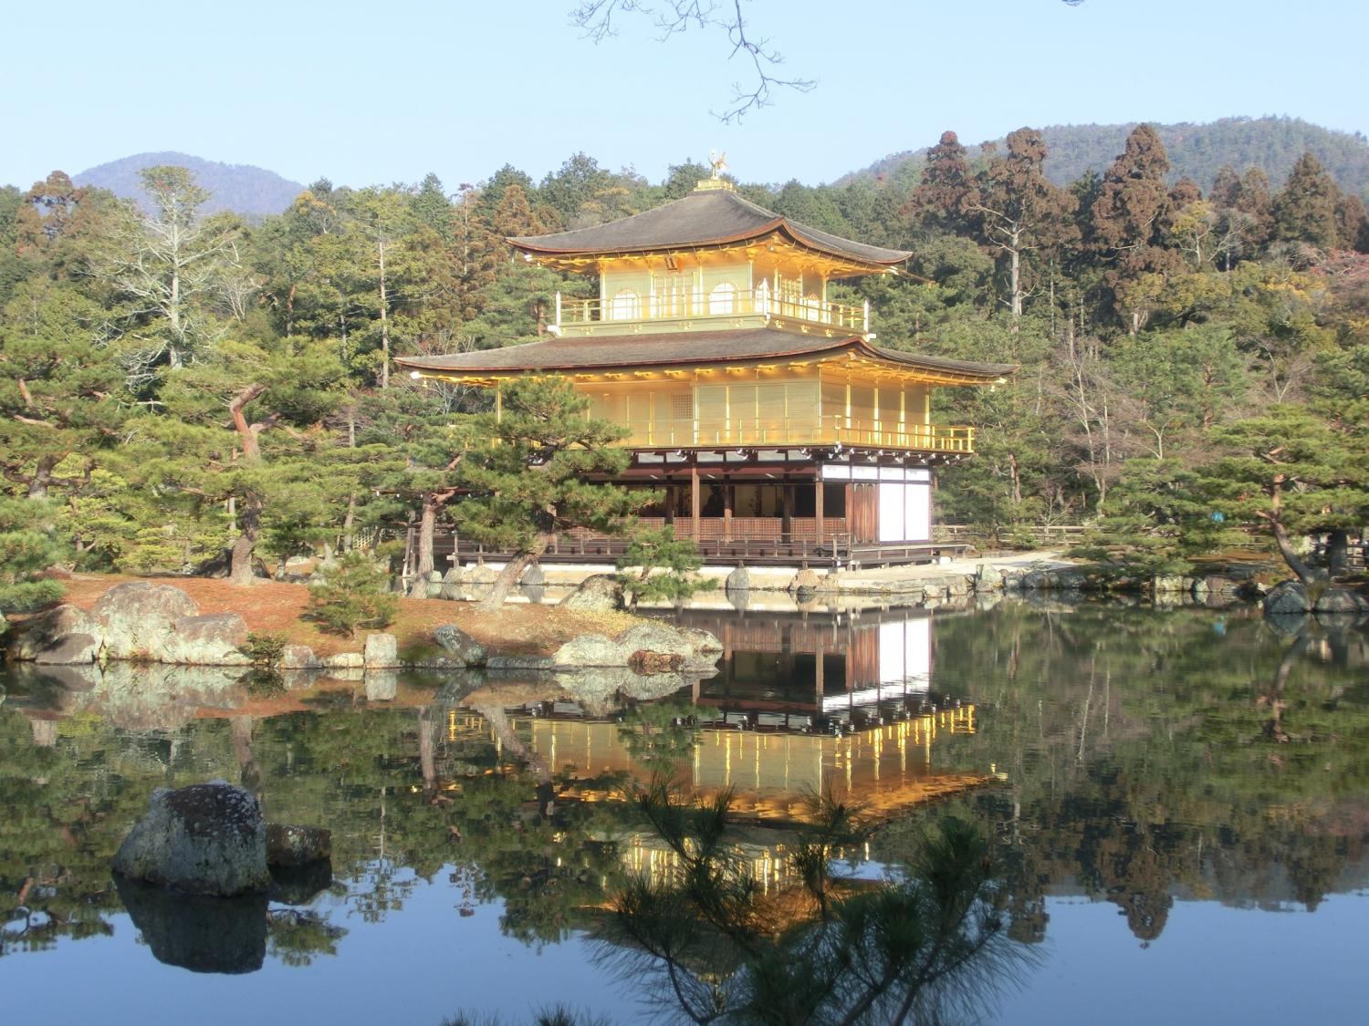
Q1
Notes:
Was Kinkaku-ji burnt in 1940?
No, it wasn’t. It was burnt in 1950.

Slide 6
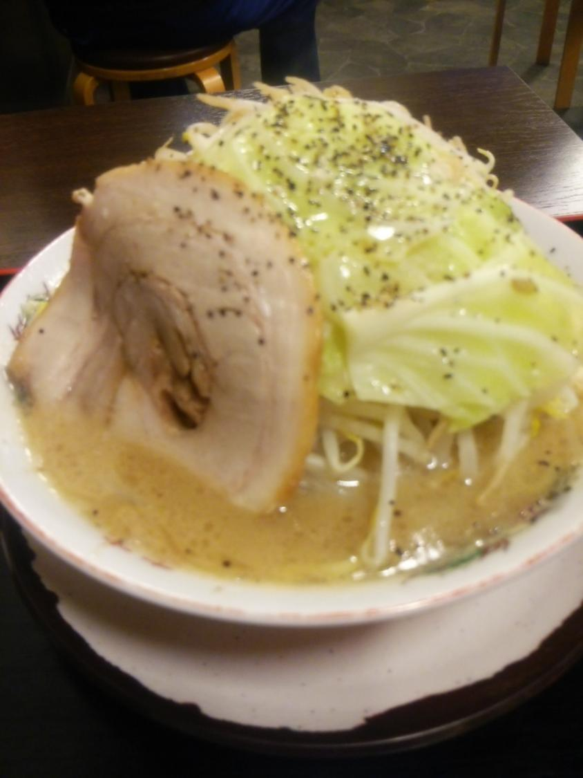
Q2
Notes:
Was Ramen eaten by Mitokomon?
Yes, it was.

Slide 7
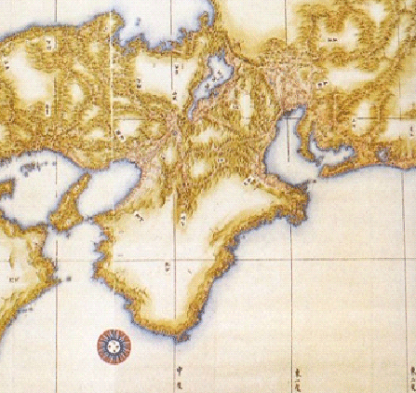
Q3
Notes:
Was this map made in Meiji era?
No, it wasn’t. It was made in Edo

Slide 8
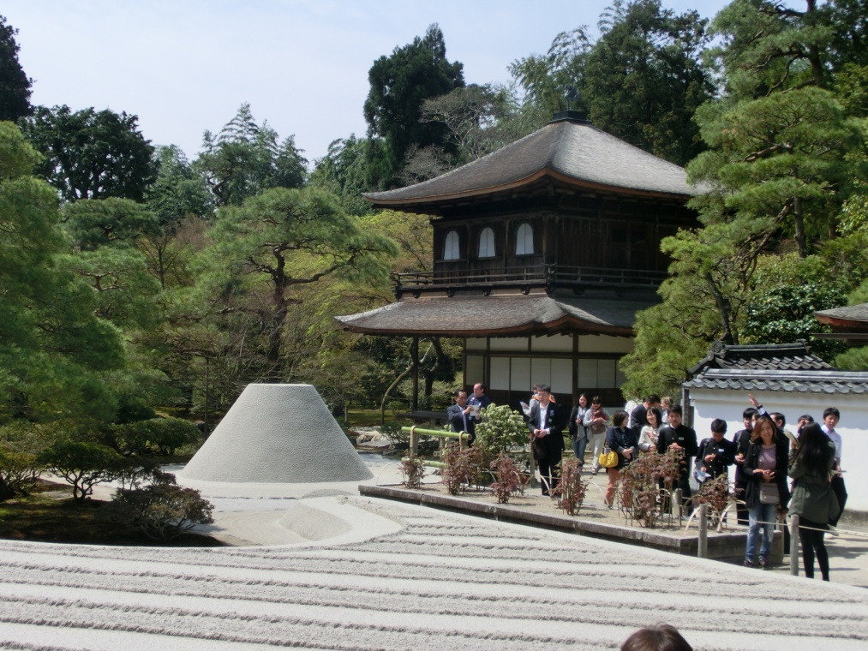
Q4
Notes:
Was Ginkaku-ji built by Ashikaga Yoshimitsu?
No, it wasn’t. It was built by Ashikaga Yoshimasa.

Slide 9

Q5
Hello.
Notes:
Was the word of hello made by Edison.
Yes, it was. Bell made a telephone but Edison made hello.

Slide 10
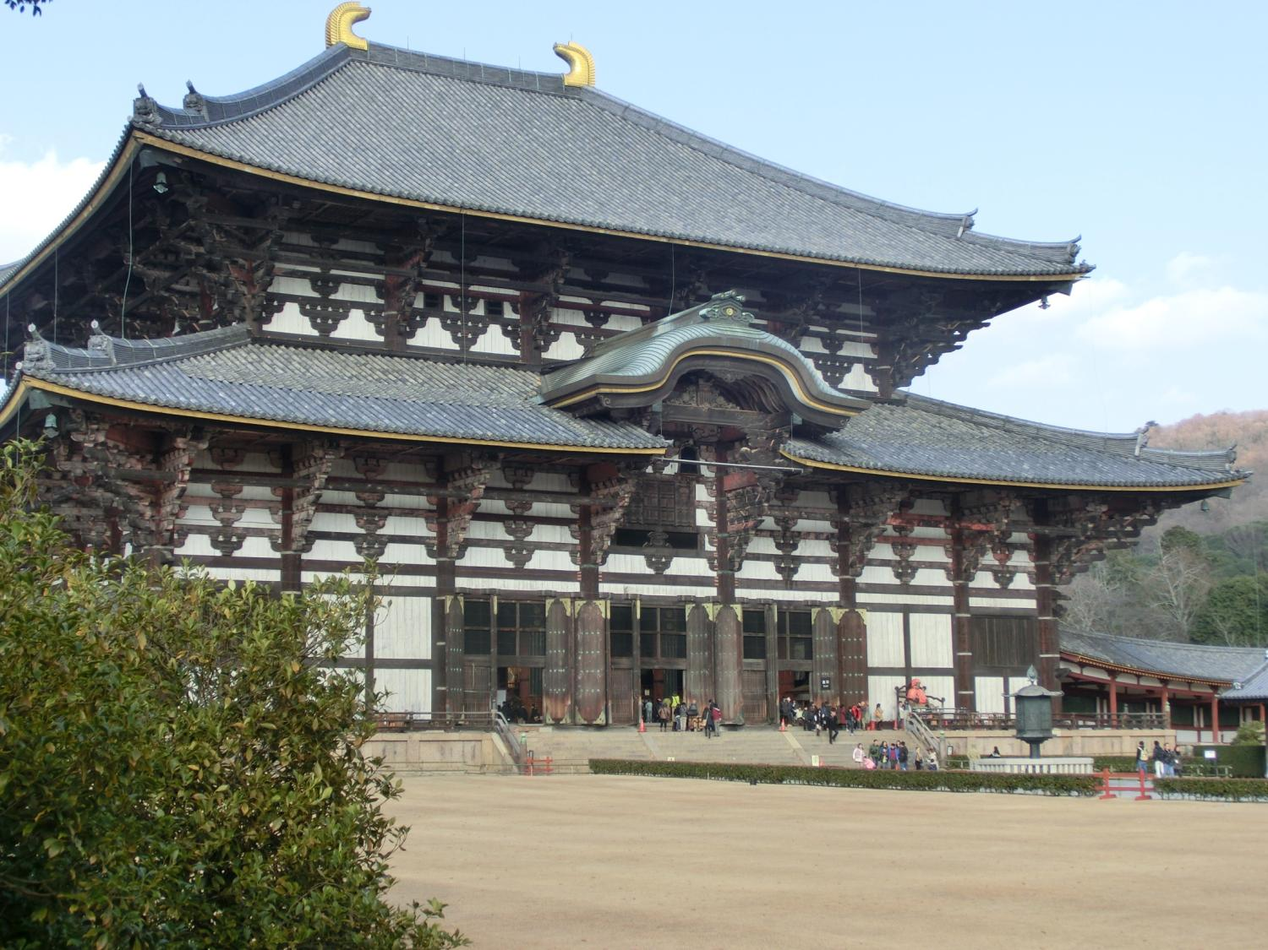
Q6
Notes:
Was Todai-ji built in Nara era?
Yes, it was.

Slide 11
Q7
9
Notes:
Was 9 eaten by 7?
Yes, it was. 7 ate 9.

Slide 12
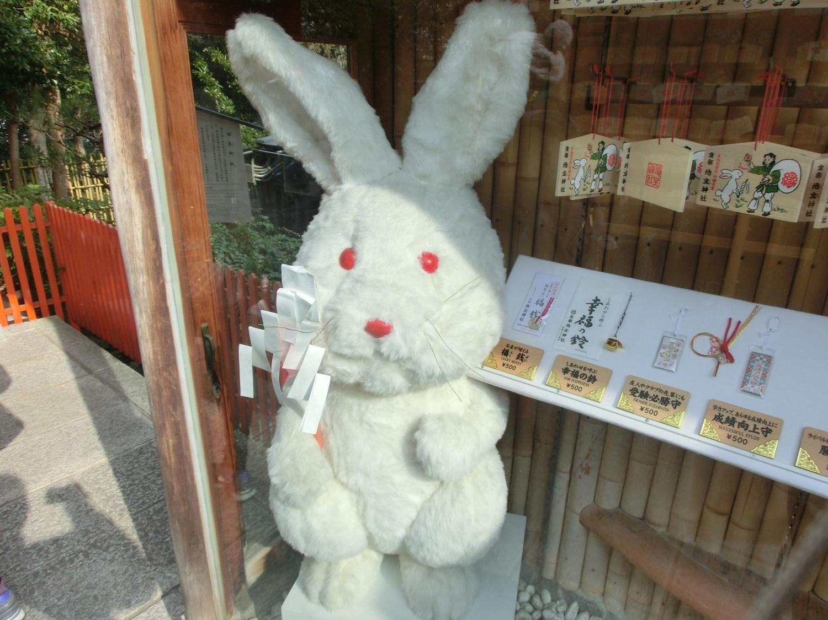
Q8
Notes:
Is this rabbit seen at Kiyomizudera?
No, it isn’t.
It is seen at Jishujinja.

Slide 13
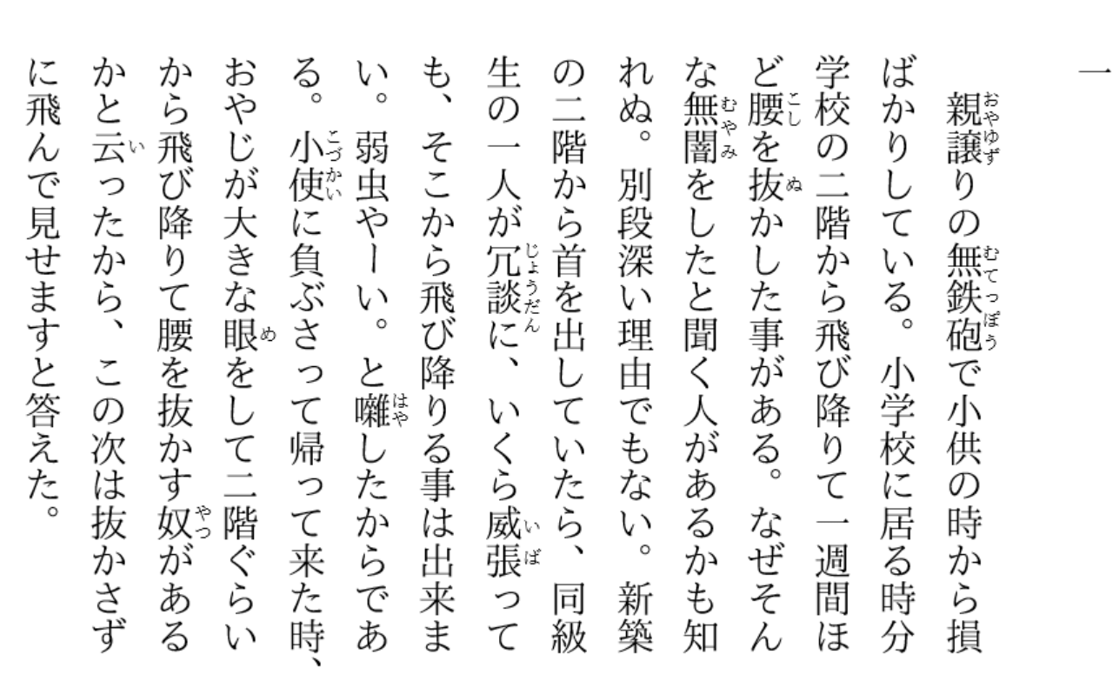
Q9
Notes:
Was Bocchan written by Natsume Soseki?
Yes, it was.

Slide 14
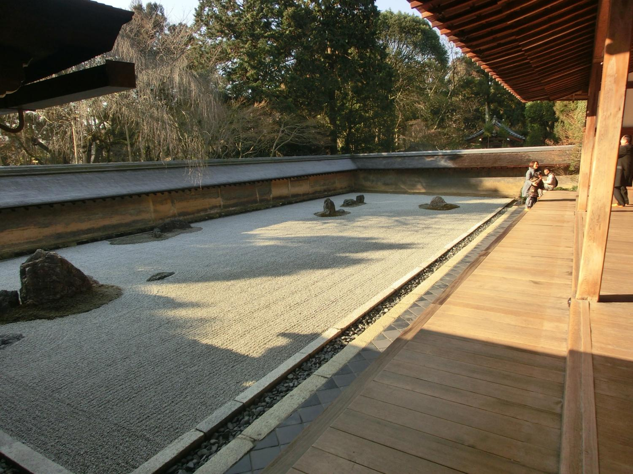
Q10
Notes:
Are 15 rocks seen at once at Ryoan-ji?
Yes, they are. It is said that you cannot see 15 rocks at once.
But you can. There is a place to see them at once.

Slide 15
Who is a winner?

Slide 16
受け身の疑問文
Practic

Slide 17
受け身の疑問文
That is your book.
is
Is
that your book?
Yes, it is. / No, it isn’t.
English is used there.
is
Is
English used there?
Yes, it is. / No, it isn’t.
Point
①受け身と言っても疑問文の形は、今までのbe動詞が
ある文と同じ。 be動詞が前にでる。
②答え方も今までのbe動詞の疑問文と同じ答え方

Slide 18
play
( Is ) basketball ( played )
by 10 players?
Yes, ( it ) is. / No, ( it ) isn’t.

Slide 19

see
( Is ) this rabbit ( seen )
at Kiyomizu-dera?
Yes, ( it ) is. / No, ( it ) isn’t.

Slide 20

make
( Are ) these cars ( made ) in Japan?
Yes, ( they ) are. / No, ( they ) aren’t.

Slide 21
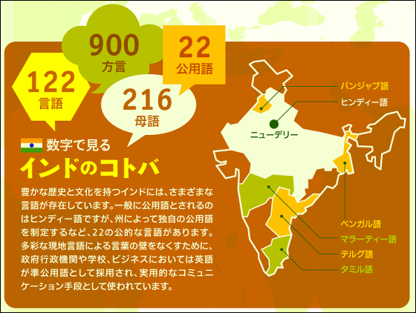
speak
( Are ) many languages ( spoken )
in India?
Yes, ( they ) are. / No, ( they ) aren’t.

Slide 22
write
( Was ) Bocchan ( written ) by Soseki?
Yes, ( it ) was. / No, ( it ) wasn’t.

Slide 23
use
( Were ) these computers ( used )
by students yesterday?
Yes, ( they ) were. / No, ( they ) weren’t.

Slide 24
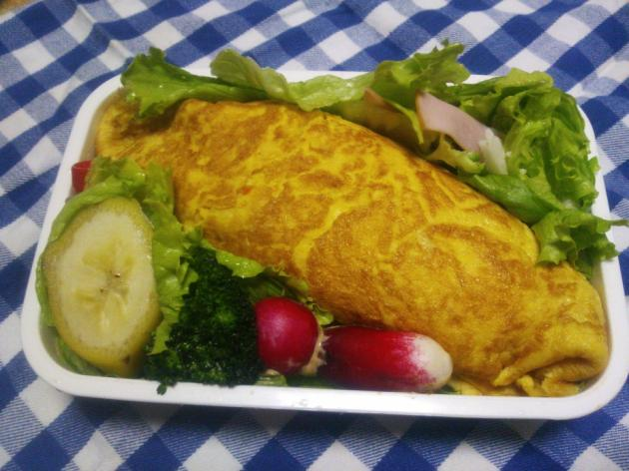
make
( Was ) this lunch ( made )
by Mr. Kasuga last year?
Yes, ( it ) was. / No, ( it ) wasn’t.

Slide 25
受け身の疑問文
That is your book.
is
Is
that your book?
Yes, it is. / No, it isn’t.
English is used there.
is
Is
English used there?
Yes, it is. / No, it isn’t.
Point
①受け身と言っても疑問文の形は、今までのbe動詞が
ある文と同じ。 be動詞が前にでる。
②答え方も今までのbe動詞の疑問文と同じ答え方

