Slide 1
受け身を練習しよう

Slide 2
Improve listening skills
Listen and write
Notes:
（１）Baseball is played by TANAKA Masahiro.
（２）English is spoken in Australia.
（３） Okonomiyaki is made in Hiroshima.
（４）Buildings are broken by Godzilla.
（５） Bananas are eaten by monkeys.
（６）“Koisuru Fortune-cookie” is sung by AKB48.
（７）Comics are read by many people.
（８）Soccer is played by 22 players.

Slide 3
Review passive

Slide 4
play
Basketball
is
played
by
10 players.

Slide 5
play
Volleyball
is
played
by
12 players.

Slide 6
play
Baseball
is
played
by
18 players.

Slide 7
use
A bat
is
used
by
baseball players.

Slide 8
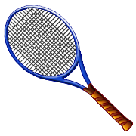
use
A racket
is
used
by
tennis players.

Slide 9
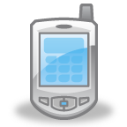
use
Smart phones
are
used
for
E-mail.

Slide 10
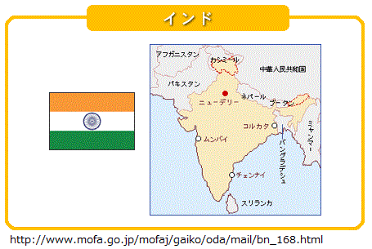
speak
Many languages
are
spoken
in
India.

Slide 11
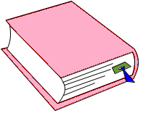
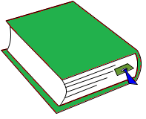

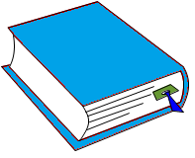

read
These books
are
read
in
many countries.

Slide 12
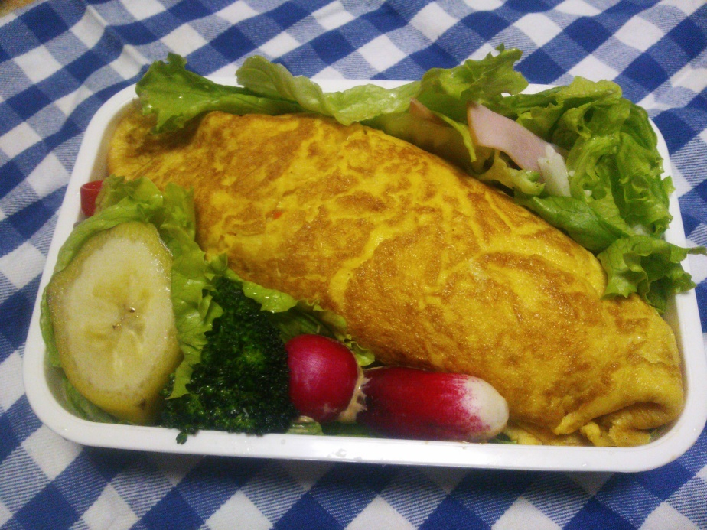
make
This lunch
was
made
by
Mr. Kasuga
last year.

Slide 13
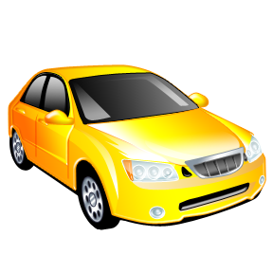
make
These cars
were
made
in
Japan.

Slide 14

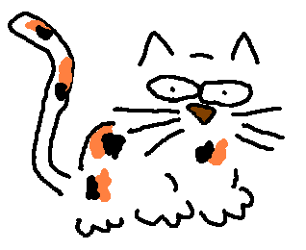
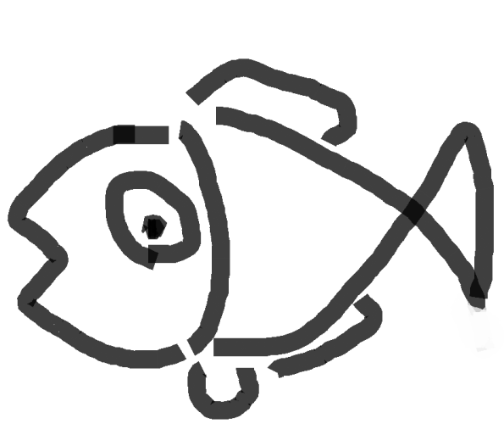
受け身の文
その猫がその魚を
食べた
The cat
ate
the fish.
その魚がその猫に
食べられた
The fish
was eaten
by
the cat.
Point
①受け身の文はbe動詞と過去分詞で表す。
②訳は「～される・された」（日本語の「れる」には受け身以外の意味もいくつかあるので注意）
③be動詞は、主語と時間に合わせて変化する。
④過去分詞の基本は「～ed」、しかし、時間とは関係がない。
⑤by～は元々の主語（行為を行う者）を表すときに使う。
⑥by～は明らかに分かる・まったく分からないときには使わない。
Notes:
日本語の「～れる」で間違えやすいものは
使役、尊敬、受け身でごちゃごちゃすると思われます。

