Slide 1
使役のmake

Slide 2
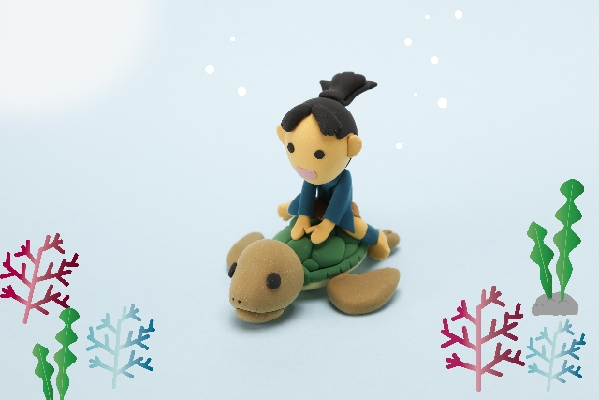
Do you know Urashimataro?

Slide 3
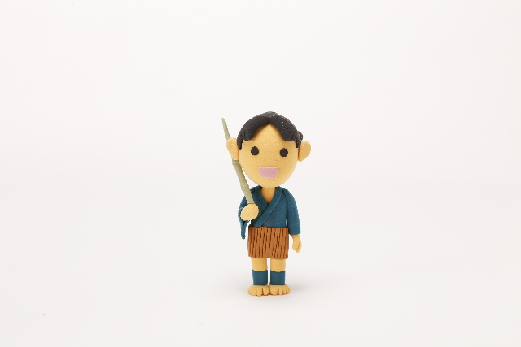
Long, long time ago…
There was a young fisherman.

Slide 4
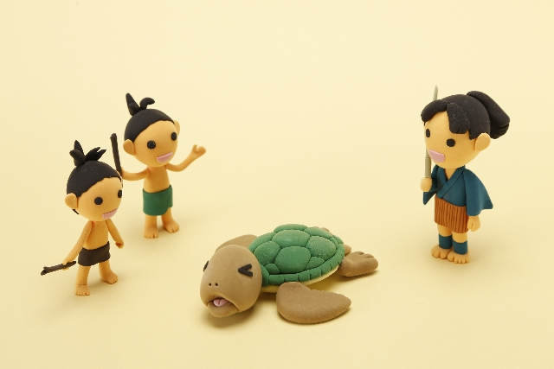
He found a turtle.
The turtle was bullied by children.
He saved the turtle.

Slide 5
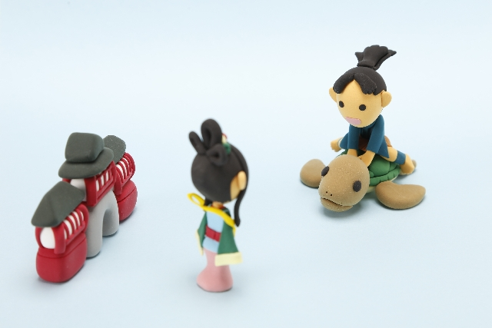
The turtle took him to the Ryugujo.

Slide 6
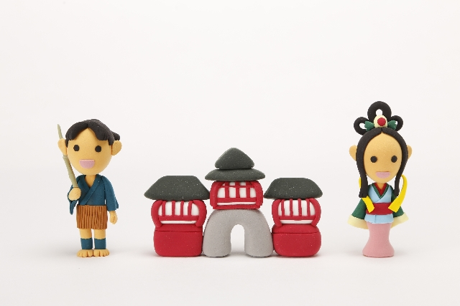
He had a special time there.
But he wanted to go back home.

Slide 7
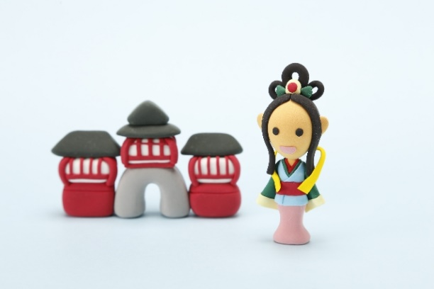
The princess, Oto gave
him Tamate box.

Slide 8
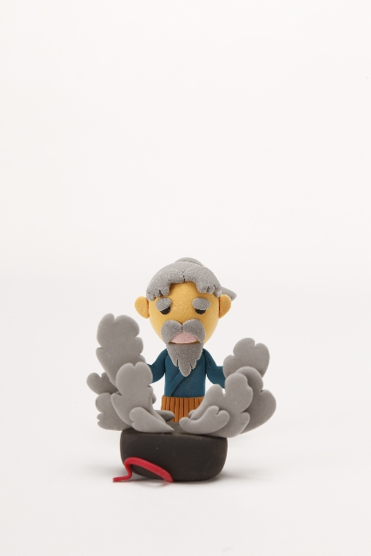
When he came back,
he opened the box.
He became old.

Slide 9

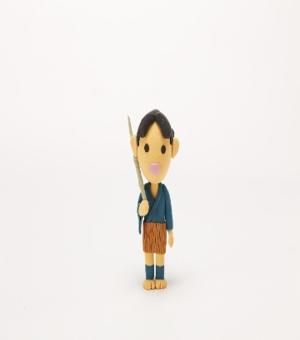
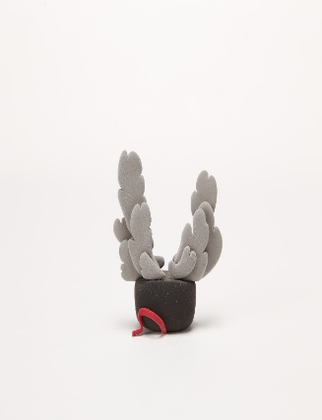

Taro
opened
the box
Taro
became
old

Slide 10
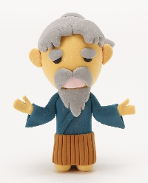
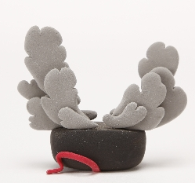
使役のmake
The box
made
＜ ＞
［ ］
Taro
old .
＜ ＞
［ ］
その箱が、 太郎を 老人に した。
Point
① make は、「～をつくる」という意味以外に
下のような使い方をして、使役の表現ができる。
主語
make
A
＜人・もの＞
B
［形容詞］
主語が
＜Aを＞
［Bに］
する・させる
②日本語の「～する・させる」は、受け身や尊敬でも使われるので注意。
③ A の部分には代名詞がくることが多いが、動詞の後ろなので、
目的格（me, you, him, her, it, them）の形を使う。

Slide 11
使役のmake
Fill in the blanks
Notes:
プリントを配布して考えさせます。

Slide 12
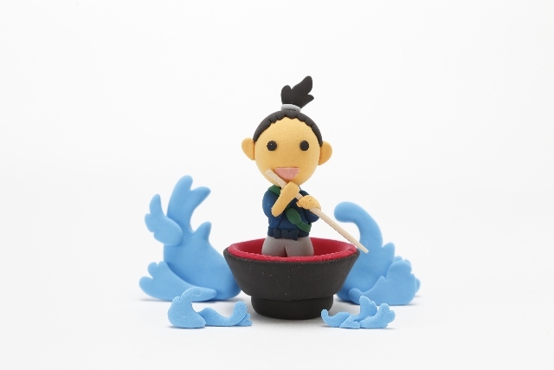
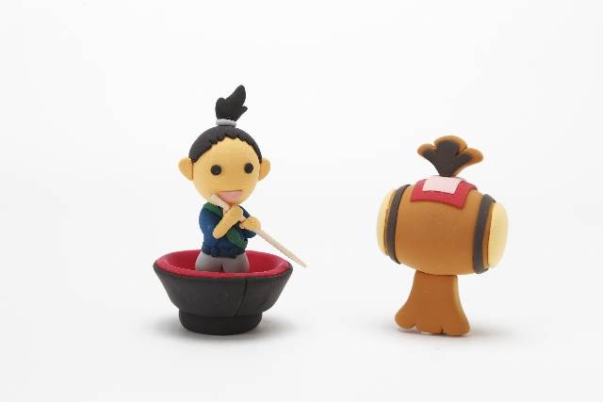
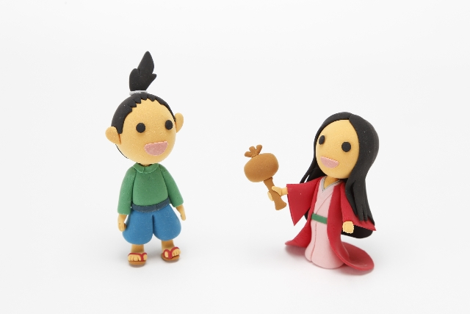
≪Uchidenokozuchi≫ made
Issunboshi bigger.

Slide 13
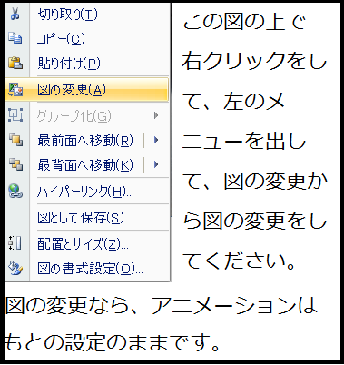
≪Dorayaki≫ makes
Doraemon happy.
Notes:
図はドラえもん

Slide 14

≪ Love ≫ makes
the world peaceful.

Slide 15
Shizuka makes
＜ Nobita ＞ happy.
Notes:
図は静香ちゃん

Slide 16
Beans make ＜ oni ＞ weak.
* weak ↔ strong

Slide 17

Love makes
＜ girls ＞ beautiful.

Slide 18
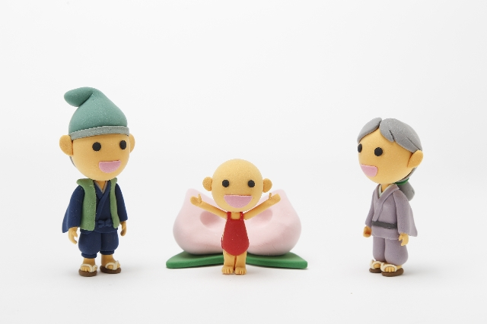
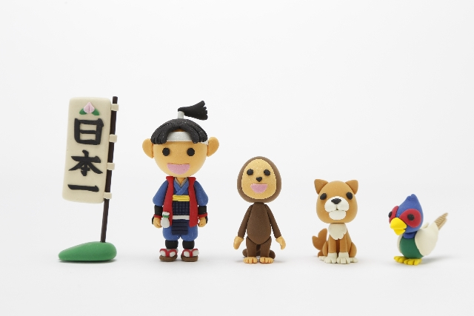
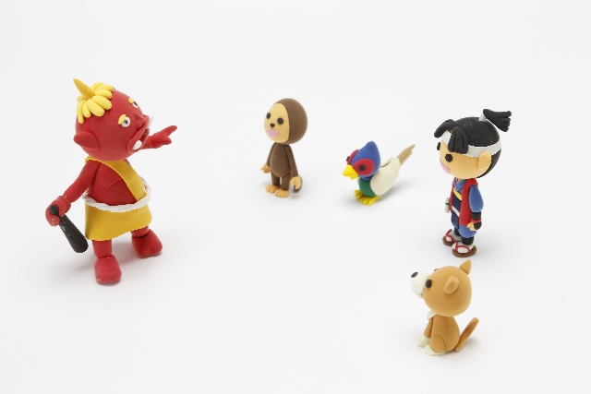
Kibidango made
Momotaro ［ strong ］.

Slide 19
Love and courage make
Ampanman ［ strong ］.
Notes:
図はアンパンマン

Slide 20
Water makes
Ampanman ［ weak ］.
Notes:
図はアンパンマン

Slide 21
使役のmake

Slide 22
≪Uchidenokozuchi≫ made
Issunboshi bigger.

Slide 23
≪Dorayaki≫ makes
Doraemon happy.

Slide 24
≪ Love ≫ makes
the world peaceful.

Slide 25
Shizuka makes
＜ Nobita ＞ happy.

Slide 26
Beans make ＜ oni ＞ weak.
* weak ↔ strong

Slide 27
Love makes
＜ girls ＞ beautiful.

Slide 28
Kibidango made
Momotaro ［ strong ］.

Slide 29
Love and courage make
Ampanman ［ strong ］.

Slide 30
Water makes
Ampanman ［ weak ］.

Slide 31
Free talk

Slide 32
No 1
≪ ≫made me happy.
≪ ≫makes me happy.
≪ ≫ will make me happy.

Slide 33
No 2
≪ ≫made me sad.
≪ ≫makes me sad.
≪ ≫ will make me sad.

Slide 34
No 3
≪ ≫made me excited.
≪ ≫makes me excited.
≪ ≫ will make me excited.

