Slide 1
より詳しく、より効果的に
相手に伝えよう

Slide 2
Review

Slide 3
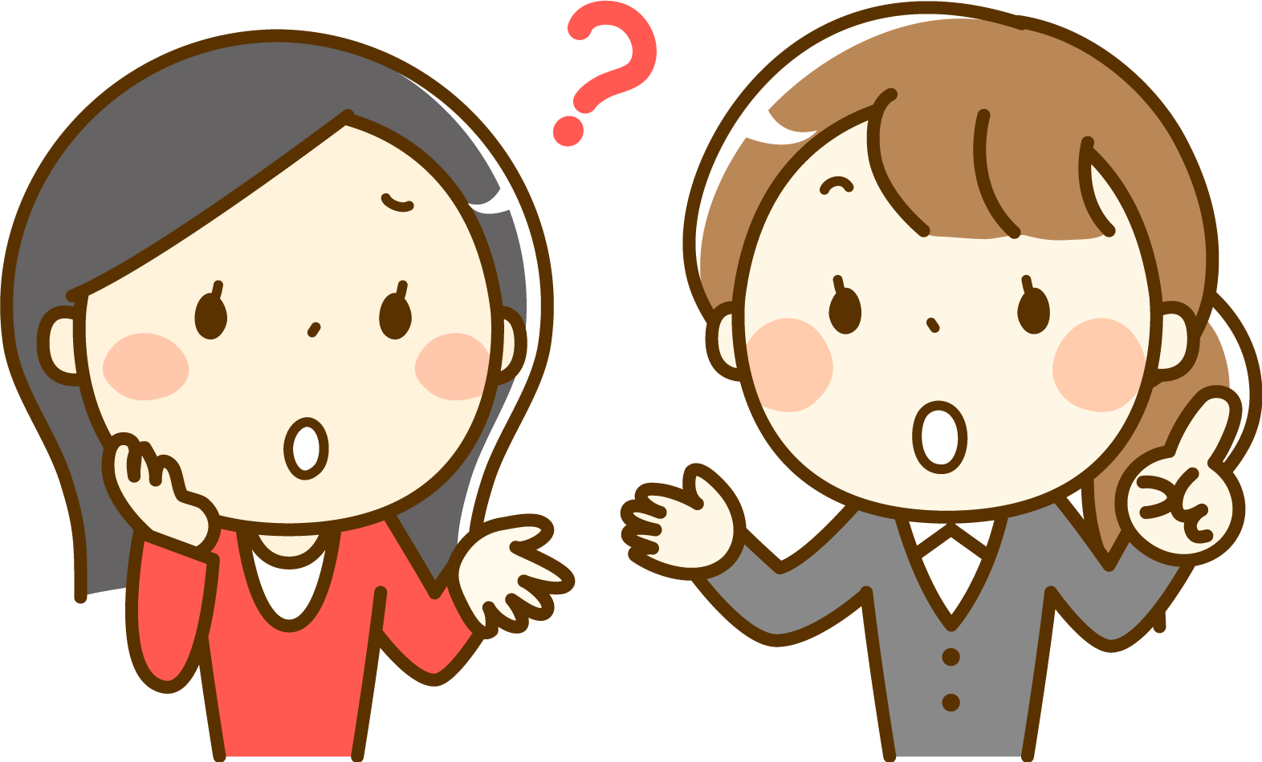
English is difficult.

Slide 4
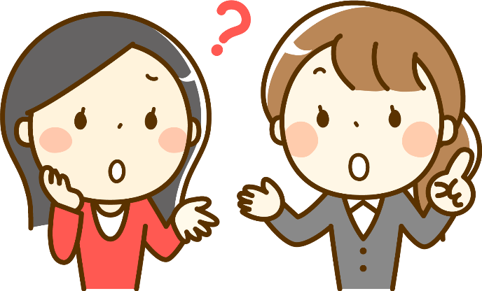
Difficult?
To listen to English?
To speak English?
To read English?
To write English?

Slide 5
具体的に伝えよう

Slide 6

English
is difficult.
To listen to English
is difficult.

Slide 7

English
is difficult.
To speak English
is difficult.

Slide 8

English
is difficult.
To read English
is difficult.

Slide 9

English
is difficult.
To write English
is difficult.

Slide 10
さらに詳しく伝えよう

Slide 11

To listen to English
is difficult
for me.

Slide 12

To speak English
is difficult
for Mika.
Mika

Slide 13

To read English
is difficult
for Ken.
Ken

Slide 14

To write English
is difficult
for him.
him

Slide 15
Effectively

Slide 16
It
is difficult
for me
to speak English.
?
What is ‘It’ ?
!!!
‘It’ = to speak English!
Notes:
Itって、なんだよ～～～
そういうことかぁ！！！

Slide 17

It is 形容詞 for 人 to 動詞の原形 の文
To speak English
To speak English is difficult for me.
It is difficult for me
to speak English.
It
It is difficult for me to speak English.
Point
①difficult, importantなどの * 形容詞 (funのみ名詞) は、
It から文をはじめて、
「動詞の原形することが、形容詞なんだ 」という文章を作ります。
* easy / difficult / important / hard / interesting / exciting /
necessary / good* / bad* / useful / natural / dangerous / *fun
② 訳すときには、Itを「それは」と訳さず、to動詞の原形 のところ
から訳します。→ 「動詞の原形することが、形容詞なんだ」
また、この It を仮主語のitと言います。
③ for + 人（目的格）をつけて、誰にとってのことなのかを表す
ことがあります。必要がなければつけません（みんなのことなど）。

Slide 18
It is 形容詞 to 動詞の原形
｢ 動詞の原形することは形容詞だ｣

Slide 19
行為を表す形容詞
easy
簡単な
necessary
必要な
difficult
good
よい
難しい
important
重要な
bad
悪い
hard
大変な・難しい
useful
役立つ
interesting
natural
当然な・自然な
おもしろい
exciting
わくわくする
dangerous
危険な
fun
楽しみ（名詞）

Slide 20
It is 形容詞 for 人 to 原形
｢ 人 が 原形することは形容詞だ ｣

Slide 21
To speak English
is difficult
for Mika.
( It )is difficult for Mika
( to )( speak )( English ).
It
to
speak
English

Slide 22
To read English
is difficult
for Ken.
( It )is ( difficult ) for Ken
( to )( read )( English ).
It
difficult
to
read
English

Slide 23
To write English
is difficult
for him.
It ( is )( difficult )( for )( him)
( to )( speak )( English ).
is
difficult
for
him
to
write
English

Slide 24
interesting
study math
me
It( is )( interesting )( for )( me )
( to )( study )( math ).
is
interesting
for
me
to
study
math

Slide 25
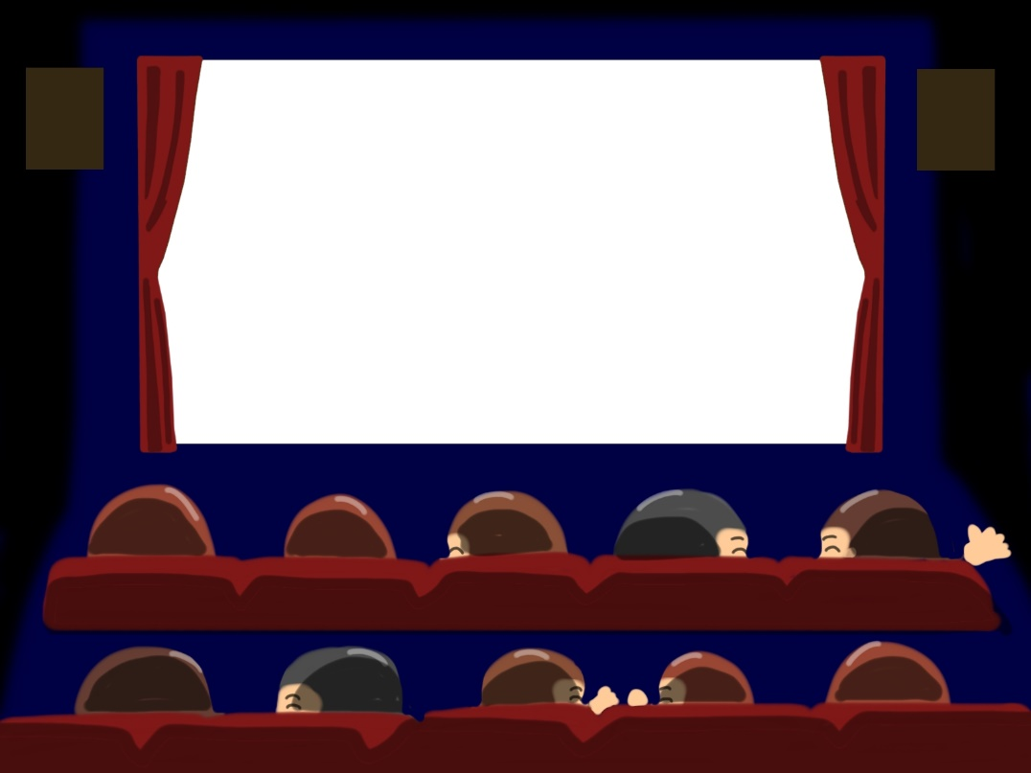
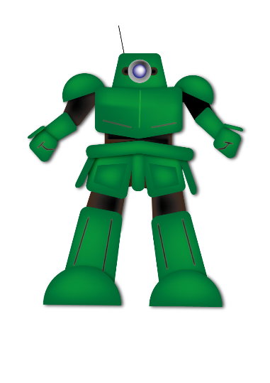
exciting
watch the movie
them
It( is )( exciting )( for )( them )
( to )( watch )( the ) ( movie ).
is
exciting
for
them
to
watch
the
movie

Slide 26
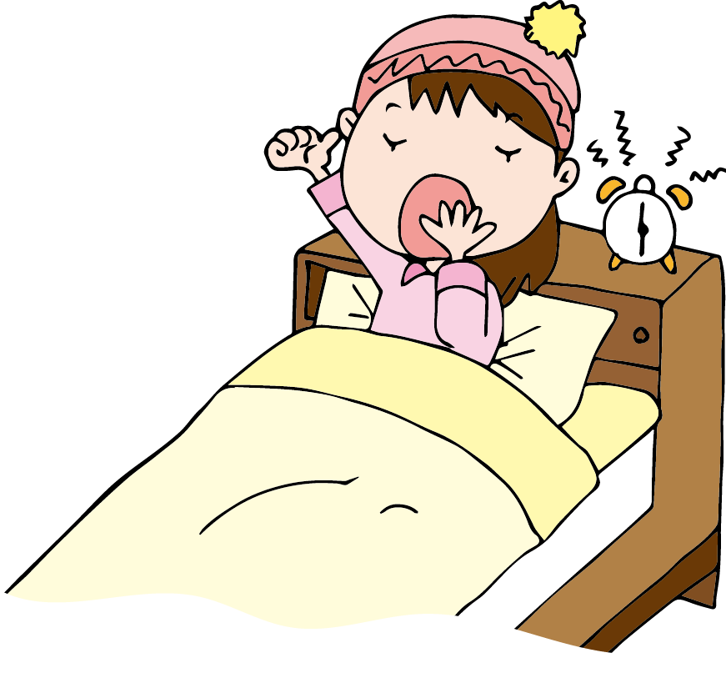
important
get up early
us
It( is )( important )( for )( us )
( to )( get )( up ) ( early ).
is
important
for
us
to
get
up
early

Slide 27

easy
use this tablet
It( is )( easy )
( to )( use )( this ) ( tablet ).
is
easy
to
use
this
tablet

Slide 28


dangerous
enter the house
It( is )( dangerous )
( to )( enter )( the ) ( house ).
is
dangerous
to
enter
the
house

Slide 29
