Slide 1
Today’s Goal: Use irregular verb
不規則変化動詞を身につけよう

Slide 2
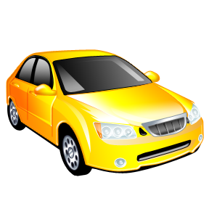
I drive it every day.
Notes:
I have a car.
I drive it every day.
自分の車の写真に置き換えると良いです。

Slide 3
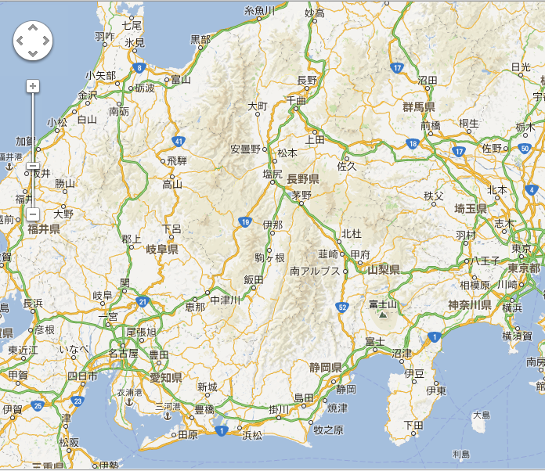
I drove it to Ina yesterday.
I went to Ina yesterday.
Notes:
Yesterday, I drove it to Ina.
Hara is here.
Ina is here.
I lived in Ina last year.
I went to Ina yesterday.

Slide 4

過去形
不規則変化動詞
I drive a car every day.
I drive a car yesterday.
I drive a car yesterday.
I drove a car yesterday.
I drove a car yesterday.
+
ed
Point
「動詞」が「動詞ed」の形になって、過去のことを表しますが、
「動詞＋ed」でなく、動詞そのものの形が変わるものがあります。
「不規則変化動詞」と言います。

Slide 5
不規則変化動詞
過去形を練習しよう

Slide 6
go
went

Slide 7
come
came

Slide 8
eat
ate

Slide 9
have
had

Slide 10
make
made

Slide 11
buy
bought

Slide 12
swim
swam

Slide 13
see
saw

Slide 14
run
ran

Slide 15
不規則変化の過去形を練習しよう
不規則変化の動詞

Slide 16
I went to the USA last week.

Slide 17
He came to school yesterday.

Slide 18
She ate sushi last night.

Slide 19
Tom had a cat last year.

Slide 20
She made cookies last Sunday.

Slide 21
My sister bought a comic book last week.

Slide 22
They swam in the pool last summer.

Slide 23
They saw a movie last Sunday.

Slide 24
My father ran to the station.

Slide 25
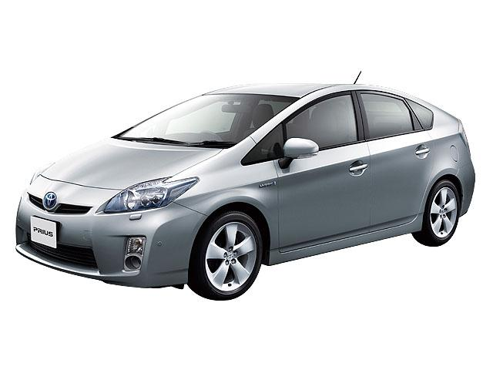
過去形
不規則変化動詞
I drive a car every day.
I drove a car yesterday.
I drive a car yesterday.
I drive a car yesterday.
+
ed
Point
「動詞」が「動詞ed」の形になって、過去のことを表しますが、
「動詞＋ed」でなく、動詞そのものの形が変わるものがあります。
「不規則変化動詞」と言います。

Slide 26
過去形
不規則変化動詞の過去形の疑問文

Slide 27
疑問文
Do
you played soccer?
Did
You played soccer.
ed
No, I did not.
Yes, I did.
/
No, I didn’t.
Do
Did
you eated sushi?
ed
You ateed sushi.
No, I did not.
Yes, I did.
/
No, I didn’t.

Slide 28
疑問文（不規則変化動詞）
Do
ate
you ed sushi?
Do
you eated sushi?
ed
Do＋
ed
Did
you eated sushi?
Yes, I did.
/ No, I did not.
/No, I didn’t.
①規則変化の動詞と同じように、過去を表す部分が、
たずねるときに使うdoとくっついてdidになります。
②不規則変化の動詞の過去の部分がはdoとくっついて
didになっているので、動詞は原形になります。
③Didで質問しているので、答えるときにもdidを使います。

Slide 29
過去形
不規則変化動詞の過去形の疑問文を練習しよう

Slide 30
Did you go to Kyoto yesterday?
Yes, I did. / No, I didn’t.

Slide 31
Did Tom buy a comic book yesterday?
Yes, he did. / No, he didn’t.

Slide 32
