Slide 1
Today’s Goal:
Ask whether your friend did yesterday or not
昨日したかをたずねよう

Slide 2
過去形
過去形の疑問文

Slide 3
疑問文
Do
you played soccer?
You played soccer .
No, I do not.
Yes, I do.
/
No, I don’t.
Do
you played soccer?
Did
You played soccer.
ed
No, I did not.
Yes, I did.
/
No, I didn’t.

Slide 4
過去形の疑問文
you played soccer?
ed
Do
You played soccer.
Do＋
ed
Did
you played soccer?
Yes, I did.
/ No, I did not.
/No, I didn’t.
過去を表す形の「動詞ed」のedが、たずねるときに使うdoとくっついてdidになります。
「動詞ed」のedはdoとくっついてdidになっているので、動詞にはedがつきません。
Didで質問しているので、答えるときにもdidを使います。

Slide 5
過去形を練習しよう
～ed

Slide 6
Did you play soccer yesterday?
Yes, I did. / No, I didn’t.

Slide 7
Did she watch TV yesterday?
Yes, she did. / No, she didn’t.

Slide 8
Did they play a video game last Sunday?
Yes, they did. / No, they didn’t.

Slide 9
Did he visit the USA last week?
Yes, he did. / No, he didn’t.

Slide 10
Did you walk to school yesterday?
Yes, I did. / No, I didn’t.

Slide 11
Did he study math last Monday?
Yes, he did. / No, he didn’t.

Slide 12

Did Kenji live in Hokkaido last year?
Yes, he did. / No, he didn’t.

Slide 13
Did Yumi enjoy volleyball last month?
Yes, she did. / No, she didn’t.

Slide 14
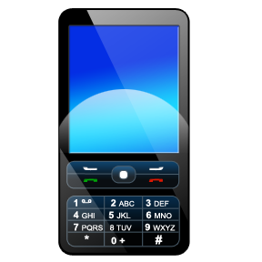
Did he want a cell phone last year?
Yes, he did. / No, he didn’t.

Slide 15
Did she help a boy three days ago?
Yes, she did. / No, she didn’t.

Slide 16
過去形の疑問文
you played soccer?
ed
Do
You played soccer.
Do＋
ed
Did
you played soccer?
Yes, I did.
/ No, I did not.
/No, I didn’t.
過去を表す形の「動詞ed」のedが、たずねるときに使うdoとくっついてdidになります。
「動詞ed」のedはdoとくっついてdidになっているので、動詞にはedがつきません。
Didで質問しているので、答えるときにもdidを使います。

