Slide 1
Occupations
Jobs

Slide 2
pilot

Slide 3
flight attendant

Slide 4
announcer

Slide 5
farmer

Slide 6
director

Slide 7
bank clerk

Slide 8
teacher

Slide 9
police officer

Slide 10
vet

Slide 11
baker

Slide 12
dentist

Slide 13
fire fighter

Slide 14
astronaut

Slide 15
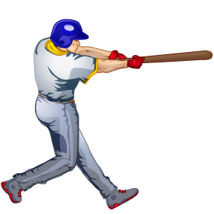
baseball player

Slide 16
soccer player

Slide 17
carpenter

Slide 18
lawyer

Slide 19
taxi driver

Slide 20
singer

Slide 21
office worker

Slide 22
florist

Slide 23
doctor

Slide 24
scientist

Slide 25
cook

Slide 26
nurse

Slide 27
patissier

Slide 28
beautician

Slide 29
model

Slide 30
architect

Slide 31
programmer

Slide 32
Occupations
Jobs

