Slide 1
Where do you want to go?

Slide 2
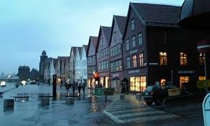

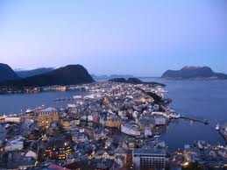
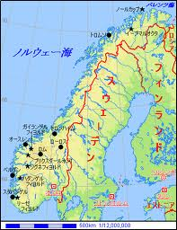
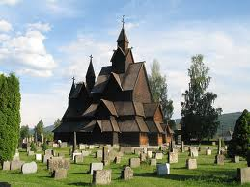

Slide 3
I want to visit Norway.

Slide 4
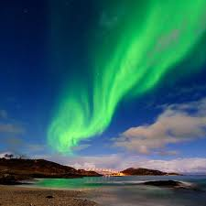
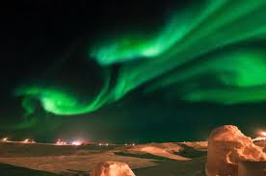
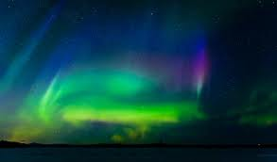

Slide 5
I want to see northern lights.

Slide 6
Practice ‘want to～’

Slide 7
I want to visit_______.
America
Canada
Australia
Notes:
Repeat after teacher
I want to visit America.
I want to visit Canada.
I want to visit Australia.

Slide 8
I want to eat _______.
hamburger
spaghetti
soba
Notes:
I want to eat hamburger.
I want to eat spaghetti.
I want to eat soba.

Slide 9
I want to __________.
baseball
soccer
basketball
Notes:
I want to play baseball.
I want to play soccer.
I want to play basketball.

Slide 10
心を1つに！
Notes:
ルール 3人のグループを作る
PPを見て、3つの中から1つ選んで言う。
3人がそろって、同じものになったらOK
1番早く同じ答えになったグループにポイント
生徒をたたせて3, 2,1, Go!といって、生徒に言わせる
同じか違っていた確認
全員が同じだったグループは座る
違っていたグループは再トライ
3,2,1,Go!と繰り返し、すべてのグループが座るまで同じスライド

Slide 11
I want to visit_______.
America
Canada
Australia
Notes:
Repeat after teacher
I want to visit America.
I want to visit Canada.
I want to visit Australia.

Slide 12
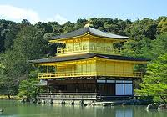
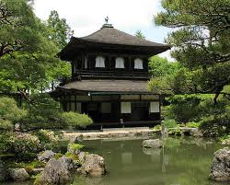
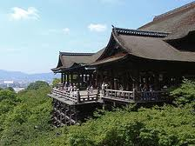
I want to go to _______.
Kinkakuji
Ginkakuji
Kiyomizudera

Slide 13
I want to eat _______.
hamburger
spaghetti
soba

Slide 14
I want to __________.
baseball
soccer
basketball
Notes:
I want to play baseball.
I want to play soccer.
I want to play basketball.

Slide 15

I want _______________.
sushi
ramen
steak

Slide 16
I want _______________.
koalas
pandas
penguins
Notes:
I want to see ～

Slide 17
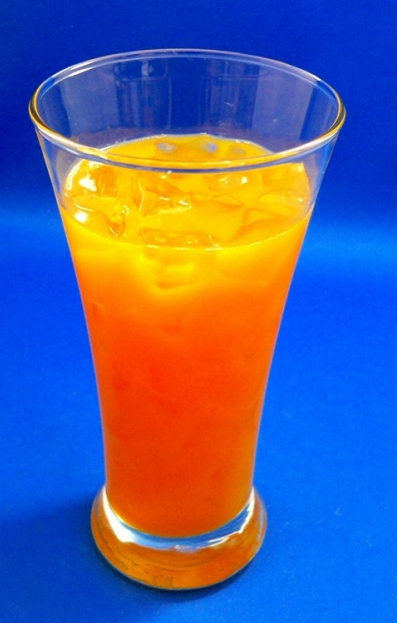
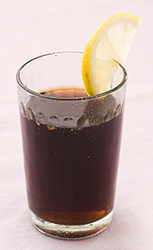

I want _______________.
coffee
Orange juice
Cola
Notes:
I want to drink～

