Slide 1
～している：進行形

Slide 2
Notes:
このスライド部分に導入の動画を入れてください。

Slide 3
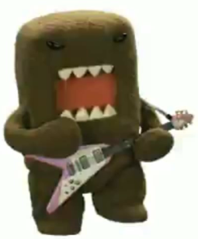

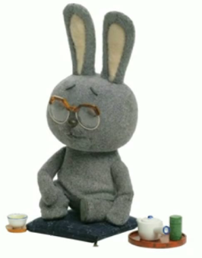

現在進行形（be動詞 ＋ 動詞ing）
（Ｃ）ＮＨＫ・ＴＹＯ
I play the guitar.
I
am
playing
the guitar.
He plays the guitar.
He
is
playing
the guitar.
Point
①「 be動詞＋動詞ing」の形で｢（今）～しています。｣と表現できます。
② 「be動詞」とは｢am, are, is｣です。使い分けに注意しよう。
③ 3単現の｢s｣の｢s｣は現在進行形の表現では無くなります。
※主語に合わせてbe動詞が変化しているため、 ｢s｣の変化は必要なくなります。
④｢動詞＋ing｣で発音の関係から変化に注意する単語があります。

Slide 4
動詞ingを練習しよう
Practice ～ing

Slide 5
reading a book
ing

Slide 6
studying
ing

Slide 7
eating ice-cream
ing

Slide 8
having
havein ramen

Slide 9
skiing
ing

Slide 10
playing soccer
ing

Slide 11
running
ning

Slide 12
playing the piano
ing

Slide 13
sleeping
ing

Slide 14
playing golf
ing

Slide 15
playing the violin
ing

Slide 16
swimming
ming

Slide 17
playing baseball
ing

Slide 18
playing basketball
ing

Slide 19
playing the guitar
ing

Slide 20
playing table tennis
ing

Slide 21
playing volleyball
ing

Slide 22
playing badminton
ing

Slide 23
driving
drivein a car

Slide 24
cook
ing

Slide 25
現在進行形を練習しよう
Practice ～ing

Slide 26
play table tennis
I
am
playing
table tennis.
You
are
playing
table tennis.

Slide 27
play the piano
I
am
playing
the piano.
You
are
playing
the piano.

Slide 28
read a book
I
am
reading
a book.
You
are
reading
a book.
He
is
reading
a book.

Slide 29
play soccer
I
am
playing
soccer.
You
are
playing
soccer.
We
are
playing
soccer.

Slide 30
study
I
am
studying.
You
are
studying.
She
is
studying.

Slide 31
eat ice-cream
Yuki
is
eating
ice-cream.
My sister
is
eating
ice-cream.
They
are
eating
ice-cream.

Slide 32
have ramen
Kenji
is
having
ramen.
His father
is
having
ramen.
They
are
having
ramen.

Slide 33
ski
She
is
skiing.
He
is
skiing.
They
are
skiing.

Slide 34
run
I
am
running now.
You
are
running now.
We
are
running now.

Slide 35
I am playing soccer.
You are playing soccer.
He is playing soccer.
She is playing soccer.
We are playing soccer.
They are playing soccer.
の違いはどこから来るの?
の違い→主語の違い

Slide 36
Be動詞（am / is / are ）の使い分け
話をするときに 出てくる人 |  | 単数 （１人、１つ） |  | 複数 （２人以上、２つ以上）
１人称 | 話す人
２人称 | 聞く人
３人称 | その他の 人や物
I
am
We
are
You
are
You
are
He
She
It
They
are
is

Slide 37
Practice more

Slide 38
I play the violin.
I（ am ）（ playing ） the violin.
am
playing

Slide 39
You play baseball.
playing
You （ are ）（ playing ） baseball.
are

Slide 40
You cook.
cooking
You （ are ）（ cooking ）.
are

Slide 41
She plays badminton.
playing
She （ is ）（ playing ） badminton.
is

Slide 42
My father drives a car.
My father （ is ）（ driving ） a car.
is
driving

Slide 43
Emi plays golf.
playing
Emi （ is ）（ playing ） golf.
is

Slide 44
Ben swims.
swimming
Ben （ is ）（ swimming ）now.
is

Slide 45
I play basketball.
I（ am ）（ playing ） basketball now.
am
playing

Slide 46
We play volleyball.
We（ are ）（ playing ） volleyball now.
are
playing

Slide 47
Tom and Mark play the guitar.
Tom and Mark
（ are ）（ playing ） the guitar now.
are
playing

Slide 48
現在進行形（be動詞 ＋ 動詞ing）
（Ｃ）ＮＨＫ・ＴＹＯ
I play the guitar.
I
am
playing
the guitar.
He plays the guitar.
He
is
playing
the guitar.
Point
①「 be動詞＋動詞ing」の形で｢（今）～しています。｣と表現できます。
② 「be動詞」とは｢am, are, is｣です。使い分けに注意しよう。
③ 3単現の｢s｣の｢s｣は現在進行形の表現では無くなります。
※主語に合わせてbe動詞が変化しているため、 ｢s｣の変化は必要なくなります。
④｢動詞＋ing｣で発音の関係から変化に注意する単語があります。

Slide 49
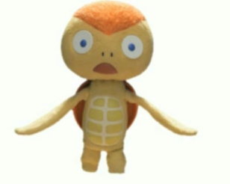
現在進行形（be動詞 ＋ 動詞ing）
（Ｃ）ＮＨＫ・ＴＹＯ
I play the guitar.
I
am
playing
the guitar.
You play the guitar.
You
are
playing
the guitar.
He plays the guitar.
He
is
playing
the guitar.
Point
①「 be動詞＋動詞ing」の形で｢（今）～しています。｣と表現できます。
② 「be動詞」とは｢am, are, is｣です。使い分けに注意しよう。
③｢動詞＋ing｣で発音の関係から変化に注意する単語があります。
Notes:
試行錯誤中の説明スライドです。
こちらが良ければこちらに変えてください。

