Slide 1
Who is he? Who is she?

Slide 2
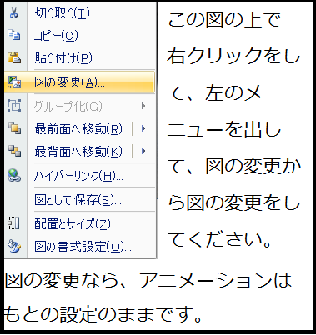
Who is he?
He is Osamu Hayashi.
He is a teacher.
Notes:
少しずらして、写真を入れ替えてください。

Slide 3
Who is she?
She is Homare Sawa.
She is a soccer player.

Slide 4
Who is she?
She is a singer.
She is Rino Sashihara.

Slide 5
Who is he?
He is Barack Obama.
He is the President.

Slide 6
Who is she?
She is a singer.
She is Kanna Hashimoto.

Slide 7
Who is he?
He is a tennis player.
He is Kei Nishikori.

Slide 8
Who is she?
She is an actress.
She is Mana Ashida.

Slide 9
Who is he?
He is a tennis player.
He is Shuzo Matsuoka.

Slide 10
Who is she?
She is a skater.
She is Mao Asada.

Slide 11
Who is he?
He is Toshiaki Kasuga.
He is a comedian.

Slide 12
Is he ～? Is she ～?

Slide 13
1 | 2 | 3 | 4 | 5
6 | 7 | 8 | 9 | 10

Slide 15

Is she～?

Slide 16

Is he ～?

Slide 17
Is he～?

Slide 18
Is he～?

Slide 19
Is she～?

Slide 20
Is she～?

Slide 21
Is he～?

Slide 22
Is she～?

Slide 23
Is he ～?

Slide 24
Is she～?

